Slide 1

FRAMING A STANDING APPROVED LIST FOR SUPPLY OF EQUIPMENT/ ASSETS, SPARES FOR OVERHEAD TRACK EQUIPMENT – BRIEFING SESSION
TECHNICAL EVALUATION
27 March 2026
1

Slide 2
TECHNICAL EVALUATIONS
SCENARIO A
  PHASE 1: Submission of Memorandum of Understanding (MOU)/Authorization letter (AL) as per category tendered for OR Original Equipment Manufacturer (OEM) /Manufacturer’s confirmation letter.
  PHASE 2: PROOF OF DELIVERY EXPERIENCE, ISO9001 ACCREDITATION OR QUALITY PLAN
  PHASE 3: TECHNICAL EVALUATIONS.
  PHASE 4: FACTORY EVALUATIONS
SCENARIO B
  PHASE 1: Submission of Memorandum of Understanding (MOU)/Authorization letter (AL) as per category tendered for OR Original Equipment Manufacturer (OEM) /Manufacturer’s confirmation letter
  PHASE 2: ISO 9001 ACCREDITATION / QUALITY PLAN
  PHASE 3: TECHNICAL EVALUATIONS.
  PHASE 4: SAMPLE TESTING.
  PHASE 5: FACTORY EVALUATIONS.

Slide 3
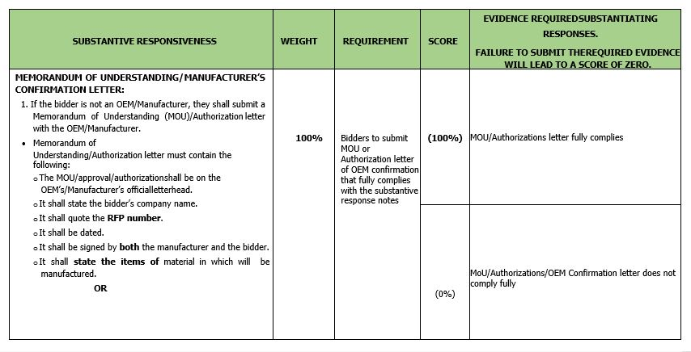
SCENARIO A
PHASE 1: Submission of Memorandum of Understanding (MOU)/Authorization letter (AL) as per category tendered for OR Original Equipment Manufacturer (OEM) /Manufacturer’s confirmation letter.
This phase will be applicable for both the scenarios A & B.
All the requirements of this phase must be met for the bidders to proceed to the next phase

Slide 4
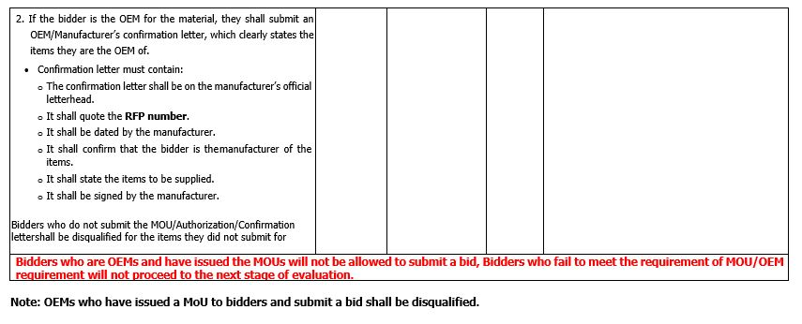
SCENARIO A
PHASE 1: continue….

Slide 5
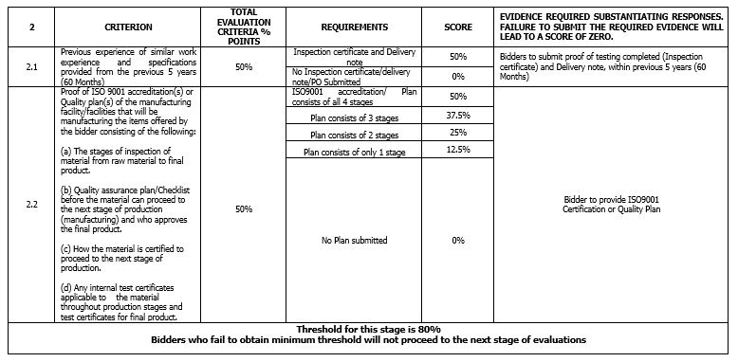
SCENARIO A
Phase 2: PROOF OF DELIVERY EXPERIENCE, ISO9001 ACCREDITATION OR QUALITY PLAN

Slide 6
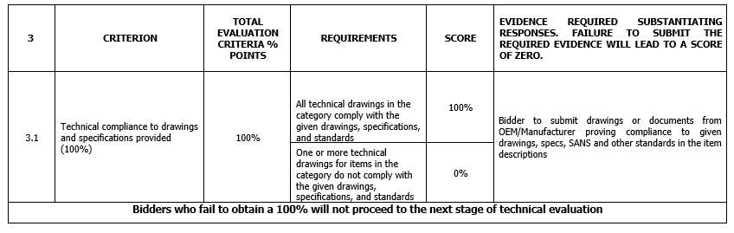
SCENARIO A
Phase 3: TECHNICAL EVALUATIONS.

Slide 7
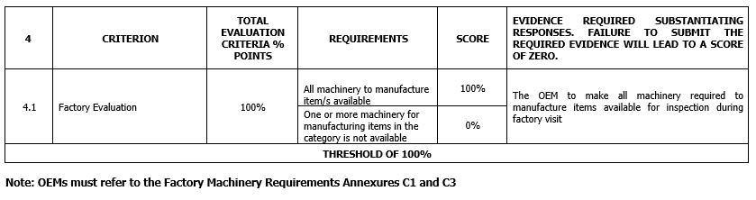
SCENARIO A
PHASE 4:FACTORY EVALUATIONS

Slide 8
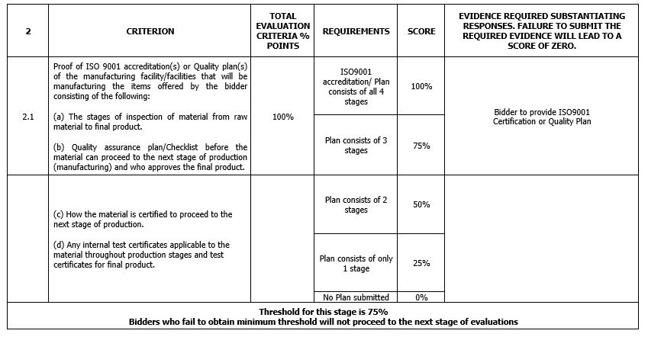
SCENARIO B
PHASE 2 :ISO ACCREDITATION / QUALITY PLAN

Slide 9
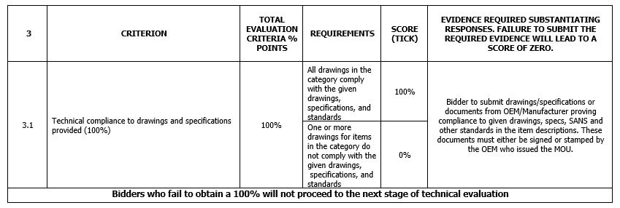
SCENARIO B
PHASE 3 :TECHNICAL EVALUATIONS.

Slide 10
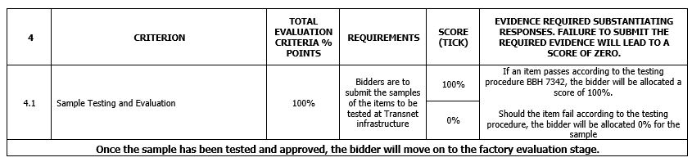
SCENARIO B
PHASE 4 :SAMPLE TESTING..

Slide 11
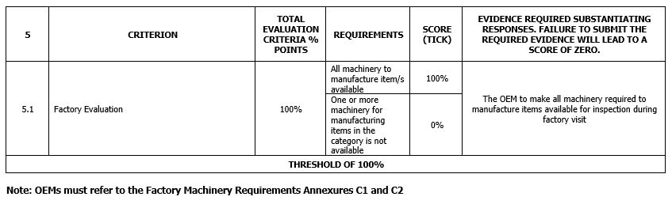
SCENARIO B
PHASE 5: FACTORY EVALUATIONS.

Slide 12
Thank you

