Slide 1



Slide 3
Creating effective presentations
Limit the number of slides – no more than 12 slides for a 10-minute presentation
Avoid long sentences – provide only key points
Provide handouts for more detailed information
Use special effects and animation sparingly
Spell-check and proofread your work
Use no more than eight words in a line
Have no more than eight lines on a page
Use graphs where applicable to explain comparisons

Slide 4

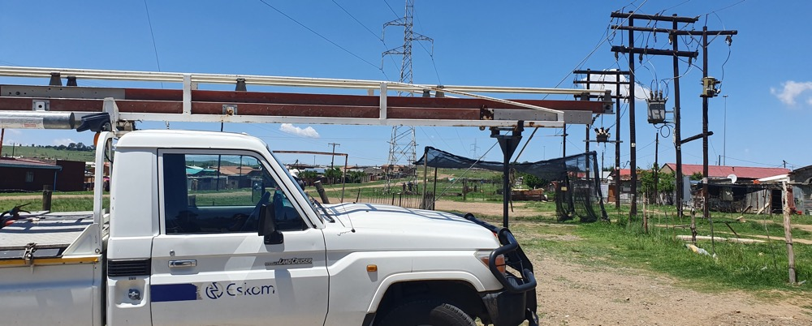
Divider Slide

Slide 5
Divider Slide

Slide 6
Recommendations for creating Eskom presentations
Allow sufficient isolation space to surround the Eskom logo
Only apply an Eskom font – Gill Sans or Arial font
Always apply sentence case (i.e., only the first letter of a sentence has a capital letter)
Apply Eskom’s primary and secondary colours or tints thereof in your presentation
Keep the style consistent throughout your presentation, i.e., numbering, borders, type of graphs, etc.
Only include visuals that will enhance Eskom’s image and not damage Eskom’s reputation

Slide 7
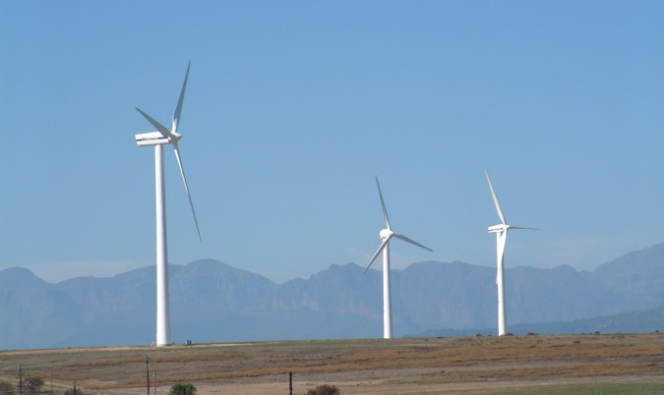

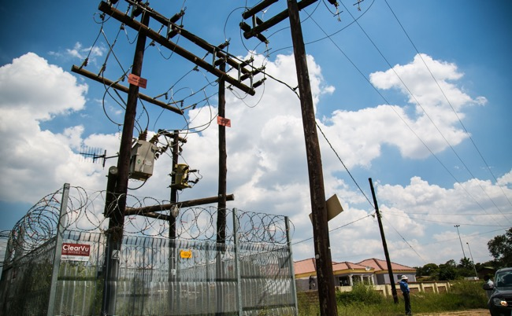
Divider Slide

Slide 8
Divider Slide

Slide 9
Colours to be used on presentations
RGB values of Eskom’s primary and secondary colours
100%
75% tint
50% tint
R G B
R G B
R G B
Primary Colours
0 56 150
64 106 176
127 155 202
Pantone 287 C
113 114 91
162 149 132
193 184 173
The stronger the colour and the greater the contrast, the better your presentation will project.
Apply Eskom’s accent colours
on slides rather than any other colours like red, yellow, etc.
Pantone 8004 C
R G B
R G B
R G B
150 51 15
176 102 75
202 153 135
Pantone 174 C
13 176 43
128 239 123
207 250 208
Secondary Colours
Pantone 361 C
201 122 0
214 155 64
228 188 127
Pantone 1385 C
89 135 135
130 165 165
172 195 195
Pantone 7475 C

Slide 10
Graph guidelines

Slide 11
Graph guideline

Slide 12
Graph guideline

Slide 13
Graph guideline

Slide 14
Graph guideline

Slide 15
Graph guideline

Slide 16
Graph guideline

Slide 17
Graph guideline

Slide 18
Graph guideline
Add
Add
Add
Add
Add
Add
Add
Add
Add
Add
Add
Add
Add
Add
Add

Slide 19
Graph guideline
Add
Add
Add
Add
Add

Slide 20
Graph guideline
Add
Add
Add
Add
Add
Add
Add
Add

Slide 21
Graph guideline
Add
Add
Add
Add

Slide 22


Conclusion

Slide 23
Conclusion

