Slide 1
Insurance RFP
Information on Portfolio B
2023

Slide 2
Portfolio B consists of:
Asset All Risk Insurance
General Liability
Director's and Officers liability
Cyber Liability
Commercial crime
Crime and Civil Liability
Construction Insurance (PCI)

Slide 3
Limits of Liability
CLASS | LIMIT OF INDEMNITY
Assets All Risk & Business Interruption | R 3 Billion per occurrence
General Public Liability | R 750 Million
Crime & Civil Liability | R 100 Million
Commercial Crime | R 100 Million
Cyber Liability | R 50 Million
Directors & Officers | R 2,1 Billion
PCI (Annual Contract Works) 75% M & D | R 1 Billion
PCI Public Liability | R 100 Million
PCI Professional Indemnity | R 100 Million

Slide 4
Assets All Risk & Business Interruption Policy Structure
Inner Deductibles:
Transnet Freight Rail: R100 000 per occurrence
All Other Divisions R50 000 per occurrence
Mobile Plant & Cranes R50 000 per occurrence
Motor Vehicles All Divisions: R7 500 per occurrence
Business Interruption: 5 days on an Average Daily Cost basis
Stop Loss – towards the aggregate
TFR – R250 million per occurrence
Fire – R250 million per occurrence
Storm – R250 million per occurrence
All other losses – R30 million per occurrence
Transnet Aggregate R1,5billion
Primary Equalizer Retention
R500 000 000 in the Aggregate
Loss Limit R 3billion in excess of inner and aggregate
Residual Deductibles
(after Aggregate has been absorbed; replaces inner and stop loss):
Transnet Freight Rail:
Rolling Stock R5 000 000 per occurrence
Non Rolling Stock Losses R2 000 000 per occurrence
National Ports Authority R2 000 000 per occurrence
Port Terminals R1 000 000 per occurrence
All Other Divisions R500 000 per occurrence

Slide 5
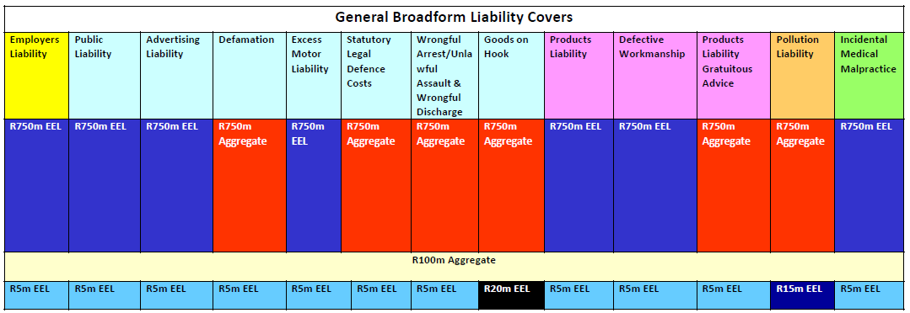
General Public Liability Policy Structure

Slide 6
Claims History - Assets and Business Interruption
PERIOD | NUMBER OF INCIDENTS | GROSS AMOUNT | PAID NET OF EXCESS | AGGREGATE RETENTION | SELF RETENSION | INSURER OUTSTANDING | PAID BY INSURERS | OUTSTANDING AMOUNT NET OF INNER EXCESS
2018 / 2019 | 849 | 974 265 129 | 893 645 491 | 697 637 446 | 146 008 225 | 0 | 0 | 26 914 638
2019 / 2020 | 1089 | 1 086 349 233 | 948 404 311 | 577 906 273 | 237 922 739 | 0 | 76 975 298 | 67 450 429
2020 / 2021 | 1246 | 762 319 230 | 693 959 322 | 586 709 856 | 14 914 354 | 0 | 0 | 212 697 905
2021 / 2022 | 2145 | 2 922 825 440 | 256 556 618 | 2 794 015 988 | 0 | 0 | 0 | 2 537 459 371
2022 / 2023 | 2559 | 5 447 740 793 | 17 506 636 | 267 506 636 | 250 000 000 |  | MD R 349 900 000 BI R 600 000 000 | 5 239 844 407
2022/2023 Claim include Durban storms and the 2021/2022 include Richardsbay Fire – Both at an estimate of R 1 Bn. Estimate has not been revised
Down pending decision by TPT as to whether they will institute legal action against ESCAP. Possible revised estimate is R 362 703 078.

Slide 7
Claims History - PDBI SASRIA
PERIOD | NUMBER OF INCIDENTS | GROSS CLAIMS | INNER DEDUCTIBLE | NET OF INNER DEDUCTIBLE | AMOUNT TO INSURER | CLAIMS ABOVE INNER DEDUCTIBLE
2018 / 2019
2019 / 2020
2020 / 2021 | 1 | 4 123 959.92 | 2 000 000 | 2 123 959.92 | 2 123 959.92
2021 / 2022
2022 / 2023
R2m voluntary deductible Applicable for Assets Claims

Slide 8
Claims History - General Public Liability
PERIOD | NUMBER OF INCIDENTS | RESERVE AMOUNT | CLAIM AMOUNT | PENDING AMOUNT | PAID WITHIN EXCESS | PAID WITHIN AGGREGATE FUND | PAID BY INSURERS | GROSS PAID
2018 / 2019 | 24 | 7 521 634.55 | 6 200 630.36 | 6 010 926.62 | 39 970 | 232 747.70 | 0 | 272 717.70
2019 / 2020 | 62 | 43 118 372.34 | 21 455 639.82 | 7 868 847.71 | 8 950.00 | 0 | 0 | 8 950.00
2020 / 2021 | 1160 | 51 580 622.47 | 285 698 118.82 | 676 218.17 | 20 768.55 | 0 | 0 | 20 768.55
2021 / 2022 | 314 | 53 900 181.54 | 31 993 248.25 | 44 431.66 | 12 995.00 | 0 | 0 | 12 995.00
2022 / 2023 | 337 | 3 526 853 140.46 | 3 506 994 274.40 | 3 506 757 039.28 | 3 138 998.10 | 38 210.31 | 0 | 3 081 187.58

Slide 9
Claims History - Directors & Officers Liability
PERIOD | NO OF INCIDENTS | NO OF CLAIMS | GROSS CLAIM | INCIDENT
2018 / 2019 | - | - | -
2019 / 2020 | 1 | 1 | - | Harbour Master Claim
2020 / 2021 | - | -
2021 / 2022 | - | -
2022 / 2023 | - | -

Slide 10
Claims History - Commercial Crime Policy
POLICY YEAR | NUMBER OF INCIDENTS | GROSS CLAIMS
2018 / 2019 | 0 | -
2019 / 2020 | 1 | 37 734 440.00
2020 / 2021 | -
2021 / 2022 | -
2022 / 2023 | -

Slide 11
Claims History - PCI (Contract Works)
POLICY YEAR | NUMBER OF INCIDENTS | GROSS CLAIMS
2018 / 2019 | 0 | -
2019 / 2020 | 2 | 847,601
2020 / 2021 | 1 | 500,000
2021 / 2022 | 0 | 0
2022 / 2023 | 4 | 9 482 189.07
The number of claims for 2022/2023 include the Jet and Dry Dock claims, the values are above the PCI limit

Slide 12
Claims History - PCI (Public Liability)
POLICY YEAR | NUMBER OF INCIDENTS | GROSS CLAIMS | INNER DEDUCTIBLE | AMOUNT TO INSURER
2018 / 2019 | 3 | 1,756,673 | 278,410 | 1,453,263
2019 / 2020 | 2 | 71,704 | 25,000 | 46,704
2020 / 2021 | 8 | 7 396 724.32 | 448 901.90 | 6 947 822.42
2021 / 2022 | 2 | 27 458 068.99
2022 / 2023 | 1 | 5 000 000

Slide 13
Policies With No Claims For The Past 5 Years
Cyber Liability
Special Contingency Cover
Contract Works Professional Indemnity
PCI Professional Indemnity

Slide 14
Policy Wordings
Its deemed to be private and confidential and Transnet will not be shared the policy wording during the tender process.

