Slide 1
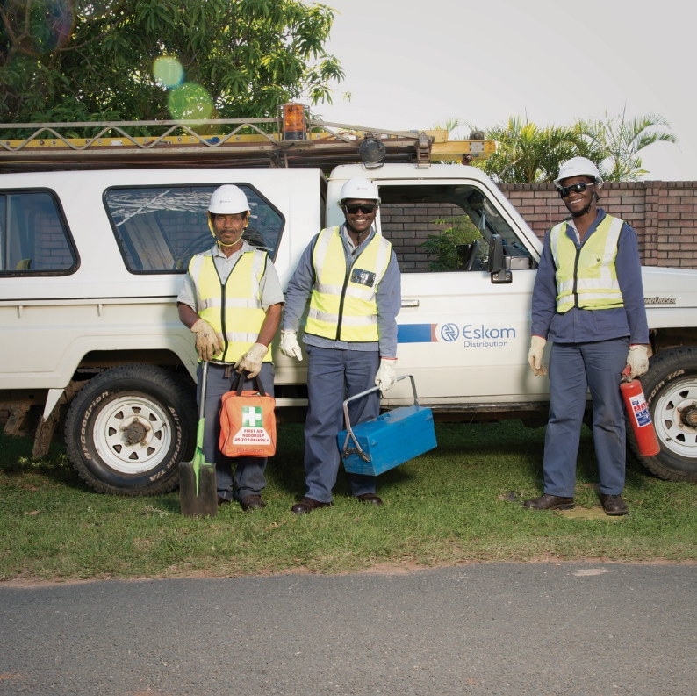
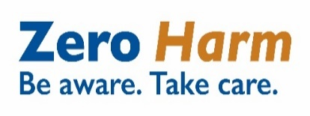

Life-saving Rules Standard 240-62196227 (Rev7)
Division: Risk and Sustainability
Compiled by: Kgosi Modiole
Date: March 2025

Slide 2
Introduction
Eskom and its subsidiaries will conduct business with respect and duty of care for people to ensure that no operating condition or urgency of service endangers the life of anyone or causes injury, ill-health or damage to the environment. Eskom is committed to preventing all work-related injuries and ill-health. In fulfilling this commitment to protect people, the environment and property, management will provide and maintain a safe and healthy work environment, in accordance with industry standards and compliance with legislative requirements.
At-risk behaviour leads to incidents. Life-saving Rules are safety rules created to enforce zero tolerance for serious at-risk behaviours. These rules have been determined in terms of the consequences of the behaviours they describe, that is, a particular set of behaviours or actions with a high probability of causing disabilities or fatalities when performed.
The Eskom Life-Saving Rules complement our existing health and safety best practices and are safety rules to be followed at all locations.
The Life-Saving Rules apply to all Eskom employees, agents, consultants, and contractors. Visitors to Eskom should also respect and adhere to these rules as applicable and could be instructed to leave the Eskom premises with immediate effect should they refuse to do so.
* Note: All “red font” indicates changes from revision 6 to revision 7

Slide 3
Scope & Purpose
Scope:
This standard shall apply at all Eskom sites to promote a safe working environment for all Eskom employees, agents, consultants, and contractors. Visitors to Eskom should also respect and adhere to these rules, as applicable.
Purpose:
This standard clarifies the six most prominent causes of serious injuries, and fatalities within Eskom, and Eskom’s intention to enforce “ZERO TOLERANCE” concerning non-adherence to these rules, due to the potential consequences of serious injury or fatality at the workplace.

Slide 4
Applicability and Effective date
Applicability
This standard shall apply throughout Eskom Holdings SOC Limited, its divisions, subsidiaries, and entities wherein Eskom has a controlling interest and/or Eskom contractors unless specifically exempted by Risk and Sustainability, where the business transacted may be completely different to the core business of Eskom.
Effective date
This procedure is effective from the date of authorisation. 17 February 2025

Slide 5
Key definitions added or amended
Definition | Explanation
Contractor | (Also referred to as mandatory as per section 1 of the OHS Act): Any employer formally contracted (directly or indirectly) by Eskom and who performs work and supplies a service, product, equipment or material to advance Eskom’s business or other interests is classified as a contractor. This includes Eskom non-executive board members, personal contractors (that is, consultants) and third-party contractors (that is, vendors, suppliers, agents, joint ventures, principal contractors and subcontractors).
Equipotential zone | means a safe work area created to ensure that any two or more conducting parts that can be touched by a person simultaneously are bonded together by approved earthing leads to ensure a zone of equal potential between different parts of the working area.
Life-Saving Rule | Rules that, if not adhered to, have the potential to cause serious harm to people. The consequences of a person knowingly and wilfully violating this rule will result in a disciplinary process in accordance with the Eskom Disciplinary Code and Procedure.
Visitors | Any person (including a minor) who visits an Eskom site/office during working hours to attend a meeting or for any reason whatsoever.
Work at height | This means any work performed above a stable work surface or where a person puts himself/herself in a position where he/she exposes himself/herself to a fall from or into. Work at height is, as a result, work in any place (except a staircase in a permanent workplace), including a place at, above or below ground level, where a person could be injured if he/she fell from that place. Access and egress that present a risk of fall can also be classified as work at height.
Zero Tolerance | The standard that provides for the imposition of severe consequences for a prescribed offence or behaviour without making exceptions for extenuating circumstances.

Slide 6
Roles and Responsibilities: Risk and Sustainability OHS Department
The Risk and Sustainability OHS Department shall:
Compile and review the Life-Saving Rules for Occupational Health and Safety;
Develop awareness material;
Ensure that the rules are communicated throughout the business;
Ensure compliance is monitored; and
Ensure that violations that are related to safety incidents are communicated to the organisation.

Slide 7
Roles and Responsibilities: All Groups/Divisions
The management at Group/Divisional level shall be responsible for:
Implementing the Eskom Life-Saving Rules in their Groups/Divisions/Subsidiaries/ Clusters/Business Units.
Communicating to all their employees, contractors, contractor employees and visitors the importance of compliance with the Eskom Life-Saving Rules and the consequences of non-compliance therewith. This includes communicating Life-Saving Rules to all new employees and new contractors.
Ensuring that the awareness material is made available, distributed and displayed at all workplaces.
Ensuring all employees sign confirmation that the rules have been discussed with them, that they understand the rules and the consequences of violating these rules and retain copies thereof.
Investigating any violation of a Life-Saving Rule and initiate the disciplinary process within five (5) working days.
Ensuring consistency in the application of appropriate sanctions on employees, contractors and contractor employees.

Slide 8
Roles and Responsibilities: All employees (Eskom and contractors)
Always observe and adhere to the Life-Saving Rules.
Ensure that you have the relevant training, competence and/or authorisation before undertaking any task.
Avoid taking shortcuts when executing tasks. Always do the right thing even when no one is watching.
Only perform work that you are authorised to do.
Where the situation exists that there is a likelihood of a contravention of a Life-Saving Rule, you shall exercise the right to refuse to perform such work.
Process for monitoring
Groups/Divisions shall be responsible for ensuring compliance with the standard through their annual audit and inspection plans.

Slide 9
Document content
Life-Saving Rules are safety rules that, if not adhered to, have the potential to cause serious harm to people. The consequences of a person knowingly and wilfully violating these rules will result in a disciplinary process in accordance with the Eskom Disciplinary Code and Procedure.
The objective of this Standard is to clarify Eskom’s intention to enforce “ZERO TOLERANCE” with respect to behaviour resulting in serious risk to an individual at the workplace.
It must be noted that the content of this standard does not detract from the requirements for safe behaviour for all other work-related activities or other health and safety requirements, but rather emphasises the importance thereof.

Slide 10
Eskom Life-Saving Rules
RULE 1: OPEN, ISOLATE, TEST, EARTH AND CREATE AN EQUIPOTENTIAL ZONE BEFORE TOUCH
To ensure a safe electrical work environment, no person may work/operate on, around or near any electrical network, line or apparatus, electrically connected to the power system and/or electrically charged and/or not electrically charged unless:
He/she is trained and authorised as competent for the task to be done;
There is a valid permit to work where required and they are being supervised by a competent person;
A pre-task risk assessment to identify all risks and hazards has been conducted before any work commences;
He/she follows the requirements on OPEN, ISOLATE, TEST, EARTH, AND CREATE AN EQUIPOTENTIAL ZONE BEFORE TOUCH, based on applicable/related standards, procedures and outcome of risk assessment fit for the type of work or task to be performed;
The work area shall be within the equipotential zone, with the working earth visible at all times.
The authorised person has physically shown all team members that the apparatus is safe to work on;
He/she makes the specific electrical environment safe before performing the work; and
All the appropriate PPE (including face shield and insulated gloves for low voltage work) are worn.
Note: The equipotential zone is only applicable for work being done on medium and high voltage apparatus.

Slide 11
Eskom Life-Saving Rules
RULE 2: HOOK UP AT HEIGHT
Working at height is a significant part of work in Eskom Holdings and is regarded as a high-risk activity, as a result, all precautions must be taken to prevent incidents while working at height.
Wherever reasonably practicable, preference must be given to the performance of work at ground level as opposed to work in an elevated position. Where work in an elevated position is necessary, the requirements in this document and all other Eskom requirements pertaining to working from height shall apply.
No person may work at height where there is a risk of falling unless:
A Fall Protection Plan has been developed by a trained fall protection plan developer and communicated to all employees working at height based on the scope of work/task;
He/she is medically fit to work at height;
He/she is trained in accordance with Eskom’s requirements for working at height;
A pre-task-specific work at height risk assessment to identify all risks and hazards has been conducted and communicated to all participants before commencing any work of this nature;
He/she appropriately conducts work as determined by the risk assessment;
He/she is appropriately secured during ascending and descending where applicable; and
He/she is using an Eskom-approved fall arrest system where applicable.

Slide 12
Eskom Life-Saving Rules
RULE 3: BUCKLE UP
Where required, the proper wearing of seat belts for any driver, operator and passenger is mandatory in all vehicles/equipment when driving and/or travelling for Eskom business purposes. The driver is obligated to ensure that he/she as well as all passengers are properly seated and wearing their seatbelts at all times while being transported in the vehicle, as per Eskom specifications.
Note: This rule is applicable on any road or parking lot, irrespective of the speed, and when the vehicle moves in a forward or backward direction.

Slide 13
Eskom Life-Saving Rules
RULE 4: BE SOBER
No person who is under the influence or who appears to be under the influence of intoxicating liquor or drugs will be permitted to enter or remain on an Eskom site conduct Eskom business or drive/operate a vehicle/equipment for Eskom business purposes.
This includes any level of alcohol or the presence of any drugs, controlled substances, and/or illegal substances in the body that impairs or could impair mental and physical functioning, irrespective of when the substance was used.

Slide 14
Eskom Life-Saving Rules
RULE 5: ENSURE THAT YOU HAVE A PERMIT TO WORK
No person shall work without the required Permit to Work (PTW), which is governed by but not limited to:
Plant Safety Regulations; or
Operating Regulations for High Voltage Systems (ORHVS) (handover or permit); or
Low Voltage Operating Regulations; or
Any other activity where a permit is required, for example, driver and statutory permits.
No apparatus is to be returned to service without the cancellation of all permits on that plant in accordance with procedure, unless permission is granted for a particular plant to be returned to service with permits still open, like in the case of redundant systems.
NOTE: In the case of live work, a “Live Work Declaration Form” is to be completed by the authorised person, who is the person responsible for the safe execution of work according to relevant standards and procedures.

Slide 15
Eskom Life-Saving Rules
RULE 6: ENSURE SAFE LIVE WORKING
To ensure safe live work, each live worker shall:
Ensure all live work basic principles are adhered to, as outlined (for the method being used) in the High Voltage Live Working Standard for the respective division.
Observe and maintain the minimum approach distance (MAD).
Only perform live work (never mix live and dead work on the same site at the same time – Refer to ORHVS Section 7 and 5 handouts respectively).
Perform tasks they are authorised for and only undertake tasks that are documented in the respective Task Manual (TM). Only work on one potential (voltage) at a time.

Slide 16
Consequences of Violating a Life-Saving Rule
In terms of general health and safety in Eskom, if any of the Life-Saving Rules are violated, it will be treated as serious misconduct, and result in a disciplinary process in accordance with the Eskom Disciplinary Code and Procedure.
It must be highlighted that Eskom takes a ZERO TOLERANCE stance to violation of these rules.
Depending on the circumstances, Eskom reserves the right, where a contractor manager/supervisor allows the violation of a Life-Saving Rule, to suspend the contractor’s activities while determining an appropriate sanction.
Where a contractor employee allegedly violates a Life-Saving Rule, the contractor shall immediately remove the employee from the site and initiate the disciplinary process. The contractor shall investigate any violation of a Life-Saving Rule and initiate the disciplinary process within five (5) working days of the violation. The contractor shall furnish Eskom with a copy of the sanction after the disciplinary process.

Slide 17
Related/ Supporting Documents
Life-saving Rules Acknowledgement Form Rev3 (240–63942960)
https://opentextcs.eskom.co.za/otcs/cs.exe/app/nodes/4433154
Life-saving Rules Leadership Overview Questionnaire Rev2 (240-102079637)
  https://opentextcs.eskom.co.za/otcs/cs.exe/app/nodes/1116705

