Slide 1
PROVISIONING OF AN APPROVED LIST OF SERVICE PROVIDERS FOR THE SUPPLY, INSTALLATION,
COMMISSIONING, SUPPORT AND DELIVERY OF NATIONAL RADIO NETWORK MODERNIZATION
FOR A PERIOD OF THREE (3) YEARS ON AN “AS AND WHEN REQUIRED” BASIS.
HOAC_VAR_52088
25 April 2025
1

Slide 2
Introduction
Deployment of a digital Wireless network to facilitate mission critical Communication
Legislative requirements (GG-38640 – March 2015) designates 450-470 as IMT band
Transnet has tested LTE for mission critical communication in Railways.
The AGA Act mandates regulates the Radio emission in the Northern Cape, Impacting 300 km (Loop 7 – 15)
  Area identified for DMR narrowband deployment
  .

Slide 3
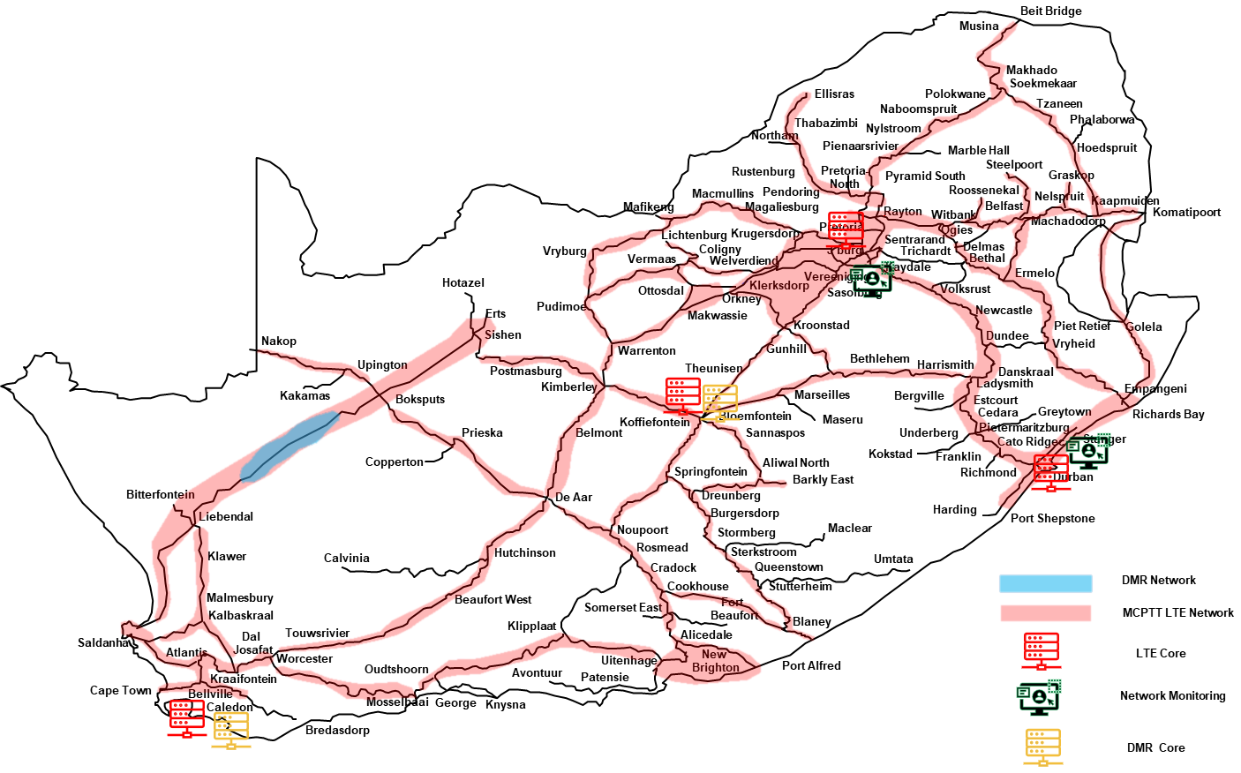
Purpose and Objective
OBJECTIVE : To Establish an Approved list of supply, installation, commissioning and support for LTE & DMR Technology
Upgrade the UHF radio network nationwide to LTE digital technology, excluding the Northern Cape where the SKA footprint is located.
Ensure that the LTE digital technology operates within the 450-470 MHz IMT frequency band.
Deploy DMR Tier 3 narrowband technology in the SKA region of the Northern Cape, on the Frequency Band that will be permitted by the AMA and ICASA.
Support rail reform 3rd party Train operating Company’s communication requirements.

Slide 4
Radio Network Modernisation
Corridor Phased Approach
Phased Approach Deployment: TRIM focus
2025-2026
2026-2027
2027-2028
2028-2029
2029-2030
Ore-line Corridor incl. National Core network
Container Corridor
North Corridor / Coal Line
Cape Corridor
Central Corridor
North-East Corridor
Post Implementation Review (PIR)
P1:Main Scope
Supporting Ports / OD’s
Supporting Ports / OD’s
P2: Feeder Scope

Slide 5
Scope of Requirements
The Scope of Work detailed on Annexure B and Appendix 1.
Conformance to TRIM specifications on Annexure I.
Written proof from the OEM for authorized suppliers and are equipped to supply and provide support of the equipment according to OEM specifications.
To conform to the list of equipment, materials, spares proposed to Transnet.
To provide a detail methodology of acquiring, purchasing, renewing, testing and quality assurance of all equipment and installation, testing proposed to Transnet.
Supplier shall detail their repair process including locations of available workshops, technical facilities, and resources in the country.
Suppliers shall indicate the value-added services such as OEM training, tier level support etc.

Slide 6
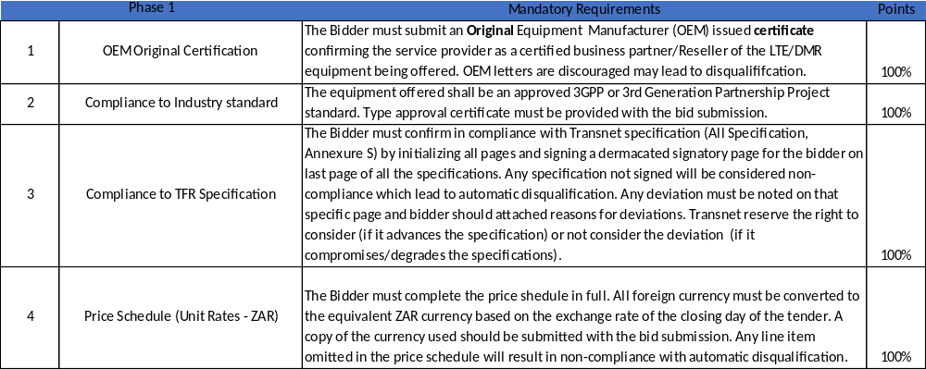
Technical Evaluation – Phase 1: Mandatory
.

Slide 7
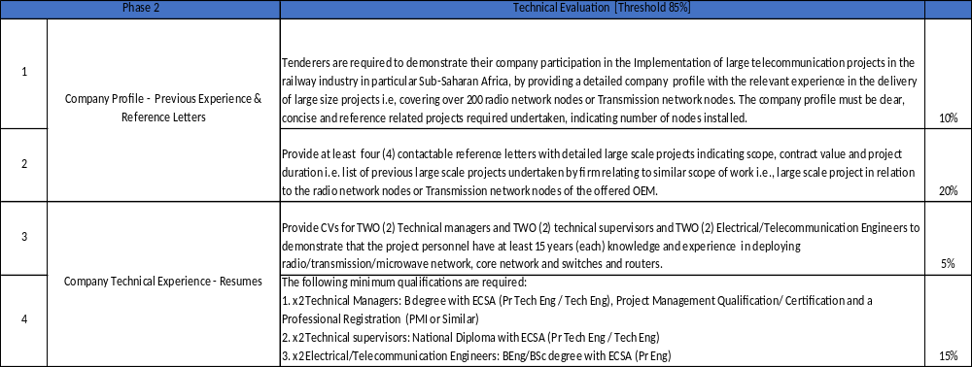
Technical Evaluation – Phase 2: LTE
.

Slide 8
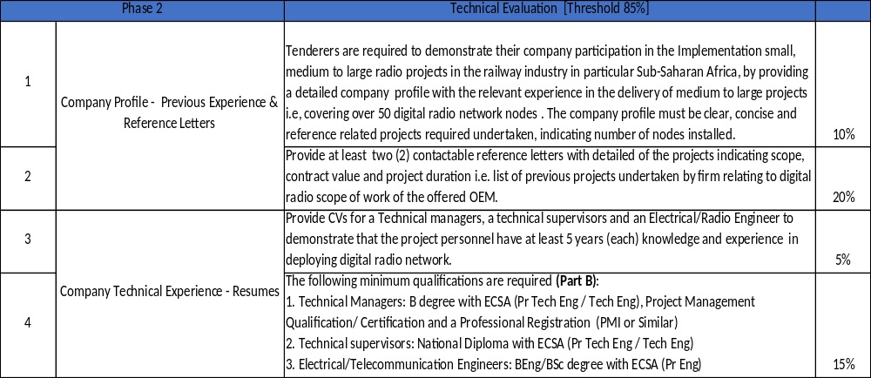
Technical Evaluation – Phase 2: DMR
.

Slide 9
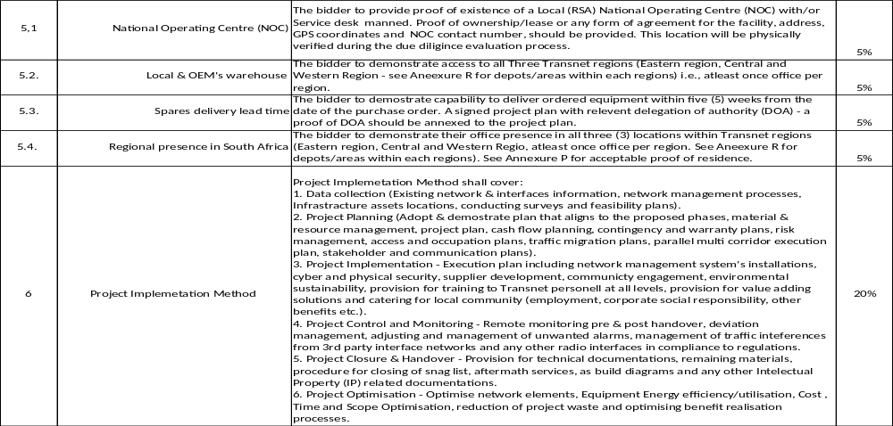
Technical Evaluation – Phase 2: LTE & DMR Cont.
.

Slide 10
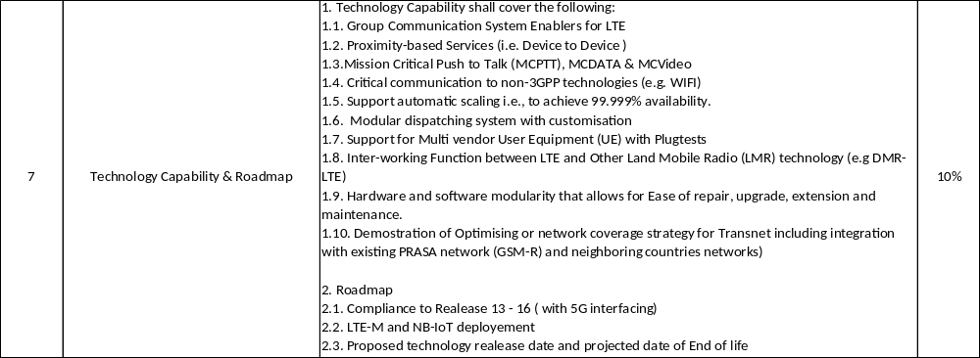
Technical Evaluation – Phase 2: LTE Technology Roadmap
.

Slide 11
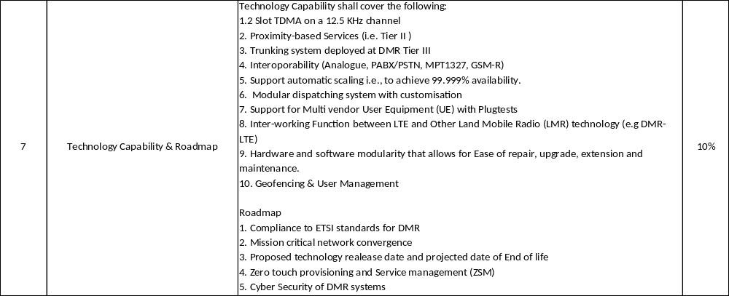
Technical Evaluation – Phase 2: DMR Technology Roadmap
.

Slide 12
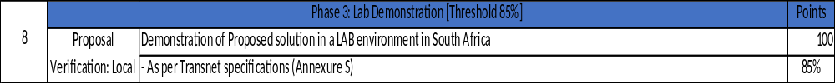
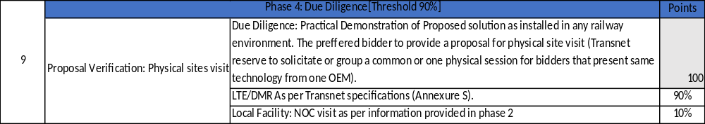
Technical Evaluation – Phase 3 & 4: Demonstration & Due Diligence
.

Slide 13
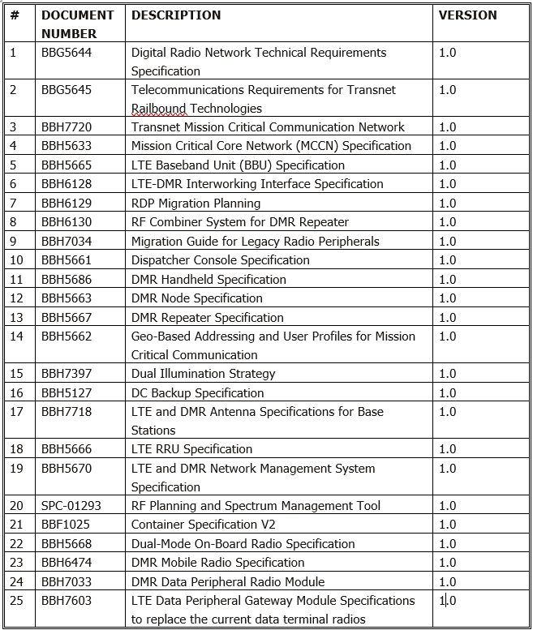
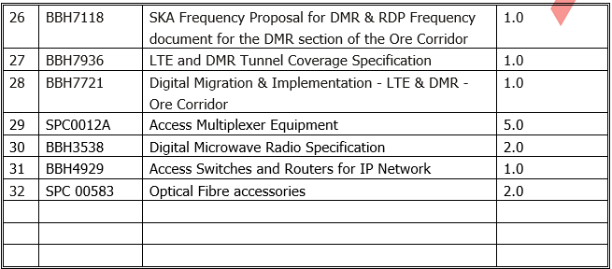
Mandatory List of Specifications – Annexure S

Slide 14
Implementation requirements for LTE & DMR
LTE
1. Frame and Appoint a maximum of six (6) service providers as part of the approved list of service contractors, the Price- specific goals scorecard will be used for the highest (x6) scoring bidder’s unit rates, to be framed on the list.
2. Utilize the approved list on a rotational basis in order to promote the principle of cost-effectiveness. The unit price itemized list will be used for this purpose.
3. Appoint a maximum of six (6) service providers as part of the approved list of service contractors, the Price- specific goals scorecard of the highest scoring bidders will be considered under the following scenarios/conditions:
• The first x6 highest scoring bidders will be framed for LTE technology.
• The minimum service providers that Transnet can frame is two (2) and maximum is six (6) service providers for LTE. Transnet reserves the right to frame responsive bidder(s) below a minimum of two (2) service providers.
DMR
1. Frame and Appoint a maximum of three (3) service providers as part of the approved list of service contractors, the Price- specific goals scorecard will be used for the highest (x3) scoring bidder’s unit rates, to be framed on the list.
2. To appoint a maximum of three (3) service providers as part of the approved list of service contractors, the Price- specific goals scorecard of the highest scoring bidders will be considered under the following scenarios/conditions:
• The first x3 highest scoring bidders will be framed for DMR technology.
• The minimum service providers that Transnet can frame is one (1) and maximum is three (3) service providers for DMR.
3. To appoint a maximum of three (3) service providers based on the Price- specific goals scorecard, bidders to complete in full the Unit Price Schedule (Bill of Material) (all Unit Price (ZAR) per Items filled) (Annexure H: Price Schedule)

Slide 15
RFP Technical corrections/additions to note
Technical Errors/Omissions
1. Missing yard location information:
3. Missing other corridor’s site information for pricing information purposes i.e., economies of scale.
3. Annexure A & H to be updated to include the Dispatcher Console on both documents.
4. RFP Page 18 of 54, clause 2.3.5: Fourthly, in order to appoint a maximum of two OEM technologies to a maximum of six (6) service providers as part of the approved list of service contractors,……
5. RFP Page 18 of 54, clause 2.3.6: To appoint a maximum of one OEM technology to a maximum of three (3) service providers as part of the approved list of service contractors,…….
6. ANNEXURE G2 DMR Radio Modernisation-Technical Evaluation (002): 'LTE/DMR As per Transnet specifications (Annexure I).
Corrections
Annexure P: Shunting Yards names & Locations to be shared.
List of sites for other corridors attached to be provided as Annexure Q.
Annexure H - DMR price list Update 1 and Annexure A - DMR Equipment list Update to be shared.
4. RFP Page 18 of 54, clause 2.3.5: Fourthly, in order to appoint a maximum of six (6) service providers as part of the approved list of service contractors,……
5. RFP Page 18 of 54, clause 2.3.6: To appoint a maximum of three (3) service providers as part of the approved list of service contractors,…………
6. 6. ANNEXURE G2 DMR Radio Modernisation-Technical Evaluation (002): DMR As per Transnet specifications (Annexure I).

Slide 16
THANK YOU

