Slide 1

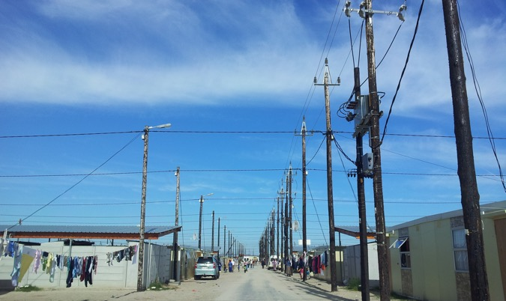
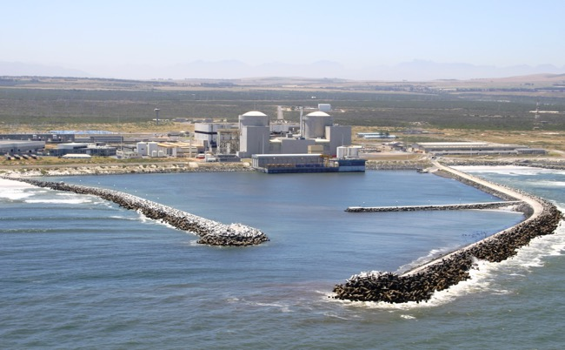
Provision of Actuarial Services
Tender clarification
E2096CXMWP
07 November 2025

Slide 2

Index
  Welcome and safety
  Commercial
  Scope
  SDL& I
  SHE
  Quality
  Clarification, questions and responses

Slide 3
Commercial Process
    Eskom’s tender process consists of the following stages:
    This is a non-compulsory clarification session.
    The validity period is 180 calendar days from tender closing date.
    Clarification questions – will be accepted until 14 November 2024 .
        Eskom Representative details:
        Mandisa Sithole
        sitholmd@eskom.co.za
Stage | Details | Key Dates
Issue a tender | Tender Bulletin $ NT tender bulletin | 04 November 2025
Clarification Meeting | For bidders | 07 November 2025
Closing Date | Deadline for submission | 19 November 2025 @10H00am
Evaluation of RFP submission | Commence with Evaluation | 21 November 2025
Award of the Contract |  | 01 February 2026

Slide 4
Evaluation Methodology
PPPFA evaluation methodology will be applied 80/20.
The first evaluation will be done on commercial for basic compliance of tender returnables.
Second phase evaluation will be: SD&L : BBBEE level
The third phase will be evaluated for functionality based on achieving a minimum threshold of 70%. Tenderers need to pass the threshold to qualify for the next stage of evaluation which is Pricing and Contractual requirements.
The following will be contractual requirements.
Supplier Development and Localisation (SD&L)
SHE Requirements
Quality Requirements
Financial Analysis

Slide 5
Pricing
Prices must be submitted on an activity schedule provided, NEC document.
Suppliers should not deviate from the activity schedule provided as this will be used for pricing evaluation.
Activity schedule provided is exclusive of VAT however VAT will be added during evaluation.

Slide 6
Tender Details
Basic compliance - All mandatory tender returnables need to be submitted with the tender to be responsive for evaluations
Mandatory returnables – Refer to the invitation to tender document –
  Technical Evaluation requirement
The tenderer must upload the tender documents on Eskom Tender bulleting site on the Eskom E-tender page. The documents needs to be uploaded under relevant folder (Technical, Commercial, Financial, and other). www.etendering.eskom.co.za
All documents need to be submitted in a PDF format (The upload size per document is 500 megabytes and total submission is restricted to 4 gigabytes).
Supplier Help manual guide and video can be found on Eskom E-tendering page.
Tender closing date: 10h00am on 19 November 2025

Slide 7
Contracting
The following contract apply:
  NEC3 Professional Services Contract.
  Published with the tender.
  NB: No contract deviations will be allowed after the tender closing date.

Slide 8
The End

