Slide 1
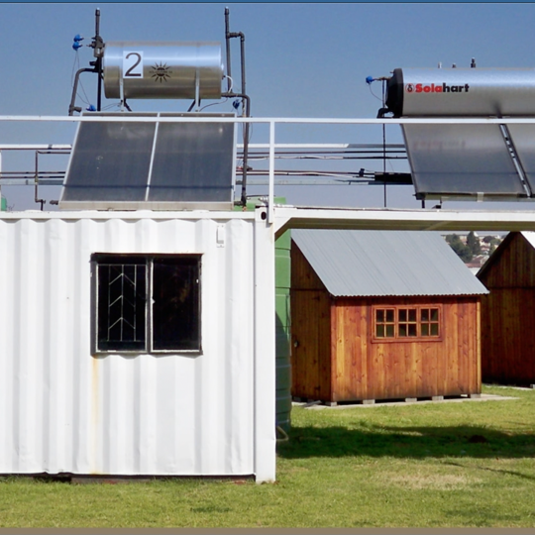
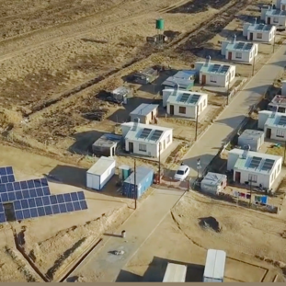
RFP Technical Presentation
24 April 2023

Slide 2
Scope of Work
The scope of work entails
  the project management,
  design,
  supply,
  installation,
  testing,
  commissioning,
  storage,
  delivery and off-loading / transfer and re-gasify (if applicable)
  of the complete natural gas supply logistic solution to Ankerlig and/or Gourikwa Power Station/s delivery point for a period of five (5) and ten (10) years.
The natural gas supply will be continuously metered, and composition analysed prior to transferring to Eskom. This would need to be negotiated with the successful contractor.

Slide 3
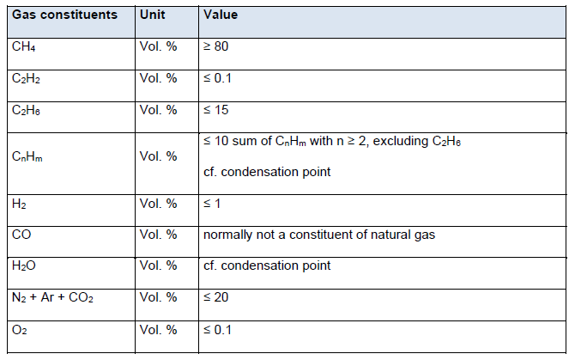
Required Natural Gas Constituents/Specification Limits

Slide 4
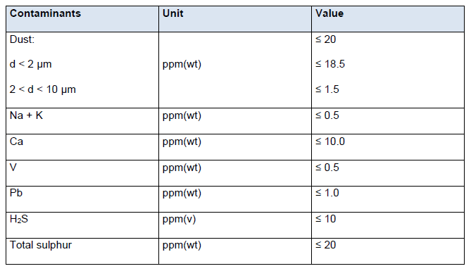
Natural Gas Contaminants Limits

Slide 5
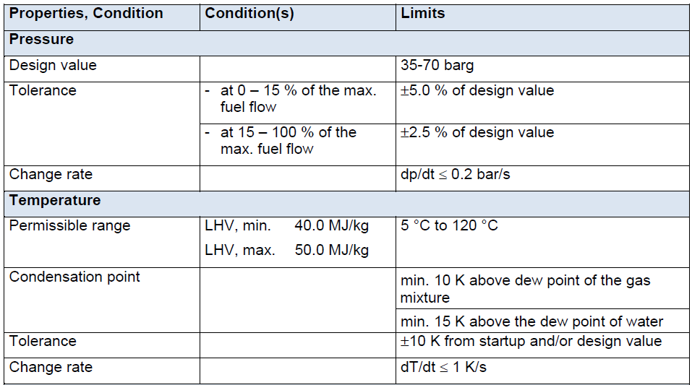
Natural Gas Properties/Requirements @ Delivery Point
Design Value: A “design value” must be selected between the minimum and maximum values for the ranges indicated. This will be the value that will be managed by the gas sales agreement.

Slide 6
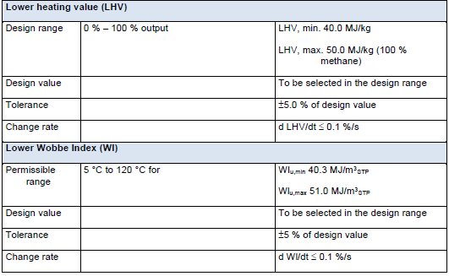
Natural Gas Properties/Requirements @ Delivery Point (cont.)

Slide 7
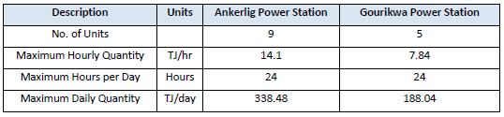
Ankerlig and Gourikwa Power Station Estimated Gas Quantities
Note quantities total per station.

Slide 8
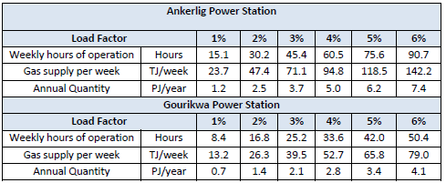
Ankerlig and Gourikwa Power Stations Load Factor Gas Quantities
The natural gas supply must be for an annual load factor of 6% for a contract period of five (5) and ten (10) years.
Due to the peaking operating regime of Ankerlig and Gourikwa Power Stations, anything from a single unit to all units of the power station could be utilised in a week.
In the 2020 and 2021financial years, the annual load factor of 80th percentile for Ankerlig and Gourikwa Power Stations was 10-15% and 20-25%, respectively.

Slide 9
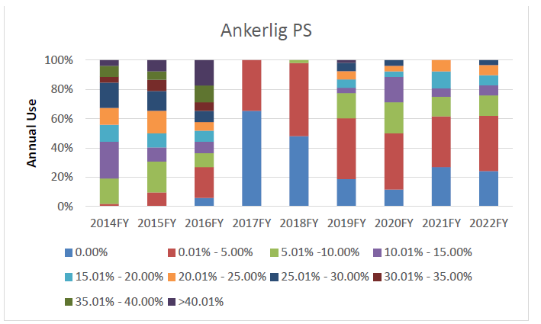
Ankerlig Power Station Weekly Load Factors per Financial Year
weekly load factors in a percentile format
Indicative

Slide 10
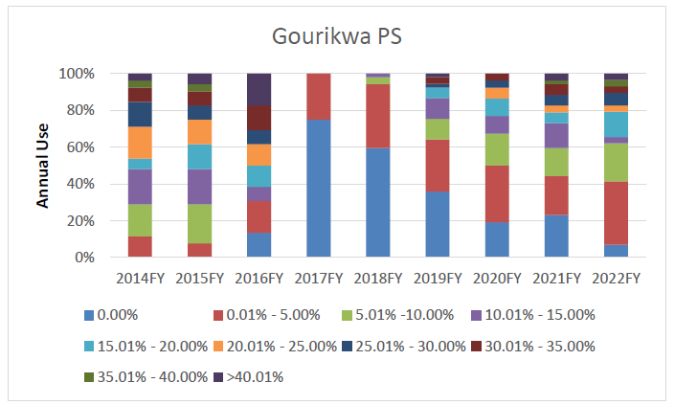
Gourikwa Power Station Weekly Load Factors per Financial Year
Due consideration to be given on the plant operating regime when sizing the gas storage, transport infrastructure and logistical solution.

Slide 11
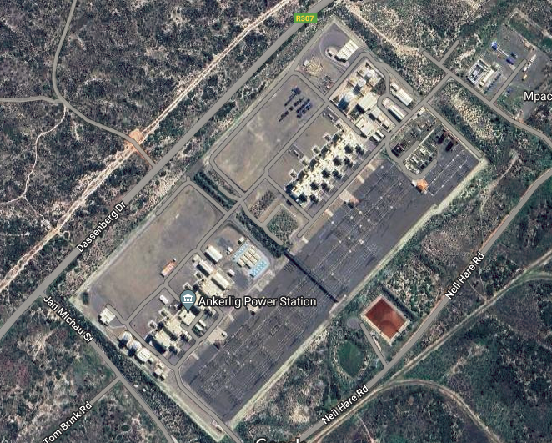
Delivery Point
The delivery point for Ankerlig and Gourikwa Power Stations is the site boundary fence.

Slide 12
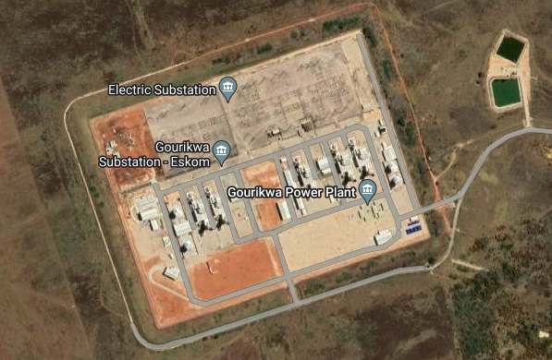
Delivery Point

Slide 13
Tender Returnables
The Tenderer to provide at least three (3) references that encompasses similar activities to this tender within the last ten (10) years. The references should be for supplying turnkey gas supply solutions of similar or greater volumes and logistics for contract duration of at least 10 years.
The Tenderer to provide technical documentation/information on the Engineering Studies performed for this tender on the logistical supply of natural gas to the delivery point. The Engineering Studies technical documentation/information includes the following:
  a. Process Description
  b. Operating Description
  c. System Description
  d. Technical risk assessment
  e. Terminal point register
  f. Process Flow Diagram/Process Instrumentation Diagram
  g. Layout drawings
  h. Hazardous and Operation assessment

Slide 14
Tender Returnables (Continued 1)
The Tenderer to provide a laboratory accredited natural gas composition/specification which should meet or exceed that which is stipulated in the technical specification. Reference should be provided on the gas analysis standards used for the analysis.
The Tenderer to provide the international standards that will be used for both random and continuous gas analysis.
The Tenderer to indicate on a drawing the position of the delivery point at the Ankerlig and Gourikwa Power Stations site boundary.
For each of the annual load factors at Ankerlig and Gourikwa Power Stations, the Tenderer is to provide the following information:
  a. A letter from the source / accreditation indicating volume of gas to be supplied
  b. Logistical solution for the gas supply (agile and less susceptible to gas supply interruptions)
  The Tenderer to indicate what indexing method will be used for the gas price. Reference is made to the NERSA paper on “Methodology to Approve Maximum Prices of Piped-Gas in South Africa”.

Slide 15
Tender Returnables (Continued 2)
The Tenderer to indicate the natural gas process condition of supply temperature and pressure at the delivery point.
The Tenderer to list the permits e.g., EIA, etc. that are required together with timelines and a risk register in obtaining these permits
The Tenderer to submit a Level 3 project schedule with realistic durations that detail all activities from the date of contract award to the delivery of the first gas to Ankerlig Power Station and Gourikwa Power Station separately.
The Tenderer to indicate in the schedule when commissioning natural gas can be provided to Ankerlig and Gourikwa Power Stations separately. Eskom’s current expectation is that the commissioning gas is provided by 09 December 2027 (Subject to change – to be managed during contract execution).

Slide 16
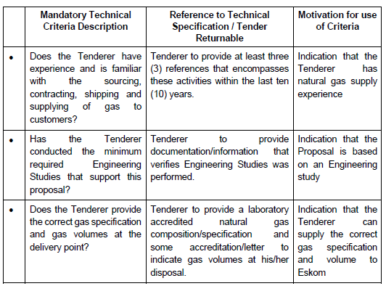
Technical Evaluation Overview
The minimum weighted final score (threshold) required for a tender to be considered from a technical perspective is 70%.
Mandatory Criteria

Slide 17
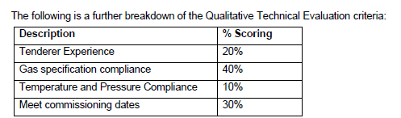
Technical Evaluation Overview

Slide 18
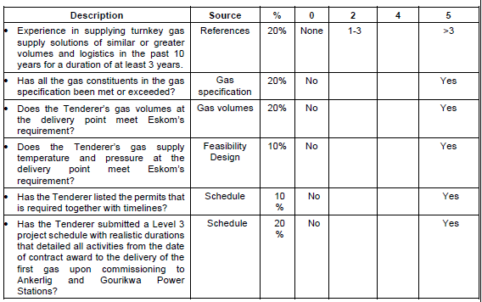
Technical Evaluation Overview
Prices will be requested for flexible annual load factor of 6% for a period of 5 and 10 years to be provided by the suppliers.

Slide 19


Technical Evaluation Overview
Gas Sales Agreement Timeline
Supply agreement for 5 and 10 years at various contracting options

Slide 20
Supply Options to be considered
The following potential gas contracting strategies will be negotiated:
  1. The flexible annual natural gas supply load factor of 6% at Take-and-Pay.
  2. The flexible annual natural gas supply load factor will be 6%. (A minimum portion of the annual load factor (6%) to be assigned to Take-or-Pay with the remaining load factor being Take-and-Pay).
  3. Alternative options the Tenderer would suggest.

Slide 21
Technical questions?

