Slide 1
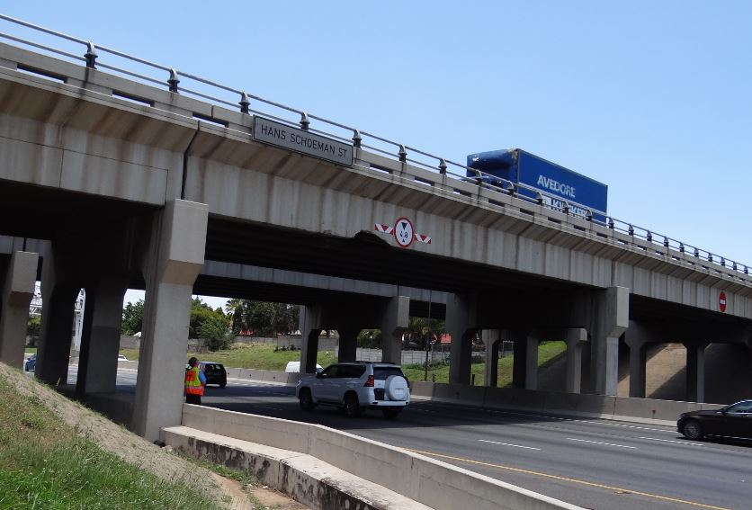



CONTRACT SANRAL N.001-200-20191
FOR THE REPAIRS TO THE HANS SCHOEMAN BRIDGE No. 262 A AND B
Tender Briefing
JANUARY 2021

Slide 2


Agenda
Attendance register
Welcome and Introductions
Background and description of the Works
Tendering procedures
Questions from tenderers
Site visit – No site visit (virtual presentation only)
Conclusion of meeting

Slide 3
Welcome and Introductions

Slide 4
Welcome
Virtual Tender Briefing for:
SANRAL N.001-200-2019/1 FOR THE REPAIRS TO THE HANS SCHOEMAN BRIDGE No. 262 A AND B
Attendance:
The signature on the duly completed and signed Form A1 shall be considered proof that the tenderer viewed and attended the whole clarification briefing presentation and clearly understood all directives and clarifications given in the presentation.
The onus rests with the tenderer to ensure that the representative attending and viewing the clarification briefing presentation is appropriately qualified to understand all directives and clarifications given in the presentation.

Slide 5
Introductions
SANRAL
  Mr. Alan Agaienz (SANRAL Project Manager)
SANRAL Tender Queries
• Mr. Andile Gogotya : e-mail: gogotyaA@nra.co.za
SNA / Kgarebana
  Mr. Gert Loubser (Project Leader)
RRM Route Manager (TBC)
  The details of the Contractor will be confirmed.

Slide 6
COVID – 19 Regulations
Legislation to be adhered to governing workplaces in relation to COVID – 19:
Occupational Health and Safety Act, Act 85 of 1993, as amended, to read with the Hazardous Biological Agents Regulations. Section 8 (1) of the Occupational Health and Safety (OHS) Act, Act 85 of 1993.
Act requires the employer to provide and maintain as far as is reasonably practicable a working environment that is safe and without risks to the health of employees.
Specifically Section 8(2)(b) requires steps such as may be reasonably practicable to eliminate or mitigate any hazard or potential hazard.
No additional fees will be payable – All cost to be included in tendered rates.

Slide 7
Background and Description of the Works

Slide 8
Locality
This project is located in Randburg, within the City of Johannesburg in Gauteng.
The Hans Schoeman Bridge is situated at Km 33.65 on road N1 section 20.
The N1 is a dual carriageway road with paved shoulders. The surfacing width of each carriageway in the vicinity of the bridge is approximately 18.55m. The bridge is situated at on a straight horizontal alignment.
The project locality and project area are shown on the next slides.

Slide 9
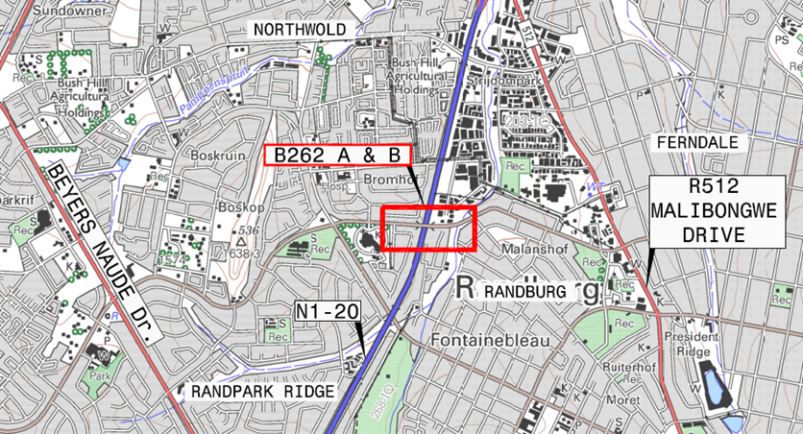

Slide 10
Objective
The overall objective of the project is to repair of precast concrete beams on the
Hans Schoeman Bridge that have been damaged by vehicle impact.

Slide 11
Project Description
The works entail the following main components:
Liaise with community through RRM, and appointment of PLO.
Set-up procedure for appointment of local labour.
Site establishment and provision of office and meeting facilities.
Accommodation of traffic on the N1
Concrete Repairs to the damaged Hans Schoeman bridge beam
The RRM team will remain responsible for the section of the N1

Slide 12
Working Hours/Days
Special non-working hours/days (A6.5)
(a) All designated public holidays (including all foreseeable statutory declared election days)
(b) The annual shut-down period between December and January
(c) Day before Easter Weekend
(d) Day of State school term closure and day prior to State school term start
(e) Other non-working days and restricted working hours:
Between: Monday 5:00AM and Friday 21:00PM
As defined under 1.1.3.11: “Working day” means a day that is not listed as a Special non-working day and is taken as an 8 hour shift.”
From Friday evenings at 21:00 PM to Monday mornings at 05:00 AM is 32 Hours which consist of 4 x 8 hour shifts (working days).

Slide 13
Traffic Accommodation
Traffic accommodation on Hans Schoeman
Traffic accommodation on N1 (up to 130 000 veh/day)
Overhead work on the Hans Schoeman road bridge will require certain lanes on the N1 to be closed.
The traffic accommodation along the N1 and Hans Schoeman will only be in place during weekends. Traffic accommodation measures may only be placed from Friday evenings at 21:00 PM, and the road will be fully open for traffic on Monday mornings at 05:00 AM.

Slide 14
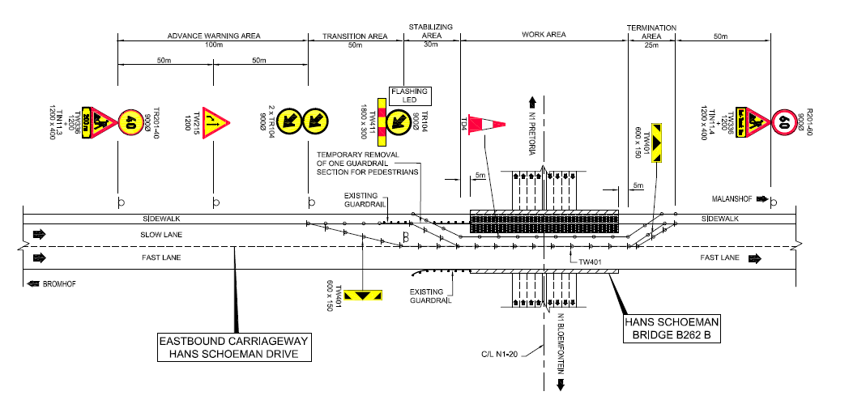
Traffic Accommodation (Hans Schoeman Rd)

Slide 15
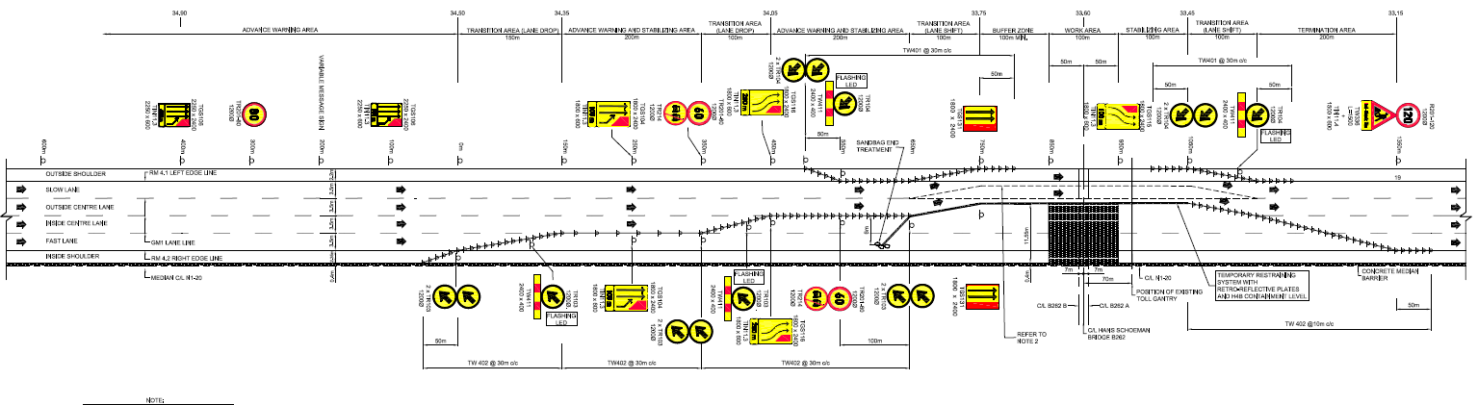
Traffic Accommodation (N1) – Stage 1

Slide 16
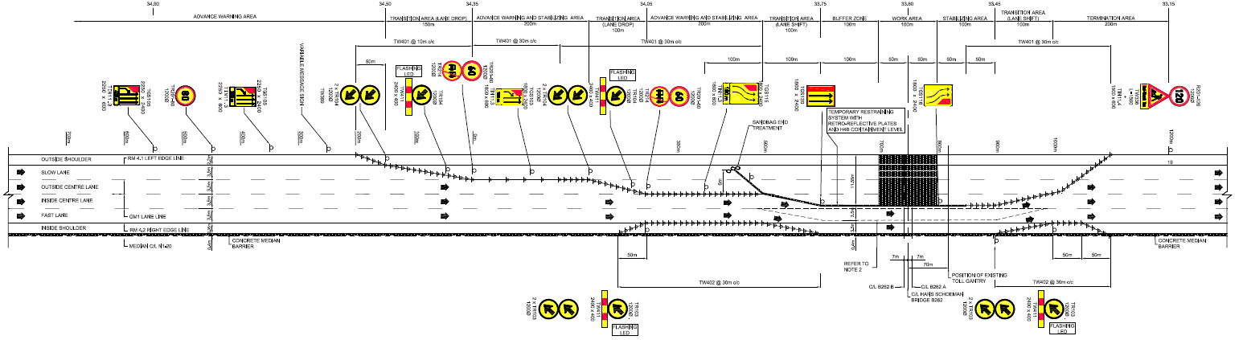
Traffic Accommodation (N1) – Stage 2

Slide 17
Structural Works
Major edge beam repair (B262-B Edge beam 1 Southbound Carriageway)
  Preparation of concrete surface (inclusive of mapping rebar and prestressing ducts, saw cutting repair edge, high pressure water jetting, and grit blasting).
  Inspect and confirm with the Engineer which ducts and tendons have been damaged for repair and re-grouting.
  Installation of carbon fibre strips.
  Installation of steel plates.
  Casting of micro concrete beam inclusive of:
    Installation of temporary shuttering,
    Installation of ducts and pre-stressing bars,
    Installation of reinforcement,
    Placing of steel shuttering and strengthening plates,
    Pre-wetting of concrete surfaces (by means of ponding),
    Casting beam, and
    Curing.
  Installation, stressing and grouting of prestressed bars and ducts.

Slide 18
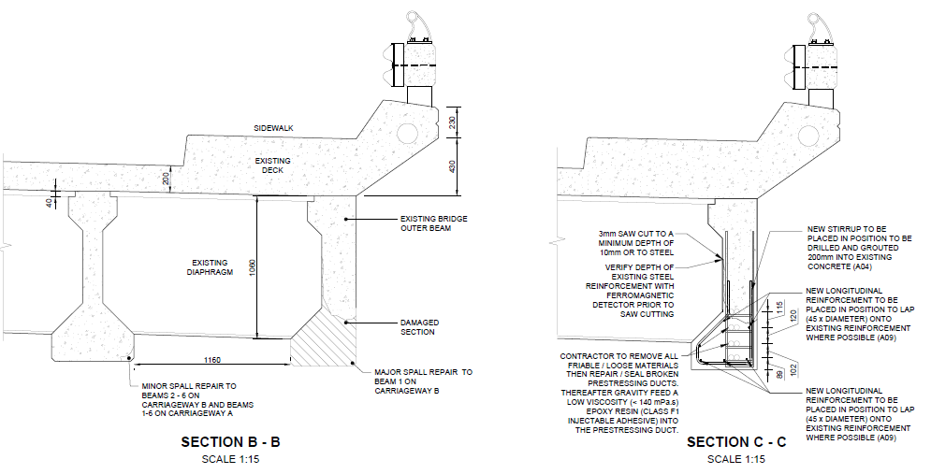
Structural Works

Slide 19
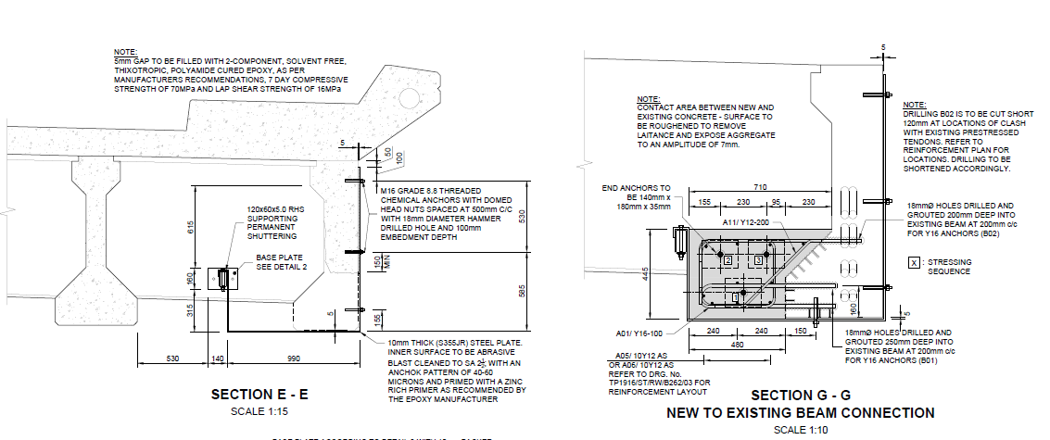
Structural Works

Slide 20
Structural Works
Minor edge beam repair (B262-A Beams 1-6 & B262-B Beams 2-6 Southbound Carriageway B262-A Beams 1-6 & B262-B Beams 1-6 Northbound Carriageway)
Preparation of concrete surfaces, inclusive of:
  Mapping rebar and pre-stressing ducts,
  Saw cutting repair edge,
  High pressure water jetting, and
  Grit blasting.
Straightening of existing rebar and splicing of new rebar where required.
Re-profiling of longitudinal beams using shrinkage compensating cementitious grout.

Slide 21
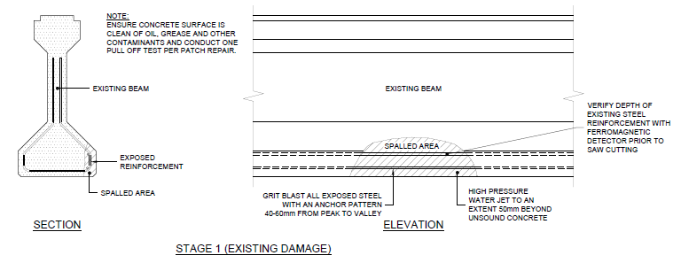
Structural Works

Slide 22
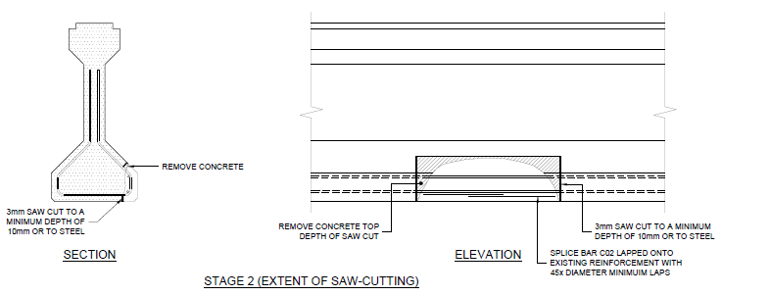
Structural Works

Slide 23
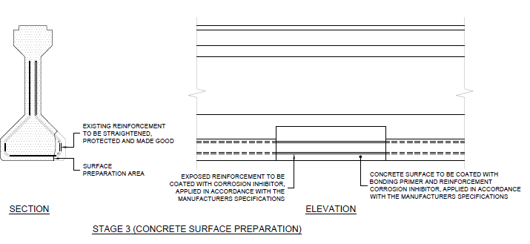
Structural Works

Slide 24
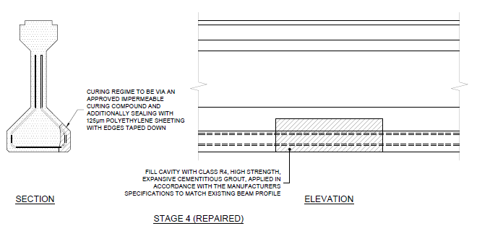
Structural Works

Slide 25
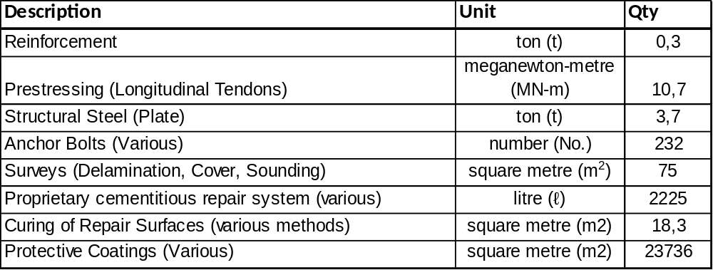
Quantities

Slide 26
Tendering Procedures

Slide 27
Tender Documents
Volume 1: The Conditions of Contract - FIDIC
Volume 2: The COLTO Standard Specifications
Volume 3: The Project Document, containing the tender notice, Conditions of Tender, Tender Data, Returnable Schedules, general and particular conditions of contract, project specifications, Pricing Schedule, Form of offer and Site Information, is issued by the Employer
Volume 4: The road works drawings
Volume 5: The structural drawings
Volume 6: Materials investigation and utilisation (No dedicated Volume 6).
Volume 7: Environmental Management Plan report (Included under Volume 3).

Slide 28
Volume 3 Tender Document
The tender documents issued by the Employer comprise:
Part T1: Tendering Procedures
T1.1 Tender notice and invitation to tender
T1.2 Tender data
Part T2: Returnable Schedules
T2.1 List of returnable documents
T2.2 Returnable schedules
Part C1: Agreements and contract data
C1.1 Form of offer and acceptance
C1.2 Contract data
Part C2: Pricing data
C2.1 Pricing instructions (assumptions)
C2.2 Pricing Schedules / Bills of Quantities
Part C3: Scope of work
C3 Scope of work
Part C4: Site Information
C4 Site Information
Part C5: Annexures
The conditions of tender are the standard conditions of tender as contained in SANS 10845-3:2015 Edition 1

Slide 29
Submission of a Tender
Volume 3 is issued at tender stage in electronic format and contains the following files:
The full Project Document in PDF format (Volume 3 to 5)
The returnable forms in word format
The pricing data in excel format
SUBMISSION OF TENDER
Of the contract documents, only the following elements of Volume 3 needs to be submitted electronically on CD / flash drive marked “Postulated (followed by the Tenderer name)” in a sealed envelope, in the following order :
- Form of Offer (signed and scanned as .pdf);
- All returnable schedules and attachments and certificates (signed and scanned as .pdf);
- Completed pricing schedule (scanned copy in .pdf and copy in Excel).

Slide 30
Tender Eligibility
Only tenderers with a B-BBEE contributor status level of 1, 2, 3 or 4 and who is a QSE and who are registered on the National Treasury Central Supplier Database and meet the minimum threshold designated for local production and content as stated in the Tender Data C.2.1.1, are eligible to tender.
Only tenderers who comply with the functionality criteria for: Key Persons, Environmental, Social, Health, and Safety (ESHS) past performance, financial capability, experience and past contract performance, as stated in the Tender Data, are eligible to tender.
It is estimated that tenderers should have a CIDB contractor grading designation of 7CE or higher, however tenderers attention is drawn to clause 4.1.1 of the Tender Data when submitting their tender.

Slide 31
Tender Eligibility
Tenders from tenderers registered as potentially emerging enterprises but with a CIDB contractor grading designation lower than a contractor grading designation determined in accordance with the sum tendered, or a value determined in accordance with Regulation 25(7A) of the Construction Industry Development Regulations, will not be accepted.
Only locally produced or locally manufactured goods with a stipulated minimum threshold for local content and production as stated in the Tender Data will be considered.

Slide 32
Tender Documents
Tender documents are available at no cost in electronic format downloaded from the SANRAL’s website by the following link: https://www.nra.co.za/service-provider-zone/tenders/open-tenders/.
Tenderers must have access to MS Office ©2013 and Acrobat Adobe ©9.0, or similar compatible software.
Tenderers must have access to MS Office ©2013 and Acrobat Adobe ©9.0, or similar compatible software.
A non - compulsory clarification briefing meeting will be held via a virtual platform on the 18th of January 2022 where the project will be presented. A link to the clarification briefing meeting will be sent to tenderers.

Slide 33
Submission of a Tender
Closing date for receipt of tenders:
As per Tender Advertisement
Location of tender box: SANRAL Regional Office: Main Security Gate
Physical address: 38 Ida Street, Menlo Park, Pretoria
Identification details: TENDER: CONTRACT SANRAL N.001-200-2019/1 FOR THE REPAIRS TO THE HANS SCHOEMAN BRIDGE No. 262 A AND B
*The employer shall respond to clarifications received up to 7 working days before tender closing date.
**The employer shall issue addenda until 5 working days before tender closing date.

Slide 34
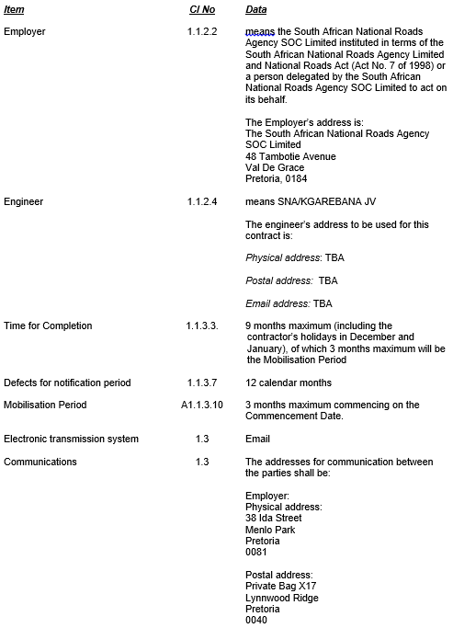
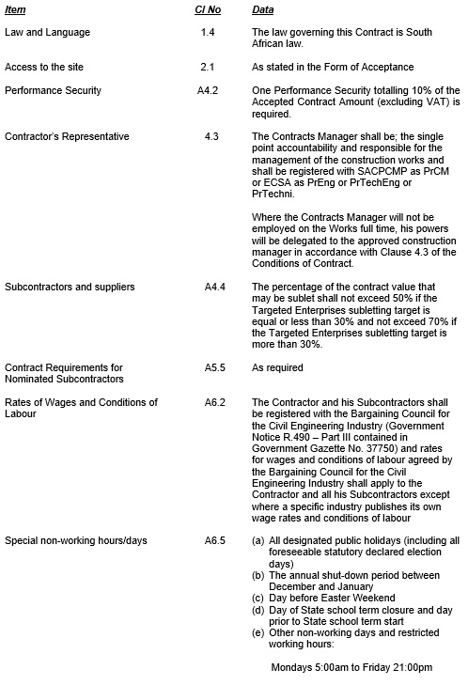

Appendix to Tender

Slide 35
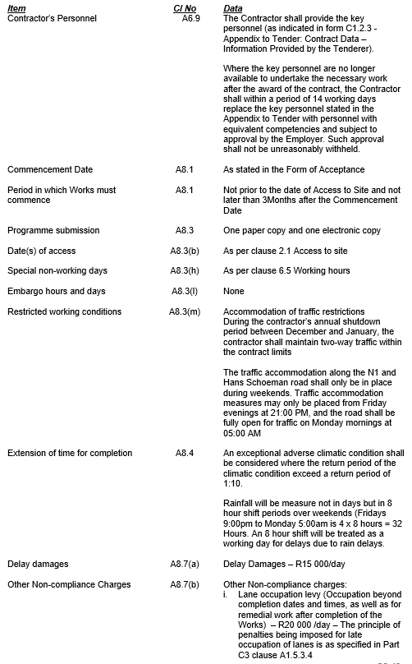
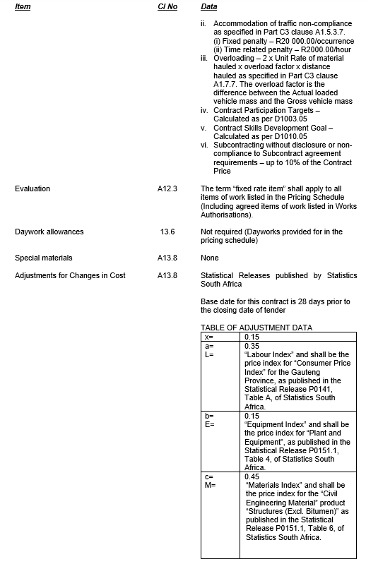
Appendix to Tender

Slide 36
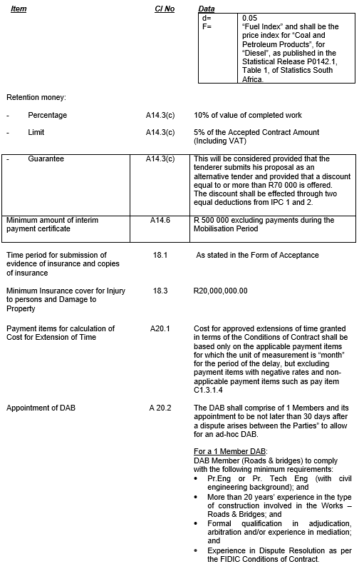
Appendix to Tender

Slide 37
SECTION C: Environmental Management Plan
The Employer recognises environmental management as a key component of road infrastructure development and as part of its environmental policy has developed this Environmental Management Plan (EMPl) as a tool for continual improvement in environmental performance.
The provisions of this EMPl are binding on the contractor during the life of the contract. They are to be read in conjunction with all the documents that comprise the suite of documents for this contract, particularly the conditions of any environmental authorisation and associated Environmental Management Programme (EMPr)
SANRAL is in the process of obtaining a General Authorization

Slide 38
SECTION D: Small contractor development, training
and community participation
Please note New SANRAL Section D Requirements and Specifications which describes the structured engagement with project Stakeholders and affected Communities to the project. It also guides the selection and the enhanced utilisation and development of Targeted Labour.
Section D is included to facilitate better project level liaison with local communities and structures.

Slide 39
SECTION E: Requirements of the Occupational
Health and Safety Act and Regulations
The Occupational Health and Safety Act, Act 85 of 1993 and its Regulations together with SANS Codes set out minimum standards with regards to Occupational Health and Safety. SANRAL has developed the Occupational Health and Safety Specifications with these minimum standards in mind and in certain stages the requirements of SANRAL exceeds the minimum legal requirements to follow best practices and to ensure a healthy and safe workplace for all.
This part of the specification has the objective to assist the contractor entering into contracts with the Employer that they comply with the Occupational Health and Safety (OH&S) Act, No. 85 of 1993, as well as all applicable Regulations.
NOTE - PROJECT/SITE SPECIFIC REQUIREMENTS
For the project specific baseline risk assessment and Site specific health and safety specification, refer to Volume 3: Appendix 4.

Slide 40
Questions from Tenderers
- To be submitted to SANRAL SCM as per tender document instructions.

Slide 41
Site Inspection
- Virtual Site Inspection

Slide 42
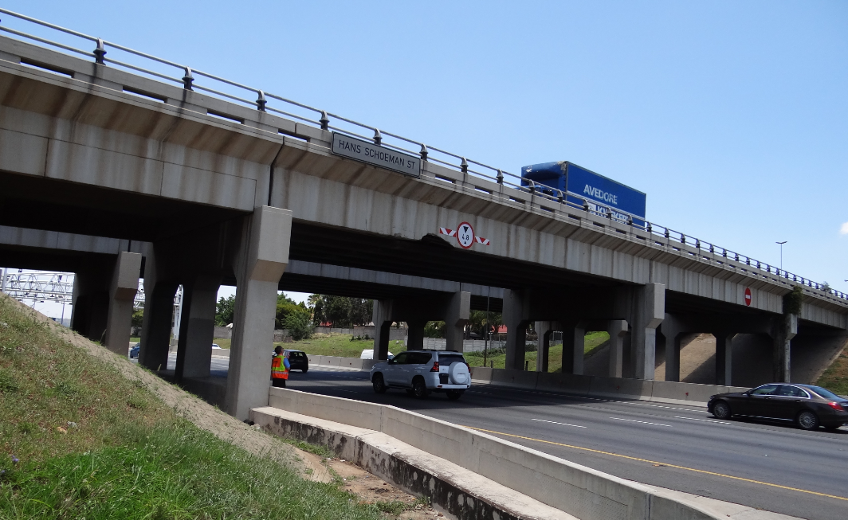
Site Photographs
Photograph 1: Hans Schoeman Bridge travelling South on N1

Slide 43
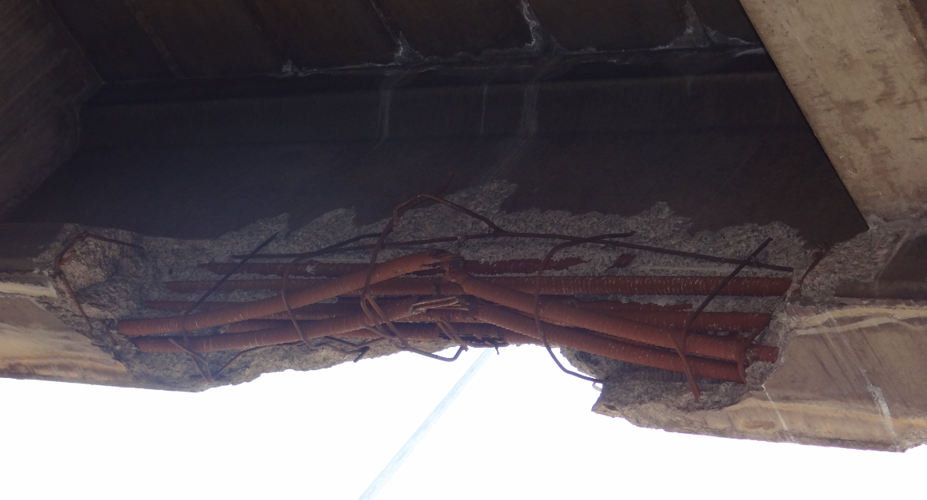
Site Photographs
Photograph 2: Bridge beam with major damage (Inside face)

Slide 44
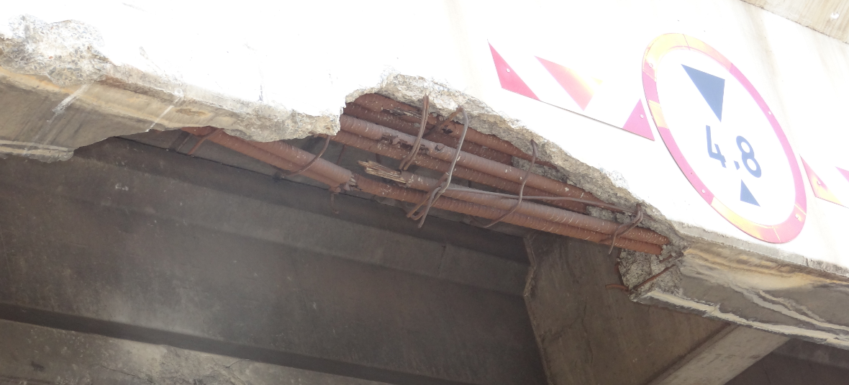
Site Photographs
Photograph 3: Bridge beam with major damage (Outside face)

Slide 45
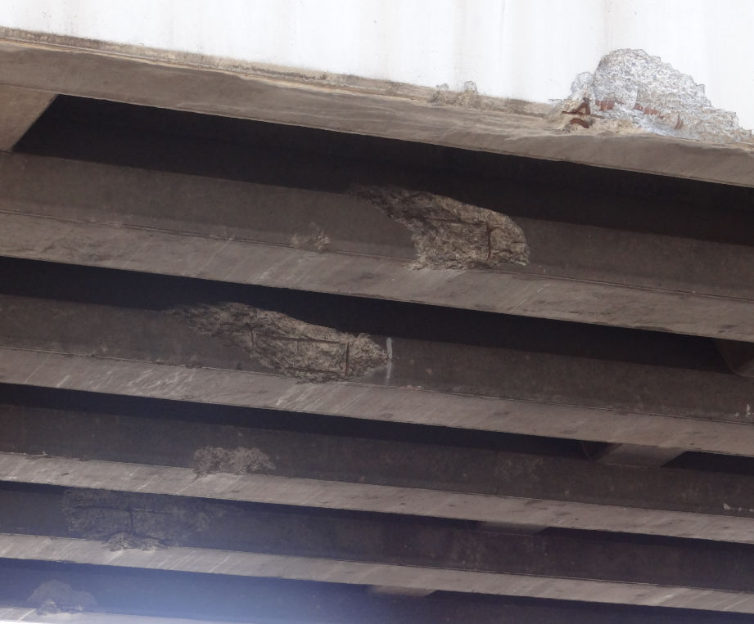
Site Photographs
Photograph 4: Beams with minor damage

Slide 46
Certificate of Tenderer’s attendance
- As per SANRAL Requirements explained during the compulsory clarification briefing meeting, where the project was presented.

Slide 47
END – THANK YOU
Tender Briefing
APRIL 2021

