Slide 1
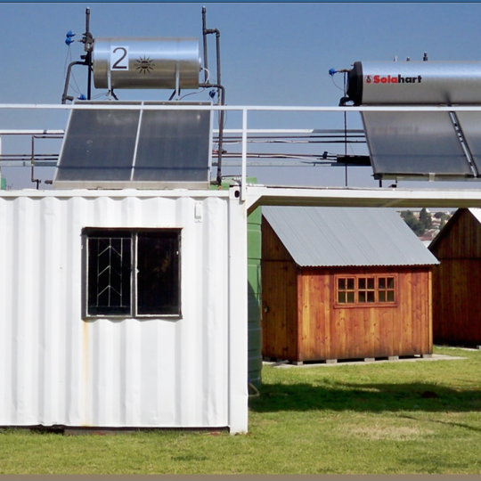
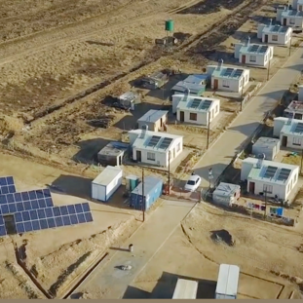
Contracting Principles for Smart Meters
Donovan Kumkaran
24/01/2025

Slide 2
1. Introduction
All contracting will be done utilizing the NEC3 Supply Contract April 2013 version.
Various Secondary Options will/may apply:
  X1 Price adjustment for inflation
  X2 Changes in the Law
  X3 Multiple Currencies
  X4 Parent Company Guarantee
  X7 Delay Damages
  X13 Performance Bond
  Z Additional Conditions of Contract

Slide 3
2. General Principles
Risk – The core clauses contain the Employers Risks allocated in the contract, whatever risk is not the Purchasers risk is the Suppliers risk.
Goods Information – Contains references and specific goods requirements relevant to the goods purchased as well as reference to the applicable specifications.
Period of reply – There is a set period of reply to be applied to the contract unless otherwise agreed on a specific matter basis.
Lead times – Will be agreed upon at negotiation stage based on the Supplier’s capacity and will be negotiated for batches. Suppliers to propose lead times for batches at tender stage which will provide the basis for the negotiations.
Testing and Defects – To be agreed upon at negotiation stage pertaining to time for correction.
Payments – All assessments will be done after each batch delivery. Payment periods are 30 days for contract values under R50 million and 60 days for contract values above R50 Million and will not be negotiated. (Eskom Payment Policy)
Compensations Events – As per the core clause document.
All goods will be delivered FCA.

Slide 4
3. Liabilities
The Supplier will be liable to the Purchaser for the total of all Purchase orders placed and this will include consequential loss as Eskom is dependent on meters for income.
Liability for defects is limited to the value of the batch order from which the defective products arise.
End of liability will be 3 years after the whole delivery of the goods and services.

Slide 5
4. Dispute resolution
Any dispute must first be referred to adjudication for resolution.
If any party is dissatisfied with the outcome of adjudication the matter must then be referred to arbitration.
Should any party be dissatisfied with the outcome of the arbitration the relevant court may then be approached.

Slide 6
5. Bonds and Guarantees
There are two types of bonds – performance and parent company guarantee.
The value of the performance bond if elected will be determined based on the outcome of the financial evaluation carried out on the suppliers audited financial statements. Can be up to a maximum of 40% of the contract value.
The parent company guarantee will only apply to a subsidiary of a holding company.

Slide 7
6. Pricing
Pricing will be determined and negotiated based on the outcome of an RFQ and will be reflected on the Purchase Order.
Escalation will apply to all Purchase Orders with a delivery period exceeding 12 months from the Purchase Order date based on agreed indices.
All Purchase Orders with a delivery period less than 12 months will not be subject to escalation and will be based on a fixed price.

Slide 8

Conclusion

