Slide 1

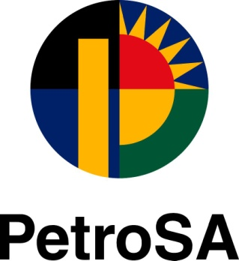
BRIEFING SESSION
CTT25229
THE APPOINTMENT OF A PANEL OF TRANSACTION AND DUE DILIGENCE ADVISORS – GENERAL PROJECTS
SESAKHO MAGADLA / WAYNE LIEBENBERG / HENNIE FORTUIN / SALEEM SOOBADER/LEON BEZUIDENHOUT
The Petroleum Oil and Gas Corporation of South Africa (SOC) Ltd Reg. No. 1970/008130/07

Slide 2
AGENDA :
CTT25229
THE APPOINTMENT OF A PANEL OF TRANSACTION AND
DUE DILIGENCE ADVISORS – GENERAL PROJECTS
ITEM | TIME | BY WHOM
ADMISSION INTO TEAMS PLATFORM | 12H00 – 12H05 | M Fortuin CONTRACTS MANAGER
OPENING / WELCOME / INTRODUCTION | 12H05 – 12H10 | M Fortuin CONTRACTS MANAGER
CLARIFICATION ON SCOPE OF WORK | 12H25 – 12H45 | S MAGADLA CHIEF OPERATING OFFICER (ACTING)
QUESTIONS AND ANSWERS | 12H45 – 13H15 | S MAGADLA CHIEF OPERATING OFFICER (ACTING)
GENERAL & CLOSURE | 13H15 – 13H30 | ALL

Slide 3
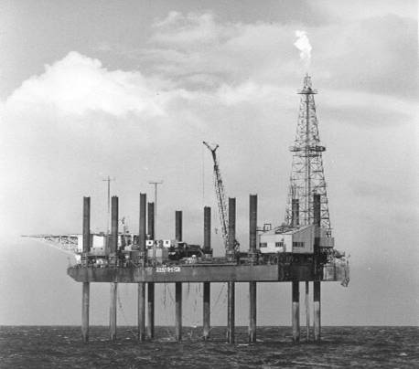
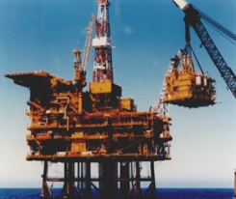
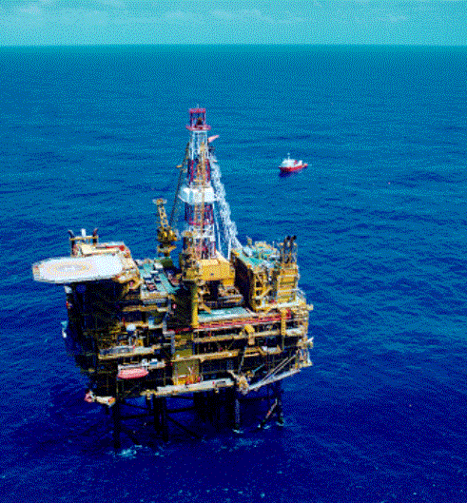
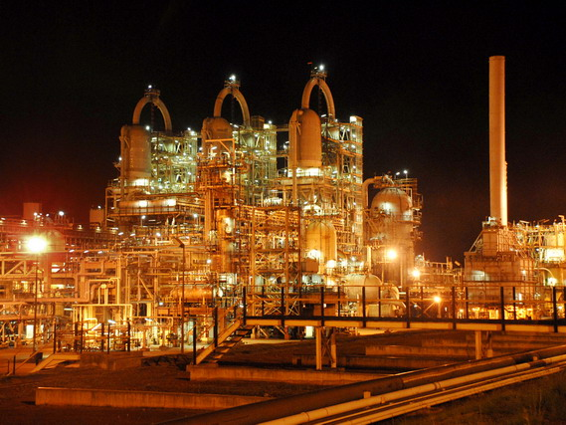
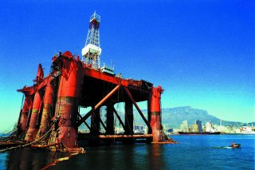
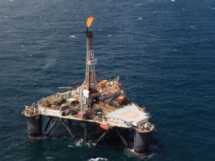
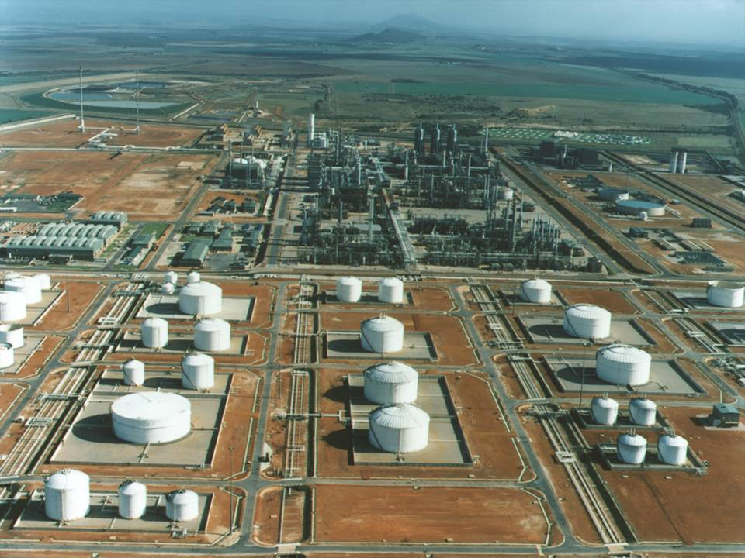

PetroSA Background / Company Overview
  Formed in 2002 through the merger of Mossgas, Soekor and parts of the Strategic Fuel Fund
  Wholly state-owned company of the Government of South Africa and registered as a commercial entity under the South African law.
  Subsidiary of CEF (Central Energy Fund) SOC Ltd which is a schedule 2 state owned diversified energy company reporting to the department of mineral resources and energy (DMRE)
Upstream Milestones:
2013
Ikhwezi/FO starts producing.
2007
South Coast Gas comes on stream.
2003
Sable starts producing on 15 October.
1969
Following the establishment of Soekor, first offshore well drilled off the Southern Cape Coast.
First gas discovery
(Block 11A).
1983
Discovery of E-M field, which together with F-A field provides basis for the Mossgas Project.
1991
Drilling E-BD, the second discovery well for Sable .
1990
Oribi oil field discovery
(E-BT1), 140 km South-West of Mossel Bay.
1966
First onshore Soekor well drilled in Beaufort West. Small , non-commercial accumulations of oil found.
1980
F-A gas field discovered
in Block 9 of f Bredasdorp Basin, off Southern Cape coast.
1988
Discovery of Oryx oil field, RS A’s 1st oil discovery.
1997
Oribi, F-AH & F-AR fields come on production.
2000
Oryx and E-M fields come on production in May 2000.
1989
F-O gas field discovery. Drilling (EC-E), Sable oil field.

Slide 4
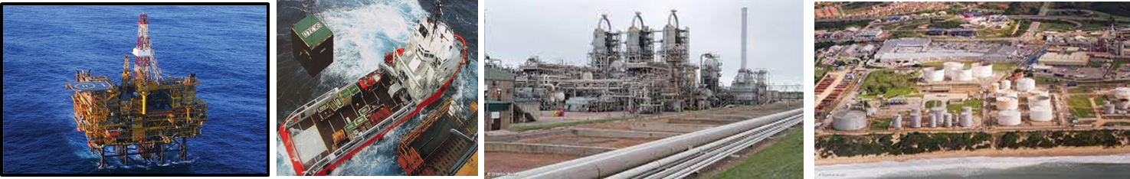
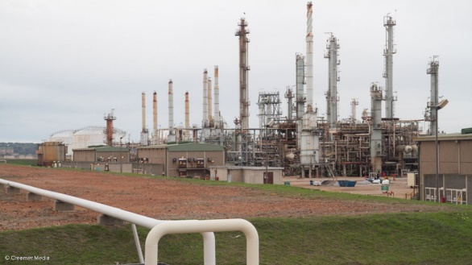
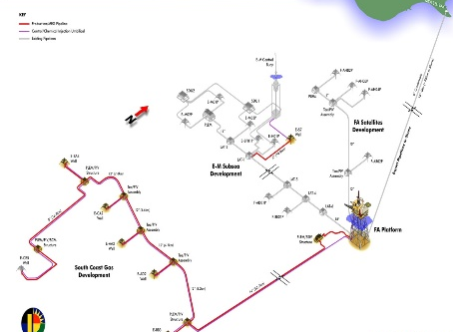
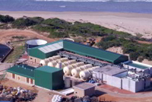
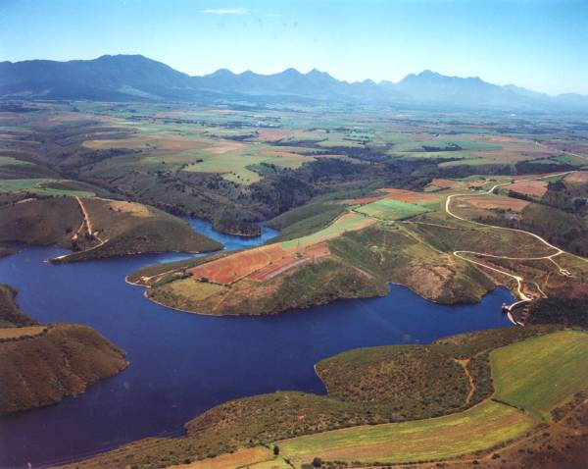
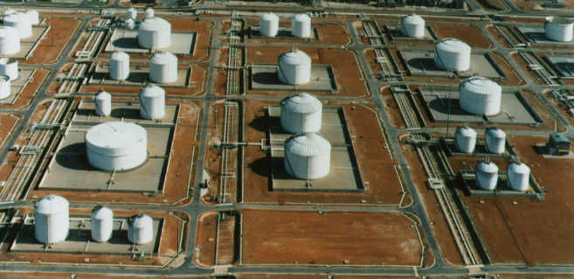
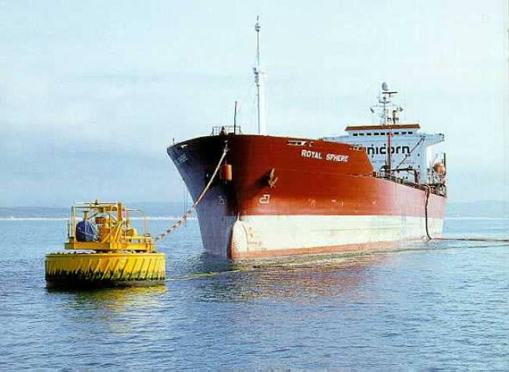
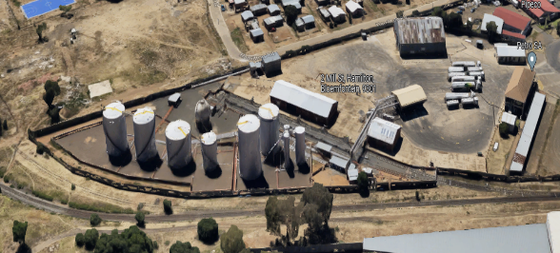
PetroSA GAS & LIQUIDS, PROCESSING, AND TRANSITION STORAGE INFRASTRUCTURE
FA PLATFORM WITH SUBSEA
GTL OPERATION
LIQUIDS (LIGHT CRUDE) REFINERY
FA Condensate
NG Gas
SUBSEA
DESALINATION PLANT & WOLWEDANS DAM
U51TANK FARM- GAS&LIQUIDS
BLOEMFONTEIN & TZANEEN DEPOT
SPM/CBM
VOORBAAI TANK FARM
Final Product
Final Product

Slide 5
SCOPE OF WORK
INTRODUCTION
  The Petroleum Oil and Gas Corporation of South Africa SOC Ltd (“PetroSA”) is a wholly-owned subsidiary of the Central Energy Fund (CEF) Group of companies
  PetroSA is a schedule 2 company subject to the Public Finance Management Act (PFMA).
  PetroSA is an integrated oil and gas company with business activities spanning:
    Upstream (the Exploration and Production of Oil and Gas),
    Midstream (the refining of Oil and Gas at the GTLR to produce liquid fuels such as diesel, petrol, kerosene etc.) and,
    Downstream (marketing and distribution of finished product to the customers).

Slide 6
SCOPE OF WORK - GENERAL
PetroSA is looking to appoint a panel of Transactional Advisors with complementing skills and expertise to advise on:
    Major hydrocarbon investment projects such as:
      Evaluation of Portfolio of Hydrocarbon Projects to determine which should be pursued to create maximum value and strategic fit
      Farm-out agreements
      Forming Upstream Partnerships
      Mergers and acquisitions
      Refinery enhancement projects
      Refinery Re-instatements and/or capacity upgrade
      Gas to Power Project
      Hydrocarbon trading projects
    Supporting implementation of the changing business model from vertically integrated business to specific business (Carve-outs)
    Support implementation of South African National Oil Company as directed by Shareholder and DMRE
    Support in efforts to commercialise patents

Slide 7
ROLE AND DELIVERABLES OF CONSULTANT
Intends to appoint a panel of Transactional Advisors to assist PetroSA to evaluate the projects that flows from the previously mentioned RFP’s as well as internal projects across the value chain.
Services will include screening of opportunities, commercial evaluations, risk management, due diligence, asset and corporate valuations and due diligence, identifying contractual obligations and liabilities, facilitation of capital raise / securing project funding and portfolio management.
Deliverables
    Commercial evaluation of individual and/or basket of opportunities
    Determine the technical quality of the asset / project
    Due diligence of projects and partners
    Determining strategic and commercial fit
    Determine the size of the market related to the asset / transaction
    Risk assessments and management
    Assisting in building business cases fit for securing funding

Slide 8
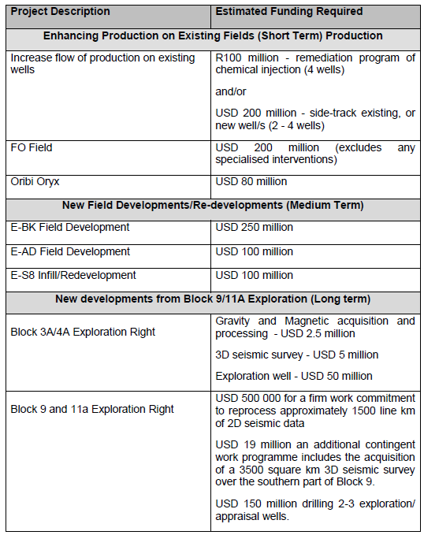
SCOPE OF WORK - UPSTREAM
  Upstream Division has various projects and assets in different stages across the value chain and released a RFP to seek partners (RFP 0003/ 2023 ).
  Also see RFP 0004/ 2023 - FUNDING REQUIREMENTS
  The main objective of these partnerships is to assist PetroSA in commercially monetising the remaining gas potential in the Block 9 Production Rights, and for carrying PetroSA in Block 3A/4A and Block 9/11a work programmes:

Slide 9
SCOPE OF WORK – MIDSTREAM
  The GTL Refinery has an infrastructure for operating both:
    High Temperature Fischer-Tropsch (HTFT) process at commercial scale
    Low Temperature Fischer-Tropsch (LTFT) process at semi-commercial scale.
    Refinery includes a marine terminal and product storage infrastructure in Voorbaai as well as at the Refinery site
  Currently the GTL Refinery is in a partially preserved state and PetroSA is looking to re-instate it with either indigenous feedstock (Block 9), the TotalEnergies discoveries on the South Coast, imported LNG or converting it to a liquid feedstock refinery.
  Various Midstream projects are under consideration, including power generation, Clean Fuels 2 as well as the reinstatement of the GTL Refinery.
  Projects may also be initiated to upgrade the marine loading facilities (SPM), to increase the capacity and flexibility of PetroSA’s storage infrastructure.
  Refer to RFP 0001/ 2023

Slide 10
GENERAL IMPORTANT INFORMATION
Technical evaluation will be scored out of 100 point with a min threshold of 60 points being required,
Tender closes on 23 February 2023 @ 15:00 (CAT)
To be submitted on the portal
No late proposals will be considered
All procurement queries on this may be directed to martinhennie.fortuin@petrosa.co.za
Minutes of this meeting will be posted on the PetroSA website
Please access our website www.procurement.petrosa.com to view any other procurement matters and to submit the tender.

Slide 11
QUESTIONS AND ANSWER SESSION

