Slide 1

PORT OF RICHARDS BAY MASTERPLAN
Date: 31 January 2024
Notes:
Growth and Reinvent

Slide 2
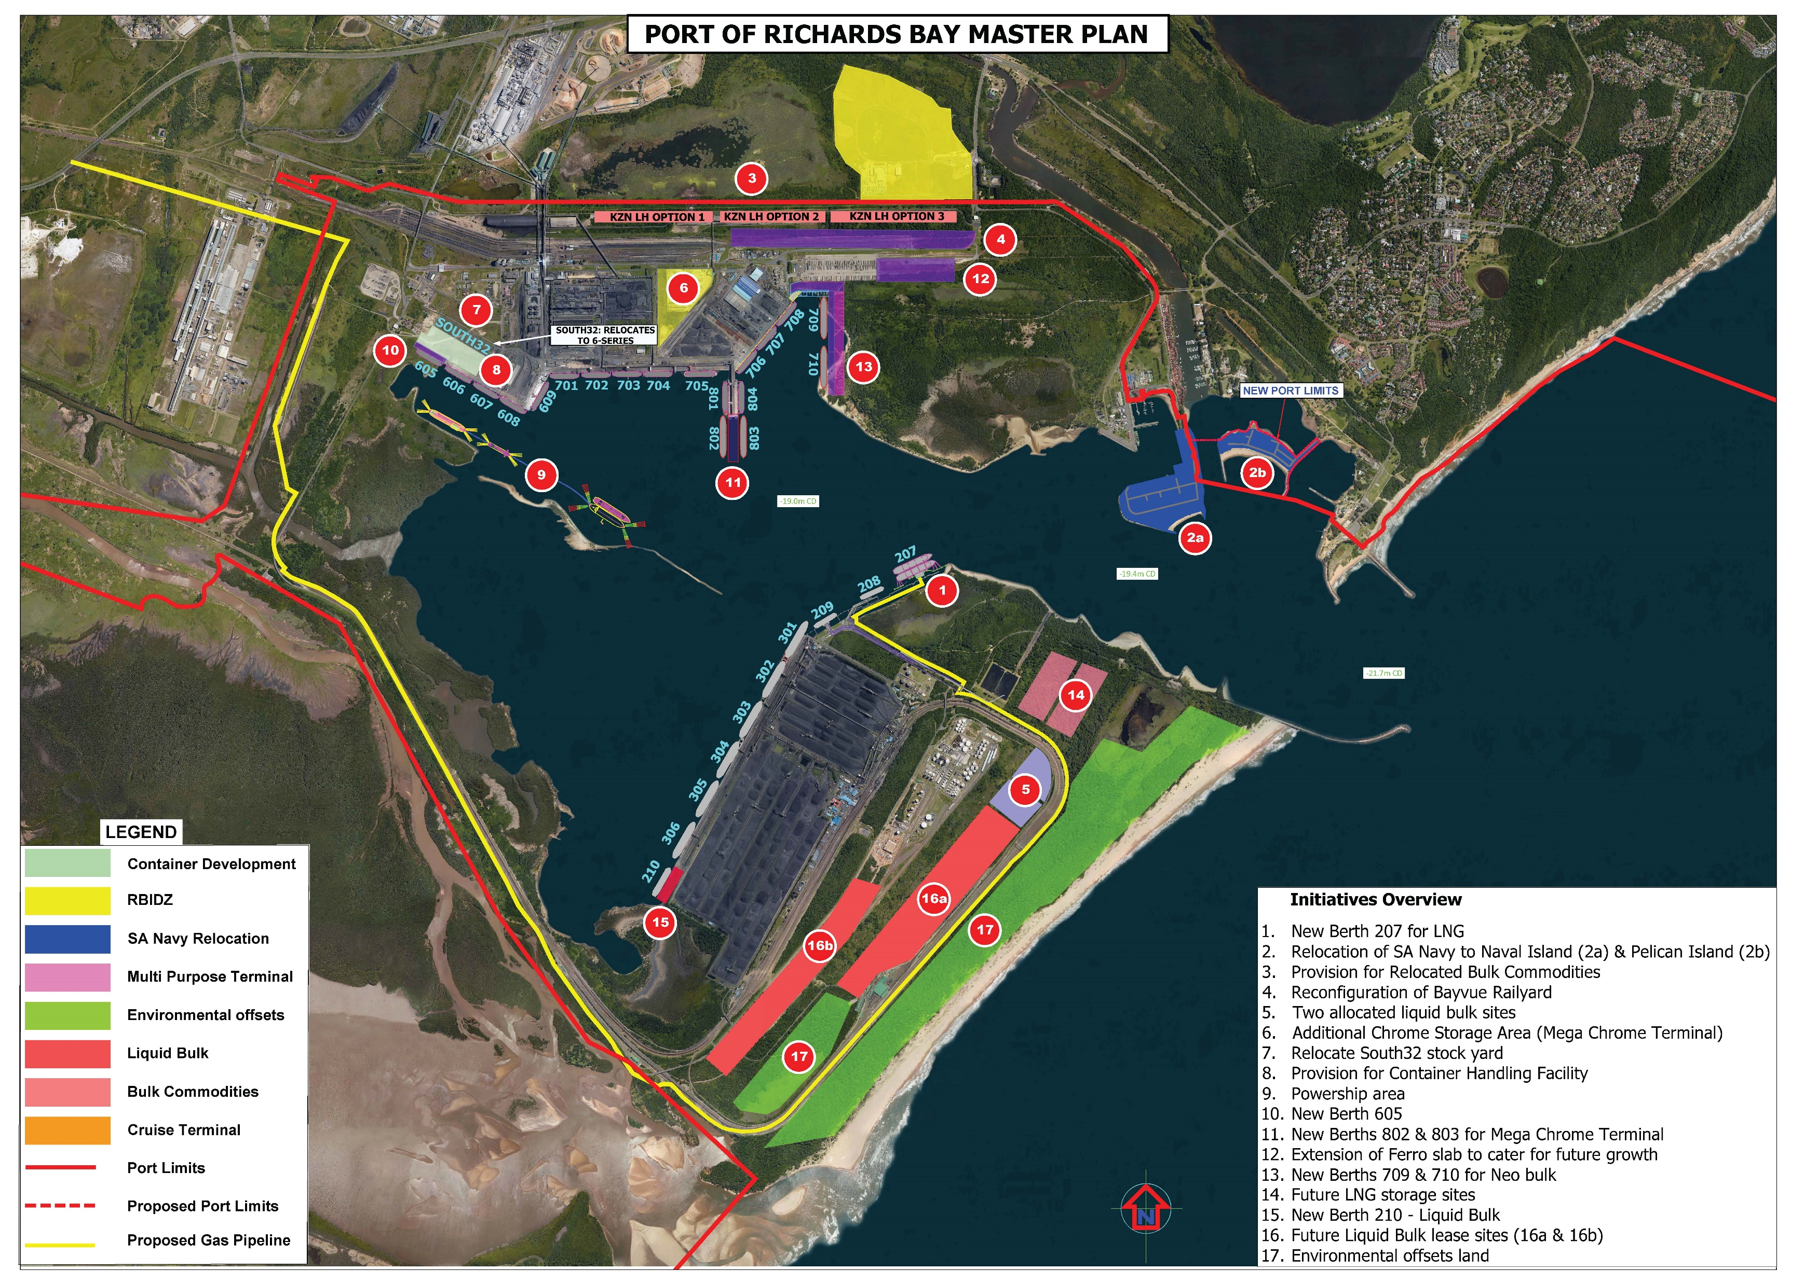
Port of Richards Bay Masterplan
Overview:
3
A
4
7
6
12
10
8
13
9
11
B
2b
2a
1
Initiatives Overview​ Edible Oil Pipeline Cruise Terminal 1. New LNG Berth 207​ 2. Relocation of SA Navy to Naval Island (2a) & Pelican Island (2b)​ 3. Provision for Relocated Bulk Commodities​ 4. Reconfiguration of Bayvue Railyard​ 5. Two allocated liquid bulk sites​ 6. Additional Chrome Storage Area​ 7. Relocation of South32 Bulk​ 8. Provision for Container Handling Facility​ 9. Powership Area​ 10. New Berth 605​ 11. New Berths 802 & 803 for Mega Terminal​ 12. Extension of Ferro slab to cater for future growth​ 13. New Berths 709 & 710 for Neo bulk​ 14. Future LNG Storage Sites​ 15. New Berth 210 – Liquid Bulk​ 16. Future Liquid Bulk lease sites (16a & 16b)​ 17. Environmental offsets Land​
14
5
16a
15
17
16b
17

Slide 3
Thank you

