Slide 1



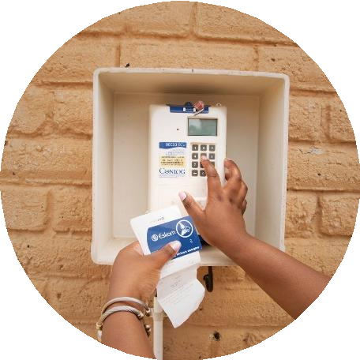
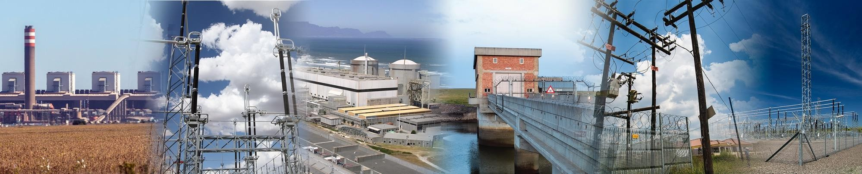
Enquiry No. E3017GXMPTUT: Provision of Maintenance Services for Electrostatic Precipitators during Outages and Routine Maintenance at Tutuka Power Station for a Period of 60 Months
Commercial Requirements
Clarification Presentation
19 June 2026 By Tsakani Shingange

Slide 2
AGENDA
Item No. | Agenda Item | Presenter / Responsible Person
1 | Opening and Welcome | Chairperson / Eskom Representative
2 | Safety Moment: Evacuation Procedure, Assembly Point, Restrooms, Emergency Arrangements and Housekeeping | Chairperson / All Attendees
3 | Introduction of Eskom Team/Tenderers Declaration of inteerests | Eskom Representative / Site Representative
4 | Purpose of the Clarification Meeting and Rules of Engagement | Chairperson / Eskom Representative
5 | Commercial Requirements | Tsakani Shingange
6 | NEC / Contracts Management Requirements | Johnson Magale / Tembi Mnqokoyi
7 | Technical Requirements (SOW & TES) | Mike Molepo/Sello Kgantsi / Chris Ndlovu
8 | Occupational Health and Safety Requirements | Questions to be submitted by email to the Buyer
9 | Environmental Requirements | Mosa Chipa
10 | Quality Requirements | Questions to be submitted by email to the Buyer
11 | SDL&I Requirements | Martin Mojela
12 | Clarification Questions and Responses | Eskom Team / Tenderers
13 | Closing Remarks and Reminder on Submission Requirements | Chairperson / Eskom Representative
14 | Meeting Closure | Chairperson

Slide 3
Tender Data Summary
Title: Provision of Maintenance Services for Electrostatic Precipitators during Outages and Routine Maintenance at Tutuka Power Station.
Contract Term: 60 Months / 5 Years.
Tender Number: E3017GXMPTUT.
Issue Date: 05 June 2026.
Closing Date and Time: 30 June 2026 at 10:00 South African Standard Time.
Tender Validity Period: Twelve (12) weeks from closing date and time.
Clarification Meeting: Non-compulsory, 19 June 2026 at 08:00, Tutuka Power Station outside conference center.
Eskom Representative: Tsakani Shingange, ShingaTP@eskom.co.za.
Tender Submission: Tenders are to be submitted electronically via Eskom E- tendering site by the stipulated closing date and time.
Tenderers to check the bulletin regularly for updates on the tender
E3017GXMPTUT

Slide 4
Basic Compliance and Submission
Tenderer must meet eligibility criteria and not be restricted by Eskom, National Treasury or listed as a tender defaulter.
Tender must include complete Commercial, Financial and Technical information.
Mandatory commercial returnables must be submitted by the stated deadlines.
Upload via Eskom E-Tendering / Tender Bulletin before closing date and time.
Upload documents under correct folders: Technical, Commercial, Financial and Other.
All documents must be in PDF format; price list must be PDF plus Excel copy.
No hard copy and no ZIP / condensed files will be accepted.
Upload limits: 500 MB per document and 4 GB total submission size.
Final submission status must show complete; latest resubmission replaces earlier versions.
E3017GXMPTUT

Slide 5
Tender Returnables at Closing
Category | Returnables / Evidence | Status
Disqualifiable | Basic Compliance: electronic tender copy in PDF, with price list in PDF and Excel copy. | Submit at closing
Disqualifiable | Annexure E: CPA for local goods/services, if applicable. | Submit at closing
Disqualifiable | Annexure F: CPA(IG) for imported goods/services, if applicable. | Submit at closing
Disqualifiable | NEC or other Contract completed in full. | Submit at closing
Disqualifiable | Additional documents such as ECSA/SACPCMP/CVs/permits/licenses/specific registrations where applicable. | Submit at closing
Evaluation | Technical Evaluation Criteria – Attachment 20. | Submit at closing for scoring
E3017GXMPTUT

Slide 6
Non-Disqualifiable and Prior Award Returnables
Timing | Returnables / Evidence
Tender Closing – Non-disqualifiable | Annexure A Authorisation; Annexure B Acknowledgement; Annexure C Tenderer’s Particulars; Annexure D Integrity Pact; Annexure J SBD 4.
Tender Closing – Non-disqualifiable | E-Tendering Help Manual acknowledgement; JV/consortium documents where applicable; Specific Goals proof for scoring.
Prior to Contract Award | Annexure H SBD 1; Tax Clearance/SARS PIN or CSD verification; Tax Evaluation Questionnaire; Employment Equity compliance where applicable.
Prior to Contract Award | Proof of valid CSD registration; COIDA / Letter of Good Standing; Quality, Safety, Environmental and Due Diligence evidence as stipulated.
Compiled from ITT E3017GXMPTUT Rev 27

Slide 7
Eskom eTendering Summary
Platform: https://etendering.eskom.co.za
Purpose: secure online submission of tender documents.
Access: tenderer must be registered and have a CSD number.
Submission steps:
  Register and verify via OTP.
  Login and select tender reference E3017GXMPTUT.
  Upload documents under correct folders: Technical, Commercial, Financial and Other.
  Finalise submission and retain confirmation email.
File limits: 500 MB per document and 4 GB total submission size.
Further information: refer to Eskom E-Tendering supplier help manual and videos.
E3017GXMPTUT

Slide 8
Pricing, Clarification and Evaluation
Item | Commercial briefing note
Pricing schedule | Price list must be submitted in PDF and Excel format (Excel format not disqualifiable).
Price evaluation | Prices evaluated inclusive of VAT, corrected for arithmetic errors and adjusted for acceptable variations and risk factors.
Discounts | Unconditional discounts are considered for evaluation. Conditional discounts are not considered for evaluation but may be implemented at payment.
Scoring | Price scored out of 90 points; Specific Goals scored out of 10 points.
Ranking | Tenderers ranked using the 90/10 preference point system; price and specific goals added together.
Objective criteria | Applicable. Eskom may award to a tenderer other than the highest scoring where objective criteria justify the award.
Clarification | Queries must be in writing to Tsakani Shingange at ShingaTP@eskom.co.za, five working days before tender closing.
E3017GXMPTUT

Slide 9
Functionality, SHEQ and Due Diligence
Area | Key requirements
Functionality | Minimum threshold 70%. Tenderers below 70% are disqualified. Submit Technical Evaluation Criteria – Attachment 20 at tender closing for scoring.
Quality | Form A – Category 1; List of Tender Returnables – Category 1; Supplier Quality Management Specification; Method Statement; QCP/ITP; Control Quality Plan.
Safety | Annexure B; OHS Specification; Health & Safety Plan/OHS Manual aligned to scope and risks; H&S costing broken down; Baseline OHS Risk Assessment with methodology.
OHS Competency | CVs and certificates covering applicable scope, medical fitness, risk-based PPE, SHE Rep, First Aid, HIRA and incident investigation.
Environmental | Waste management, environmental induction, incident management, emergency planning, environmental structure, resources, controls, Environmental Officer and detailed costing.
Due Diligence | Audited financial statements for previous 18 months or last available year; JV/SPV to submit statements for each participant.
E3017GXMPTUT

Slide 10
QUESTIONS?????
All questions must be sent to the buyer (5) five days before the closing date 30-06-2026
Response/answers will be published on the Eskom tender bulleting and the eTender portal of the National Treasury

Slide 11
Questions

