Slide 1
    SAT TENDER NUMBER 303/25
    Digital Assets Management System and Services
    Non- Compulsory Briefing
    Date: 07 August 2025

Slide 2
Date: 07 August 2025 AT 3PM BEIJING TIME ( 9H00 SA TIME)
VIRTUAL NON-COMPULSORY BRIEFING SESSIONS
AGENDA
Scope of Services by Project Lead
Phase 1 Evaluation by SCM
Phase 2A Evaluation by Project Lead
Phase 3 by SCM
Tender submission process by SCM
Q & A - All

Slide 3
BRIEF SCOPE OF WORK
A digital asset system and digital asset management of SA Tourism current digital assets and assets SA Tourism will accumulate across campaigns, activations , events ,partnerships , media and other stakeholders. * June 2025 estimated 42TB-tera bytes of assets .
Digital storage and management ,this includes digital storage and handling of the content on behalf of SA Tourism .
The system/platform : Security and access control: Permissions, role-based access, and backup mechanisms to safeguard assets .
Functionality for different users to access the system:
Contributor level/rights (Access levels – front end user).
Digital assets / Content should be categorized as per SA Tourism events / media / partnerships - menu tab for easy navigation for the users .
Report on the content review and performance (content downloads& uploads, content requests, users, system performance etc.) .

Slide 4
Service experience :
Experience in distributing film to local and international broadcasters and understanding the technical specifications of local and International media requirements;
In managing, promoting, marketing and licensing film and still images.
Experience in editing and distributing film to production houses that require film/images to promote tourism to South Africa.
Experience in managing and distributing an image library. (Editing, compiling into categories, captioning, numbering and digitizing of photographic/digital images);
Storage and safekeeping of footage, Brand commercials and still images.
Support on the system across all user queries and functions.
Support services on SA Tourism client relationship.
Rights and usage permissions including valid dates and original content creation agreements and talent releases according to the asset management framework of the organisation.

Slide 5
1. PROCUREMENT PROCESS (EVALUATION PHASES)
SUMMARY OF THE EVALUATION PHASES
Phase 1 Administrative and Compliance requirements | Phase 2 Desktop Functional Technical and Presentation Evaluation | Phase 3 Price Evaluation
Bidders must submit all documents on Part A for this tender document. | Bidder(s) are required to achieve a minimum threshold of 70% to proceed to Phase 3. All bidders are required to attend Pitch Presentations of their proposals as per the Evaluation criteria | Service provider/Bidder(s) who achieved a minimum threshold of 70% in phase 2 will be evaluated on the 80/20 or 90/10 preference points system. Once a tender is received, the highest acceptable tender wi ill be used to determine the preference point system for the evaluation. Where the highest acceptable tender is below R50 million, the 80/20 preference point system must be used. If the highest acceptable tender is above R50 million, the 90/10 preference point system must be used.
    Procurement

Slide 6
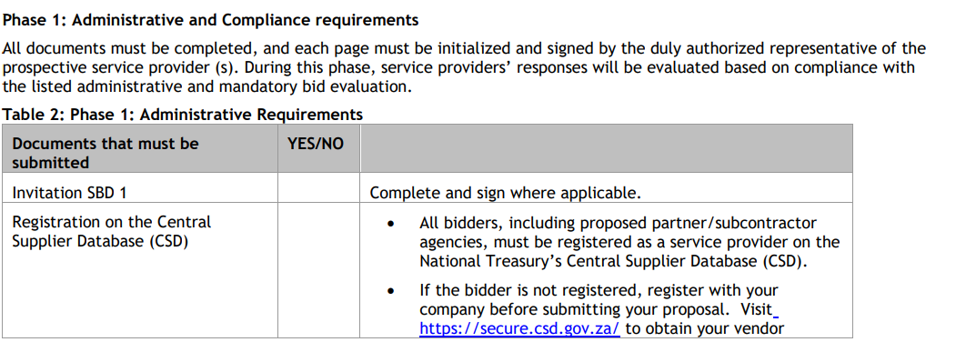

Slide 7
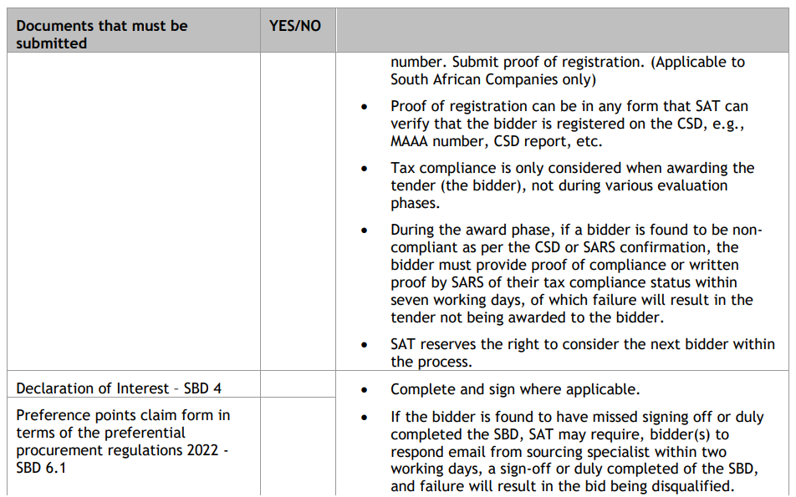

Slide 8
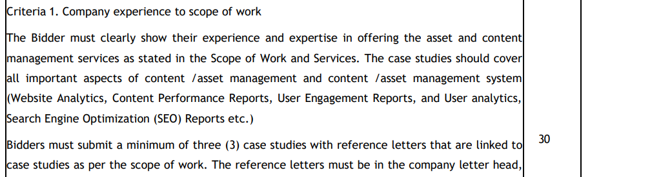
Phase 2: Technical Evaluation Criteria = Weighting out of 100 basis points All bidders are required to respond to the technical evaluation criteria scorecard and provide information/portfolio of evidence that they unconditionally hold the available capacity, ability, experience, and qualified staff to provide the requisite business requirements to South African Tourism under this tender.
Phase 2 Desktop technical, functional evaluation and Pitch Presentations- A bidder will be evaluated out of 100% and is required to score a minimum threshold of 70 % to qualify for Phase 3

Slide 9
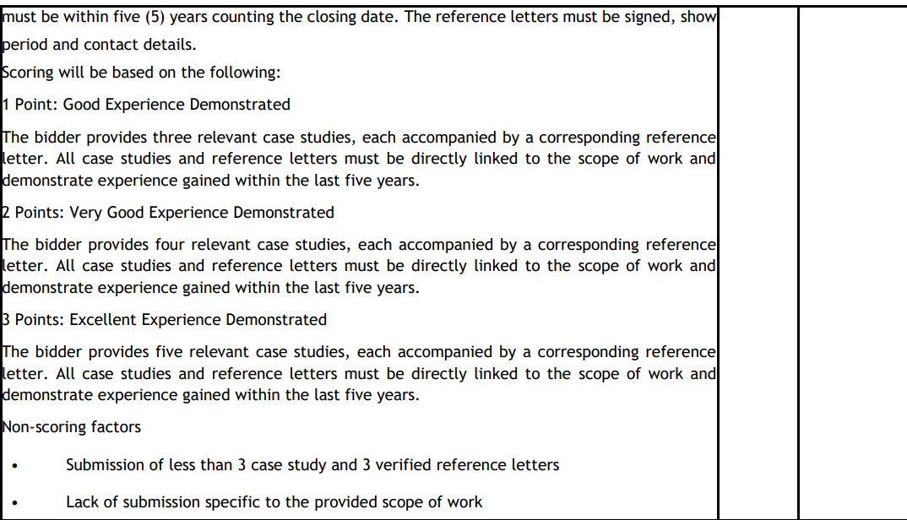

Slide 10
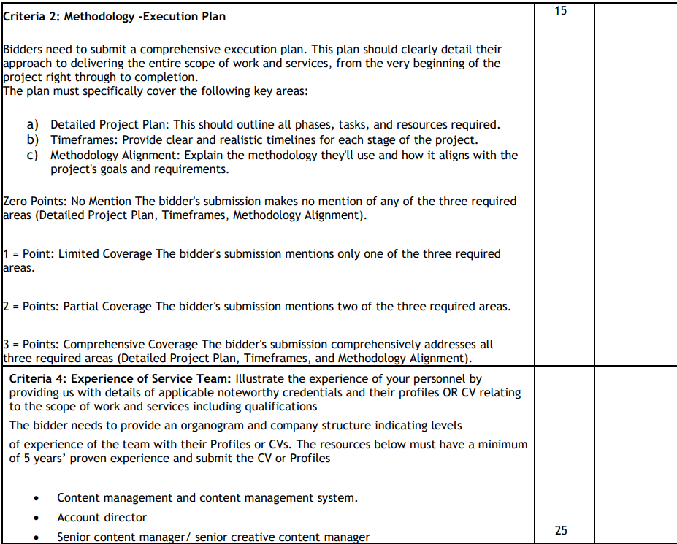

Slide 11
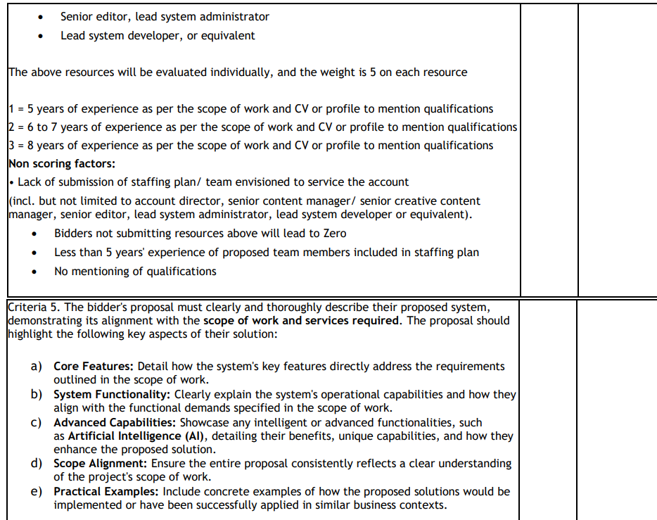

Slide 12
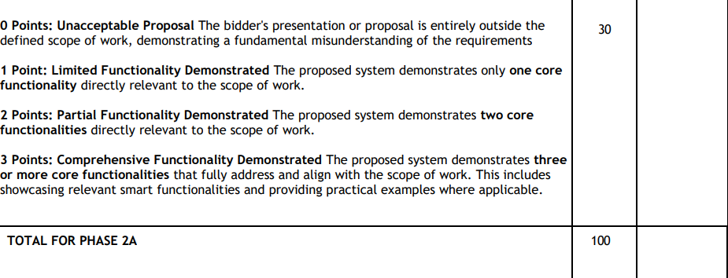

Slide 13
SUBMISSION INFORMATION
Bid Submission Link: https://e-procurement.southafrica.net
Tender Number: SAT 303/25
Description: Digital Asset Management System and services
Closing date: 29 August 2025 @12pm (SA TIME)
Name of Bidder: (Bidder/supplier’s name/details)
Contact Person: (Bidder’s representative)

Slide 14

    Q & A ?

