Slide 1
HOAC-HO55944
REQUEST FOR PROPOSAL (RFP) FOR THE APPOINTMENT OF A SERVICE
PROVIDER TO CONDUCT DESKTOP STUDY FOR RAIL INFRASTRUCTURE
ASSET CONDITION ASSESSMENT AND COST VALIDATION OF THE COPEX
AND SUSTAINABLE CAPEX SCOPE FOR TRANSNET RAIL INFRASTRUCTURE
MANAGER (TRIM) IN THE NORTHEAST, CENTRAL AND CAPE CORRIDORS
FOR A PERIOD OF THREE (03) MONTHS.
Date: 20 October 2025
Time: 10:00am
1

Slide 2
Content
Discussion Presenters
Welcome Brenda Baloyi
Introduction Brenda Baloyi
Ground rules Brenda Baloyi
RFP timelines Brenda Baloyi
Scope of work Dirk Engelbert
Evaluation Criteria Brenda Baloyi

Slide 3
Ground Rules
Attendees are to ensure that their mics are on mute
RFP document will not be issued in this meeting
Late comers will be allowed however information will not be repeated for their benefit.
Questions will be allowed by raising a hand after every section of the presentation –Procurement, Technical and Specific Goals
The meeting is recorded, minutes and presentation will be published on NT e-tender portal.
Attendees are required to remain for the entire briefing session as important information pertaining to the RFP will be presented.

Slide 4
RFP Timelines
Timelines
ISSUE DATE: 13 October 2025
Briefing Session: 20 October 2025 10:00 AM
Clarification deadline 22 October 2025 16:00 ( Page 8 of the RFP document)
Closing Date: 28 October 2025
Closing Time: 10:00 AM
Closing address Via electronic tender submission system
Bid Validity Period: 14 August 2026
Each company must register its profile using its company details and use the corresponding registered profile to log an intent to bid as well as submitting any bid. (Page 7 of the RFP document)

Slide 5
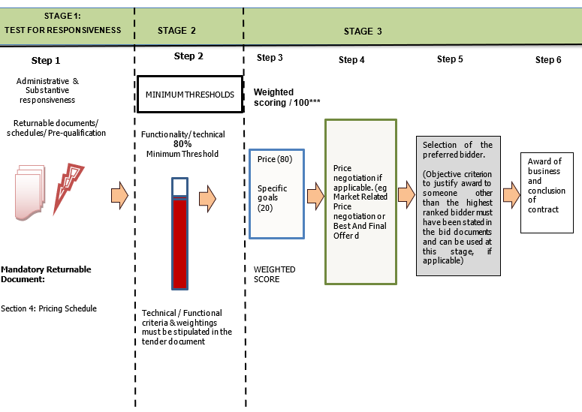
Evaluation Methodology

Slide 6
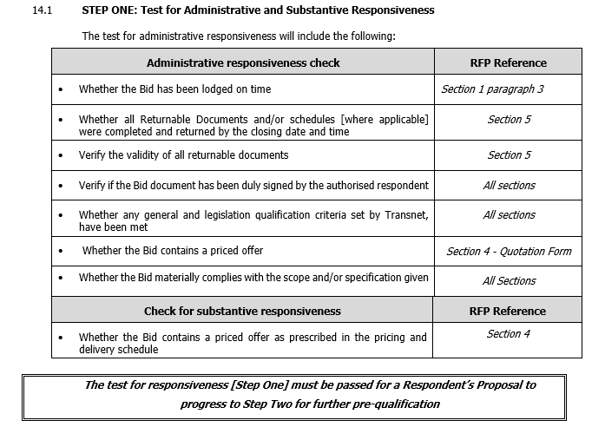
  STEP ONE: Test for Administrative and Substantive Responsiveness

Slide 7
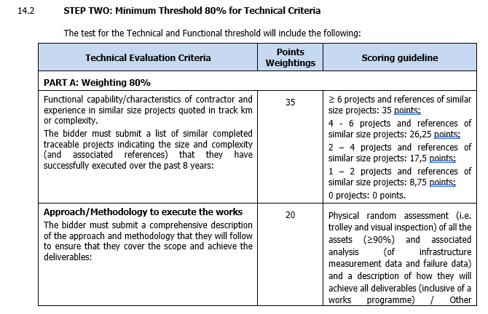
  STEP TWO: Minimum Threshold 80% for Technical Criteria

Slide 8
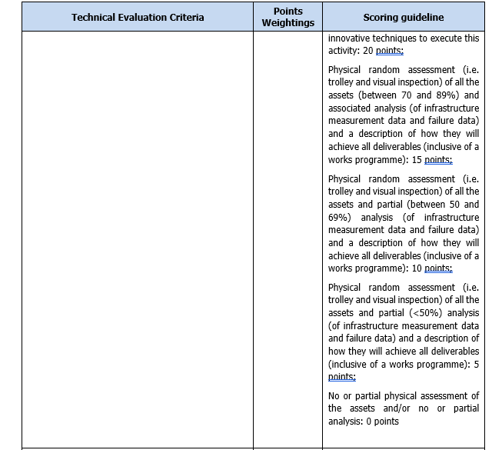
  STEP TWO: Minimum Threshold 80% for Technical Criteria

Slide 9
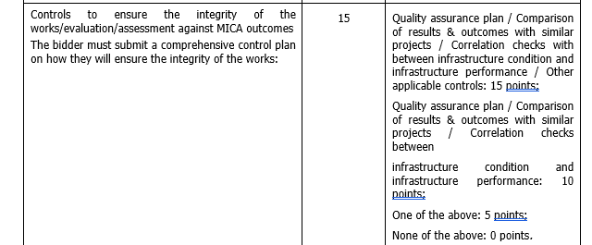
  STEP TWO: Minimum Threshold 80% for Technical Criteria

Slide 10
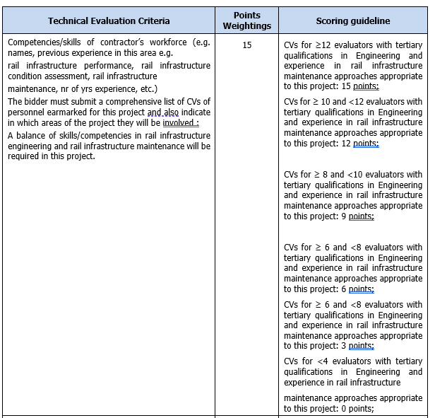
  STEP TWO: Minimum Threshold 80% for Technical Criteria

Slide 11
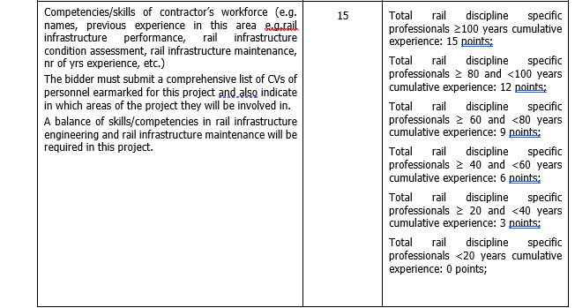
  STEP TWO: Minimum Threshold 80% for Technical Criteria

Slide 12
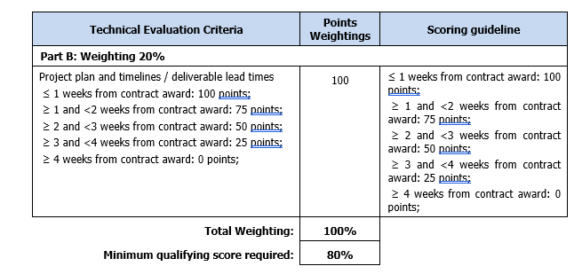
  STEP TWO: Minimum Threshold 80% for Technical Criteria

Slide 13
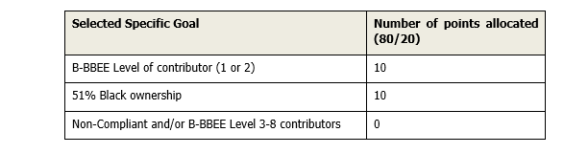
Specific Goals

Slide 14
Returnable Documents
MANDATORY RETURNABLE DOCUMENTS | SUBMITTED [Yes/No]
SECTION 4 : Pricing and Delivery Schedule

Slide 15
Returnable Documents
RETURNABLE DOCUMENTS USED FOR SCORING | SUBMITTED [Yes or No]
B-BBEE Certificate / Sworn- Affidavit / B-BBEE CIPC Certificate (in case of JV, a consolidated scorecard will be accepted) as per DTIC guideline
List of similar completed traceable projects indicating the size and complexity (and associated references) that they have successfully executed over the past 8 years.
Comprehensive description of the approach and methodology
CVs of personnel earmarked for the project
Project plan and timelines / deliverable lead times

Slide 16
Returnable Documents
ESSENTIAL RETURNABLE DOCUMENTS & SCHEDULES | SUBMITTED [Yes or No]
In the case of Joint Ventures, a copy of the Joint Venture Agreement or written confirmation of the intention to enter into a Joint Venture Agreement
Latest Financial Statements signed by your Accounting Officer or latest Audited Financial Statements plus 2 previous years
SECTION 1: SBD1 FORM
SECTION 5 : PROPOSAL FORM AND LIST OF RETURNABLE DOCUMENTS
SECTION 6 : CERTIFICATE OF ACQUAINTANCE WITH RFP, TERMS & CONDITIONS & APPLICABLE DOCUMENTS
SECTION 7 : RFP DECLARATION AND BREACH OF LAW FORM
SECTION 9 : SPECIFIC GOALS POINTS CLAIM FORM
SECTION 10: PROTECTION OF PERSONAL INFORMATION

Slide 17
Returnable Documents
ESSENTIAL RETURNABLE DOCUMENTS & SCHEDULES | SUBMITTED [Yes or No]
ANNEXURE A: TRANSNET’S GENERAL BID CONDITIONS
ANNXURE B: MASTER AGREEMENT
ANNXURE C: TRANSNET’S SUPPLIER INTEGRITY PACT
ANNEXURE D: NON-DISCLOSURE AGREEMENT
Proof of National Treasury Central Supplier Database Registration
Valid and signed Letter of Good Standing from the Compensation fund for Occupational Injuries and Diseases Act (COIDA).
Proof of authority must be submitted e.g., company resolution
Tax Clearance Certificate or electronic access PIN obtained from SARS’s new Tax Compliance Status (TCS) system, [Consortia / Joint Ventures must submit a separate Tax Clearance Certificate/PIN for each party]

Slide 18
QUESTIONS?

Slide 19
THANK YOU

