Slide 1


Ingula Pumped Storage Scheme Project
CCTV & IAC Clarification Presentation
Zwelibanzi Msibi
Enquiry No: MWP2163CX
08 September 2023 @ 10:00 AM

Slide 2
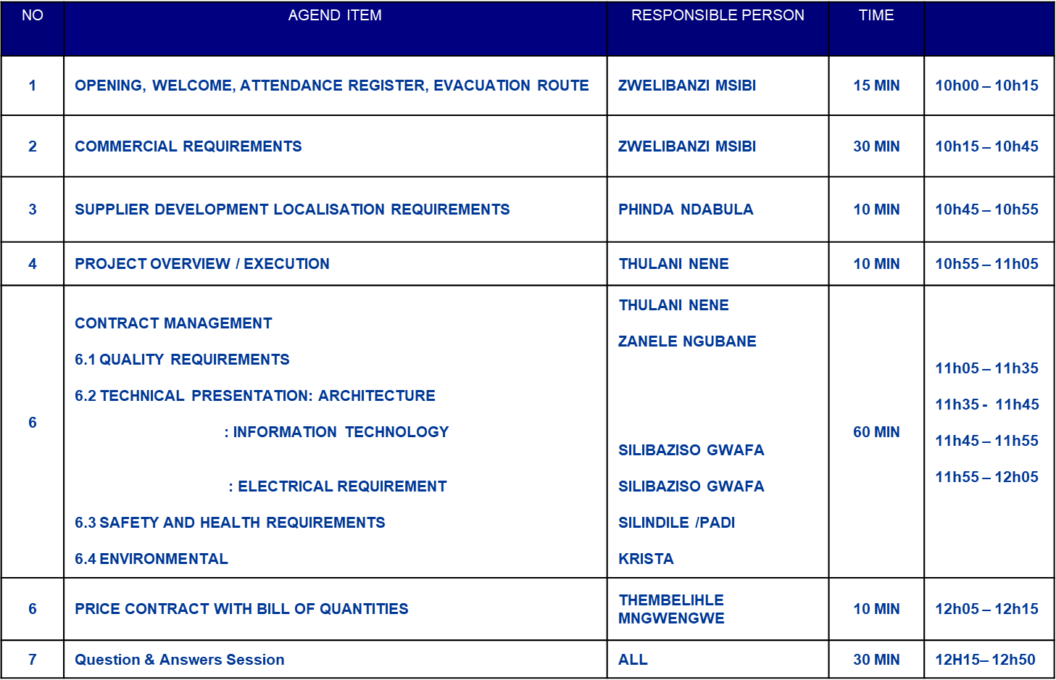
CONTENT

Slide 3
COMMERCIAL
KEY DATES
TENDER SUBMISSION
RETURNABLES
EVALUATION CRITERIA
COMMUNICATION DURING TENDER PERIOD AND CORRESPONDENCE

Slide 4
KEY DATES
  Clarifications closing date: 22 September 2023 @12:00 pm
  Tender closing date: 29 September2023
  Tender closing time: 10H00 AM

Slide 5
TENDER SUBMISSION
Tender is to be divided into 3 documents namely:
1 original hard document
1 copy of the original hard document
1 Soft copy of the BOQ in Excel Format ( On Flash Drive/ CD)
Eskom also require that one (1) additional complete soft copy of the original tender in a Memory Stick/USB be submitted
Submit a complete tender with commercial, technical and SHEQ information.
NOTE: Failure to comply with the above your tender will be declared non-responsive and it will be disqualified.

Slide 6
TENDER SUBMISSION (CONT)
The place for delivery of the Tender is :
THE TENDER OFFICE
ESKOM MEGAWATT PARK
NEXT TO ESKOM RETAIL OFFICES
01 MAXWELL DRIVE
SUNNINGHILL EXT 3
SANDTON
Documents should be marked clearly, stating:
CONFIDENTIAL, TENDER NO. MWP2163CX
ESKOM HOLDINGS SOC LIMITED
ATT: ZWELIBANZI MSIBI
      LATE TENDERS WILL NOT BE ACCEPTED

Slide 7
TENDER RETURNABLES
Acknowledgement Form
SBD 4 – Standard Bidding Document
Price Activity Schedule
Original and valid SARS Tax Clearance Certificate/ Pin number
A valid B-BBEE Verification Certificate from a Verification Agency/Sworn Affidavit
Letter of Good Standing or Similar

Slide 8
RETURNABLES (CONT)
CK document with ID document with percentage(s) of ownership
Declaration of Authority
Completed Declaration of Fair Tendering Practice
Completed NEC ECC document
Latest comparable, audited and signed Annual Financial Statements together with the Company’s cash flow

Slide 9
EVALUATION CRITERIA
Financial
An analysis of the tenderers financial statements will be conducted for the purposes of establishing the tenderers financial viability and ability to meet all of its contractual obligations for the duration of the contract, should the tenderer be awarded the contract.
Where applicable a financial evaluation will be conducted by Eskom to further evaluate the financial viability of the tenderer.
80/20 principle shall apply
Tenderers are required to submit original and valid B-BBEE Status Level Verification Certificates or certified copies thereof together with their bids to prove the B-BBEE claims.
Tenderers who do not submit B-BBEE Status Level Verification Certificates or non-compliant contributors to B-BBEE will not qualify for preference points for B-BBEE however will not be disqualified from the tender process. Such a tenderer will score points out of 80 for price and 0 points out of 20 for B-BBEE.

Slide 10
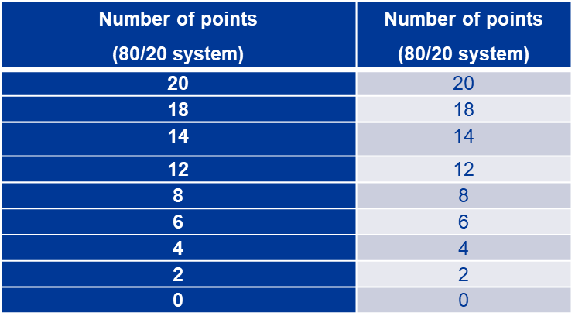
EVALUATION CRITERIA CONT……
In terms of Regulation 6 (2) and 7 (2) of the Preferential Procurement Regulations, preference points must be awarded to a bidder for attaining the B-BBEE status level of contribution in accordance with the table below:
(80/20 system)
Number of points
(80/20 system)
20
20
18
The points scored for price will be added to the points scored for
B-BBEE status level of contribution to obtain the tenderers total points scored out of a 100.
“Eskom reserves the right to award to a supplier who may not be the highest scoring or highest ranked supplier, in line with Section (2) (1) (f) of the PPPFA.”

Slide 11
Communication during tender period
Communication during tender period:
One point of communication between Eskom’s representative and the Tenderer
Name: Zwelibanzi Msibi
Tel: (011) 690 4333
E-mail: MsibiZP@eskom.co.za
any clarifications will be done via E-Mail.

Slide 12


Questions?

Slide 13
Thank You

Slide 14
Ingula Pumped Storage Scheme Project
CCTV & IAC Clarification Presentation
Phinda Ndabula
SUPPLIER DEVELOPMENT, LOCALISATION AND INDUSTRIALISATION
(SDL&I)

Slide 15
TENDER RETURNABLES
Tender Returnables:
SBD 6.2 -Declaration Certificate for Local Production and Content
Tenderers who do not comply with these Local Content Thresholds will BE DISQUALIFIED, unless
The Tenderer has obtained an EXEMPTION from the Department of Trade, Industry and Competition and submit with the Tender.

Slide 16
Ingula Pumped Storage Scheme Project
CCTV & IAC Clarification Presentation
Thulani Nene
Contract Overview

Slide 17
CONTRACT DATA
(NEC3 ECC CONTRACT DOCUMENT)
Type of contract : NEC 3 Engineering & Construction
Contract (ECC) 2013
Main Option Clause : B – Priced contrcat with BoQ
Delay Damages : Limited to 10% of the Total of Prices
Performance Bond : Limited to 10% of the Total of Prices
Retention Bond : Limited to 10% of the Total of Prices
Start Date : 01 December 2023 (or ASAP thereafter)
Contract Duration : 12 Months
End Date : 30 November 2024
First programme : 2 week of the contract date
Updated programme : weekly thereafter

Slide 18
SECTIONAL COMPLETION DATE
Condition to be met | Key date | Delay damages/day
Final SHE File Submission to the Employer for review and acceptance | 12 Des 2023 | R1 000
Detail Design Submission for Review and Acceptance Complete | 11 April 2024 | R5 000
Site Establishment | 22 Des 2023 | R1 000
Underground Power-House Integrated Access Control, Fire Detection System and CCTV SAT Complete | 10 Jun 2024 | R1 000
BMS SAT Complete | 24 Nov 2024 | R 10 000

Slide 19
CONTRACT RETURNABLES,
(NEC ECC CONTRACT DOCUMENT)
  The entire NEC contract is to be submitted.
  ♣ C1.1 Form of Offer and Acceptance
  ♣ Schedule of Deviations
  ♣ C1.2 Contract Data provided by the Employer
  ♣ C1.2 Data provided by the Contractor
  ♣ C1.3 Forms of Securities
  ♣ C2.1 Pricing Data ( Bill of Quantities)
  Tenderer to ensure that the entire NEC document is filled in where required and submitted with the tender. Where no figures, percentages and pricing are filled in will be treated as zero and to have been included elsewhere by the tenderer.

Slide 20


Slide 21
Ingula Pumped Storage Scheme Project
CCTV & IAC Clarifications Quality Presentation
Presented by Zanele Ngubane
08 September 2023 Time: 10:00-13:00

Slide 22
QUALITY REQUIREMENTS
The following requirements shall also be met for the entire duration of the contract. The standard 240-105658000, “Supplier Quality Management Specification (QM58)” shall be complied with.
The supplier shall complete and sign Form A (Enquiry/Contract/Quality Requirements for QM 58 and ISO 9001).
The supplier shall submit objective evidence of a developed QMS that complies with ISO 9001 (or the latest applicable revision). The following documents (approved/signed copies) shall be submitted:
Quality management system manual or a document that have defines and describes the QMS and its scope
Quality Policy
Quality Objectives
Control of documented information
Records required by ISO 9001 standard
Internal audit procedure
Control of nonconformity output
Nonconformity and Corrective action procedure

Slide 23
QUALITY REQUIREMENTS
The QMS should drive all the supplier’s business management processes to ensure that all of Eskom’s requirements are fully met on a consistent basis.
The supplier shall submit a draft contract quality plan that is specific to the scope of work as described in the tender documents. The plan must address the minimum requirements as per ISO 10005.
Where applicable; the supplier shall submit an example inspection and test plan (ITP) or quality control plan (QCP). The plan must address the minimum requirements as per ISO 10005 (if applicable).
The supplier shall submit documented information for Control of Externally Provided Processes, Products and Services.
The supplier shall submit a copy of documented information for roles, responsibilities and authorities.
Note: specific requirements per tender will be selected using the List of Tender returnable document (240-12248652)

Slide 24
QUALITY REQUIREMENTS
Quality: For Noting:
The Supplier shall comply with the Quality requirements as stated in 240-105658000 - Supplier Quality Management Specification.
Compliance with Category 3 quality requirements and all other relevant requirements is required
Compliance with all Eskom standards pertaining to this transaction and governance is essential for all aspects of the works including ( if applicable) mechanical, C&I, civil, metallurgical, non-destructive testing, electrical, structural, administration and all other aspects.
Quality: Specific Requirements
An assessment/visit of the Suppliers facilities will be conducted if required by Eskom.
The Supplier shall submit a proposed Quality Table of Payments (Quality Payment Schedule) showing the relationships between BoQ/Activity Schedule Items, draft programme Items, Inspection & Test Plans/Quality Control Plans. Sign off by the Employer’s Quality department and proposed Payment Applications (Invoices) which will attest to the works having been done to required quality. This table must be finalised and approved by the Employer within 30 days of contract award.

Slide 25
Thank You

Slide 26
Ingula Pumped Storage Scheme Project
CCTV & IAC Clarification Presentation
Silibaziso Gwafa
Technical Presentation

Slide 27
Ingula Pumped Storage Scheme Project
CCTV & IAC Clarification Meeting SHE Presentation
Presented by Silindile Thobela and Krista Mothapo
08 September 2023

Slide 28
CONTENT
Eskom Values and SHE Principles
SHE FILE COMPONENTS
  COVID Requirements
  OH&S Requirements
  Environmental Requirements

Slide 29

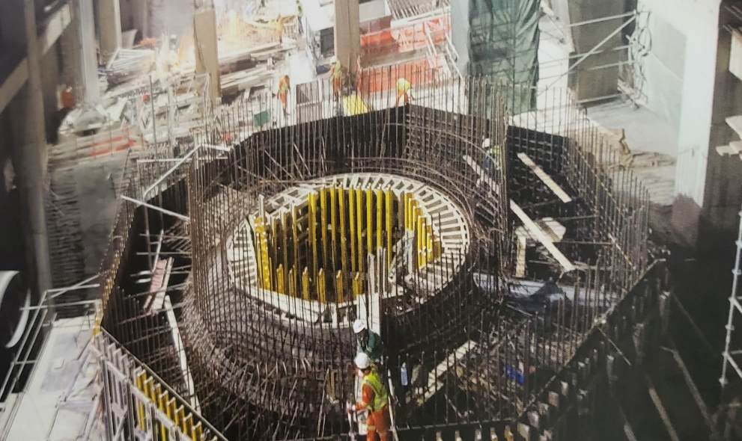
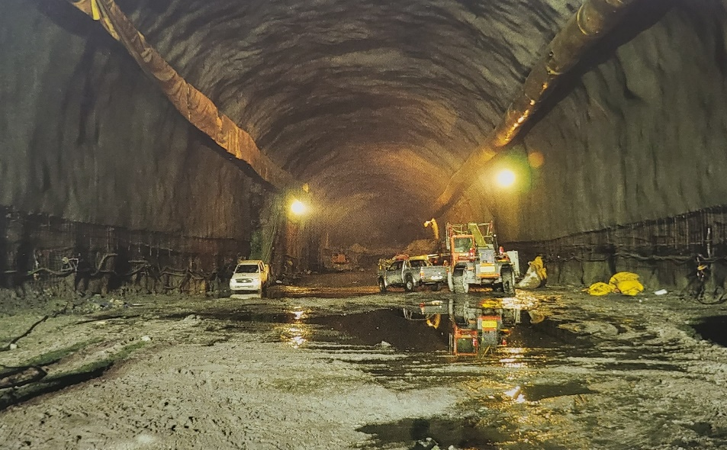
ESKOM VALUES AND SHE PRINCIPLES

Slide 30
VALUES AND PRINCIPLES
ZERO HARM
ZERO SHE INCIDENTS
ZERO LEGAL CONTRAVENTIONS
EXCELLENCE
SINOBUNTU
INTEGRITY

Slide 31
OHS REQUIREMENTS

Slide 32
OHS REQUIREMENTS – SECTION A
We check on past OHS performance (incident management, legal contravention) – the incident management process should be aligned to the 32-95 rev 9
OHS achievements – sharing of the background history of the safety performance.

Slide 33
OHS REQUIREMENTS – SECTION B
Documented proof of OHS management system
Sub-contractor and supplier management program
OHS organogram ( company resources) , roles and responsibilities, appointments
Competency, training and awareness program
Signed SHE policy
Hazard identification, risk assessment and controls
Incident management program ( corrective and preventative action from incident including lesson learnt and communication)
Communication program ( interface internally and with relevant stakeholders on OHS issues)
observation / inspection and audit programs
Emergency and response procedure.

Slide 34
OHS REQUIREMENTS – SECTION C
Letter of good standing with the compensation commissioner ( with license insurer / equivalent)
Medical Surveillance Program ( certificate of fitness, medical surveillance plan)
Certificate of medical fitness for person performing work at height ( if applicable)

Slide 35
OHS COMPETENCE – SECTION D
SHE competences for SHE personnel ( appoint the registered full - time health and safety officer onsite – for compliance)
SHE competencies for Supervisors (person in charge/ managing workers)

Slide 36
SECTION E: HIGH RISK ACTIVITIES / SAFE SYSTEM OF WORK
Baseline risk assessment ( key risk identified)
Work at height
Lifting and rigging
Excavations
Barricading
Traffic management plan (vehicles & pedestrians)
Blasting
Hazardous chemical substances management.
PPE management program
Housekeeping programs.

Slide 37
SECTION F: OHS FORUMS
Internal OHS forums

Slide 38
SECTION G: DISCIPLINARY PROGRAMS
OHS rules identified
Substance abuse management
Program for managing OHS non-compliance

Slide 39
SECTION H: COSTING FOR OHS
Costing for OHS compliance
Includes safety Resources
Personal Protective Equipment
Medicals
Safety file

Slide 40
SECTION I: OPERATIONAL CONTROL
Principal contractor `s safety file returnable to be submitted electronically
Subcontractor`s safety files shall be reviewed by the client before approval
Safety induction before commencement of the works on MS Teams.
Plant management – onboarding inspections
Storage and stacking of material
Risk assessments and safe work procedures
Behavioral based safety observations (jointly weekly walk down )
Incident reporting done within 24 hours of incident
Investigation shall be conducted within 7 days of the incidents.
Senior management presentation on health and safety plan
Timeliness for Occupational hygiene risk assessment and survey roadmap
Health and safety audits conducted monthly electronically
Weekly stats submitted every Monday at 12:00 to Eskom Safety Department electronically
Monthly Safety stats submitted on the last day of the month to Eskom Department electronically
Weekly health and safety report submitted to Eskom Safety Dept every Thursday

Slide 41

ENVIRONMENTAL REQUIREMENTS

Slide 42

ENVIRONMENTAL REQUIREMENTS
Department of Forestry, Fisheries and Environment
Ingula Powers Station Project has been declared/added to the Ramsar wetland with international importance and international treaty for the conservation and sustainable use of wetlands.

Slide 43
ENVIRONMENTAL REQUIREMENTS
Environmental Officer Appointment Letter and CV
Formal appointment of the fulltime on site EO
SHE/Environmental Policy
Mandatory Method Statements applicable to the scope of work as per the CEMP and WUL/SHE Plan e.g:
  Site Establishment including search and rescue, approved layout plan and ambient air baseline assessment
  Stripping and vegetation clearance
  Waste Management with waste stream inventory
  Erosion and Storm Water Management
  Biodiversity Management
  Incident Investigation
  Rehabilitation
Permits and Licenses for significant aspects e.g waste transportation and disposal
Internal and external stakeholders' identification and needs analysis

Slide 44
ENVIRONMENTAL REQUIREMENTS
SHE documents and records must be submitted 14 days minimum before mobilization to site
Method statements must be approved by the Eskom Ingula EO and ECO before activity commencement
SHE inspection shall be conducted on a weekly basis with the Eskom Project Team
Weekly environmental performance /inspection reports with actions and realistic completion dates must be submitted to the Eskom EO
The following audits will be conducted:
  ECO quarterly audits
  Internal and external audits
  root causes, corrective actions and target completion dates must be tabulated in an action

Slide 45
Thank You

Slide 46
Ingula Pumped Storage Scheme Project
CCTV & IAC Clarification Meeting Quantity Survey Presentation
Presented by Thembelihle Mngwengwe
08 September 2023

Slide 47
PRICE SCHEDULE - Requirements
Use the an unpriced BOQ provided for pricing. If there is any information that as a supplier realize that it was missed and forms part of the works, please clarify with the Buyer on how it can be submitted.
Shorter Schedule of Cost Component rates to be submitted and to be priced in detail, if the space provided on the Data by Contractors is not sufficient submit on a separate sheet. Percentages also to be clear.
The soft copy information to be in linked formulas so that it can be detected where the final price is coming from and to minimize arithmetic errors.
BOQ can only be filled after reading the works information thoroughly and the drawings provided.

Slide 48
Thank You

