Slide 1
Compulsory Tender Briefing Session
RFP iCLM HQ 926/TPT
CUSTOM DESIGN, SUPPLY, INSTALLATION, CONFIGURATION, TESTING AND COMMISSIONING OF A FUEL MANAGEMENT SYSTEM FOR TRANSNET SOC LIMITED (REG. NO. 1990/000900/30) OPERATING AS TRANSNET PORT TERMINALS (HEREINAFTER REFERRED TO AS “TPT”), AT THE RICHARD’S BAY,
DURBAN, EASTERN CAPE AND WESTERN CAPE TERMINALS
Technical Presentation
Transnet Port Terminals
Venue: MS Teams
Date: 15/04/2025
1

Slide 2
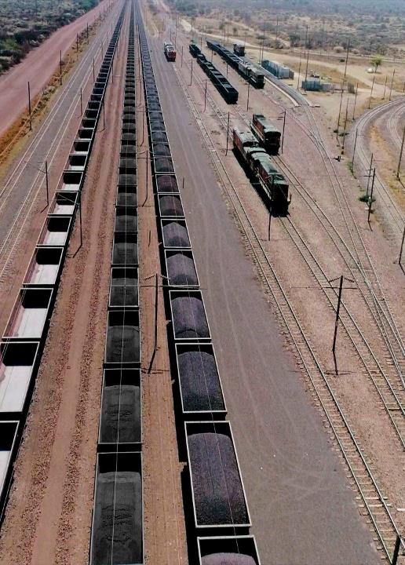
Contents
RFP iCLM HQ 926/TPT
01 | Business Background | Description of the business
02 | Project Background | Description of the project background
03 | Scope of Requirements | High Level Scope Overview
04 | Technical Specification | Annexure A – Scope of Services
05 | Technical Evaluation | Technical & Functional Scoring Criteria
06 | Technical Presentation Evaluation | Technical Presentations Scoring Criteria
07 | Pricing & Delivery Schedule | Activity Schedule
2

Slide 3
Business Background
RFP iCLM HQ 926/TPT
Transnet Port Terminals (TPT) is a division of Transnet SOC Limited, a state-owned freight transport company in South Africa. TPT's core business is the handling of a variety of products that are destined for either import, export, or transhipment. TPT operates bulk, break bulk, automotive, and container terminals, located nationwide in the KwaZulu-Natal, Eastern Cape, and Western Cape ports. TPT also operates inland terminals located in the North West, Western Cape and Mpumalanga. The mobile equipment within the terminals is highly dependent on fuel for business operations. Diesel is the primarily used fuel for operations and the fleet comprises of the following mobile equipment:
  i. Rubber-Tyred Gantry Cranes (RTGs)
  ii. Mobile Harbour Cranes (MHCs)
  iii. Empty Container Handlers (ECHs)
  iv. Mobile Ship Loaders
  v. Mobile Bowsers
  vi. Straddle Carriers
  vii. Reach Stackers
  viii. Forklifts
  ix. Tractors
  x. Haulers
  xi. Sky jacks
  xii. BobCats
  xiii. Cherry pickers
  xiv. Sweepers
  xv. Self-Bunded Containerized Tanks

Slide 4
Project Background
RFP iCLM HQ 926/TPT
TPT currently uses manual processes and controls at its fuel facilities, which places the business at risk of:
  inadequate fuel inventory management
  inadequate fuel movement tracking and fuel consumption monitoring
  fuel pilferage from its bulk storage tanks, mobile bowsers, mobile equipment and self-bunded containerized tanks
  being unable to prevent unauthorized fuel dispensing into unauthorized equipment
The Fuel Management System (FMS) is intended to address the following problems:
  Inadequate fuel issuing & fuel dispensing management
Poor measurement, data capturing, tracking, and monitoring of fuel deliveries and transactions.
  Ineffective tank level management
Poor fuel level reading and monitoring of bulk storage tanks, mobile bowsers and self-bunded containerized tanks.
  Absence of access controls for authorized personnel identification & authorization controls for equipment identification
No technology is present for identifying and authorizing fuel attendants, and authorized mobile equipment
  Inadequate fuel consumption reporting
Poor fuel consumption reporting of individual storage locations and mobile equipment.
  Lack of accurate fuel reconciliation
Reconciliation of fuel delivered (purchased) vs fuel consumed is currently not possible.

Slide 5
Background
RFP iCLM HQ 926/TPT
Drivers for Change
Automation
The FMS system seeks to automate the current Fuel Receiving and Fuel Dispensing processes thereby reducing the need for manual intervention by users.
Accuracy
Accurate capture of Fuel Receiving and Dispensing transactions will be recorded and sent (via technology such as sensors) directly to the FMS database ensuring that the margin of error during capture process is reduced.
Predictability
Key areas of the business process will have embedded technology such as RFID for equipment identification and enhancing predictability of fueling cycles of equipment.
Non-repudiation
The FMS will utilise biometrics at strategic areas of the business processes ensuring that there is no deniability on who performed a transaction and when it was performed. A fully automated FMS ensures that all fuel transactions are accurately conducted by authorised users and automatically recorded as such.
Traceability
The FMS will provide an ability to identify which equipment, operator was involved in a transaction. The logging of the operator information and Fuel attendants’ details will be done thereby enabling a secure platform to transact.
Integration
FMS Integration into TPT Systems e.g. PowerBI for Dashboards, Reporting, and Analytics functionality. All of which are currently unavailable.

Slide 6
Scope of Requirements
RFP iCLM HQ 926/TPT
For the custom design, supply, installation, configuration, testing and commissioning of a fuel management system, the following is required:
a) Supply and installation of automation hardware
(i.e. fuel measuring instruments, biometric access control devices, telematics)
  IoT fuel flow meters
  IoT automatic tank gauging (with tank fuel level probes or fuel level sensors).
  IoT water-in-fuel sensors/detectors
  Biometric controlled fixed tank fuel decanting/receiving pumps.
  Biometric controlled fuel dispenser pumps
  Biometric controlled mobile bowser issuing pumps
  Tamper proof vehicle and mobile equipment authentication via radio-frequency identification (RFID) tagging
  Telematics devices or units to capture odometer readings and/or engine hour readings, depending on the mobile equipment
Data network connectivity and communication setup
  Enable automation hardware with the capability to connect and transfer data through mobile cellular connectivity (GPRS/GSM/3G/4G/LTE/5G) for real-time data collection & reporting
  Setup and configure a centralised cloud-based database at Transnet site, referred to as the FMS Database, with backup and restore capability. The database must be scalable.
  Ensure all relevant automation hardware data is communicated to the FMS Database.
  Ensure the communication layer is secured in line with Transnet Security standards
  Ensure the fuel management system and data is owned by Transnet
  Ensure that the relevant data from the FMS Database will integrate to the relevant Transnet systems for business processing

Slide 7
Scope of Requirements
RFP iCLM HQ 926/TPT
c) Design and deployment of a centralised cloud-based fuel management dashboard owned by TPT
  Fuel data acquisition, processing, and visualization
  Online real-time fuel transaction tracking, monitoring, analysis, and reporting
  Live real-time tank level readings of bulk storage fuel facilities, mobile bowsers and self- bunded containerized tanks
  Live water detection/monitoring of bulk storage fuel facilities, mobile bowsers and self- bunded containerized tanks
  Online mobile equipment fuel consumption tracking, monitoring, analysis, and reporting
  Monitor and reconcile received/decanted, stored, transferred and dispensed fuels
  Daily, weekly, and monthly fuel transaction and consumption reporting
  Trend analysis based on Transnet KPIs
  Pre-programmed stock level thresholds (min/max or high/low levels)
  Automated alert/alarm notifications for stock replenishment on the bulk storage facilities
  Pre-programmed discrepancy/warning alerts and alarms
  Flag irregular usage, abnormalities and suspicious fuel transactions

Slide 8
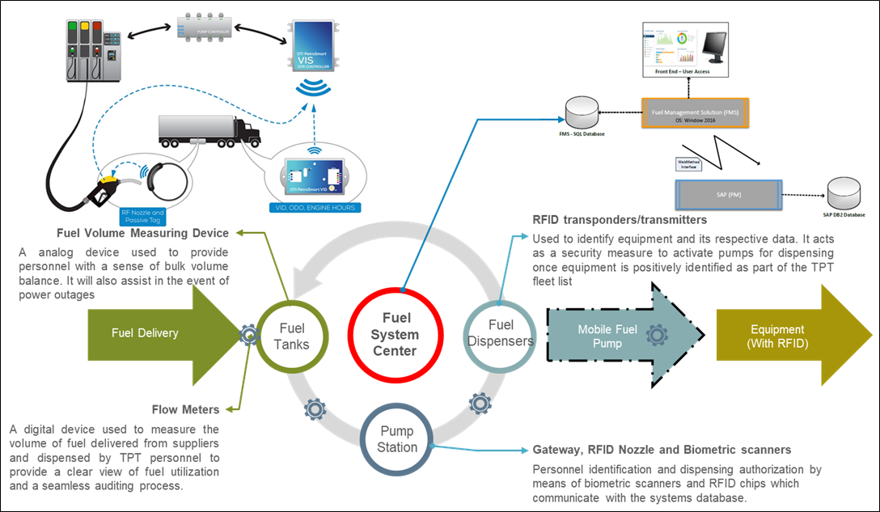
Technical Specification: System Architecture (Concept View)
RFP iCLM HQ 926/TPT

Slide 9
Technical Specification: System and Services Integration
RFP iCLM HQ 926/TPT
Services which will be created through the FMS for efficient and effective fuel management:
Service name | Owner | Analysis Item
Materials Management (MM) Service | TPT | Equipment and consumption data as maintained in SAP
Plant Maintenance (PM) Service | TPT | Equipment and consumption data as maintained in SAP
Power BI Service | TPT | Business Intelligence for Reporting, dashboards and analytics
T&A Service | TPT | T&A (Time and Attendance) system utilises biometric and card facility to allow for recording of arrival and knock-off times of employees. The T&A service will utilise the biometrics component of this system for user identification when performing a transaction at fueling stations and bowser fueling or validating user details within the FMS scope of requirements.

Slide 10
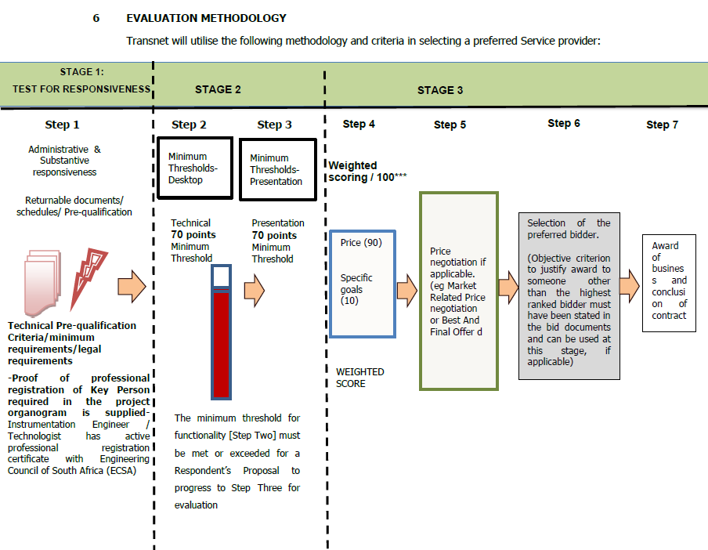
Technical Evaluation
RFP iCLM HQ 926/TPT
Using the technical evaluation scorecard, the technical and functional criteria will be tested and scored in accordance with the following schedules:
Annexure B - Mandatory Eligibility (Professional Registration)
Annexure C - CV's of Key Persons
Annexure D - Previous Experience
Annexure E - Method Statement
Note: The minimum technical threshold is 70 points

Slide 11
Technical Evaluation
RFP iCLM HQ 926/TPT
TECHNICAL EVALUATION
DESCRIPTION OF THE WORKS: CUSTOM DESIGN, SUPPLY, INSTALLATION, CONFIGURATION, TESTING AND COMMISSIONING OF A FUEL MANAGEMENT SYSTEM FOR TRANSNET SOC LIMITED (REG. NO. 1990/000900/30) OPERATING AS TRANSNET PORT TERMINALS (HEREINAFTER REFERRED TO AS “TPT”), AT THE RICHARD’S BAY, DURBAN, EASTERN CAPE AND WESTERN CAPE TERMINALS
Evaluation Criteria | Description | Scoring Principal |  |  |  | Returnable Schedule | Criteria Yes/No | Sub-Criteria Weighting | Weighting
Eligibility (Mandatory) | Proof of professional registration of Key Person required in the project organogram is supplied. | Instrumentation Engineer / Technologist has active professional registration certificate with Engineering Council of South Africa (ECSA) |  |  |  | T2.2-01 | Yes/No | NA | NA
CVs of Key Persons | Engineering and ICT | Sub-Criteria | Weighting |  | Scoring
 |  | Project Manager | 100% | 20% | Work Experience (refer to returnable for points allocation) Education and training (refer to returnable for points allocation) Knowledge, skills and experience pertinent to the project (refer to returnable for points allocation) | T2.2-02 | CVs of Key Persons | 7 | 35
 |  | Instrumentation Engineer |  | 20% |  |  |  | 7
 |  | Instrumentation Technician |  | 18% |  |  |  | 6
 |  | Integration Architect |  | 14% |  |  |  | 5
 |  | Azure Cloud Architect |  | 14% |  |  |  | 5
 |  | Dashboard Developer |  | 14% |  |  |  | 5
Previous Experience | Tenderers are required to demonstrate their company’s past experience within the last 10 years in delivering similar services to various logistics/trucking/mining companies with mobile equipment greater than 150 units (“of a minimum value of R5m per project”) , rendering services to companies with multiple sites and providing a cloud-based solution using mobile connectivity in relation to the Employer’s scope of services. Tenderers must submit a detailed reference list with contact details of existing customers, detailing the services/works conducted for the customer and provide completion or handover certificates. | Proof of experience demonstrating the design, supply and installation of IoT-based automation hardware for fixed bulk storage fuel tanks, fuel dispenser pumps, mobile bowsers, self-bunded containerized tanks and fuel consuming mobile equipment | 100% | 50% | The tenderer has submitted no information or inadequate information to determine a score = 0 points The tenderer completed 1 similar service/project = 20 points The tenderer completed 2 similar services/projects = 40 points The tenderer completed 3 similar services/projects = 60 points The tenderer completed 4 similar services/projects = 80 points The tenderer completed 5 and more similar services/projects = 100 points | T2.2-03 | Previous Experience | 15 | 30
 |  | Proof of experience demonstrating the design and development of fuel management dashboards integrated with other business systems and IoT-based fuel management automation hardware |  | 50% | The tendeer has submitted no information or inadequate information to determine a score = 0 points The tenderer completed 1 similar service/project = 20 points The tenderer completed 2 similar services/projects = 40 points The tenderer completed 3 similar services/projects = 60 points The tenderer completed 4 similar services/projects = 80 points The tenderer completed 5 and more similar services/projects = 100 points | T2.2-03 | Previous Experience | 15

Slide 12
Technical Evaluation
RFP iCLM HQ 926/TPT

Slide 13
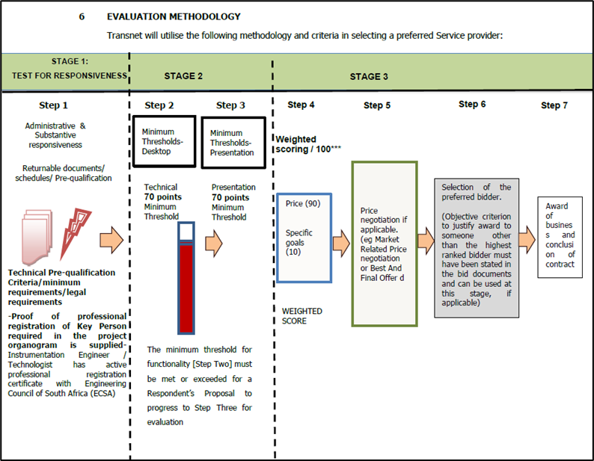
Technical Presentation Evaluation
RFP iCLM HQ 926/TPT
Using the technical presentation evaluation scorecard, the presentation criteria will be tested and scored in accordance with the following schedule:
Annnexure F – Presentations & Live Demo
Note: The minimum technical threshold is 70 points

Slide 14
Technical Presentation Evaluation
RFP iCLM HQ 926/TPT
TECHNICAL PRESENTATION EVALUATION
DESCRIPTION OF THE WORKS: CUSTOM DESIGN, SUPPLY, INSTALLATION, CONFIGURATION, TESTING AND COMMISSIONING OF A FUEL MANAGEMENT SYSTEM FOR TRANSNET SOC LIMITED (REG. NO. 1990/000900/30) OPERATING AS TRANSNET PORT TERMINALS (HEREINAFTER REFERRED TO AS “TPT”), AT THE RICHARD’S BAY, DURBAN, EASTERN CAPE AND WESTERN CAPE TERMINALS
Evaluation Criteria | Description |  |  | Returnable Schedule | Criteria Yes/No | Weighting
 |  | Weighting | Scoring
Case Study Presentaion of High-Level Approach: In the form of a block diagrams | Tenderers are required to demonstrate the approach taken from award to hand over, for a real-life case study/implementation similar to the technical scope of services | 100% | The presentation addressed 0% of the demonstration requirements = 0 points The presentation is not acceptable & only addressed 20% of the demonstration requirements = 20 points The presentation is poor, & only addressed 40% of the scope demonstration requirements = 40 points The presentation is generic, only addressed 60% of the scope demonstration requirements, & is not tailored to address the specified scope objectives & requirements = 60 points The presentation is satisfactory, only addressed 80% of the scope demonstration requirements, & moderately addressed specified scope objectives & requirements = 80 points The presentation is exceptional, addressed 100% of the scope demonstration requirements, & fully addressed all specified scope objectives & requirements = 100 points | T2.2-05 | Presentations & Live Demo | 10
Case Study Presentation of Design Proposal | Tenderers are required to demonstrate the design proposal for a similar real-life case study/implementation with the following design components: automation hardware design, data acquisition design & setup, dashboard software architecture & system design blueprint , cloud environment & data integration architecture, system integration architecture, integrationa architecture to ERP platform (i.e. SAP) – APIs, implementation plan, roll out plan (multi-site deployment), training & changement plan | 100% | The presentation addressed 0% of the demonstration requirements = 0 points The presentation is not acceptable & only addressed 20% of the demonstration requirements = 20 points The presentation is poor, & only addressed 40% of the scope demonstration requirements = 40 points The presentation is generic, only addressed 60% of the scope demonstration requirements, & is not tailored to address the specified scope objectives & requirements = 60 points The presentation is satisfactory, only addressed 80% of the scope demonstration requirements, & moderately addressed specified scope objectives & requirements = 80 points The presentation is exceptional, addressed 100% of the scope demonstration requirements, & fully addressed all specified scope objectives & requirements = 100 points | T2.2-05 | Presentations & Live Demo | 35
Case Study Presentation of Dashboard Functionalities & Capabilities, including Live Demo | Tenderers are required to demonstrate a real-life case study/implementation similar to the technical scope of services with the following dashboard core functionalities & capabilities: real-time cloud based fuel transaction (fuel receiving & dispensing) data collecting, visualization, tracking, monitoring, reporting, analytics, reconciliation of fuel transactions, scalability, flexibility, multi-user capability, user-authentication, customizable alerts & notifications, customizable reports, fuel usage insights, tank level monitoring & management, multi-site visualization, monitoring & reporting, centralized visualization, monitoring & reporting | 100% | The presentation addressed 0% of the demonstration requirements = 0 points The presentation is not acceptable & only addressed 20% of the demonstration requirements = 20 points The presentation is poor, & only addressed 40% of the scope demonstration requirements = 40 points The presentation is generic, only addressed 60% of the scope demonstration requirements, & is not tailored to address the specified scope objectives & requirements = 60 points The presentation is satisfactory, only addressed 80% of the scope demonstration requirements, & moderately addressed specified scope objectives & requirements = 80 points The presentation is exceptional, addressed 100% of the scope demonstration requirements, & fully addressed all specified scope objectives & requirements = 100 points | T2.2-05 | Presentations & Live Demo | 35
Case Study Presentation of Company Organogram & Full System Maintenance & Support | Tenderers are required to present their company organogram & demonstrate the following maintenance & support components for a real-life case study/implementation similar to the technical scope of services: recovery time, response time, 24/7 technical support, automation hardware replacements, repairs, re-calibrations and re-configurations, cloud environment maintenance (data storage, data back-up recovery, data handling, data security) warranties & guarantees for automation hardware & full system Installation, software licensing, skills transfer plan | 100% | The presentation addressed 0% of the demonstration requirements = 0 points The presentation is not acceptable & only addressed 20% of the demonstration requirements = 20 points The presentation is poor, & only addressed 40% of the scope demonstration requirements = 40 points The presentation is generic, only addressed 60% of the scope demonstration requirements, & is not tailored to address the specified scope objectives & requirements = 60 points The presentation is satisfactory, only addressed 80% of the scope demonstration requirements, & moderately addressed specified scope objectives & requirements = 80 points The presentation is exceptional, addressed 100% of the scope demonstration requirements, & fully addressed all specified scope objectives & requirements = 100 points | T2.2-05 | Presentations & Live Demo | 20

Slide 15
Activity Schedule
RFP iCLM HQ 926/TPT
Item | Activity Description | Total Cost
SECTION 1: PRELIMINARIES & PROJECT INITIATION
1.1 | Participation at Kick-off Meeting
1.2 | Participation at Technical Meetings
1.3 | Baselining of Programme
1.4 | Mobilisation of Service Provider Project Team
SECTION 2: HEAD OFFICE (CENTRAL LOCATION))
2.1 | Functional Requirement Specification (Enterprise Level) *note: inclusive of user customizations
2.2 | Central Dashboard Software Architecture & System Design Blueprint (Enterprise Level)
2.3 | Central System Dashboard Development & Implementation
2.4 | Central Azure Cloud Environment Development & Configuration
2.5 | Central System Integration with Transnet Systems
2.6 | Central System Training & Onboarding
2.7 | Central System UAT
2.8 | Central System Deployment
2.9 | Perpetual License
2.10 | Project Close Out Documentation

Slide 16
Activity Schedule
RFP iCLM HQ 926/TPT
SECTION 3: TERMINALS
KwaZulu-Natal: Richard’s Bay Terminal
3.1 | Site Survey
3.2 | Functional Requirement Specification (Terminal Level)
3.3 | Automation Hardware Design
3.4 | Data Acquisition Design (Data Network Connectivity & Communication)
3.5 | Terminal Software Architecture & System Design Blueprint
3.6 | Provision of All System Hardware Based on Terminal Design
3.7 | Automation Hardware Installations
3.8 | Data Acquisition Setup
3.9 | Terminal System Integration into Centralised System
3.10 | Terminal System Testing & Commissioning
3.11 | Develop & Supply Terminal User Manuals & Standard Operating Procedure Document
3.12 | Terminal System User Training & Onboarding
3.13 | Terminal UAT & Deployment

Slide 17
Activity Schedule
RFP iCLM HQ 926/TPT
Item | Activity Description | Total Cost
KwaZulu-Natal: Durban Point Terminal
3.14 | Site Survey
3.15 | Functional Requirement Specification (Terminal Level)
3.16 | Automation Hardware Design
3.17 | Data Acquisition Design (Data Network Connectivity & Communication)
3.18 | Terminal System Design Blueprint
3.19 | Provision of All System Hardware Based on Terminal Design
3.20 | Automation Hardware Installations
3.21 | Data Acquisition Setup
3.22 | Terminal System Integration into Centralised System
3.23 | Terminal System Testing & Commissioning
3.24 | Develop & Supply Terminal User Manuals & Standard Operating Procedure Document
3.25 | Terminal System User Training & Onboarding
3.26 | Terminal System UAT & Deployment
KwaZulu-Natal: Durban Maydon Wharf
3.27 | Site Survey
3.28 | Functional Requirement Specification (Terminal Level)
3.29 | Automation Hardware Design
3.30 | Data Acquisition Design (Data Network Connectivity & Communications)
3.31 | Terminal System Design Blueprint
3.32 | Provision of All System Hardware Based on Terminal Design
3.33 | Automation Hardware Installations (incl. Calibrations & Configurations)
3.34 | Data Acquisition Setup
3.35 | Terminal System Integration into Centralised System
3.36 | Terminal System Testing & Commissioning
3.37 | Develop & Supply Terminal User Manuals & Standard Operating Procedure Document
3.38 | Terminal System User Training & Onboarding
3.39 | Terminal System UAT & Deployment

Slide 18
Activity Schedule
RFP iCLM HQ 926/TPT
Item | Activity Description | Total Cost
KwaZulu-Natal: Durban Container Terminal Pier 1
3.40 | Site Survey
3.41 | Functional Requirement Specification (Terminal Level)
3.42 | Automation Hardware Design
3.43 | Data Acquisition Design (Data Network Connectivity & Communication)
3.44 | Terminal System Design Blueprint
3.45 | Provision of All System Hardware Based on Terminal Design
3.46 | Automation Hardware Installations
3.47 | Data Acquisition Setup
3.48 | Terminal System Integration into Centralised System
3.49 | Terminal System Testing & Commissioning
3.50 | Develop & Supply Terminal User Manuals & Standard Operating Procedure Document
3.51 | Terminal System User Training & Onboarding
3.52 | Terminal System UAT & Deployment
KwaZulu-Natal: Durban Container Terminal Pier 2
3.53 | Site Survey
3.54 | Functional Requirement Specification (Terminal Level)
3.55 | Automation Hardware Design
3.56 | Data Acquisition Design (Data Network Connectivity & Communication)
3.57 | Terminal System Design Blueprint
3.58 | Provision of All System Hardware Based on Terminal Design
3.59 | Automation Hardware Installations
3.60 | Data Acquisition Setup
3.61 | Terminal System Integration into Centralised System
3.62 | Terminal System Testing & Commissioning
3.63 | Develop & Supply Terminal User Manuals & Standard Operating Procedure Document
3.64 | Terminal System User Training & Onboarding
3.65 | Terminal System UAT & Deployment

Slide 19
Activity Schedule
RFP iCLM HQ 926/TPT
Item | Activity Description | Total Cost
East London Multipurpose Terminal
3.66 | Site Survey Assessment
3.67 | Functional Requirement Specification (Terminal Level)
3.68 | Automation Hardware Design
3.69 | Data Acquisition Design (Data Network Connectivity & Communication)
3.70 | Terminal System Design Blueprint
3.71 | Provision of All System Hardware Based on Terminal Design
3.72 | Hardware Installations
3.73 | Data Acquisition Setup
3.74 | Terminal System Integration into Centralised System
3.75 | Terminal System Testing & Commissioning
3.76 | Develop & Supply Terminal User Manuals & Standard Operating Procedure Document
3.77 | Terminal System User Training & Onboarding
3.78 | Terminal System UAT & Deployment
Port Elizabeth Container Terminal
3.79 | Site Survey
3.80 | Functional Requirement Specification (Terminal Level)
3.81 | Automation Hardware Design
3.82 | Data Acquisition Design (Data Network Connectivity & Communication)
3.83 | Terminal System Design Blueprint
3.84 | Provision of All System Hardware Based on Terminal Design
3.85 | Automation Hardware Installations
3.86 | Data Acquisition Setup
3.87 | Terminal System Integration into Centralised System
3.89 | Terminal System Testing & Commissioning
3.90 | Develop & Supply Terminal User Manuals & Standard Operating Procedure Document
3.91 | Terminal System User Training & Onboarding
3.92 | Terminal System UAT & Deployment

Slide 20
Activity Schedule
RFP iCLM HQ 926/TPT
Item | Activity Description | Total Cost
Ngqura Container Terminal
3.93 | Site Survey
3.94 | Functional Requirement Specification (Terminal Level)
3.95 | Automation Hardware Design
3.96 | Data Acquisition Design (Data Network Connectivity & Communication)
3.97 | Terminal System Design Blueprint
3.98 | Provision of All System Hardware Based on Terminal Design
3.99 | Automation Hardware Installations
3.100 | Data Acquisition Setup
3.101 | Terminal System Integration into Centralised System
3.102 | Terminal System Testing & Commissioning
3.103 | Develop & Supply Terminal User Manuals & Standard Operating Procedure Document
3.104 | Terminal System User Training & Onboarding
3.105 | Terminal System UAT & Deployment
Cape Town Container Terminal
3.106 | Site Survey
3.107 | Functional Requirement Specification (Terminal Level)
3.108 | Automation Hardware Design
3.109 | Data Acquisition Design (Data Network Connectivity & Communication)
3.110 | Terminal System Design Blueprint
3.111 | Provision of All System Hardware Based on Terminal Design
3.112 | Automation Hardware Installations (incl. Calibrations & Configurations)
3.113 | Data Acquisition Setup
3.114 | Terminal System Integration into Centralised System
3.115 | Terminal System Testing & Commissioning
3.116 | Develop & Supply Terminal User Manuals & Standard Operating Procedure Document
3.117 | Terminal System User Training & Onboarding
3.118 | Terminal System UAT & Deployment

Slide 21
Activity Schedule
RFP iCLM HQ 926/TPT
Item | Activity Description | Total Cost
Cape Town Multipurpose Terminal
3.119 | Site Survey Assessment
3.120 | Functional Requirement Specification (Terminal)
3.121 | Automation Hardware Design
3.122 | Data Acquisition Design (Data Network Connectivity & Communication)
3.123 | Terminal System Design Blueprint
3.124 | Provision of All System Hardware Based on Terminal Designs
3.126 | Automation Hardware Installations
3.127 | Data Acquisition Setup
3.128 | Terminal System Integration into Centralised System
3.129 | Terminal System Testing & Commissioning
3.130 | Develop & Supply Terminal User Manuals & Standard Operating Procedure Document
3.131 | Terminal System User Training & Onboarding
3.132 | Terminal System UAT
3.134 | Terminal System UAT & Deployment
Saldanha Multipurpose Terminal
3.135 | Site Survey
3.136 | Functional Requirement Specification (Terminal)
3.137 | Hardware Design
3.138 | Data Acquisition Design (Data Network Connectivity & Communication)
3.139 | Terminal System Design Blueprint
3.140 | Provision of All System Hardware Based on Terminal Design
3.141 | Automation Hardware Installations
3.142 | Data Acquisition Setup
3.143 | Terminal System Integration into Centralised System
3.144 | Terminal System Testing & Commissioning
3.115 | Develop & Supply Terminal User Manuals & Standard Operating Procedure Document
3.116 | Terminal System User Training & Onboarding
3.117 | Terminal System UAT & Deployment

Slide 22
Activity Schedule
RFP iCLM HQ 926/TPT
Item | Activity Description | Total Cost
Northwest Terminal (Pendoring)
3.118 | Site Survey
3.119 | Functional Requirement Specification (Terminal)
3.120 | Hardware Design
3.121 | Data Acquisition Design (Data Network Connectivity & Communication)
3.122 | Terminal System Design Blueprint
3.123 | Provision of All System Hardware Based on Terminal Design
3.124 | Automation Hardware Installations
3.125 | Data Acquisition Setup
3.126 | Terminal System Integration into Centralised System
3.127 | Terminal System Testing & Commissioning
3.128 | Develop & Supply Terminal User Manuals & Standard Operating Procedure Document
3.129 | Terminal System User Training & Onboarding
3.130 | Terminal System UAT & Deployment
Northern Cape Terminal (Lohatla)
3.131 | Site Survey
3.132 | Functional Requirement Specification (Terminal)
3.133 | Hardware Design
3.134 | Data Acquisition Design (Data Network Connectivity & Communication)
3.135 | Terminal System Design Blueprint
3.146 | Provision of All System Hardware Based on Terminal Design
3.137 | Automation Hardware Installations
3.138 | Data Acquisition Setup
3.139 | Terminal System Integration into Centralised System
3.140 | Terminal System Testing & Commissioning
3.141 | Develop & Supply Terminal User Manuals & Standard Operating Procedure Document
3.142 | Terminal System User Training & Onboarding
3.143 | Terminal System UAT & Deployment

Slide 23
Activity Schedule
RFP iCLM HQ 926/TPT
Item | Activity Description | Total Cost
Mpumalanga Terminal (Kendal)
3.144 | Site Survey
3.145 | Functional Requirement Specification (Terminal)
3.146 | Hardware Design
3.147 | Data Acquisition Design (Data Network Connectivity & Communication)
3.148 | Terminal System Design Blueprint
3.149 | Provision of All System Hardware Based on Terminal Design
3.150 | Automation Hardware Installations
3.151 | Data Acquisition Setup
3.152 | Terminal System Integration into Centralised System
3.153 | Terminal System Testing & Commissioning
3.154 | Develop & Supply Terminal User Manuals & Standard Operating Procedure Document
3.155 | Terminal System User Training & Onboarding
3.156 | Terminal System UAT & Deployment
SECTION 4 MAINTENANCE & SUPPORT
4.1 | Full System Automation Hardware & Dashboard Maintenance & Support for 36 months
4.2 | Skills Transfer Training *note: post go live
Total Price Excluding VAT

Slide 24
Thank you

