Slide 1
Technical Information
KZN007R1

Slide 2
TECHNICAL
Replacement of Neutral VT’s (inclusive of small damping resistors), Neutral earthing capacitor units, Main Capacitor units, Damping Reactors/Resistors combination. Red & White phases.
Faulted equipment removed by Eskom, Eastern Grid
Associated cable, busbar and interconnections required as per SOW detailed in Technical Specification, 240-170000348
Technical Evaluation Criteria, 240-170000502, Rev 1
FAT includes Type testing for damping reactors and capacitor units (main capacitor unit) to be included in offer.
Damping Reactor/Resistor & Neutral VT Technical Specifications & Evaluation criteria apply

Slide 3
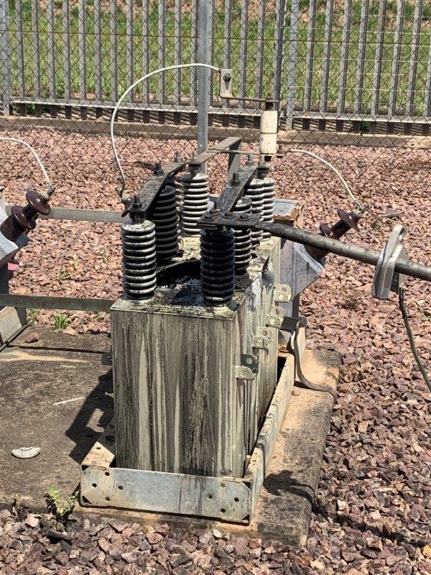
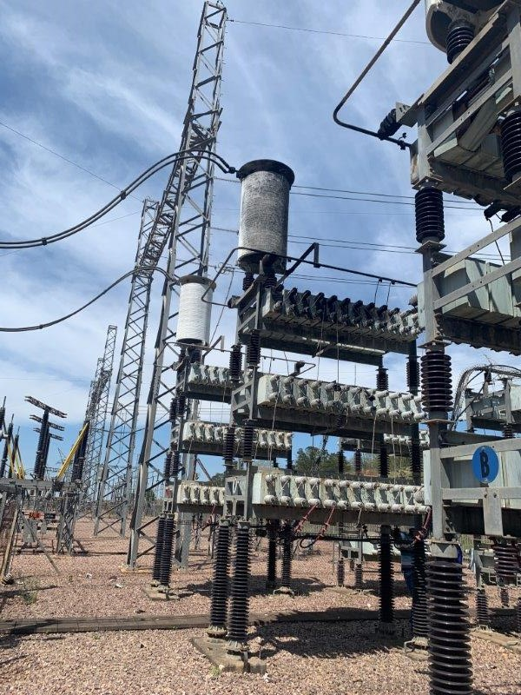
TECHNICAL – Neutral VT & Damping Reactor/Resistor

