Slide 1
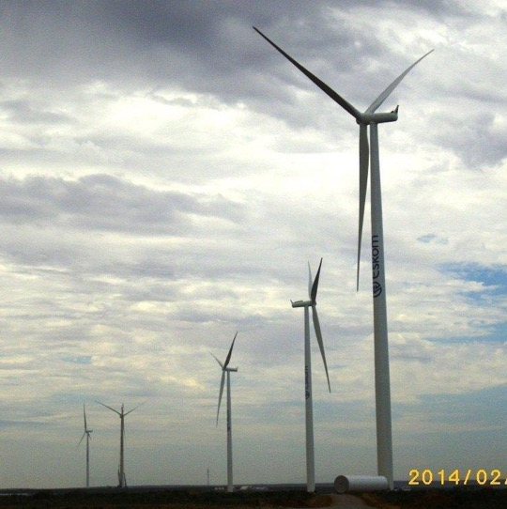
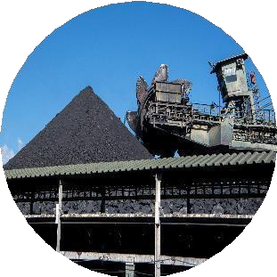
Tutuka long-term maintenance
Eskom Holding SOC Ltd retains the copyright of the documents and/or designs published for Eskom. No part of this document or design may be reproduced in any manner or form or by any means without Eskom’s written consent. Any unauthorised reproduction of this copyright work in any form or by any means will constitute a copyright infringement and render the person or company liable under both civil and criminal law.
©Eskom Holdings S O C Ltd
Lesiba Molepo
18 June 2026

Slide 2
Scope for long term contract (mechanical)
The maintenance of the ESP during outage and normal maintenance. The scope of work entails inspections of the ESP plant, providing inspection reports, repair and/or replacement of the components within the ESP plant and commissioning during maintenance and outages (Planned and unplanned outages) at Tutuka Power Station for a period of 60 months (5 years). The maintenance scope of work also includes carrying out of scheduled- based maintenance (PM’s) with the explicit objective of preventing functional plant and/or component failures.
NB: Repairs should only commence after the scope has been approved by Eskom

Slide 3
scope
The scope will include inspections, repairs/refurbish and or replacement to the following:
Distribution screens and guide vanes
Casing
Access doors
Penthouse/Insulator Cubicle
Poking rods / Agitating chains
Collector Electrodes (CE)
Collector electrode Rapper bars
Collector electrode Rapper Hammers and systems
Collector electrode rapper shaft and shaft bearing
. Collector electrode rapper gearbox

Slide 4
Scope cont’
Discharge Electrodes (DE)
. Discharge electrodes Rapper Hammers and systems
Discharge electrodes rapper shaft and shaft bearing
Discharge electrodes rapper gearbox
Discharge electrodes rapper Cam release unit
Discharge electrodes Rapper Anvils
Hopper Slide Gates
. ESP internal washing

Slide 5
Manpower
Routine Maintenance: Core Crew
For routine plant maintenance, the Contractor shall provide the following trained, qualified, and competent key resources:
1 x Supervisor
2 x Mechanical & electrical Artisans

Slide 6

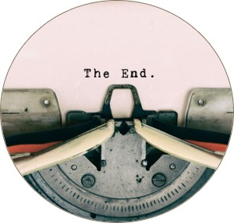
Thank you
Dankie
Siyathokoza
Re a leboha
Re a leboga
Siyabonga
Inkomu
Ro livhuwa
Enkosi
Siyabonga
Eskom Holding SOC Ltd retains the copyright of the documents and/or designs published for Eskom. No part of this document or design may be reproduced in any manner or form or by any means without Eskom’s written consent. Any unauthorised reproduction of this copyright work in any form or by any means will constitute a copyright infringement and render the person or company liable under both civil and criminal law.
©Eskom Holdings SOC Ltd

