Slide 1


TECHNICAL TENDER CRITERIA
Debt Collectors for
KwaZulu-Natal & Free State Operating Unit
10 April 2026

Slide 2
Background
Eskom requires the services of specialized debt recovery agencies who can partner with Eskom to enhance revenue collection by ensuring that Eskom and the Muncipality’s non-paying customers honour their payment obligation.
Debt collection agencies will utilize specialist collection strategies (such as a “soft” collections or “hard”/legal collections) to maximise Eskom and the Municipality's collections.
Furthermore, these debt collection agencies also have a wider access to customer databases /credit bureaus. Their expertise in data mining enables the agencies to enrich the information received from Eskom and the Munciaplity’s, easily tracing the customers thus enhancing the probability of recovery, because they perform collection services for other credit providers as well. This activity cannot be performed in house as Eskom does not have the systems and tools for these activities. It will also require additional resources, which Eskom will not be able to appoint at this stage.

Slide 3
Scope as per NEC
The work comprises:
Have a solid and integrated debt collection system (i.e. tracing & recovery system, and where possible, the service provider and Eskom to have dual viewing functionality).
Efficiently collect on all accounts handed over by Eskom with specific compliance to the relevant legislations.
Have an in-house “legal department/attorney” who will manage the debt collection process.
Conduct adverse listing on Credit Bureaus.
Have an audit trail of all interactions with customers including voice recordings (i.e. Query management).
Have a Call Centre, where customers can be phoned to remind them of payment that is overdue
Have an effective Customer relationship management.

Slide 4
Scope as per NEC
Produce performance reports timeously and client to have easy access to online reports promptly.
Write off management, i.e. recommend accounts for write off three months after hand over date if tracing or recovery is no longer feasible.
Ensure that customers make all payments directly into an Eskom bank account.
Maintain confidentiality of Eskom and Municipality’s information by ensuring that it is only used for Eskom benefits.
For all accounts, commission to be based on recoveries only -10 %.
In the event that the matter requires the issuing of summons or other litigation processes, the matter will be handled as per the process for Legal collections by the Legal department of the service provider.
The service provider must also take cognisance of Eskom’s performance requirements for debt collection as Eskom reserves the right to withdraw handed over accounts or stop handovers if performance is below target.

Slide 5
Scope as per NEC
Eskom requires the following services on accounts handed over for collection:
1. Perform ‘Soft Collections’ on Large Power Users (LPU) and Small Power Users (SPU) customers in arrears through the service provider’s Contact Centre – payments to service provider will be based on payments received
  Hand over Active accounts which are in the 15 – 30 age bracket for LPU’s and the 31-60 days age bracket for SPU customers - this is more for a reminder to customers to pay and to change the behaviour to pay on the due date.
  Include Active accounts to the value of more than R10 000 where payment was not received on the due date (R-value open to the discretion of the OU, not less than R10 000).
  Hand over all terminated accounts at Debt Management’s discretion.
  Hand over all Sundry Debtors at Financial Accounting’s discretion.
  Hand over all overdue Municipality debt (based on agreed partnership/s).
  Service provider to be paid based on the number of successful payments received.
  Campaign creation and execution.
  Query management.

Slide 6
Scope as per NEC
  Preparing letters of demand and dispatching same on behalf of Eskom and the Municipality via registered mail.
  Utilise tracing tools for data cleansing and harvesting that will increase the probability of contacting the customer.
  Service provider to recommend the ‘next best actions’ to Eskom and Municipality in order to maximise debt collections.
  Lodging claims on against the deceased and liquidated estates on behalf of Eskom and Municipality.
  Maintain an audit trail of all interactions including voice interactions with customers.
  Produce performance reports timeously.
  Weekly report on high value debt accounts.
  Consolidate monthly performance reports (adverse listing, letters of demand, promise to pay, fixed payment arrangements).

Slide 7
Scope as per NEC
2. Perform hard collections on all LPU and SPU accounts - In the event that the ‘soft collection’ has not yielded desired results, the service provider shall, in consultation with Eskom, follow the process as outlined below:-
Perform an assessment on the debtors’ ability to pay or means to pay and advise Eskom on the appropriate debt collection strategy and likelihood of recovery.
Produce a tracing report on debtor listing, current address, employment etc.
Determine and advise Eskom on the estimated legal services costs based on the following processes:
          Registered Letter of Demand
          Issue and Serve Summons
          Lodge Default Judgement
          Warrant of Execution
          Attaching Property
          Section 65A (1) notice to appear in the relevant court
          Court Appearance
          Emolument Attachment order
          Instruction letter to debtors employer

Slide 8
Scope as per NEC
  Eskom shall apply standard charges as gazetted for the “Proceedings of Magistrates/ High Courts of South Africa” for debt collection costs.
  Where a matter is defended and the debt value ranges from R100 000 up to R1 000 000.00, the debt collector shall inform Eskom and is expected to handle the matter to completion.
  Where a matter is defended and the debt value exceeds R1 000 000.00; the debt collector shall inform Eskom and the matter will have to be referred to Eskom Legal for further actions.

Slide 9
Scope as per NEC
  3. Eskom Active Accounts Collections (Ad hoc basis)
  On an ad hoc basis active SPU and LPU accounts may be handed over for debt collection that may require one or more of the following activities:-
  Courtesy calls on overdue active accounts – call or SMS as a reminder to pay overdue debt via the service provider’s call centre.
  A ‘”trace” service in order to verify the customer information on hand and/or provide correct personal information.
  Adverse listing of “slow payers” on the Credit Bureau.
  Preparing and sending “Letters of Demand” to selected customers deemed “problematic” by Eskom.
  Legal/ Hard collection on selected “problematic” active LPU and SPU accounts (Issue Letter of demand, Issue Summons).

Slide 10
Scope as per NEC
  Provide weekly reports on high value debt accounts (a dedicated resource to manage queries and provide accurate reports).
  Provide consolidated monthly reports (Adverse listing, Letters of Demand, Promise –To-Pay and Fixed Payment Arrangements).
  For all active accounts, payment for collection activities shall be based on payments received costs to be negotiated based on age of debt (31- 60 days; 61–90 days etc.).
  The service provider shall ensure that Eskom debtors make all payments into the designated Eskom’s bank account with the correct reference number.

Slide 11
Selection of Debt Collectors
The technical tender criteria has been defined in order to determine the Tenderer’s capabilities for the purpose of executing the required scope of work.
Demonstration of compliance to all technical Gatekeepers will be required for the submission to be evaluated further.
If the gatekeeper is met, then the mandatory evidence will be evaluated.
The technical evaluation for the mandatory evidence is scored out of 75 marks. Partial scoring applies where indicated. The threshold is set at 60 marks to pass.
The final scores for all submissions will be ranked from highest to lowest and the top 3 scores will be selected.
Site validation visits will be conducted on the Top 3 submissions in order to validate the results of the technical submission, prior to contract award.
A site visit will be conducted with the Suppliers that have met the Gatekeepers and passed the Technical Evaluation. The results of the site visit will determine whether the supplier is technically compliant.

Slide 12
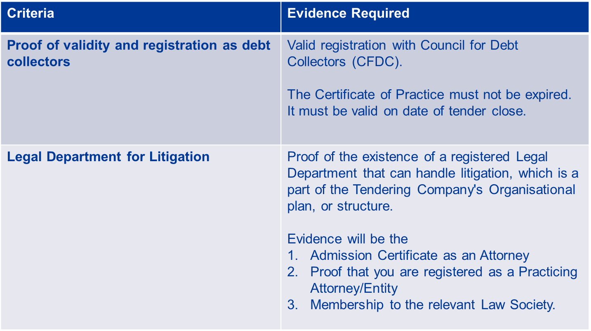
Technical Criteria - GATEKEEPER

Slide 13
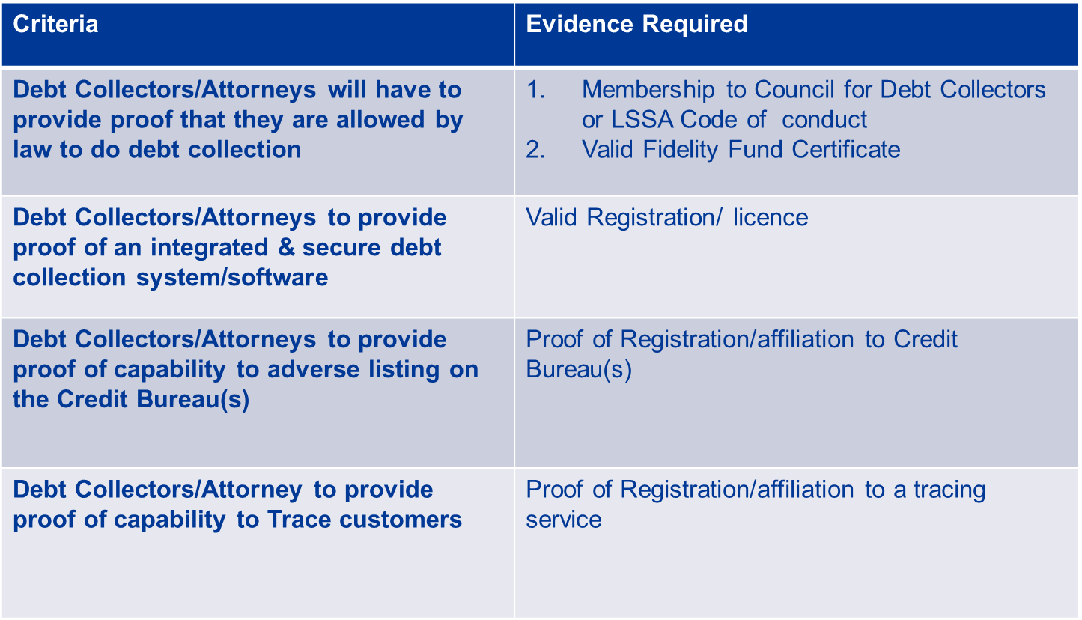
Technical Criteria - GATEKEEPER

Slide 14
Technical Criteria - GATEKEEPER
Demonstration of compliance to all technical Gatekeepers will be required for the submission to be evaluated further.
NOTE WELL!!!!
Remaining evidence will only be evaluated if the gatekeeper is passed. If not passed, the submission will not proceed further!

Slide 15
Technical Criteria – MANDATORY EVIDENCE
All Mandatory Evidence criteria has a score assigned.
The technical evaluation for the mandatory evidence is scored out of 75 marks.
Partial scoring applies where indicated.
The threshold is set at 60 marks to pass.
The final scores for all that pass the gatekeeper submissions will be ranked from highest to lowest and the top 3 scores will be selected.

Slide 16
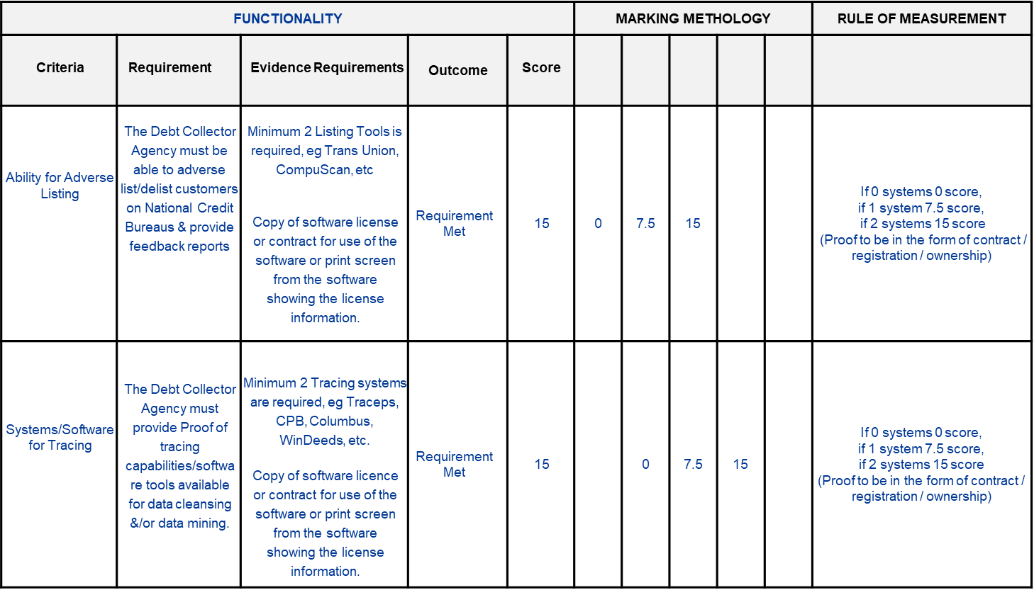
Technical Criteria – MANDATORY EVIDENCE

Slide 17
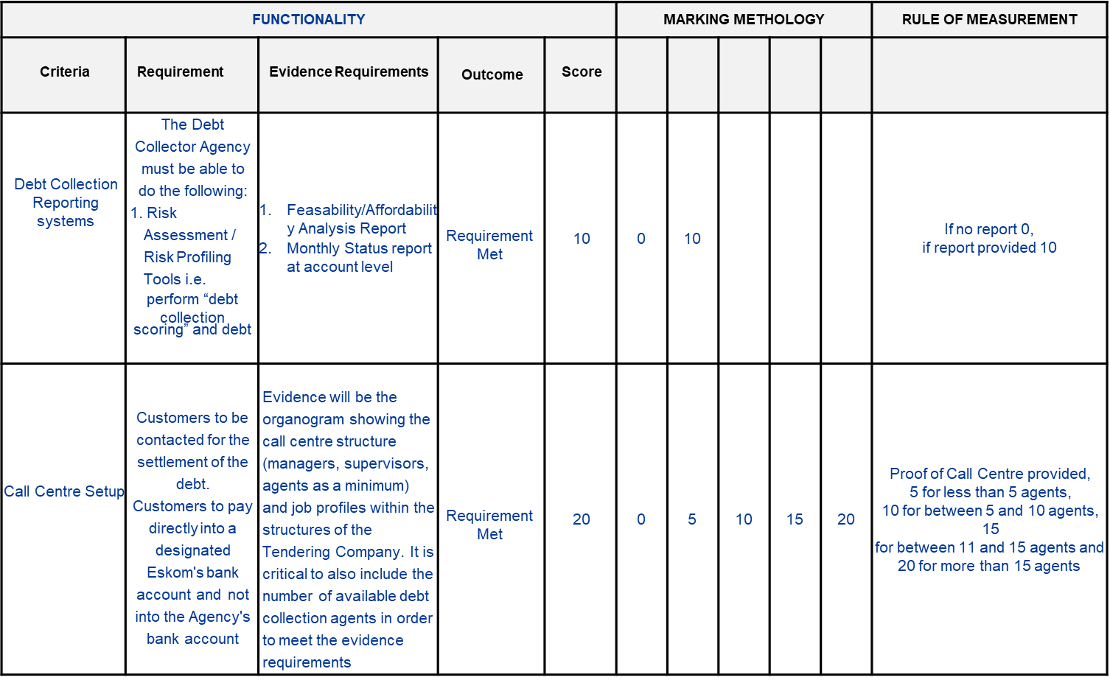
Technical Criteria – MANDATORY EVIDENCE

Slide 18
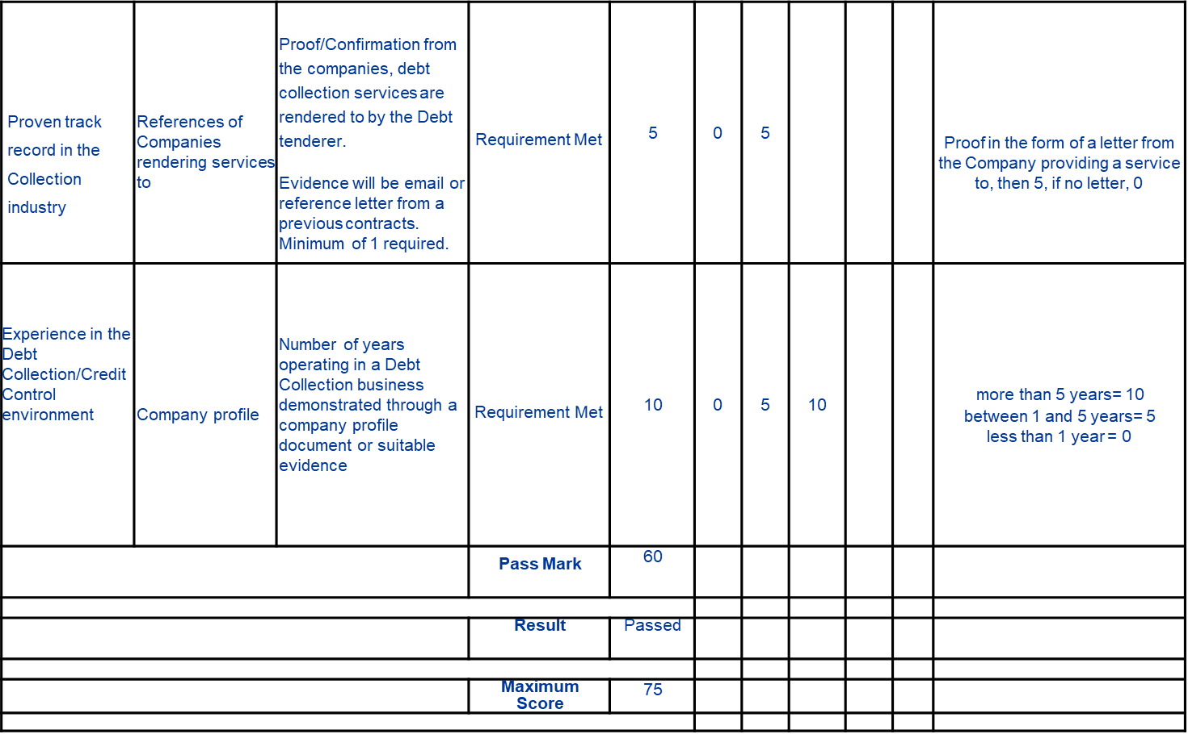
Technical Criteria – MANDATORY EVIDENCE

Slide 19
Technical Outcome
Technical submissions will be evaluated:
  First to determine if the gatekeeper has been met,
  Only if the gatekeeper has been met will the mandatory evidence be evaluated and a score allocated to the submission.
Once all submissions have been evaluated and scores allocated, the final results will be ranked.

Slide 20
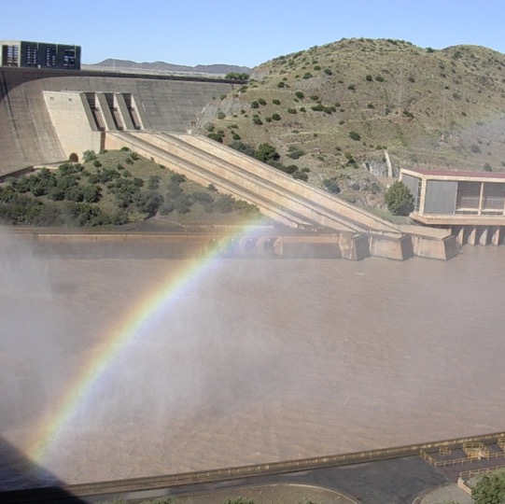

Conclusion

