Slide 1
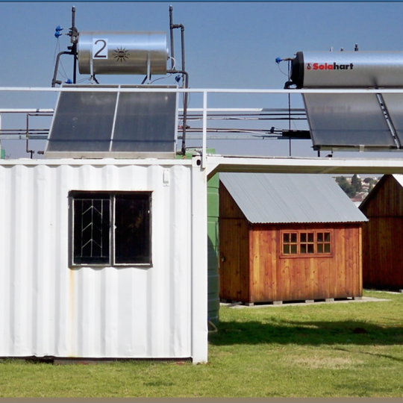
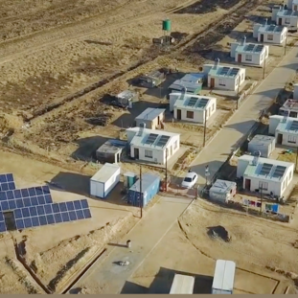
NON-COMPULSORY CLARIFICATION MEETING FOR THE SUPPLY AND DELIVERY OF PPE WORK WEAR ON AN “AS AND WHEN EQUIRED” BASIS TO ESKOM DISTRIBUTION NORTH-WEST OPERATING UNIT FOR A PERIOD OF 4 YEARS
Presented by: Tshifhiwa Mandavha
Date: 09 July 2026

Slide 2
Housekeeping Rules
Keep your microphone muted when not speaking to minimize background noise.
Keep your camera off.
Use the “Raise Hand” feature if you need to speak or ask a question.
Identify yourself when speaking, start by stating your name and company.
Keep your questions brief and to the point.
.

Slide 3
Agenda
OPENING, WELCOME & EVACUATION ROUTE/ safety
MEETING GROUND RULES & OBJECTIVES– Commercial Representative/ Tshifhiwa
Eskom Commercial Process – Commercial Representative Tshifhiwa
Tender updates, Question and Answers to date.
BOQ – Unathi Mpoza
SD&L- Jabulile Shongwe
SHEQ – Victor, Londiwe, Bonginkosi
Technical Evaluation Process – Technical Representatives: Zanele Sithole, Etienne Lizemore
Questions and Answers
Summary and closing

Slide 4

Welcome: Session Objectives
The session will focus on providing clarity on the, invitation content which should assist prospective tenderers to submit responsive tenders that are commercially and technically acceptable.
We will endeavour to:
  Provide a guideline on commercial/ Basic Compliance requirements.
  Explain the evaluation criteria (Functionality)
  Explain the Objective Criteria’s or contractual requirements
  Provide a forum for Q & A and clarify any ambiguities

Slide 5
Commercial Process - ESKOM Representative / Contact Person:
Eskom DX Gemma Cluster
Name: Tshifhiwa Mandavha
Designation: Snr Advisor Procurement
Tel No: +27 11 629 8114
E- mail: MandavT@eskom.co.za

Slide 6
Commercial Process: Submission Deadlines
Non-Compulsory Clarification Meeting
Tender Issue Date: 22 June 2026
Submission Deadline/Closing Date: 15 July 2026@10h00 AM
  Tender Validity period: 180 Days
  Clarification Queries Closing Date: 10:00am SA Telkom Time (GMT +1) on 10 July 2026 (05 working days before the deadline for Proposal submission)
  Submission Closing Time: 10:00am SA Telkom Time – (GMT +2) (no late submission/s will be accepted under any circumstances)
  ANY LATE SUBMISSION WILL BE REJECTED

Slide 7
Commercial Process: Submission Requirements
  Updates & Clarifications: Tenderers are encouraged to regularly monitor and check the Eskom Tender Bulletin and the National Treasury Website (e-Tender) for important updates relevant RFT (E3075DXNWOU) i.e. Updated tender documents, minutes, notices, clarifications etc.
  Note: The RFT shall be submitted as electronically via Eskom E- tendering site by the stipulated closing date and time.
  Note: Document must be submitted in pdf format / copies of the submitted documents should also be uploaded.
  Tenderers will not be permitted to provide the required copies after tender closing, and Eskom will not be responsible for the making of copies for the purposes of evaluation

Slide 8
Tender Info:
Tenders are to be delivered via the e-tender system:
TenderBulletin Public website: https://tenderbulletin.eskom.co.za - this is used by members of the public, to view and access Eskom published tenders. eTendering hyperlink will be found on this site. Members of the public may follow prompt instructions once they have clicked on the eTendering link (https://eTendering.eskom.co.za) . This link will allow them to upload the required tender documentation.
eTendering website Public website: https://eTendering.eskom.co.za - this is used by members of the public, to view information about published tenders and submit their tender documents.
Refer to the e-tender folder for the manual and training documents.
Tender Number: E3075DXNWOU
Description of Tender: THE SUPPLY AND DELIVERY OF PPE WORK WEAR ON AN “AS AND WHEN EQUIRED” BASIS TO ESKOM DISTRIBUTION NORTH-WEST OPERATING UNIT FOR A PERIOD OF 4 YEARS

Slide 9
Evaluation Process : (1/ 3)
As prescribed in terms of the Preferential Procurement Policy Framework Act (PPPFA), Act of 5 2000 and its Regulations. Tenderers are to note that a 4 steps evaluation
Step 1 – Basic Compliance
1. Meet the eligibility criteria for a tenderer
2. Electronic copy of the tender in a PDF format
3. Completed BOQ
4. Submission of the mandatory commercial tender returnables as at stipulated deadlines. Mandatory requirements (page 10-13 of ITT)
For E-Tendering, a tenderer’s failure to have uploaded tender documents will render the tender non-responsive.
Step 2 – Functionality requirements / Technical ( Technical will cover this)
Step 3 – PPPFA
Step 4 – SDL&I
Step 5- Contractual Criteria- Financial Analysis, SHEQ, Environmental and Quality

Slide 10
Functionality evaluation criteria

Slide 11
Pricing Schedule

Slide 12
SD&L

Slide 13
Contractual requirements
Financial Analysis:
• Auditors / Independent reviewers / Accounting officer’s / Compiler’s report.
• A signed directors / members report
• Annual financial statement (statement of financial position i.e. Balance sheet, statement of comprehensive
income i.e. Income Statement, Statement of changes in equity, Statement of cash flows, Notes to the financial
statement)
• ITA 34C Income tax assessment, only used if supplier is not audited
• Public Interest Score (PIS) – used to determine whether the financial statements are required to be audited /
independently reviewed or either
• Approved financial statements, signed auditors / independent reviewers / accounting officers report must be
valid and not outdated, received within 18 months after year end.

Slide 14
Contractual requirements
SHEQ Requirements:

Slide 15
Questions and answers

Slide 16


