Slide 1
TENDERER’S CLARIFICATION BRIEFING PRESENTATION
CONTRACT SANRAL N.017-040-2022/1F
FOR CONSULTING ENGINEERING SERVICES FOR THE PARTIAL RECONSTRUCTION ON THE NATIONAL ROUTE N17 FROM BETHAL CBD TO KM 3.2 WITHIN GOVAN MBEKI LOCAL MUNICIPALITY.

Slide 2
Tender documents are available at no cost in electronic format downloadable from SANRAL website: https://www.nra.co.za/service-provider-zone/tenders/open-tenders/.Tenderers must have access to Microsoft Office © 2013 and Acrobat Adobe © 9.0, or similar compatible software.

Slide 3
Introduction
Composition of Tender
T1.1 Tender Notice and Invitation to Tender
T.1.2 Tender Data
T.2 Returnable Schedules
C1 Agreement and Contract Data
C2 Price Data
C3 Scope of the Works
C4 Project Information
Contents of Briefing

Slide 4
INTRODUCTION

Slide 5
PROJECT DETAILS
PROJECT | N.017-040-2022/1F
CLIENT | SANRAL NORTHERN REGION
PROCUREMENT OFFICE | PROCUREMENT NR3
ALL ENQUIRIES | ProcurementNR3@sanral.co.za
TENDER ADVERTISEMENT DATE | FRIDAY, 7 JULY 2023
SUBMISSION OF FORM A1.1 (NB:Failure to submit this certificate would results in the tenderer not receiving addenda or additional issued information and may results in the tenderer being non-responsive.) | FRIDAY, 14 JULY 2023
NON-COMPULSORY CLARIFICATION MEETING DATE | TUESDAY, 18 JULY 2023
SUBMISSION OF QUERIES | FRIDAY, 28 JULY 2023
TENDER CLOSING DATE | FRIDAY, 11 AUGUST 2023

Slide 6
IMPORTANT NOTE
The onus rests with the tenderer to ensure that the representative reading or viewing the clarification briefing presentation and attending the non-compulsory meeting are appropriately qualified to understand all directives and clarifications given in the presentation.
The signature on the duly completed and signed Form A1 shall be considered proof that the tenderer read/viewed the whole clarification briefing presentation and/or attended the non-compulsory clarification meeting clearly understood all directives and clarification given in the clarification briefing presentation.

Slide 7
COMPOSITION OF TENDER:
PART T1 – C5

Slide 8
COMPOSITION OF TENDER
Book 1:T1 Tender Procedures | Book 1: T2 Returnable Schedules | Book 2: C1 Agreements and Contracts Data | Book 3: C2 Pricing Data | Book 3: C3 Scope of Work | Book 3: C4 Site Information | Book 3: C5 Annexures
T1.1 -Tender Notice | T.2.1 List of Returnable schedules | C.1.1 Form of Offer and Acceptance | C.2.1 Pricing Instructions | General Requirements | As stated in Tender Document | As provided with tender document
T.1.2 - Conditions of Tender | T.2.2 Returnable Schedules | C.1.2 Contract Data | C.2.2 Pricing Schedules and bills | Project Assessment , Investigations for Design Development, Design Development Phases,
T1.3 Tender Data |  |  | C.2.3 Summary of Pricing Schedule | Tender Documentation, Clarification Meeting, Tender Period and Tender Evaluation
 |  |  | C.2.4 Key persons for project and summary of normalised hours | Administration and Monitoring of the Works Contract.
 |  |  | D1 Tenderers B-BBEE Verification Certificate | Additional duties, Special Services and Specialist Advice.
 |  |  |  | Quality Control: Works Contract.
 |  |  |  | Close Out.

Slide 9
THE TENDER IS MADE UP OF THE FOLLOWING:
Tender document
  Appendices to Tender Document
    D3- OHS Audit Questionnaire – Conventional projects in MS Excel
    G- Request for Survey Work in MS Word
    H1-Declaration through town – Agreement between SANRAL and Municipality in MS
Word
    H2 – Agreement hand-over of new Access Roads to the relevant authority in MS Word
    H3 – SANRAL SPLUMA Agreement in PDF
    I – SANRAL Road Safety Audit Policy in PDF
    M – SARDS User Registration manual in PDF
    N - Structures Tracking Spreadsheet in MS Excel
    Tender document in PDF
Returnable Schedules
  Technical
    A-Forms in MS
    Technical submission in MS Excel
    B-BBEE Exempted Micro Enterprise Affidavit – Template in PDF
  Financial
    Form of Offer & Contract Data by Tenderer in MS Word
    Financial submission in MS Excel
A4 Booklet
  Financial Booklet in PDF
  Technical Booklet in PDF
Clarification Presentation in PDF

Slide 10
PART T1.1: TENDER NOTICE AND
INVITATION TO TENDER

Slide 11
TENDER NOTICE AND INVITATION TO TENDER (Incorporating SBD1)
CLOSING DATE (AT 11:00): 03 August 2023, Thursday
The South African National Roads Agency SOC Limited (SANRAL) invites tenders for the provision of Consulting services for the Partial Reconstruction on the National Route N17 From Bethal CBD To Km 3.2 Within Govan Mbeki Local Municipality. This project is in the province of Mpumalanga and in the district municipality of Gert Sibande District/Govan Mbeki Local Municipaltiy and the approximate programme is for design and construction documentation to be completed by August 2025, followed by supervision of 15 months, commencing February 2026 .
Only tenderers who are registered on the National Treasury Central Supplier Database and meet the minimum requirements for the key persons as stipulated in Clause C.2.1 at the tender closing date, are eligible to tender.
Joint Ventures (JV) will be allowed on condition that one JV partner is a Targeted Enterprise. The JV partner will, however, not contribute to sub-contract target for Targeted Enterprises.
Includes mobilisation
Review program

Slide 12
TENDER NOTICE AND INVITATION TO TENDER (Incorporating SBD1)
Emphasis/ Changes on eligibility Criteria:
Only tenderers who are registered on the National Treasury Central Supplier Database and meet the minimum requirements for the key persons as stipulated in Clause C.2.1 at the tender closing date, are eligible to tender.”
Joint Venture/s
Joint Ventures (JV) will be allowed on condition that one JV partner is a Targeted Enterprise. The JV partner will, however, not contribute to the sub-contract target for Targeted Enterprises.

Slide 13
TENDER DOCUMENTS
Tender documents are available from 30 June 2023 at no cost in electronic format downloadable from the SANRAL’s website by following the link: https://www.nra.co.za/sanraltenders/status?region_id=national.
Tenderers must have access to Microsoft © Office 2013 and Acrobat Adobe © 9.0 or similar compatible software.
Tenderers must submit, via email, the duly completed Form A1.1 Certificate of Intention to Submit a Tender prior to 10 July 2023. (Please quote the project number (N.017-040-2022/1F) in the subject line.)
Failure to submit this certificate would result in the tenderer not receiving addenda or additional issued information and may result in the tenderer being non-responsive.
SECTION DIVIDER TITLE GOES HERE

Slide 14
CLOSING TIME, COMPLETION AND DELIVERY OF TENDERS
The closing time and date for receipt of tenders is 11:00 on Thursday, 03 August 2023
Telegraphic, telephonic, telex, e-mail, facsimile and late tenders will not be accepted.
Tenders may only be submitted in the format as stated in the Tender Data.
Requirements for completing, sealing, addressing, delivery, opening and assessment of tenders are stated in the Tender Data.
Queries relating to issues arising from these documents may be addressed to: e-mail: ProcurementNR3@sanral .co.za
SECTION DIVIDER TITLE GOES HERE

Slide 15
CLOSING TIME, COMPLETION AND DELIVERY OF TENDERS
Tender Closing Date and delivery address:
Location of the tender box for Tender Submission: Reception
Physical address: The South African National Roads Agency SOC Ltd
Northern Region
38 Ida Street
Menlo Park
0081
Submitted tenders must reflect the contract details
e.g.: CONTRACT SANRAL N.017-040-2022/1F
SECTION DIVIDER TITLE GOES HERE

Slide 16
PART T1.2: CONDITIONS OF TENDER

Slide 17
CONDITIONS OF TENDER
T1.2 CONDITIONS OF TENDER
Note to tenderer:
The conditions of tender are the standard conditions of tender as contained in Annexure C of the CIDB STANDARD FOR UNIFORMITY IN ENGINEERING AND CONSTRUCTION WORKS CONTRACTS as per Government Notice No. 423 published in Government Gazette No. 42622 of 08 AUGUST 2019 and as amended from time to time. (see www.cidb.org.za).
https://www.cidb.org.za/wp-content/uploads/2021/07/Standard-for-Uniformity-August-2019.pdf
The standard conditions of tender make several references to the tender data for details that apply specifically to this tender. The tender data shall have precedence in the interpretation of any ambiguity or inconsistency between the tender data and the standard conditions of the tender.
Each item of data given below is cross-referenced to the clause marked “C” in the above-mentioned Standard Conditions of Tender.

Slide 18
INFORMATION PROVIDED ON THE WEBSITE
TENDER DOCUMENT
  TENDER DOCUMENT IN PDF FORMAT
  APPENDICES (IN VARIOUS FORMATS)
RETURNABLE SCHEDULES
  TECHNICAL
  RETURNABLE SCHEDULES
  (FORMS A1 TO A15) IN WORD
  CONSULTANT TECHNICAL SUBMISSION
    (FORMS B1 TO B8) IN EXCEL
  FINANCIAL
  CONSULTANT FINANCIAL SUBMISSION IN EXCEL
  FORM OF OFFER (IN WORD)

Slide 19
COMPLETION OF TENDER
C.1.3 | Interpretation Wherever reference is made in the documentation to Bill of Quantities it shall also mean Pricing Schedule. Wherever reference is made in the documentation to Contractor /Consultant it shall also mean Service Provider.
C.2.13.1 | If a tenderer, including key persons, a joint venture partner or a Targeted Enterprise, submits or participates in more than one tender for the same project, then all such tenders shall be disqualified.
C.2.13.2 | Wherever it is a requirement that the tenderer has to provide hours to match the price tendered and failed to do so, such imbalance cannot be corrected and will be declared non-responsive
C.2.13.2 | Submit the tender offer electronically on a flash drive. (In the relevant MS Word 2013 and MS Excel 2013 format as issued, and not in .pdf format, except where so specified.) *NB. The flash drive must be tested & working before submission of tender. If the Flash drive does not work (files do not open), the submission will be deemed non-responsive.
C.2.13.3 | The tenderer is required to upload all certificates as listed in the List of Returnable Schedules as scanned copies, in .pdf format, on the flash drive Wherever reference is made in the tender documentation for non-financial proposal it shall also mean technical proposal. Submit only the signed original tender offer (Note to tenderer: submit all returnable schedules as listed in Form T.2.1: List of Returnable Schedules.)

Slide 20
COMPLETION OF TENDER
C.2.12 | Alternative offers are generally not acceptable due to possible manipulation of the tender process and resulting complexity of the evaluation. Therefore, the submission of alternative tenders is strongly discouraged. The submission of alternative key persons will be declared non-responsive, even if submitted with an alternative financial offer.
C.2.12 | However, a tenderer wishing to submit an alternative offer shall first apply to the Em­ployer with full details of the principles of the alternative for confirmation that the Em­ployer’s standards and requirements are not compromised or reduced. Such con­firmation must have been provided by the Employer in writing at least 5 (five) working days before the date of tender closing, or as extended by an addendum sent to all tenderers. The application shall not be submitted later than 7 (seven) working days before the date of tender closing given in Tender Data Clause C.2.15. Acceptable alternative offers will only be considered from a tenderer with the highest number of evaluation points for the main offer.

Slide 21
PART T1.3: TENDER DATA

Slide 22
TENDER EVALUATION
Clause Number | PRE-QUALIFICATION: ELIGIBILITY CRITERIA
C.2.1 | Only those tenderers who satisfy the following criteria are eligible to submit tenders: (a) Meet the minimum requirements for the key persons as stated in the Scope of Works in Clause C.3.1.11: Personnel requirements; excluding 3.1.11(f), which is dealt with under Tender Data C.3.13(k). (b) Registered on National Treasury Central Supplier Database. Tenderers, or in the event of a Joint Venture or a Targeted Enterprise, each member of the Joint Venture or Targeted Enterprise, shall be registered on the National Treasury Central Supplier Database at the closing date for tender submissions. If not registered as verified online at tender closing, the tenderer will be declared non-responsive. Failure to satisfy the eligibility criteria will result in a non-responsive tender.

Slide 23
TENDER EVALUATION
Item | Description | Required
a. | Meet the minimum requirements for the key persons as stated in the Scope of Works in Clause C3.1.11: Personnel requirements. | Provide the details of the Project Leader and Design Specialist (Pavement & Materials Engineer) as required in the B – Forms. When a proposed candidate for any position is not in the permanent employ of the tenderer but a contracted person, this must be indicated on form B2, and a signed letter of consent from the candidate must be submitted with the relevant B-forms.
b. | Registered on National Treasury Central Supplier Database. Tenderers, or in the event of a Joint Venture (JV) or a Targeted Enterprise, each member of the JV or a Targeted Enterprise, shall be registered on the National Treasury Central Supplier Database at the closing date for tender submissions. If not registered as verified online at tender closing, the tender will be declared non-responsive | Provide your MAAA number in form A3.4

Slide 24
TENDER EVALUATION
Each item of data given is cross-referenced to the clause in the Standard and Special Conditions of Tender to which it mainly applies. The Tender Data shall have precedence in the interpretation of any ambiguity or inconsistency between it and the standard/special conditions of tender.
CLAUSE NUMBER | TENDER DATA
C.3.5 | Two Envelope System The minimum percentage of evaluation points for quality is not less than 80

Slide 25
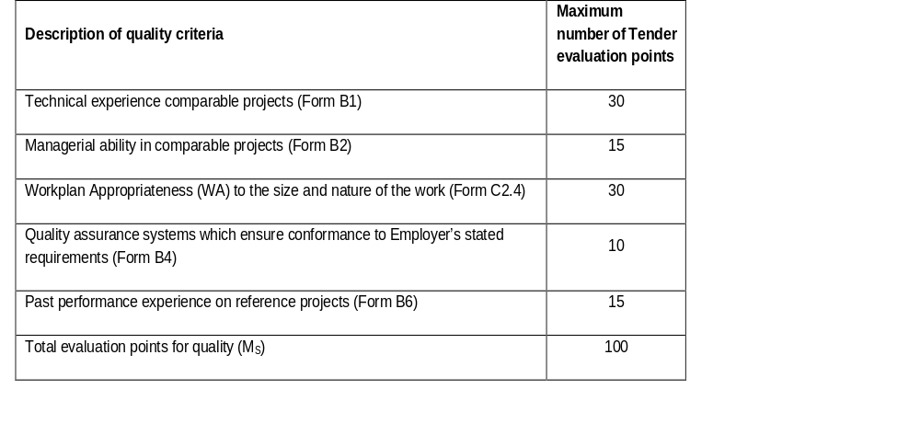
TECHNICAL EVALUATION
Condition of Tender | Tender Data
C.3.11 | Evaluating quality/functionality The quality criteria and maximum score (including the relevant returnable schedule to calculate the score) in respect of each of the criteria are as follows: A detailed explanation of the evaluation scoring is provided further in this document as “SANRAL – EXPLANATION OF CONSULTANT TENDER EVALUATION SCORING FOR CONVENTIONAL PROJECTS” The minimum number of evaluation points for quality is not less than 80

Slide 26
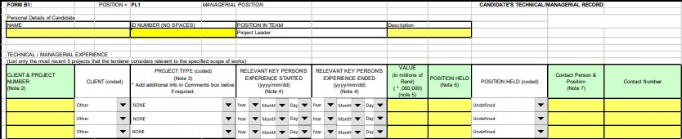
QUALITY CRITERIA
Technical Knowledge (30)
The tenderer, for each key position identified, may supply the 3 (three) most recent relevant project experiences to that which the tender is let for. This is done in the form of returnable schedules, such as the one below:
For technical knowledge three (3) areas are evaluated:
Project Type Relevance
Period Relevance
Position Held

Slide 27
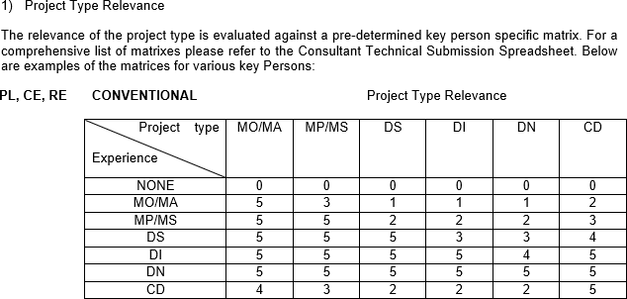
QUALITY CRITERIA

Slide 28
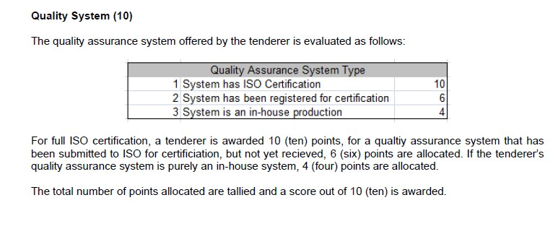
QUALITY CRITERIA

Slide 29
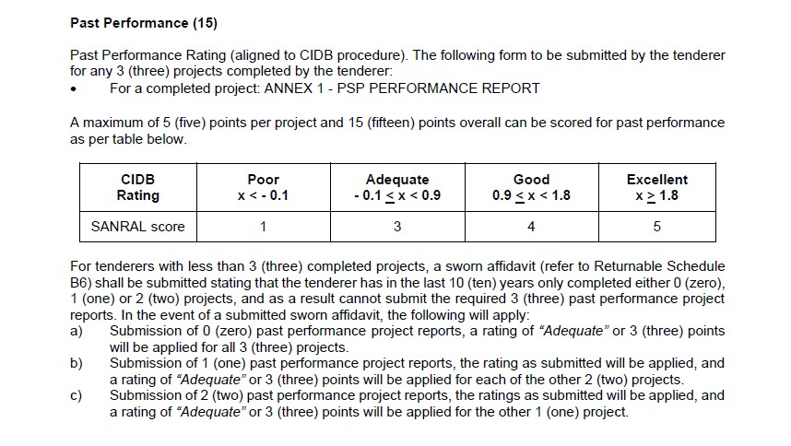
QUALITY CRITERIA

Slide 30
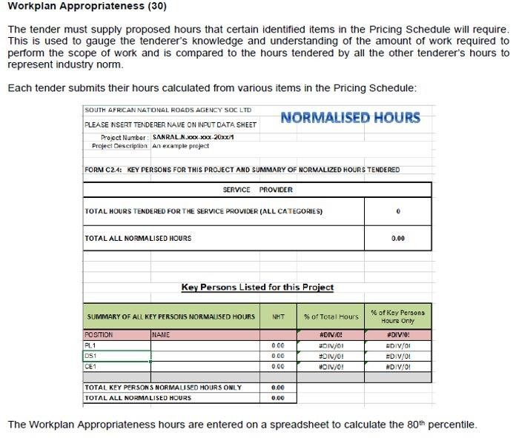
QUALITY CRITERIA

Slide 31
PLEASE NOTE THAT FAILURE TO SUBMIT THE REQUIRED INFORMATION WILL RESULT IN ZERO POINTS SCORED FOR THE SPECIFIC CRITERIA. NO DOCUMENTS REQUIRED UNDER THIS CRITERIA WILL BE REQUESTED FROM TENDERERS AFTER TENDER CLOSING:
IN ORDER TO SCORE THE POINTS ALLOCATED FOR THE QUALITY SYSTEM THE TENDERER MUST SUBMIT PROOF OF THE QUALITY SYSTEM.
IN ORDER TO SCORE POINTS ALLOCATED FOR PAST PERFORMANCE THE TENDERER MUST SUBMIT A COMPLETED AND SIGNED CIDB PAST PERFORMANCE EVALUATION REPORT FOR THE PROJECTS INDICATED ON B1- RELEVANT TO THE SCOPE OF THIS TENDER. FOR TENDERERS WITH LESS THAN 3 (THREE) COMPLETED PROJECTS, A SWORN AFFIDAVIT (REFER TO RETURNABLE SCHEDULE B6) SHALL BE SUBMITTED STATING THAT THE TENDERER HAS IN THE LAST 10 (TEN) YEARS ONLY COMPLETED EITHER 0 (ZERO),1 (ONE) OR 2 (TWO) PROJECTS, AND AS A RESULT CANNOT SUBMIT THE REQUIRED 3 (THREE) PAST PERFORMANCE PROJECT REPORTS.
FAILURE TO SUBMIT THE COMPLETED B-FORMS SHALL RESULT IN A NON-COMPLIANT TENDER
AS VERIFICATION OF KEY PERSONNEL REQUIREMENTS WILL NOT BE POSSIBLE. WHERE VERIFICATION OF KEY PERSONNEL IS POSSIBLE AND FORMS INCOMPLETE ZERO POINTS WILL
BE ALLOCATED. INCOMPLETE FORMS CANNOT BE CORRECTED AFTER TENDER CLOSING.
FORM C2.4 FOR KEY PERSONS FOR THIS PROJECT AND SUMMARY OF NORMALISED HOURS TENDERED MUST BE SUBMITTED IN PDF AND HARD COPY FORMAT IN THE TECHNICAL PROPOSAL AND ELECTRONICALLY IN THE FINANCIAL PROPOSAL. FAILURE TO SUBMIT THE FORM IN THE TECHNICAL AND FINANCIAL PROPOSAL SHALL RESULT IN THE TENDERER BEING DEEMED NON-RESPONSIVE. IF THE ELECTRONIC VERSION OF THE PRICING SCHEDULE SUBMITTED WITH THE FINANCIAL PROPOSAL DOES NOT MATCH THE PDF COPY /HARD COPY SUBMITTED WITH THE TECHNICAL PROPOSAL, THE TENDERER WILL BE DEEMED NON-RESPONSIVE.
IF YOU REQUIRE ANY ASSISTANCE WITH COMPLETING THE B-FORMS, A WRITTEN REQUEST MUST BE SUBMITTED 7 DAYS BEFORE TENDER CLOSING DATE.

Slide 32
TECHNICAL EVALUATION
Clause Number | Functionality
C.3.11 | As part of the quality criteria as specified above, key persons shall be used to calculate the technical experience and managerial ability score. For this purpose, the tenderer may pro­pose the same candidate for more than 1 (one) position simultaneously. If this is proposed and the evidence of the candidates’ suitability is different for each position in the team, then separate Returnable Schedules for each position must be completed. Each proposed candidate shall complete the relevant B1 and B2 forms included in the Returnable Schedules. The Project Leader (PL) and the Assistant Project Leader (APL) (if applicable) will be limited to participate in a maximum number of 6 (six) conventional contracts in active design phase which will be complete after the award of the Works Contract tender. Design Specialists (DS) and Assistant Design Specialists (ADS) (if applicable) will be limited to participate in a maximum number of 6 (six) conventional contracts in the design phase with the Employer which will be complete after the Detailed Design report is accepted by the Employer.

Slide 33
TECHNICAL EVALUATION
Clause Number | Functionality
C.3.11 | Tenderers must submit an alternative candidate for those positions identified as being possible areas of conflict by completing separate Returnable Schedules Form B1 and B2 for the alternate. The Employer will not request alternative candidates after tender closure and will interpret the lack of any alternative candidate as an indication the tenderer accepts that it will be impossible to be awarded more projects than the limitations applicable to Key Persons. The Employer reserves the right to select according to its best interest and not the tenderers. When a proposed candidate for any position is not in the permanent employ of the tenderer but a contracted person, this must be indicated on form B2, and a signed letter of consent from the candidate must be submitted with the relevant B-forms. When a proposed candidate for any position is a permanent staff member of the tenderer, this must be indicated on Form B2, and a signed letter of confirmation must be submitted with the relevant B-forms. The following key persons shall form part of the quality criteria: Project Leader Design Specialist (Pavement and Materials)

Slide 34
TECHNICAL EVALUATION
Clause Number | Due Diligence
C.3.13 | The due diligence will evaluate the overall risk associated with the tender. The due diligence will take into consideration the following: Assessment of financial statements to assess the financial position of the tenderer and its ability to obtain the necessary guarantees or insurances; Integrity risk evaluation; Operations, activities, locations and key customers; Reference checks from previous clients; and Risk rating (i.e., high risk, medium to high risk, medium risk or low risk) of the tenderer.

Slide 35
PRICE AND PREFERENCE
TENDERERS WHO MEET THE ELIGIBILITY AND COMPLIANCE, TECHNICAL AND FINANCIAL REQUIREMENTS SHALL BE EVALUATED FOR PRICE AND PREFERENCE.
IN ORDER TO SCORE THE POINTS FOR PRICE THE PRICING SCHEDULE MUST BE COMPLETED IN FULL
COMPLETE PRICING SCHEDULE ON MS EXCEL SHEET PROVIDED
SUMMARY SCHEDULE MUST BE COMPLETED AND SIGNED
TENDERING ZERO RATES MAY POSE A RISK TO THE EMPLOYER AND YOUR TENDER MAY BE REGARDED AS AN UNACCEPTABLE TENDER

Slide 36
FINANCIAL EVALUATION
PLEASE NOTE THAT FAILURE TO SUBMIT THE REQUIRED INFORMATION WILL RESULT IN ZERO POINTS SCORED FOR THE PRICE. NO DOCUMENTS REQUIRED UNDER THIS CRITERIA WILL BE REQUESTED FROM TENDERERS AFTER TENDER CLOSING:
ENSURE THE FINANCIAL PROPOSAL IS IN A CLEARLY MARKED ENVELOPE -
“FINANCIAL PROPOSAL”
IN ORDER TO SCORE THE POINTS FOR PRICE THE PRICING SCHEDULE MUST BE COMPLETED IN FULL
COMPLETE PRICING SCHEDULE ON MS EXCEL SHEET PROVIDED
SUMMARY SCHEDULE MUST BE COMPLETED AND SIGNED
TENDERING ZERO RATES MAY POSE A RISK TO THE EMPLOYER AND YOUR TENDER MAY BE REGARDED AS AN UNACCEPTABLE TENDER
Sheets are password protected – don’t fiddle!

Slide 37
FINANCIAL EVALUATION
Clause Number | Arithmetical errors, omissions, discrepancies and imbalanced unit rates
C.3.9 | Check responsive tenders for discrepancies between amounts in words and amounts in figures. Where there is a discrepancy between the amounts in figures and the amount in words, the amount appearing in the summary to the Pricing Schedule shall govern. Check responsive tender offers for: the gross misplacement of the decimal point in any unit rate; omissions made in completing the Pricing Schedule or Bills of Quantities; or arithmetic errors in: line item totals resulting from the product of a unit rate and a quantity in Bills of Quantities or Schedules of Prices; or the summation of the prices; imbalanced unit rates. Notify shortlisted tenderers of all errors, omissions or imbalanced rates that are identified in their tender offers. Where the tenderer elects to confirm the errors, omissions or re-balancing of imbalanced rates the tender offer shall be corrected as follows: if Bills of Quantities or Pricing Schedules apply and there is an error in the line item total resulting from the product of the unit rate and the quantity, the unit rate shall govern and the line item total shall be corrected. Where there is an obviously gross misplacement of the decimal point in the unit rate, the line item total as quoted and the unit rate shall be corrected.

Slide 38
FINANCIAL EVALUATION
Clause Number | Arithmetical errors, omissions, discrepancies and imbalanced unit rates
C.3.9 | Where there is an error in the total of the prices either as a result of other corrections required by this checking process or in the tenderer’s addition of prices, the total of the prices shall be corrected. Where the unit rates are imbalanced, the tenderer shall adjust such rates by increasing or decreasing them and selected others while retaining the total of the prices derived after any other corrections made under (a) and (b) above. Where there is an omission of a line item, no correction is possible and the offer will be declared non-responsive. Declare as non-responsive and reject any offer from a tenderer who elects not to accept the corrections proposed and/or fails to justify or balance the imbalanced rates to the satisfaction of the employer. The tenderer is required to submit balanced unit rates for Rate Only items in the Pricing Schedule. The rates submitted for these items will be taken into account in the evaluation of tenders.

Slide 39
FINANCIAL EVALUATION
Condition of Tender | Tender Data
C.3.11 | Evaluating price and preference 80/20 preference point system for acquisition of goods and services for Rand value equal to or above R2 000 and up to R50 million The following formula will be used to calculate thee points out of 80 for price: Ps =80(1-(Pt-Pm)/Pm) Where: Ps is the points scored for price of tender under consideration. Pt is the price of the tender under consideration; and Pm is the price of the lowest acceptable tender. 90/10 preference point system for acquisition of goods and services for Rand value above R50 million The following formula will be used to calculate the points out of 90 for price: Ps =90(1-(Pt-Pm)/Pm) Where: Ps is the points scored for price of tender under consideration. Pt is the price of the tender under consideration; and Pm is the price of the lowest acceptable tender. In the event that the calculated value is negative, the allocated score shall be 0 (zero).

Slide 40
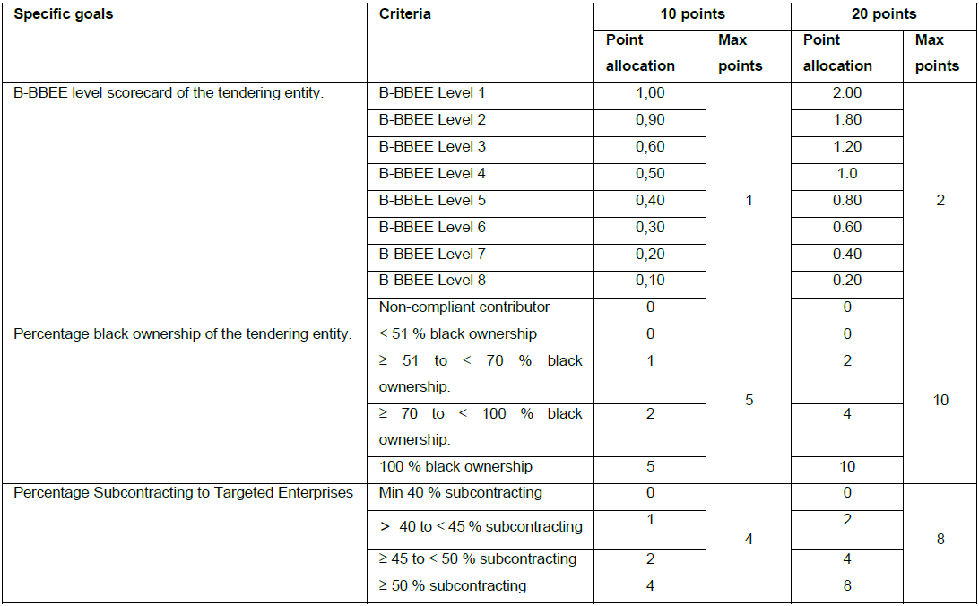
PREFERENTIAL SCORING(SPECIFIC GOALS)
Condition of Tender | Tender Data
C.3.11

Slide 41
PREFERENTIAL SCORING
Condition of Tender | Tender Data
C.3.11 | Points for specific goals will be awarded according to the table below: The tenderer’s scorecard shall be a B-BBEE Certificate issued in accordance with: the amended Construction Sector Codes published in Notice 931 of 2017 of Government Gazette No. 41287 on 1 December 2017 by the Department of Trade and Industry; or in the event that the Measured Entity operates in more than one sector or a sub-sector, the scorecard for the sector or sub-sector in which the majority of its core activities (measured in terms of annual revenue) are located will be acceptable. The tenderer must comply with the annual revenue thresholds for EME or QSE or Generic in accordance with the amended Construction Sector Codes; and The scorecard shall be submitted as a certificate attached to Returnable Schedule Form D1; and The certificate shall: be valid at the tender closing date; and have been issued by a verification agency accredited by the South African National Accreditation System (SANAS); or be in the form of a sworn affidavit or a certificate issued by the Companies and Intellectual Property Commission in the case of an Exempted Micro Enterprise (EME) with a total annual revenue of less than R1.8million if issued in accordance with the amended Construction Sector Codes published in Notice 931 of 2017 of Government Gazette No. 41287 on 1 December 2017 by the Department of Trade and Industry; and have a date of issue less than 12 (twelve) months prior to the original advertised tender closing date (see Tender Data C.2.15); and

Slide 42
PREFERENTIAL SCORING
Condition of Tender | Tender Data
C.3.11 | iii. A valid BBBEE Certificates shall contain: Name of enterprise as per enterprise registration documents issued by CIPC, and enterprise business address. Value-Added Tax number, where applicable. The B-BBEE Scorecard against which the certificate is issued, indicating all elements and scores achieved for each element. The actual score achieved must be linked to the total points as per the relevant Codes. B-BBEE status with corresponding procurement recognition level. The relevant Codes used to issue the B-BBEE verification certificate. Date of issue and expiry (e.g. 9 June 2018 to 8 June 2019). Where a measured entity was subjected to a re-verification process, due to material change, the B-BBEE Verification Certificate must reflect the initial date of issue, date of re-issue and the initial date of expiry. Re-verification does not extend the lifespan of the B-BBEE Verification Certificate. Financial period which was used to issue the B-BBEE Verification Certificate.

Slide 43
PREFERENTIAL SCORING
Condition of Tender | Tender Data
C.3.11 | iv. A valid Sworn Affidavit shall contain: - Name/s of deponent as they appear in the identity document and the identity number. - Designation of the deponent as either the director, owner or member must be indicated in order to know that person is duly authorised to depose of an affidavit. - Name of enterprise as per enterprise registration documents issued by the CIPC, where applicable, and enterprise business address. - Percentage black ownership, black female ownership and whether they fall within a designated group. - Indicate total revenue for the year under review and whether it is based on audited financial statements or management accounts. - Financial year-end as per the enterprise’s registration documents, which was used to determine the total revenue. The valid format of the Financial Year-End is Day/Month/Year - B-BBEE status level. An enterprise can only have one status level. - Date deponent signed and date of Commissioner of Oath must be the same. - Commissioner of Oath cannot be an employee or ex officio of the enterprise because, a person cannot by law, commission a sworn affidavit in which they have an interest, and

Slide 44
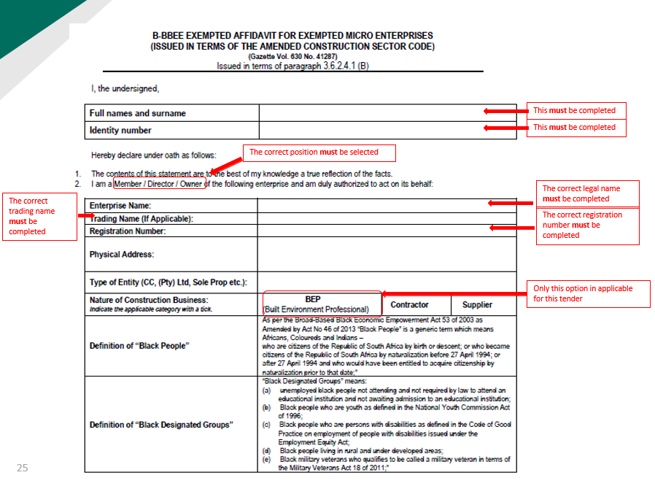

Slide 45
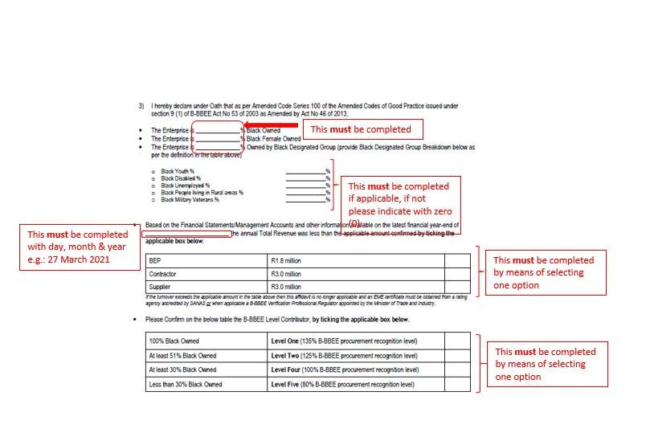

Slide 46
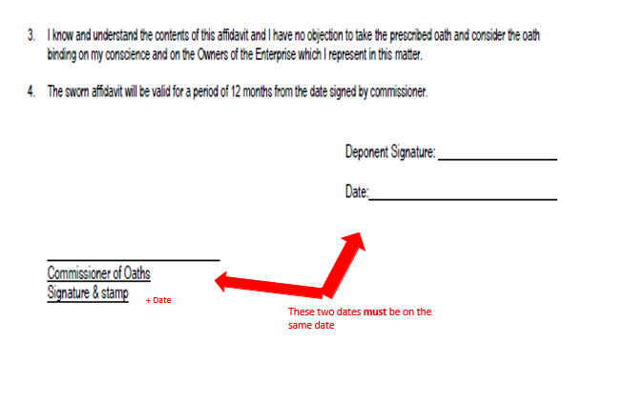

Slide 47
PREFERENTIAL SCORING
Condition of Tender | Tender Data
C.3.11 | v. Compliance with any other information requested to be attached to Returnable Schedule Form D1; and vi. In the event of a Joint Venture (JV), a project-specific consolidated (SANRAL project number indicated) valid B-BBEE verification certificate in the name of the JV, issued by a verification agency accredited by the South African National Accreditation System (SANAS) shall be submitted. 2. Black ownership The bidder must complete Form A14: Black ownership declaration. *Verification of ownership will be based on share certificate. SANRAL reserves the right to engage with the shareholders. 3 Subcontracting i) Tenderers must complete Form A15: Sub-contracting declaration. Sub-contracting If the tender documents indicate that the tenderer intends sub-contracting more than 25% of the value of the contract to any other person not qualifying for at least the status level that the tenderer qualifies for, 0 (zero) points for B-BBEE level (under Specific Goals) shall be awarded, unless the intended sub-contractor is an EME that has the capacity to execute the sub-contract.

Slide 48
ADDITIONAL CLAUSES TO CONDITIONS OF TENDER
Condition of Tender | Compliance with other Regulations
C.3.13 | Acceptance of tender offer The conditions stated in clauses C.3.13(a) to (f) of the Conditions of Tender as well as the following additional clauses C.3.13(g) to (k) shall be applied as objective criteria in terms of section 2(1)(f) of the Preferential Procurement Policy Framework Act, 2000 (Act No 5 of 2000) and as compelling and justifiable reasons not to award to the highest scoring tenderer: g) the tenderer or any of its directors is not listed on National Treasury’s Register of Tender Defaulters or Restricted Suppliers, or the Employer’s database, in terms of the Prevention and Combating of Corrupt Activities Act, 2004 (Act No 12 of 2004) as a tenderer or person prohibited from doing business with the public sector; h) the tenderer has not abused the Employer’s supply chain management system; and i) the tenderer has not failed to perform on any previous contract and has not been given a written notice to this effect. j) the tenderer is tax compliant. The recommended tenderer who becomes non-compliant, prior to award, shall be notified and must become compliant within 7 working days of the date of being notified. A recommended tenderer who remains non-compliant after the 7 working days of being notified, shall be declared non-responsive. k) the proposed Key Persons are not fully committed to the maximum number of projects in which they can participate, see Clause C3.1.11(f) in the Scope of Works In addition to the requirements in the Conditions of Tender, with regard to, where the associated risk is foreseen, in the event that a due diligence is performed as part of the tender evaluation, the due diligence report will be used to evaluate the tenderer’s ability to perform the contract as stated in sub-clause C.3.13 (b). The due diligence will evaluate the overall risk associated with the tender. The due diligence will take into consideration the following: Assessment of financial statements to assess the financial position of the tenderer and its ability to obtain the necessary guarantees or insurances; Integrity risk evaluation; Operations, activities, locations and key customers; Reference checks from previous clients; and Risk rating (i.e. high risk, medium to high risk, medium risk or low risk) of the tenderer.

Slide 49
TENDER DATA
Clause Number | Tender Data
2.18 | Any additional information requested under this clause must be provided within 5 (five) working days of date of request.
C2.16.1 | The tender offer validity period is 180 days.
C.3.1.1 | The Employer shall respond to clarifications received up to 12 (twelve) working days before the tender closing date. The Employer shall respond to any clarifications from the tenderers emanating from the addenda until 3 working days before the tender closing date.
C.3.2 | The Employer shall issue addenda until 10 (ten) working days before tender closing date.
3.7 | “The Employer shall inform the tenderer and give the tenderer an opportunity to make representations within 14 days as to why the tender submitted should not be disqualified and as to why the tenderer should not be restricted by the National Treasury from conducting any business with any organ of state for a period not exceeding 10 years.”
C.3.8.2 | The Employer will cancel a tender should all tenders be non-responsive and no negotiations will be conducted.

Slide 50
PART T2: RETURNABLE SCHEDULES

Slide 51
RETURNABLE SCHEDULES
Notes to tenderer:
The table in the three next slides is to aid tenderers in completing the returnable forms and schedules and subsequent placement in the correct envelope. The first two are for a technical submission and the third is for a financial.
The electronic format for the submissions of the relevant forms is indicated in the schedule.
Also note all the “Notes to the Tenderer” in the Forms (A1-A15) and Forms (B1-B8) in the Tender Document.
NOTES:
*1- SCHEDULES/DOCUMENTS REQUIRED FOR TENDER EVALUATION PURPOSES
*2- SCHEDULES/DOCUMENTS THAT WILL BE INCORPORATED INTO THE CONTRACT

Slide 52
RETURNABLE SCHEDULES
Notes to tenderer (T2.1):
1. Returnable schedules have been based on the CIDB Standard for Uniformity in Construction Procurement and incorporates National Treasury requirements within them. Returnable schedules are separated into the following categories:
i)Forms, certificates and schedules for completion by the tenderer for use in the quantitative and qualitative evaluation of the tender (Forms A, B, C and D).
ii)A list of other returnable documents for completion by the tenderer and which will subsequently be incorporated into the contract (Section C1).
2. Failure to fully complete the relevant returnable documents shall render such a tender offer to be declared non-responsive.
3. Tenderers shall note that their signatures appended to each returnable form represents a declaration that they vouch for the accuracy and correctness of the information provided, including the information provided by candidates proposed for the specified key positions.
4. Notwithstanding any check or audit conducted by or on behalf of the Employer, the information provided in the returnable documents is accepted in good faith and as justification for entering into a contract with a tenderer. If subsequently any information is found to be incorrect such discovery shall be taken as wilful misrepresentation by that tenderer to induce the contract. In such event, the Employer has the discretionary right under contract condition 8.4 to terminate the contract.

Slide 53
RETURNABLE SCHEDULES –TECHNICAL ENVELOPE
FORM NO | ELEC­TRONIC FORMAT | FORM DESCRIPTION | INITIAL if completed | envelope
A1 | pdf | certificate of CONFIRMATION THAT THE TENDERER READ THE PRESENTATION | *1 | TECHNICAL PROPOSAL (1St Envelope)
A1.1 | PDf | CERTIFICATE OF INTENTION TO SUBMIT A TENDER | *1
a2.1 | pdf | certificate of authority for signatory | *1
A2.2 | PDF | declaration of tenderer’s current status of any debt outstanding to SANRAL | *1 & *2
A2.3 | PDF | CERTIFICATE OF SINGLE TENDER SUBMISSION | *1 & *2
A2.4 | PDF | CERTIFICATE OF FRONTING PRACTICES | *1 & *2
A2.5 | PDF | DECLARATION – MANAGEMENT OF PROMINENT INFLUENTIAL PERSONS | *1 & *2
A2.6 | PDF | CERTIFICATE OF PERMISSION TO CONDUCT DUE DILIGENCE INVESTIGATION | *1 & *2
A2.7 | PDF | DECLARATION OF independent TECHNOLOGY-BASED INTELLECTUAL SERVICE PROVIDER | *1 & *2
A3.1 | PDF | compulsory declaration: BIDDER’S DISCLOSURE | *1 & *2
A3.2/ SBD9 | PDF | CERTIFICATE OF INDEPENDENT TENDER – REPEALED | *1 & *2
A3.3/ SBD8 | PDF | DECLARATION OF TENDERER’S PAST SUPPLY CHAIN MANAGEMENT PRACTICES - REPLACED | *1 & *2
A3.4 | PDF | registration on national treasury central supplier database | *1 & *2
a4 | pdf | SCHEDULE OF DEVIATIONS OR QUALIFICATIONS BY TENDERER | *1 & *2
a5 | pdf | SCHEDULE OF ADDENDA TO TENDER DOCUMENTS | *1
A6/ SBD2 | pdf | CERTIFICATES OF TAX COMPLIANCE | *1
A7 | pdf | CERTIFICATE OF INSURANCE COVER | *1
A8 | pdf | TENDERER’S REGISTERED FINANCIAL SERVICE PROVIDER LETTER AND BANK DETAILS | *1
A9 | pdf | DECLARATION OF TENDERER’S LITIGATION HISTORY | *1
A10 | pdf | SCHEDULE OF CURRENT COMMITMENTS | *1
A11 | pdf | POSSIBLE COMMITMENTS OF KEY PERSON | *1
a12 | pdf | CERTIFICATE OF COMPLIANCE WITH OCCUPATIONAL HEALTH AND SAFETY ACT, 1993 AND CONSTRUCTION REGULATIONS, 2014 AS WELL AS COID ACT, 1993 | *1
A13/ SBD1 | pdf | INVITATION TO BID AND TERMS AND CONDITIONS FOR BIDDING | *1 & *2
A14: | PDF | BLACK OWNERSHIP DECLARATION - NEW FORM | *1
A15 | PDF | FORM A15: SUB-CONTRACTING DECLARATION - NEW FORM | *1

Slide 54
RETURNABLE SCHEDULES –TECHNICAL ENVELOPE (Cont..)
FORM NO | ELEC­TRONIC FORMAT | FORM DESCRIPTION | INITIAL if completed | envelope
B1.1 | MS EXCEL | KEY PERSON’S TECHNICAL/MANAGERIAL RECORD | *1 | TECHNICAL PROPOSAL (1St Envelope)
b1.2 | MS excel | alternate key person’s technical/managerial record | *1
B2.1 | MS EXCEL | KEY PERSON’S QUALIFICATION AND REGISTRATION RECORD | *1
b2.2 | MS excel | alternate key person’s qualification and registration record | *1
B3 | MS EXCEL | TENDERER’S PROJECT STRUCTURE | *1
B4 | PDF | CERTIFICATE OF QUALITY SYSTEMS | *1
B5 | pdf | PRELIMINARY PROGRAMME (INCLUDING UNDERSTANDING AND APPROACH) | *1
B6 | PDF | PAST PERFORMANCE PROJECT REPORTS | *1
B7 | pdf | TARGETED ENTERPRISE/SUB-CONTRACTOR DETAILS AND DECLARATION(where applicable) | *1 & *2
b8 | pdf | joint venture agreement | *1&*2
c2.4 | pdf | KEY PERSONS FOR THIS PROJECT AND SUMMARY OF NORMALISED HOURS TENDERED | *1
D1/ SBD 6.1 | PDF | tenderer’s B-Bbee VERIFICATION CERTIFICATE PREFERENCE POINTS CLAIM FORM IN TERMS OF THE PREFERENTIAL PROCUREMENT REGULATIONS 2022 (SBD 6.1) | *1 & *2

Slide 55
RETURNABLE SCHEDULES – FINANCIAL ENVELOPE
FORM NO | ELEC­TRONIC FORMAT | FORM DESCRIPTION | INITIAL if cOM­PLETED | envelope
c1.1.1/SBD7 | pdf | FORM OF OFFER | *2 | FINANCIAL PROPOSAL (2nd Envelope)
C1.2.3 | pdf | CONTRACT DATA – INFORMATION PROVIDED BY THE TENDERER | *2
C2.2/ SBD3 | MS EXCEL | PRICING SCHEDULE | *1 & *2
c2.3 | MS EXCEL | SUMMARY OF PRICING SCHEDULE | *1 & *2
C2.4 | MS EXCEL | KEY PERSONS FOR THIS PROJECT AND SUMMARY OF NORMALISED HOURS TENDERED | *1 & *2

Slide 56
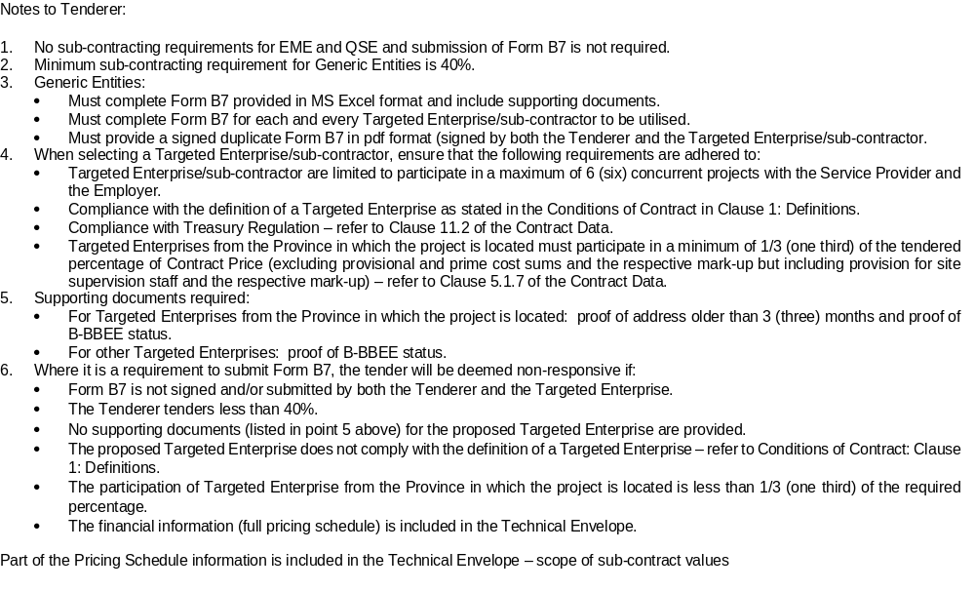
FORM B7: TARGETED ENTERPRISE/SUB-CONTRACTOR DETAILS AND DECLARATION

Slide 57
PART C1:
AGREEMENTS AND CONTRACT DATA

Slide 58
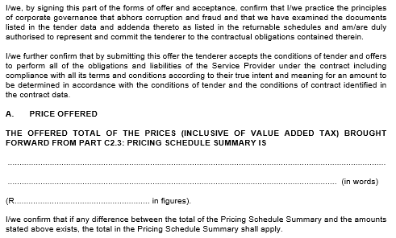
C1.1.1 FORM OF OFFER
(Incorporating SBD7)

Slide 59
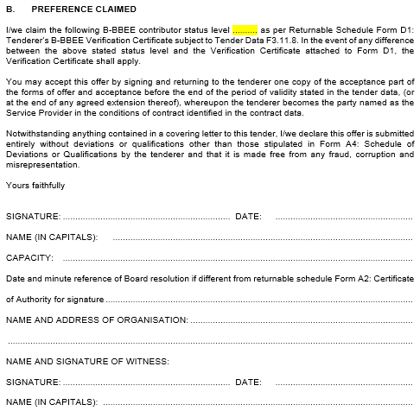

C1.1.1 FORM OF OFFER
(Incorporating SBD7)

Slide 60
Notes to tenderer:
Should a tenderer wish to offer a different period of completion than that specified by the Employer, it shall be submitted as an alternative offer on a separate Form of Offer.
If more than one alternative tender is submitted each shall be numbered
and submitted on a separate Form of Offer duly completed and signed.

Slide 61
C1.2.1 CONDITIONS OF CONTRACT
8.4 Termination
8.4.1 The Employer may in addition to his rights under sub-clauses 6.4.2, 6.4.3 and 10.5 terminate the Contract by giving not less than thirty (30) days written notice thereof to the Service Provider after the occurrence of any of the following events:
(a) if the Service Provider does not remedy a failure in the performance of his obligations under the Contract within thirty (30) days after having been notified thereof, or within any further period as the Employer may have subsequently approved in writing;
  (b) if the Service Provider becomes insolvent or bankrupt;
(c) if, as the result of Force Majeure, the Service Provider is unable to perform a material portion of the Services for a period of not less than sixty (60) days;
  Committing an offence in terms of clauses 6.1 and/or 6.4;
  if the Service Provider acts in such a way, under this contract or any other contract with the Employer, that a statute relating to the combating of fraud, corruption, uncompetitive practice and the like can be invoked; or
  if the Employer, at any time in its sole discretion determines that it no longer requires the completion of the Service by the Service Provider.”

Slide 62
PART C2: PRICING DATA

Slide 63
EXCEL SPREADSHEET ON THE WEBSITE
C2.1.8 Provisional and Prime Cost Sums: Each sum shall only be used, in whole or in part, in accordance with the Employer’s instructions and the Contract Price shall be adjusted accordingly. The total sum paid to the Service Provider shall include only such amounts, for the work, supplies or services to which the sum relates, as the Employer shall have instructed.
For each sum, the Employer may instruct plant, materials or services to be procured by the Service Provider in accordance with the Employer’s policies, and for which there shall be included in the Contract Price:
    The actual amounts paid (or due to be paid) by the Service Provider under the Sum; and
An item for compilation and printing of procurement documentation, quotation/tender process and evaluation, and all overhead charges and profit, tendered in the Pricing Schedule. Provided that for Prime Cost sums only where a percentage mark-up or lump sum mark-up is tendered, which shall exclude profit.
The Service Provider shall produce all quotations, invoices, vouchers and accounts or receipts in substantiation of any claim under a sum.
Any percentage adjustment or lump sum mark-up against the sum for handling fee, profits, etc. shall not be negative. The tendering of negative rates may render the tender offer non-responsive.
Sheets are password protected – don’t fiddle!

Slide 64
PART C3: SCOPE OF WORKS

Slide 65
SCOPE OF WORKS
C3.1.2 Location of the Project
The proposed project is located on National Road N17 Section 4 from Bethal CBD (km 0.0) to (km 3.2).
A locality plan including details of the construction history and existing pavement structure along this portion of the route are available in SARDS (South African Road Design System) online.
A user manual is included in Appendix M in Part C4 of this document.

Slide 66
SCOPE OF WORKS
Required project stages:
Project Assessment.
Investigations for Design Development.
Design Development which shall include the following phases:
  Preliminary Design
  Detailed design
Tender Documentation.
Clarification Meeting, Tender Period and Tender Evaluation.
Administration and Monitoring of the Works Contract.
Additional duties, Special Services and Specialist Advice.
Quality Control: Works Contract.
Close Out.
(REFER TO PART C3 & C4 FOR DETAILED SCOPE)

Slide 67
SCOPE OF WORKS
C3.1.5 Employer’s Cost Estimate
Current budget for the Works is based on Development Strengthening Reconstruction Partial Reconstruction (DSCPR)
The estimated costs of the different construction work types with a construction start date of February 2026 are provided below:
Road works: R 74 200 000
(EST) Total project value (excluding contingencies, CPA during the construction period and VAT)

Slide 68
Part C4: PROJECT INFORMATION

Slide 69
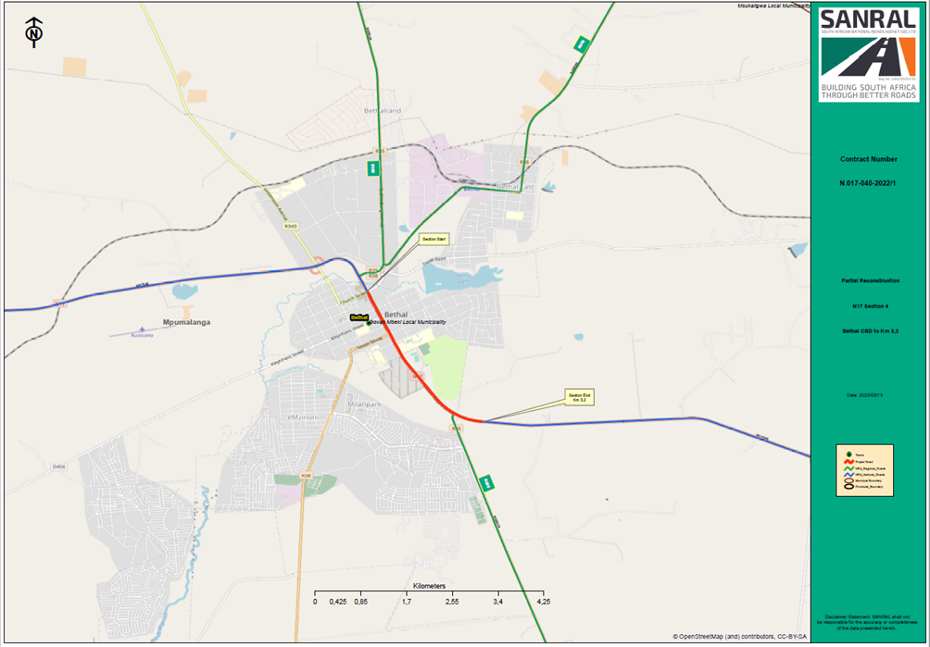
LOCALITY MAP
This project is in the province of Mpumalanga and in the district municipality of Gert Sibande District/Govan Mbeki Local Municipality

Slide 70
DESCRIPTION OF THE PROJECT
The Employer’s AMS currently indicates that the full length and width of the existing pavement requires strengthening/rehabilitation and/or the addition of new pavement layers, followed by an appropriate surfacing.
The surfacing solution therefore will have to consider current and future traffic, surface texture requirements, design life/structural capacity. An appropriate surfacing option will therefore have to be investigated, motivated, and proposed as a solution

Slide 71
SCOPE OF WORKS
The scope of the works is foreseen to be as indicated below. The service provider will however have to confirm and further refine the scope through the services to be performed under this Contract.
Traffic/Transport
Perform a detailed traffic/transport analysis study to incorporate at least the following:
Determine the current traffic patterns and composition along the entire road section and provide forecasts for a 20-year design horizon.
Determine the current public transport operations and assess future public transport infrastructure needs.
Determine current Non-Motorised Transport (NMT) activities along the road section and determine future NMT infrastructure needs with appropriate Universal Access were feasible.
Undertake the capacity analysis (LOS) along the road section using the Highway Traffic Model (HTM) for the current and design year.
Undertake the capacity analysis of formal intersections taking cognisance of access management requirements.
Determine if the road section is part of an Abnormal/Super Load route and consider any abnormal vehicle geometric design requirements

Slide 72
SCOPE OF WORKS
Geometrics
      Upgrade of existing intersection and providing pedestrian safety facilities including providing public transport facilities
      Is the road section part of the Abnormal/Super Loads route, if yes this must be considered in the geometric design requirements.
      Assess cross fall/camber on existing roadway and need for modification,
      Where required, develop an access management plan with the aim of consolidating accesses to acceptable standards and close illegal and or unsafe accesses. This includes review of the number, location, and type of farm accesses.
Drainage
      Check capacity of drainage structures as well as road surface to handle storm water.
      Address issues where capacity does not compare to standards.
      Provide appropriate subsoil and surface drainage system.
      Do a visual assessment of all structures.
      Determine compliance with standards with respect to hydraulic capacity, geometrics etc;
      Determine whether structures need to make provision for Non-Motorised (NMT);
      Widening of structures where required for capacity improvements.
      Rehabilitation of structures where required.
      Carry out post rehabilitation/ construction Inspections with purpose of loading new data into SANRAL’s ITIS system;

Slide 73
SCOPE OF WORKS
Pavement
Identify required pavement capacity for design life.
Determine condition and capacity of existing pavement.
Determine pavement rehabilitation/ strengthening /reconstruction and/or new pavement required, utilising the existing capacity optimally.
Provide options for flexible and rigid pavements.
Provide surfacing options; and
Provide pavement design life strategy, e.g., maintenance actions over design life.
Material Investigation and Utilisation
      Identify material sources required;
      Optimise the utilisation of project identified borrow pits/ hard rock quarries vs commercial material sources for earthworks and pavement layers;
      Where applicable, provide a Mass Haul Plan/Diagram;
      Provide information on commercial sources:
  Contact details
  Types of material available
  Compliance of the material with the specifications.
  Alternative mining waste material if available
      Identify potential water sources for construction purposes;
      The possibility of using alternative material from Mine waste dumps, Tailings and or other
      recycled materials should be explored. This will entail liaison/negotiating with Mining companies or other land-owners.

Slide 74
SCOPE OF WORKS
Ancillary Works
Assess and address road safety issues;
Provide for adequate fencing and guardrails where required;
Provide for appropriate roads signs and road markings
Traffic Accommodation
Traffic accommodation to be optimised to ensure the greatest possible mobility along the route.
Provide accommodation of traffic options taking into account traffic volumes, peak hour traffic, requirements of the Employer, etc.
Services
Investigate and identify the services that will be affected by the project. These could include amongst others: (Telkom, Eskom, ICT fibre optic cables, Farmer irrigation pipes/Canals)
Determine the existence of current wayleaves of affected service/s and obtain copies thereof;
Determine the entity responsible for the relocation and the cost thereof;
Where the Employer has no wayleave for the service, the Service Provider must complete a wayleave application on behalf of the service owner to the Employer.

Slide 75
SCOPE OF WORKS
Electrical
Assess the need to replace/upgrade the existing non-functional streetlights and install new streetlights
Environmental
The Service Provider shall manage the procurement of the sub-service providers, participate in the processes, and provide the required information
Other
Identify and report on any glaring obvious aspect/item/element of the road that may require some form of action.

Slide 76
COMMON ERRORS
IN TENDER SUBMISSIONS

Slide 77
COMMON ERRORS ON TENDER SUBMISSIONS
Empty Flash drive submitted.
2. B-BBEE certificate issued by an Agency not accredited by SANAS or Commission for Intellectual Property Companies
3. B-BBEE certificate/ Sworn Affidavit issued based on Old Codes and not Amended Sector Codes- BEP
4. Sworn Affidavit not dated by the Commissioner. This invalidates the affidavit as the validity is based on the date signed by the Commissioner, not the certification date
5. Sworn Affidavit without the latest financial year or with an old financial year, and month
6. Not submitting other required documents that will make the company compliant for the particular project e.g., COIDA, A8 information etc.
7. Submitting a proposal consisting of only a financial offer (depending on the requirements of a project)
8. Mixing/ Swapping the A-form with the Financials (Bills of Quantities especially when there are various projects closing at once).
Blank/corrupt Flash drive.

Slide 78
COMMON ERRORS ON TENDER SUBMISSIONS
Financial Submission
- Form C1.1.1 - Form of Offer; and
- Form C2.3 - Summary of Pricing Schedule.
1. No Form of Offer and Summary of Pricing schedule in the Financial folder.
2. Scanned forms saved in separate folders – rather combine into one file.
3. Separate scorecards for JV submissions (Score ZERO for preference).
Incorrect project codes.
Do not ZIP files to the Flash Drive. Do not PASSWORD PROTECT files to the Flash drive.
Check the contents of your Flash drive before you submit your tender.

Slide 79
SUCCESSFUL TENDER TIPS
When using a courier company, ensure that the delivery to SANRAL is before the specified closing time. The courier MUST complete the correct register using your company name and not their courier company name.
Tender documents must be submitted electronically on a flash drive. (In the relevant MS Word 2013 and MS Excel 2013 format as issued, and not in .pdf format, except where so specified).
The tenderer is required to upload all certificates as listed in the List of Returnable Schedules as scanned copies, in .pdf format, on the flash drive.

Slide 80
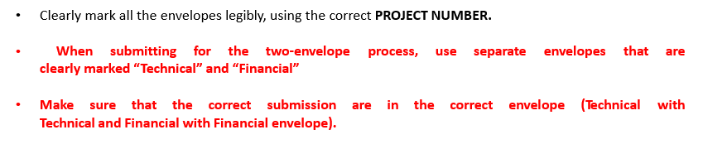
SUCCESSFUL TENDER TIPS

Slide 81
THANK YOU
SANRAL web address: www.nra.co.za
SANRAL Fraud Hotline: 0800 204 558

