Slide 1

FOR THE RENOVATIONS TO MARINE SERVICES MESS AND ABLUTION REFURBISHMENT BUILDING AT POINT PRECINCT
TENDER CLARIFICATION MEETING
28 AUGUST 2025
10H00
Notes:
Growth and Reinvent

Slide 2
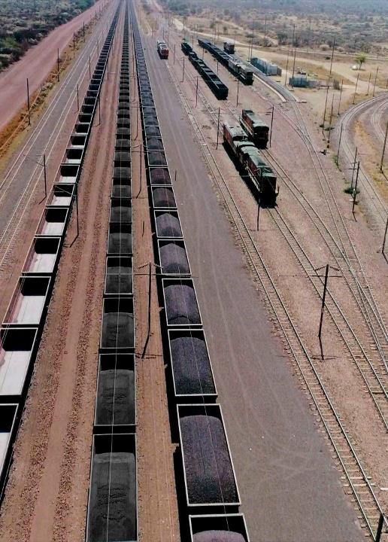
Contents
Agenda
01 | Welcome
02 | Introduction and Agenda
03 | Safety Briefing and Evacuation Procedure
04 | Project Overview
05 | Commercial Presentation
06 | Enterprise Supplier Development
07 | Technical Presentation
08 | Question and Answer
2

Slide 3
Project Background- Nokusa

Slide 4
PROJECT BACKGROUND
The works that the Contractor is to perform involve refurbishment of the existing marine building Mess and Ablution at the Port of Durban. The primary purpose of this document is to outline the scope of services and deliverables that Transnet National Ports Authority (TNPA) will require of a Principal Contractor with necessary experience and expertise to conduct repairs and renovations with no disruption to operations in Port of Durban.
The Employer’s objectives are, The Employer, Transnet National Ports Authority, requires the Work comprising the maintenance of renovations or maintenance of Marine Services Building at Point precinct in the Port of Durban. The Employer intends to appoint a Contractor to provide maintenance as per Employer‘s specifications.

Slide 5
Commercial- Hlengiwe

Slide 6
COMMERCIAL REQUIREMENTS
PLEASE GO TO NATIONAL TREASURY eTENDER PUBLICATION PORTAL AT www.etenders.gov.za and the Transnet website at https://transnetetenders.azurewebsites.net TO DOWNLOAD ALL PDF’S
CLARIFICATION REGISTERS
ADDENDUMS

Slide 7
TENDERING PROCEDURES
All communications whether general, commercial or technical to go via the Procurement
Department, HLENGIWE DLAMINI in writing.
Email – TNPAtenderenquiriesdbn@transnet.net
All communication will be sent via a clarification register and will be e-mailed to all attendees of this clarification meeting and posted on the Transnet Portal.
Please complete the attendance register and ensure that the contact details are correctly recorded (as these contact details will be used to issue all clarifications and addendums).
Last day for Clarification – Five working days before the closing date (08 September 2025, 16:00).
Electronic Tenders Documents must be legible.

Slide 8
TENDERING PROCEDURES (Continued)
TENDERING PROCEDURES
Tender closing date: 16 September 2025 at 14h00 via the new electronic tender submission system, the e-Tender Submission Portal
“HOW TO” GUIDE FOR BIDDERS IS INCLUDED IN THE TENDER (ALLOW TIME)
Tenderers are required to ensure that electronic bid submissions are done at least a day before the closing date to prevent issues which they may encounter
NO LATE TENDERS WILL BE CONSIDERED

Slide 9
TENDERING PROCEDURES (Eligibility Criteria)
Stage One - Eligibility with regards to Test for Administrative and substantive Responsiveness
Stage Two – Eligibility with regards to attendance at the clarification meeting
Ensure your Clarification Meeting Returnable is signed today and returned with your tender.
Stage Three – CIDB Registration 4GB or higher or 4CE or higher class of construction work
Account to be “Active”

Slide 10
TENDERING PROCEDURES (Eligibility Criteria Continued)
The tenderer is required to submit all documents as stated in C.2.23 of the tender data and the
tender offer will only be accepted if the tenderer complies with C3.13 of the tender data such as:
A valid Tax Clearance Certificate issued by the South African Revenue Services. Tenderers also to provide Transnet with a TCS PIN to verify Tenderers compliance status.
A valid B-BBEE Certificate from a Verification Agency accredited by the South African Accreditation System [SANAS], or sworn affidavit confirming annual turnover and level of black ownership in case of all EMEs and QSEs with 51% black ownership or more together with the tender;
A valid CIDB certificate in the correct designated grading;
Proof of registration on the Central Supplier Database
Letter of Good Standing with the Workmen’s compensation fund by the tendering entity or separate Letters of Good Standing from all members of a newly constituted JV.

Slide 11
CONTRACT DATA
NEC 3 ECC
Main Option B – Priced Contract with Bill of Quantities
Secondary Clauses
  X2: Changes in the law
  X7: Delay damages: R1 660.00 per day
  X16: Retention = 10% on certified payments
  X18: Limitation of liability
  Z: Additional conditions of contract

Slide 12
Enterprise & Supplier Development- (Specific Goals)
Salathiso

Slide 13
TRANSNET PREFERENTIAL PROCUREMENT POLICY SPECIFIC GOALS
The following preference points must be awarded to a bidder who provides the relevant required evidence for claiming points:
The following specific goals will apply for this transaction.
Specific Goals | Number of points (80/20 system) | Number of points (90/10 system)
B-BBEE Status Level of Contributor 1 or 2 | 05 | 02
30% Black women Owned entities | 05 | 03
EME or QSE 51% Black Owned Entities | 10 | 05
Non-Compliant and/or B-BBEE Level 3-8 contributors | 00 | 00

Slide 14
EVIDENCE REQUIRED FOR CLAIMING SPECIFIC GOALS
In terms of Transnet Preferential Procurement Policy (TPPP) and Procurement Manuals, preference points must be awarded to a bidder for providing evidence in accordance with the table below:
Specific Goals | Acceptable Evidence
B-BBEE Status Level of Contributor 1 or 2 | (1) B-BBEE Certificate / Sworn - Affidavit / B-BBEE CIPC Certificate (in case of JV, a consolidated scorecard will be accepted) as per DTIC guideline
30% Black women Owned entities | (1) B-BBEE Certificate / Sworn-Affidavit / B B-BBEE CIPC Certificate (in case of JV, a consolidated B-BBEE scorecard will be accepted) as per DTIC guideline. (2) Certified copy of ID Documents of the Owners.
EME or QSE 51% Black Owned Entities | Audited Annual Financial. B-BBEE Certificate/Sworn- Affidavit / CIPC B-BBEE Certificate
Note: Tenderers who fail to submit acceptable evidence for specific goals applicable in will be allocated zero (0) preference points.

Slide 15
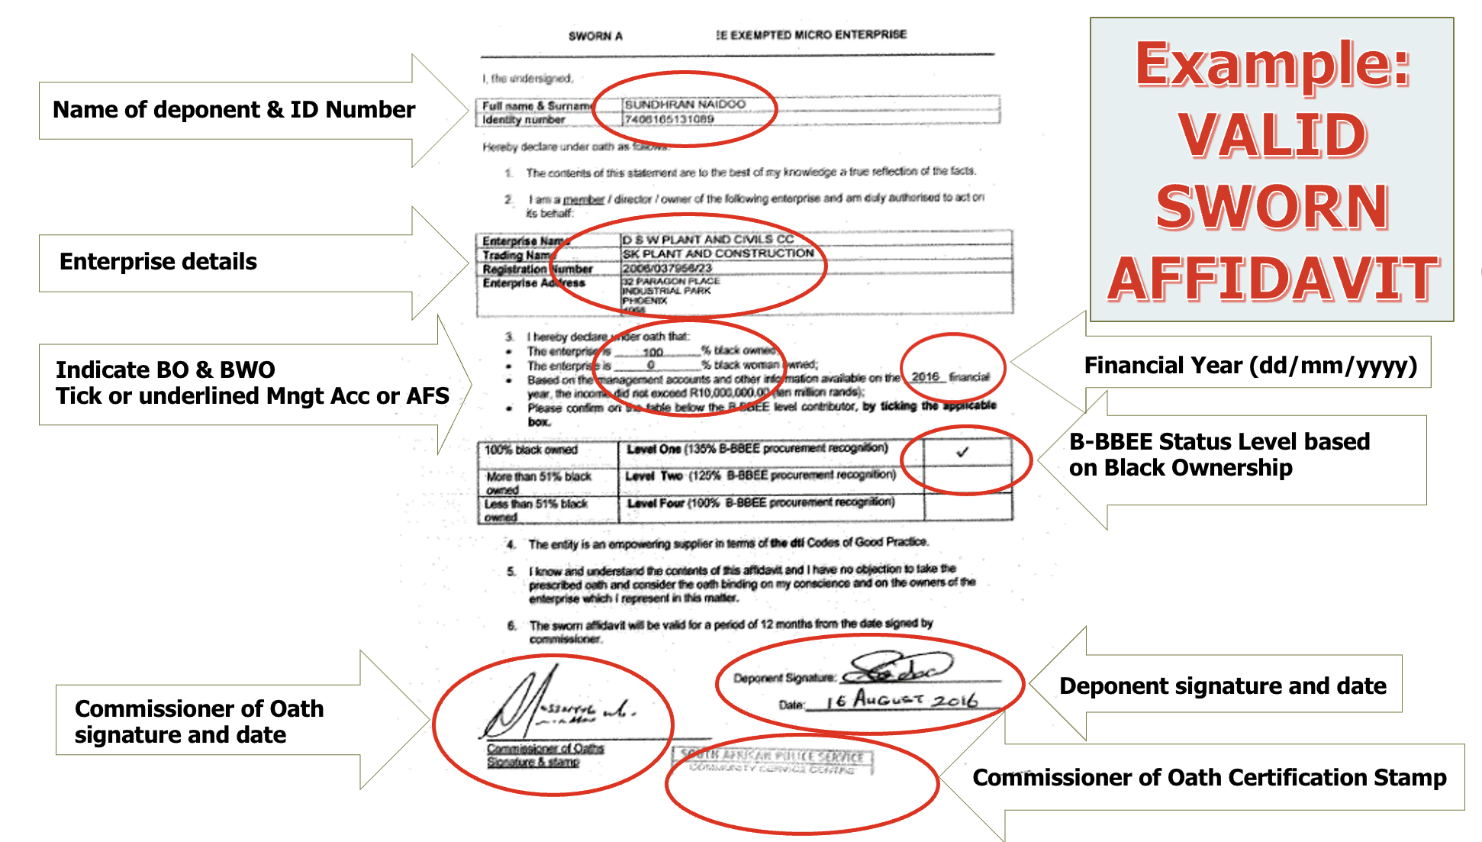
VALID B-BBEE SWORN AFFIDAVIT

Slide 16
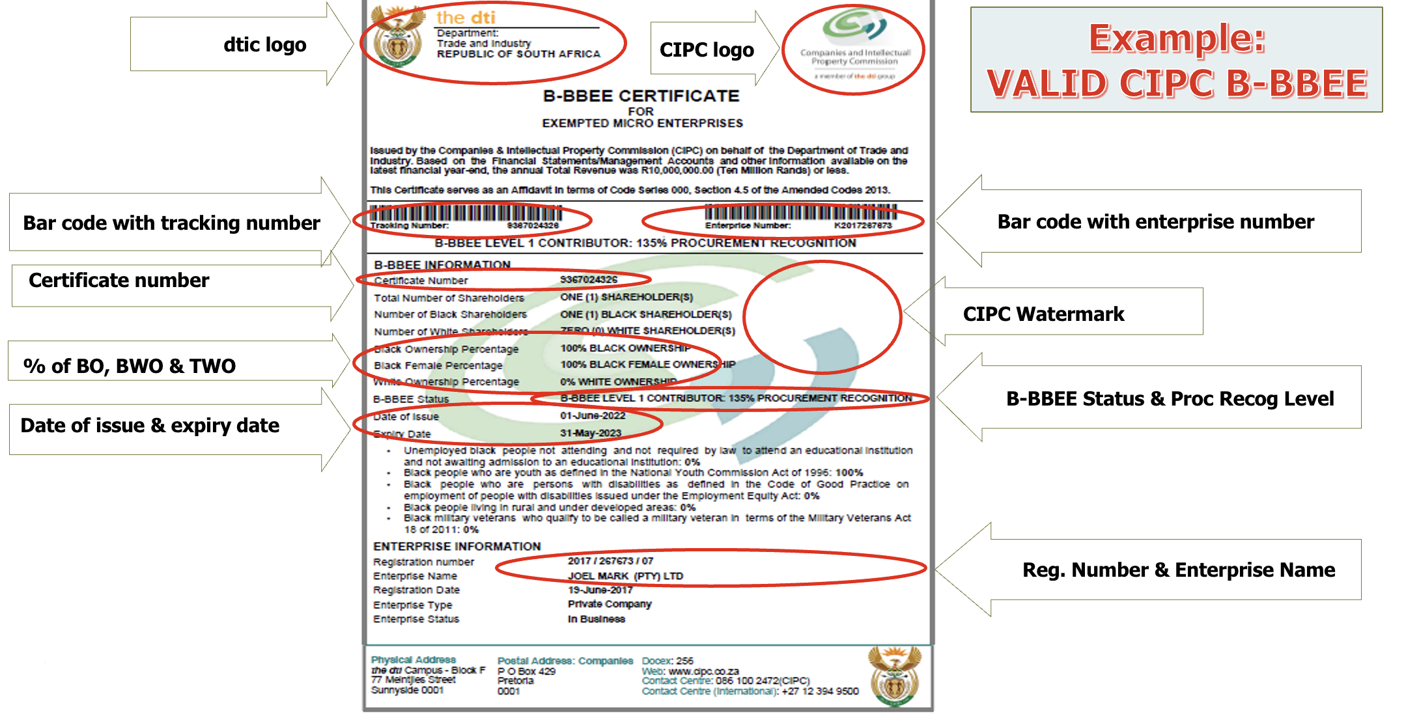
VALID CIPC B-BBEE CERTIFICATE

Slide 17
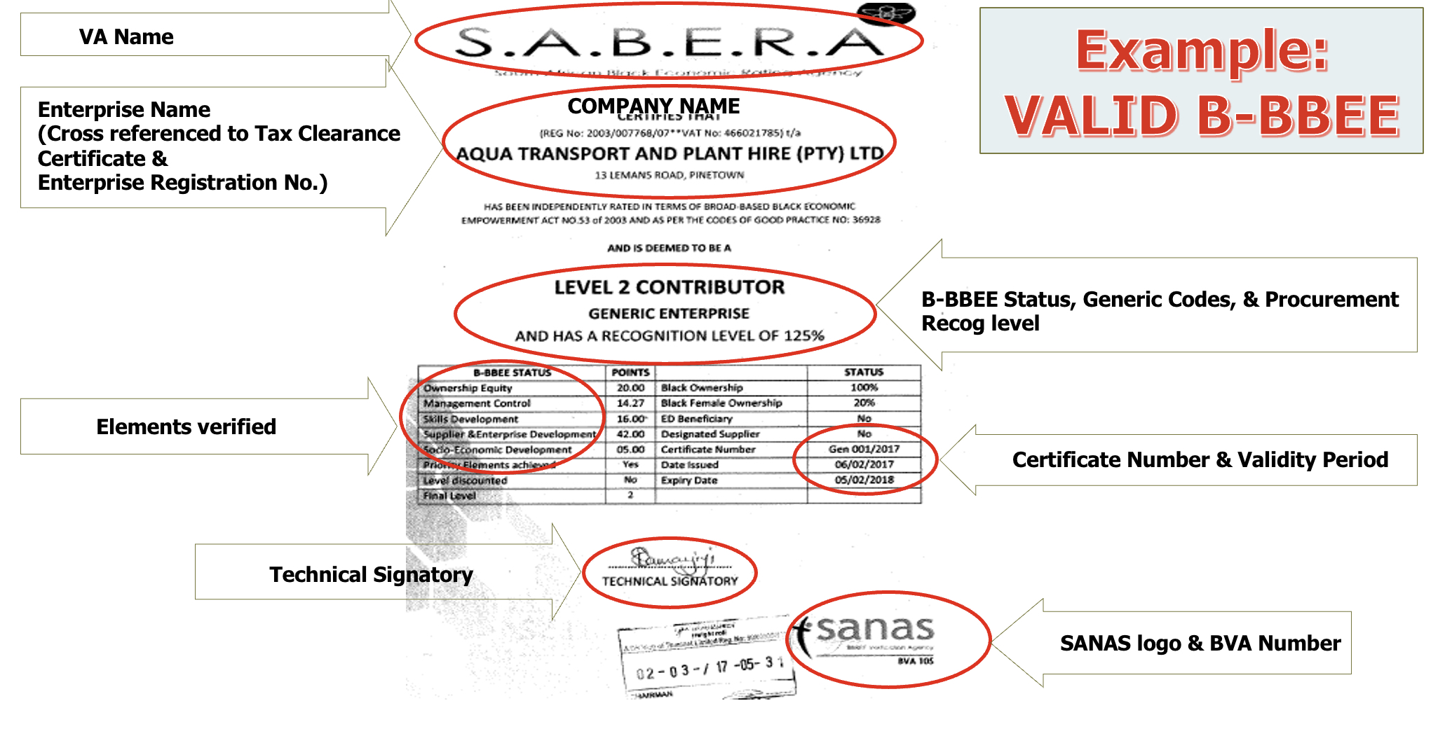
VALID B-BBEE CERTIFICATE

Slide 18
Technical Presentation - Nokusa

Slide 19
SCOPE OF WORK
The overview of the scope entails, but not limited to:
Employer’s Objectives:
The Employer’s objectives are, The Employer, Transnet National Ports Authority, requires the Work comprising the maintenance of renovations or maintenance of Marine Services Building at Point precinct in the Port of Durban. The Employer intends to appoint a Contractor to provide maintenance as per Employer‘s specifications.
Details as per C3 Works information.

Slide 20
Thank you

