Slide 1
Contract SANRAL N.002-223-2020/1
For the Operations and Maintenance of the N2 South Coast Toll Plazas
2 February 2023 at 14:00

Slide 2

Agenda
Description of the project
Scope of work
Programme
Tender
Plaza visits
Housekeeping
Questions

Slide 3
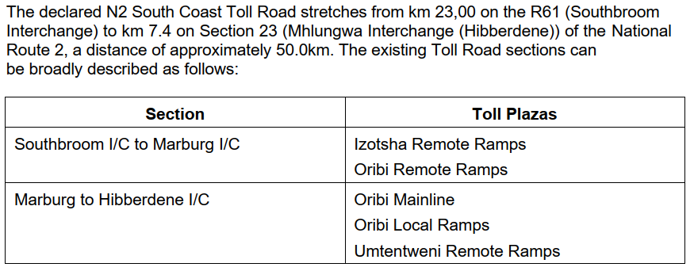
1. Description of the project
N2 South Coast Toll Road

Slide 4
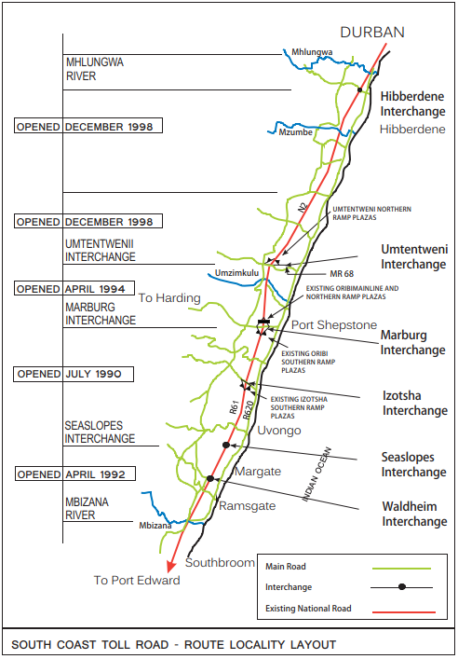
1. Description of the project

Slide 5
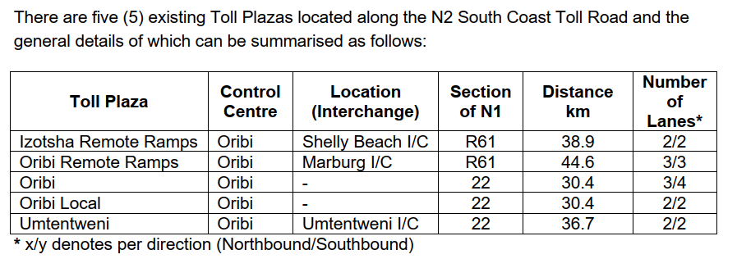
1. Description of the project
Toll plazas

Slide 6
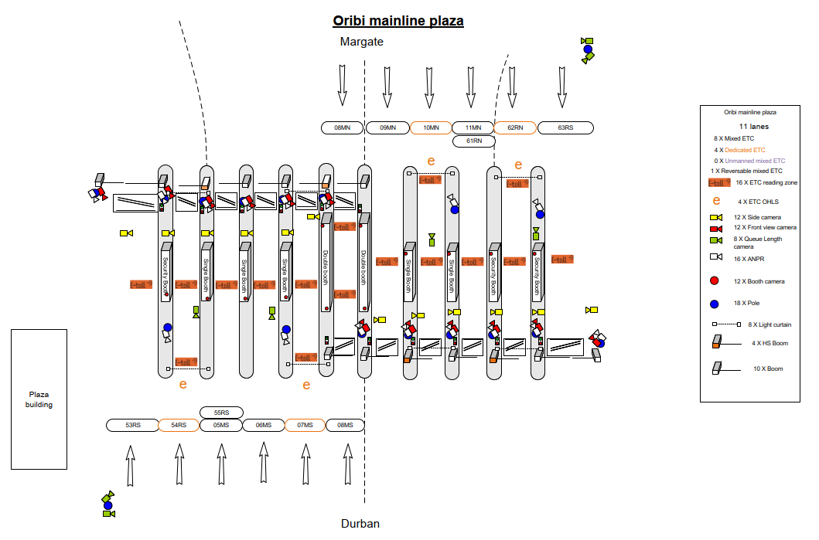
1. Description of the project
Toll plaza lane layouts (future) (Oribi mainline and local ramps)

Slide 7
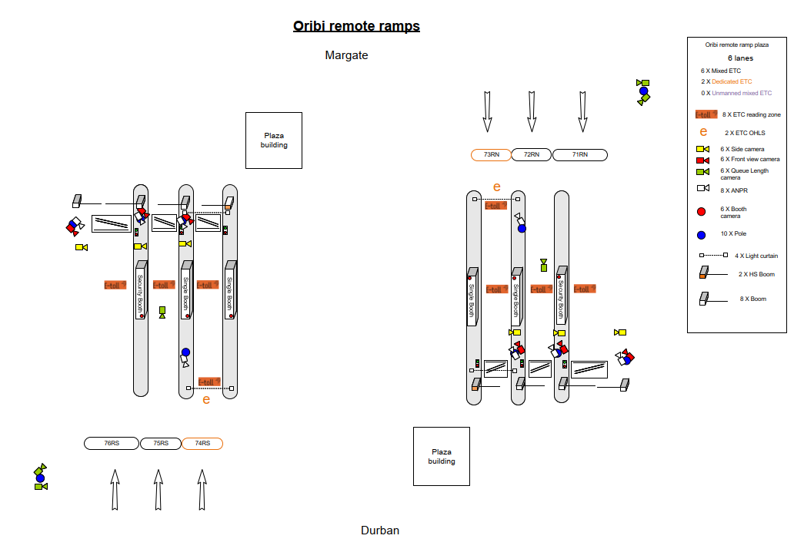
1. Description of the project
Toll plaza lane layouts (future) (Oribi remote ramps)

Slide 8
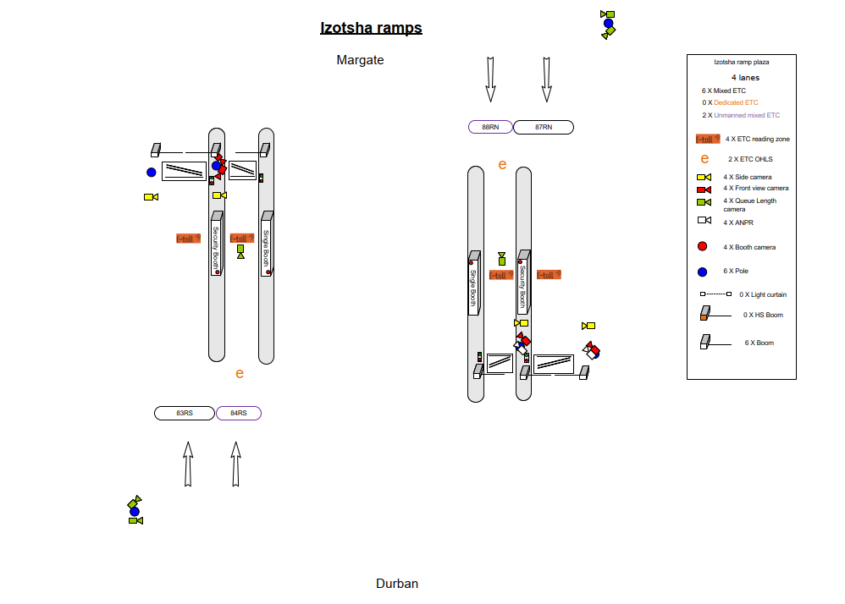
1. Description of the project
Toll plaza lane layouts (future) (Izotsha ramps)

Slide 9
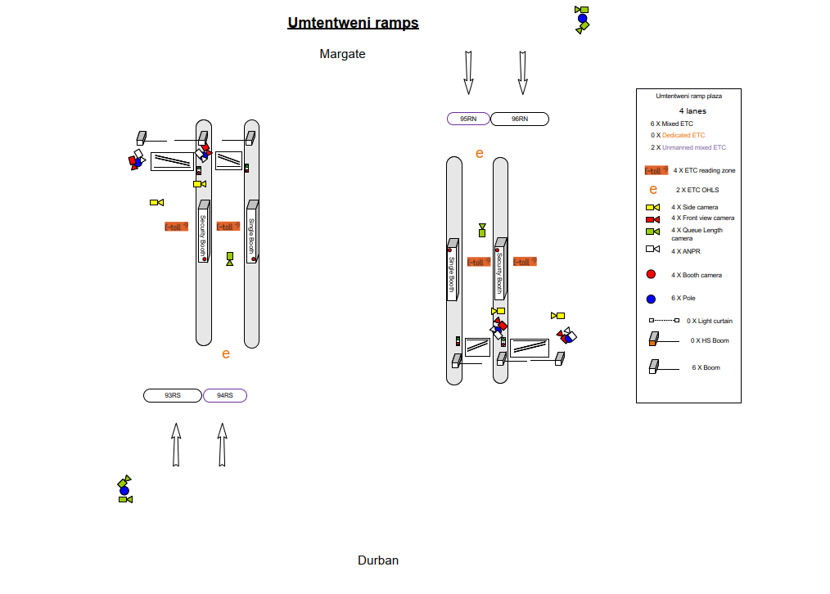
1. Description of the project
Toll plaza lane layouts (future) (Umtentweni ramps)

Slide 10
2. Scope of work
General
Toll Plaza Operations (Collection and control of toll, Traffic management and Financial management)
Mentoring of Targeted Enterprise (New Entrant)
Management of Nominated Subcontractor (NSC)
Continuation with current toll system
Assets
  Provision, installation and maintenance of Employer’s Facilities and Permanent DB
  Provide and maintain Contractor’s Facilities and equipment
Participation in RIMS
Provision of route patrols and customer call centre services

Slide 11
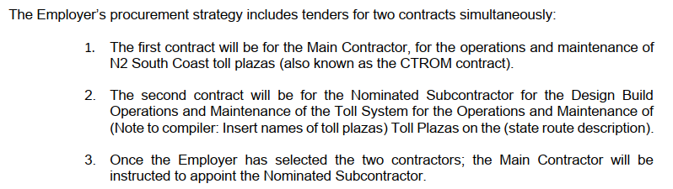
2. Scope of work
Associated contracts and terminology

Slide 12
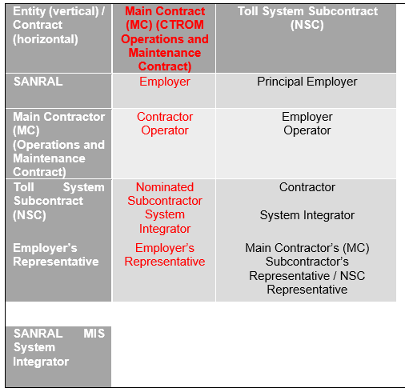

2. Scope of work
Associated contracts and terminology

Slide 13
2. Scope of work
Toll Operations and Maintenance
Collection and control of toll revenue
Traffic management
  Historic Traffic from AVC, MIS, TEL1 and TEL2 included from Part C16 to Part C19 of Volume 4.
  Predicted Traffic for Duration of Contract – see Part F of Volume 4.
Financial management
  Historic Data – Part C20 of Volume 4.
General maintenance of toll plaza assets

Slide 14
2. Scope of work
Traffic management (Class 1 traffic)

Slide 15
2. Scope of work
Traffic management (Heavy vehicle traffic)

Slide 16
2. Scope of work
Financial management
Exempt users (SANDF, SAPS)
Local user discount (none)
Local public transport operator discount (none)
Frequent user discount (Oribi mainline and ramps, Izotsha, Umtentweni, Class 1)
  20 to 39 trips per single card per month – 20%
  40 or more trips per single card per month – 40%

Slide 17
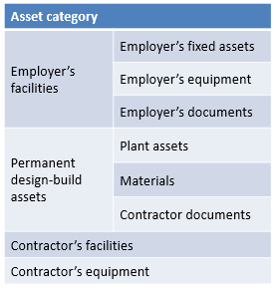
2. Scope of work
Assets
Employers Facility (fixed assets, equipment, documents)
  Contractor responsible for day-to-day maintenance.
  Contractor to repair these assets and cost to be recovered from the Employer on 3 quotations system.
Permanent Design-Build Assets (plant assets, material, Contract documents)
  Contractor to maintain, repair, replace, upgrade, provide or dispose of these assets.
  Contractors’ Facility and Equipment
Contractor facilities and Contractor equipment
Existing Asset Register listing all the assets were provided in Part C4 of Volume 4.

Slide 18
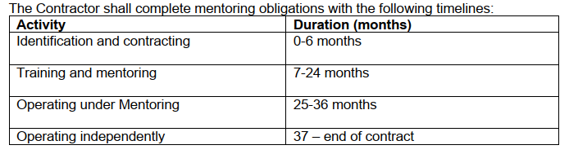
2. Scope of work
Mentoring of Targeted Enterprise (New entrant)
Requirement to involve Targeted Enterprise (TE) (30% of contract value)
TE component to include a New Entrant
  To train, develop and monitor for the duration Operation Service Period.
  The Contractor must transfer all the skills related to all levels of toll operations and maintenance, in order for the TE (New Entrant) to be able to operate and maintain a toll plaza on his/her own
  The Contractor must provide the mentor role to the TE (New Entrant) during the entire process from identifying the TE (New Entrant) to end the Operations Service Period when the TE (New Entrant) has gained the necessary skills and experience for the TE (New Entrant) to be ready to tender for future toll operations and maintenance contracts

Slide 19
2. Scope of work
Split of risk – Form D13
Form D13 defines a Risk Transfer Model, i.e., split of risk between Contractor and NSC
  MC responsible for NSC management
  Operator will operate and have access to health monitoring data and VGS audit tool
  NSC will maintain and upgrade, and ensure toll system optimal performance and KPI compliance
  Data variance is handled by Payment Methodology (V2B7a), including AVC detection and classification issues
  Responsibility to ensure optimal system performance both MC and NSC, focused on early detection
  Health monitoring and statistical performance assessment
  Configuration control ensure that NSC do not modify system (Changes reported by health monitoring system)
  MC supply help desk, ERS and stock control
  NSC supply spares, maintain and keep spares above minimal levels. Replenish at end of contract.
NSC carries main risk related to toll system aspects. However, Contractor carries a small portion of risk, as Contractor remains responsible for overall management of NSC.

Slide 20
2. Scope of work
Toll system (Design build sections – V3B1: C1.2.3 APPENDIX 1 and Table 5-1: System upgrades)
Maintenance of legacy system (S1) – 6 Months
Establishment upgrades (S2) – 18 Months
Upgrade/ replacement of equipment (S3.1 to S3.9) – 18 Months (Commissioning of sections of the Works)
Interface to the SANRAL MIS (S3 and S4) – 6 Months
SANRAL Toll System (S5) – 6 Months
End of contract upgrades

Slide 21
2. Scope of work
Toll collection lane equipment
Standard 2010 system with enhancements including:
  TCH interface (PGW on site, via route and GORT fibre)
  Dedicated ETC lanes (Reversible and switchable to mixed mode) (e-sign for dedicated and tag only lanes)
  Contactless bank card(EMV) processing (PCI compatible) readers). Proof before roll-out
  ANPR: Pilot followed by deployment
  VGS audit role:
    Incident and missing/duplicate transaction
    AVC count accuracy
    Concession/Discount verification (ANPR/VLN discrepancies)
  Health monitoring (Response by NSC, with or without MC reporting) and configuration control
  PCI level 2 merchant implementation
SANRAL MIS interface (Basic TCH type interface) and further enhancements
SANRAL toll System (Assessment, selection, pilot and roll-out) [SANRAL access to source code]

Slide 22
2. Scope of work
TCH interface
Move TCH PGW to OPS level at a plaza on the route (S2, establishment)
Utilize National and GORT fibre networks

Slide 23
2. Scope of work
Employer’s MIS and Toll System
Employers MIS Interface (DB S4) – 6 Months
  Basic
  Full (WA)
Contact details of the RIMS coordinator is in Part C37 of Volume 4.
SANRAL toll system procurement process (Tendered rates)
  Assessment of NSC systems
  Selection of system to be deployed and access to source code (for use or to own fully)
    Test and evaluation phase (In parallel on selected routes)
    Central NSC contract (Use tendered rates per route)
    Development and test environment Pilot deployment (parallel deployment) at a site
  Route roll-out and decommissioning of NSC system
SANRAL Toll System NSC provide system and support (Procurement models)

Slide 24
2. Scope of work
ITIS
Submit data to ITIS
Use ITIS data as part of payment tree

Slide 25
2. Scope of work
RIMS
The Contractor shall participate on the existing RIMS for KZN, specifically Cluster 1 that includes the Ugu District Municipality
Contact details of the RIMS coordinator is in Part C37 of Volume 4.

Slide 26
2. Scope of work
Electrical and Mechanical – key works
UPS (tendered rates for replacement)
Generator (tendered rates for replacement)
Bulk diesel fuel tank (tendered rates for replacement or improvement)
Photovoltaic (PV) with battery storage solution (design, with implementation as PS)
SCADA
EPC
Gas installations
Earthing and lighting protection (survey and testing)

Slide 27
2. Scope of work
Electrical and Mechanical – key works
Air conditioning and ventilation
  No fresh air systems
  Replace air conditioners at all plazas
Lighting
  Design to replace lighting with new energy efficient LED technology luminaires
  Replacement (Provisional Sum)
  Some lighting mast repairs
Security cameras

Slide 28
2. Scope of work
Customer service centre and Route patrol
Route patrol
  The Contractor shall patrol the N2 South Coast Toll Road at least 2 return trips every 8 hours
  The Contractor is required to provide a minimum of one (1) vehicle that must cover the entire N2 South Coast Toll Road. The Contractor should however have contingency measures in place, in case this vehicle is temporarily unavailable (e.g. for service, or repairs)
  Minimum equipment requirements
Call centre
  The Contractor may utilize the facilities at the existing Toll Plazas for this purpose.
  The Contractor is to note that there are no upgrades scheduled to the existing facilities for the duration of the Contract.

Slide 29
2. Scope of work
KPIs
The Performance Measurements are detailed in Volume 2 Book 6a.
See Clause C3.2.6 from page C3-173 onwards for modifications.
These modifications are in line with the consolidated KPI Model agreed on the National Performance Review Committee (NPRC).

Slide 30
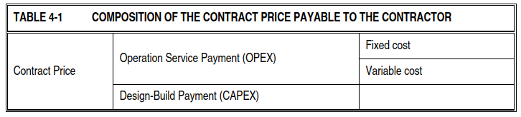
2. Scope of work
Payment methodology
Fixed and Variable Cost Payment Mechanism will be used in this contract.
Schedule of Payments/Cost Matrix consist of 2 schedules:
  Schedule A – Operation Service Period (OPEX).
  Schedule B – Design-Build Period (CAPEX).

Slide 31
2. Scope of work
Payment methodology – traffic sources
Actual Gross Income (AGI) to be paid to Employer every month.
Traffic sources:
  MIS
  AVC
  TEL1
  TEL2
  Historic traffic
See decision tree being applied in Volume 2 Book 7a
Historic traffic data provided in Volume 4

Slide 32
3. Programme
Tender
Submission of Form A1.1 24 January 2023
Tenderers meeting 2 February 2023
Last day for questions by Tenderers 8 February 2023 (Closing date minus 12 working days)
Last day for Employer Addenda 10 February 2023 (Closing date minus 10 working days)
Closing date 24 February 2023
Start of operations service period 1 June 2023

Slide 33
3. Programme
Project
Effective date Date of Letter of Acceptance
Commencement date Date of Commencement meeting
Access to site for establishment 6 weeks before start of services
Provision of Performance Bond 28 days after letter of acceptance
Start of operations service period and DB period 1 June 2023
Operation service period 6 years
Design-Build period 3 years

Slide 34
3. Programme
Sections
Operations service period (6 years)
  Section 1: Operations using Legacy toll system, or Contractor’s toll system
  Section 2: Operations using the Employer’s MIS

Slide 35
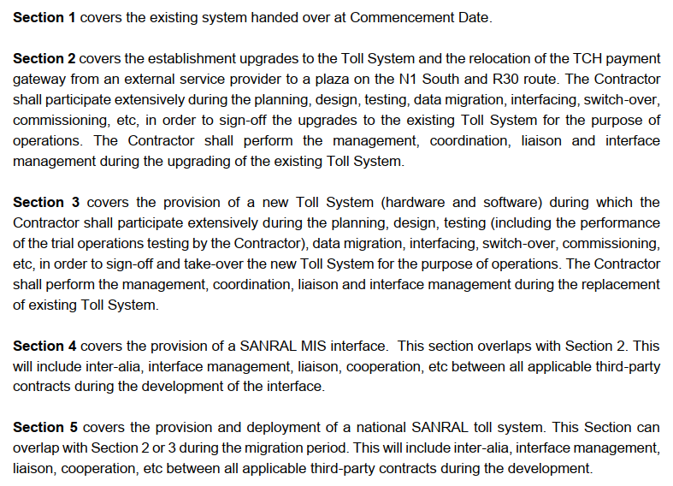
3. Programme
Sections
Design-build period (3 years)
  Maintenance of legacy system (S1) – 6 Months
  Establishment upgrades (S2) – 18 Months
  Upgrade/ replacement of equipment (S3.1 to S3.9) – 18 Months (Commissioning of sections of the Works)
  Interface to the SANRAL MIS (S3 and S4) – 6 Months
  SANRAL Toll System (S5) – 6 Months

Slide 36
4. Tender
Covered by SANRAL

Slide 37
5. Plaza visits
Visits to the Toll Plaza (Oribi) to be conducted after tender meeting.
Visit to all plazas can be arranged through the Employer’s Agent (ProcurementER7@sanral.co.za).

Slide 38
6. Housekeeping
Attendance register
Form A1

Slide 39
7. Questions
All questions to be formally submitted to: ProcurementER7@sanral.co.za
Also opportunity for questions at tender briefing session

