Slide 1
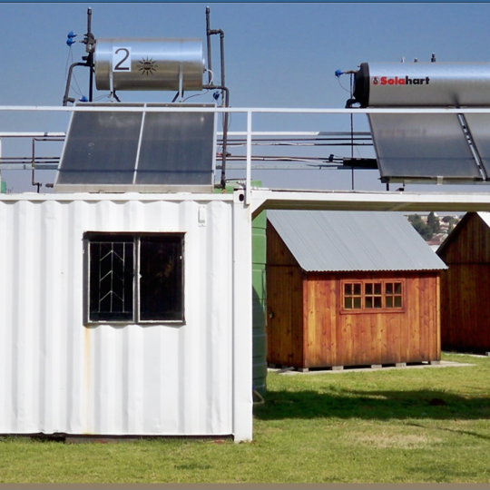
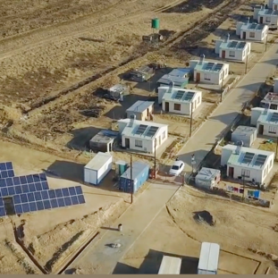
Chatbot
Clarification Session: Technical
14 February 2023

Slide 2
Contents
# | Requirements Description
1 | Background
2 | High Level Requirements
3 | Implementation Priority
4 | Evaluation Criteria Summary
5 | Architecture

Slide 3
Background
Implementation of an Artificial Intelligence (Chatbot) that will serve as an intermediatory to facilitate customer interactions via various channels i.e. (Social Media Channel API (WhatsApp), email, telephony etc.
Request for a low code, off premise, Platform as a Service (PaaS) for a Chatbot as well as a turnkey solution for the design, development, testing (Unit, SIT, Regression, UAT, Performance, DR, Vulnerability, Security etc.), integration and deployment the Chatbot.

Slide 4
High Level Requirements
Implementation of an Artificial Intelligence (Chatbot) that will serve as an intermediatory to facilitate customer interactions via various channels i.e. (Social Media Channel API (WhatsApp), web portal, App etc. The Chatbot will power the Social Media Channel (i.e., WhatsApp channel) resulting in an automated interaction.
  There is a chatbot that is currently implemented in the organisation using free and open-source software, but Eskom needs an Enterprise grade Chatbot platform.
The key issue that the Chatbot needs to address is Electricity Supply Problem issues (70% of all interactions) and upwards of 80% of these issues are prepaid (single faults, low buying, load reduction, load management). These interactions need to move to a chatbot.
The Chatbot will need to facilitate interactions and perform the same activities as performed by the “Human” agents in the Contact Centre. These Customer service interactions are listed as Service Categories and types.

Slide 5
Implementation Priority
Vendor capability to prioritize the following service types:
Balance Enquiry
Receive Meter Reading
Update Customer Information
Faulty Prepaid Token
Application of Supply
Emergency or Faulty Eskom Equipment
Isolated Eskom Fault
Low buying/Zero buying -segmenting these from the normal buyers)
Status of Service requests (i.e. reference number Feedback on faults/Applications )

Slide 6



Evaluation Criteria Summary

Slide 7
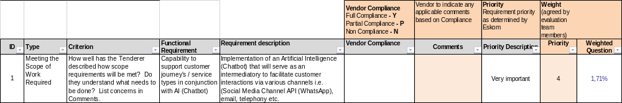
Evaluation Criteria Summary
Guidelines to complete the Technical Evaluation Questionaire for The Chatbot
1 | Complete ALL the Sheets/Tabs at the bottom of the book. There are Six(6) Tabs including:
 | Functional (Business Requirements)
 | Non-Functional (Development, Performance, Reporting , Training etc.)
 | Technical
 | Integration and Testing
 | Cloud
 | Security
2 | Please read the details in the Criterion, Functional Requirement and Requirement Description colum headings to determine what is required
3 | Then complete the following 2 columns:
 | 1. Vendor Compliance: Select the most appropriate response from the drop down list, as indicated below:
 | Full Compliance - Y Partial Compliance - P Non Compliance - N
 | 2. Vendor Response: Vendor to indicate any applicable response feedback based on Compliance selected
 | Please ensure that you complete ALL the requirements per Sheet
4 | Demo Tab: This tab indicates the requirements that the selected vendors need to demo

Slide 8
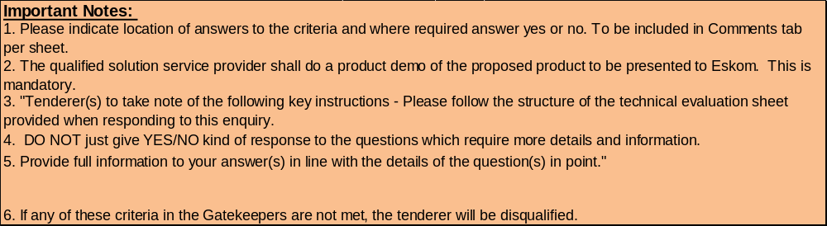
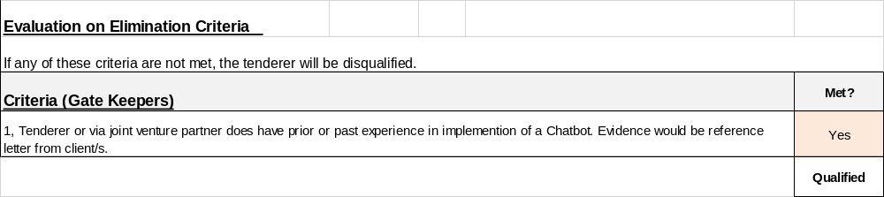
Evaluation Criteria Summary

Slide 9
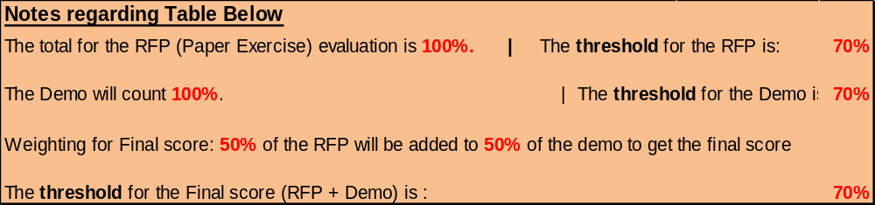
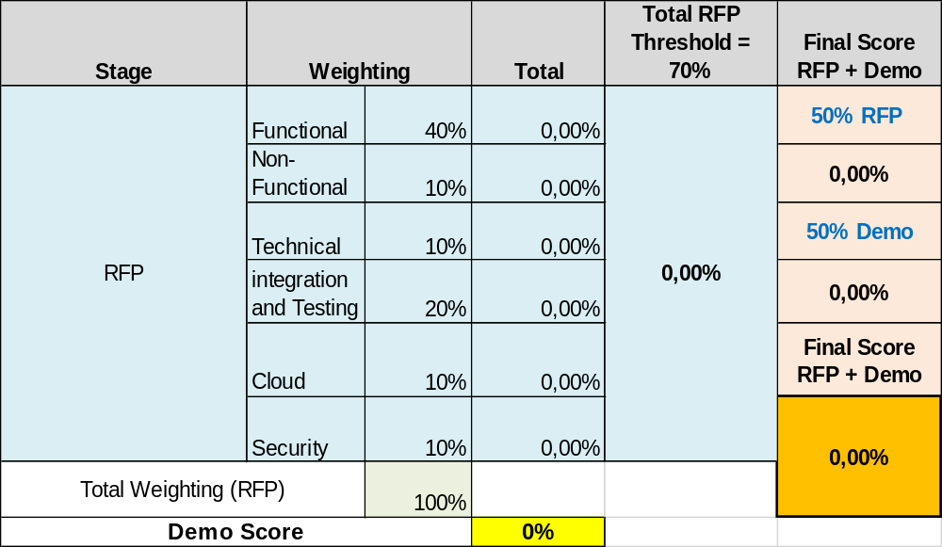
Evaluation Criteria Summary

Slide 10
Architecture

Slide 11
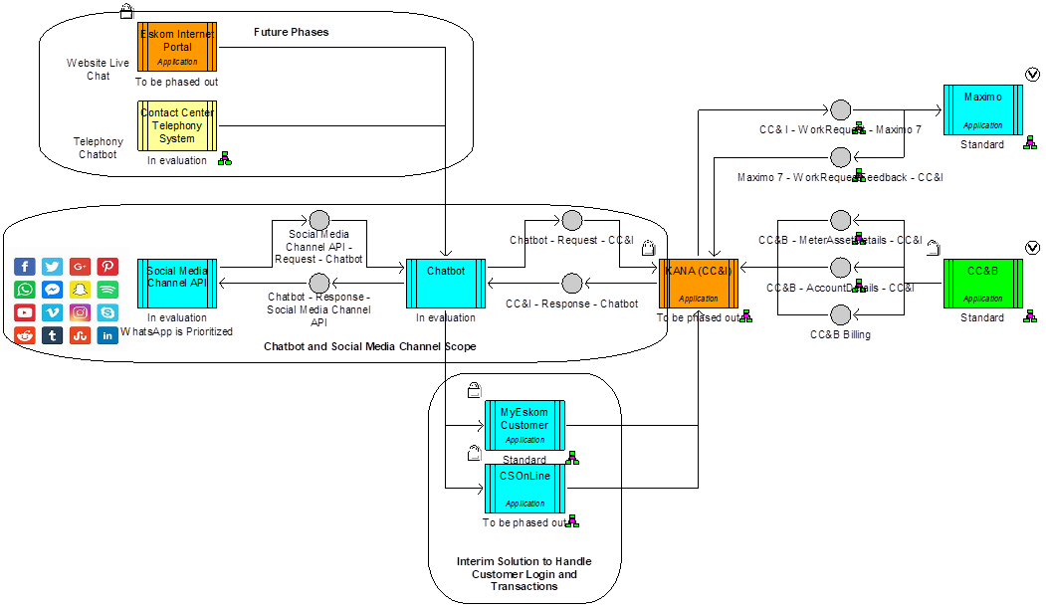
Architecture

Slide 12
Conclusion

