Slide 1




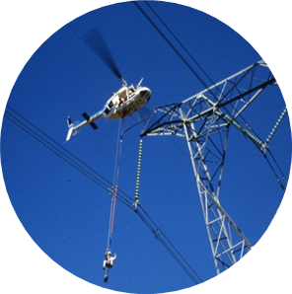

Provision of Vegetation Removal Services for Small Hydro Stations in the Eastern Cape Operating Unit – Mthatha Zone in the Eastern Cape
Technical Clarification
Date: 14 September 2023

Slide 2
Quality Requirements
Tender returnables for Category 4 quality requirements:
A.1 Quality Method Statement
Quality Method statement based on scope of work and should address all the supplier’s business management processes to ensure that all of Eskom’s requirements are fully met on a consistent basis.
A.2 Quality Policy Approved by top management.
A quality policy is a brief statement that aligns with your organisation’s purpose and strategic direction, provides a framework for quality objectives, and includes a commitment to meet applicable requirements (ISO 9001, customer, statutory or regulatory) as well as to continually improve.

Slide 3
Quality Requirements continued
A.3 Quality Objectives Approved by top management.
Quality objectives are goals organisations use to improve the value of their products, services or products.
B.1 Documented information for defined roles, responsibilities and authorities.
Organization chart and Responsibility matrix (must include but not limited to quality management function/role.

Slide 4
Quality Requirements continued
B.2 Documented information for Control of Externally Provided Processes, Products and Services.
Criteria for the evaluation, selection, monitoring of performance, and re-evaluation of external providers (Clause 8.4 of ISO 9001:2015)
E.1 Form A is completed and signed.
Tender & Contract Quality Requirements for 240-105658000 and Quality Requirements For ISO 9001 Standard.

Slide 5

Thank You

