Slide 1
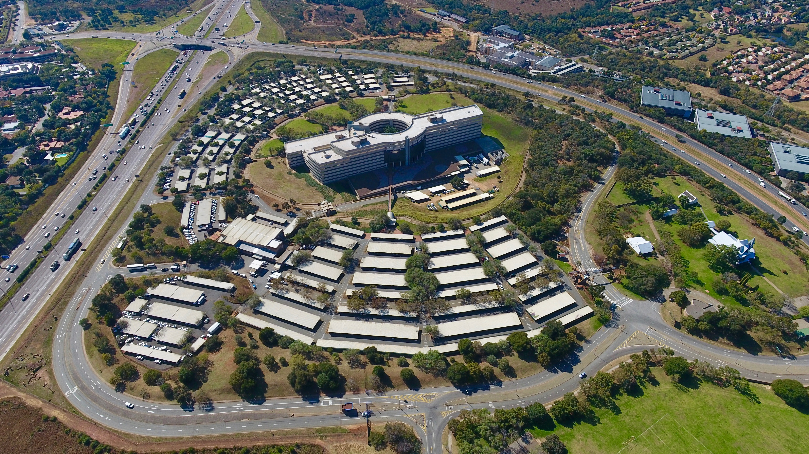
ARMSCOR

Slide 2

PROVISION OF PHYSICAL GUARDING SERVICE FOR PERIOD OF 5-YEARS- GAUTENG PROVINCE SITES
EFAC 2025/04
A-TEMP-009 -1 ISSUE 002
Compulsory Bidders Briefing
08-10 JULY 2025
GAUTENG PROVINCE

Slide 3
AGENDA ITEMS
WELCOME - MS P. MANGAKANE
BACKGROUND - MS P. MANGAKANE
SPECIFICATION - MR C. RAMUSHU
EVALUATION CRITERIA - MS P. MANGAKANE
SPECIFIC GOALS REQUIREMENT - MR. S Manyoni
SPECIAL REQUIREMENTS - MR. S Manyoni
SPECIAL CONTRACT CONDITIONS - MS P. MANGAKANE MR W. MANANA
SITES WALK-ABOUT - MR C. RAMUSHU, MR H. MAHLATSI, MR P. SAM

Slide 4
WELCOME
compulsory bidders briefing
Please ensure that at least 1x member from your company signs the attendance register.
PLEASE ENSURE THAT YOU ATTEND ALL THE GAUTENG SITE VISITS (X4 SITES) ON 08, 09 AND 10 JULY 2025

Slide 5
BACKGROUND
EFAC/2023/06 was cancelled on October 2024 for the Gauteng, Western Cape and Northern Cape provinces.
This bid EFAC/2025/04 is issued only for the Gauteng Province 4x sites.
Armscor seeks to appoint a PSIRA registered contractor to provide Physical Guarding Services across all Armscor 4x sites in the Gauteng Province.
The successful bidder will commence with services on the 1st October 2025 (dates may change depending on the readiness of the new service provider).
Armscor will appoint one service provider across all the 4xsites of the Gauteng province.

Slide 6
SPECIFICATION
ANNEXURE C ATTACHED TO THE RFB DOCUMENT

Slide 7
SPECIFICATION
Physical Guards – Grade C, Armed and Dog Handler
Shift Leader- Grade B, Armed
Ops Manager- Grade A , Armed
Fire Arms with ammunition
Station Radio
Rechargeable Torches
Gun Safe(s) with combination keys
Security handcuffs with 2 keys
Guard Monitoring system
Vehicle(s)
Note: for detail description and quantities, refer to RFB Document Anexxure C

Slide 8
SPECIFICATION
The requirement has been developed using x2 shift system (Day & Night – 06:00-18:00/18:00 -06:00) operating for 24 Hours/7-days a week.
The requirement did not include how you intend to manage Leave and shift rotations, hence each bidder must have a way to include such in your pricing consideration.

Slide 9
SITE ESTABLISHMENT
There is financial provision of R300 000,00 for all the sites for preparation to take over from the existing service provider.
The Successful Bidder will receive their appointment letter 1-month before the actual start date to allow them time to prepare to take over the site.
The preparation includes site induction, vetting of guards and other Special Contract Condition Requirements.

Slide 10
COMPLIANCE TO MINIMUM WAGE
The Bidder shall quote remuneration for the allocated guards to the Armscor sites in Accordance with the minimum wage as prescribed in terms of section 56 (1) of the Basic Conditions of Employment Act, No. 75 of 1997 for the Sectoral Determination 6: Private Security Sector, South Africa, as promulgated by the Minister of Labour in the Government Gazette. Non-compliance to the National Bargaining Council for the Private Security Sector (NBCPSS): Extension to Non-Parties of the Main Collective Agreement, as amended, effective from 2 March 2023 until 1 March 2027. The agreement can be downloaded from their website, www. nbcpss.org.za.
The bidder shall complete Appendix –A , minimum wage declaration and submit with the bid.

Slide 11
EVALUATION CRITERIA
EVALUATION CRITERIA

Slide 12
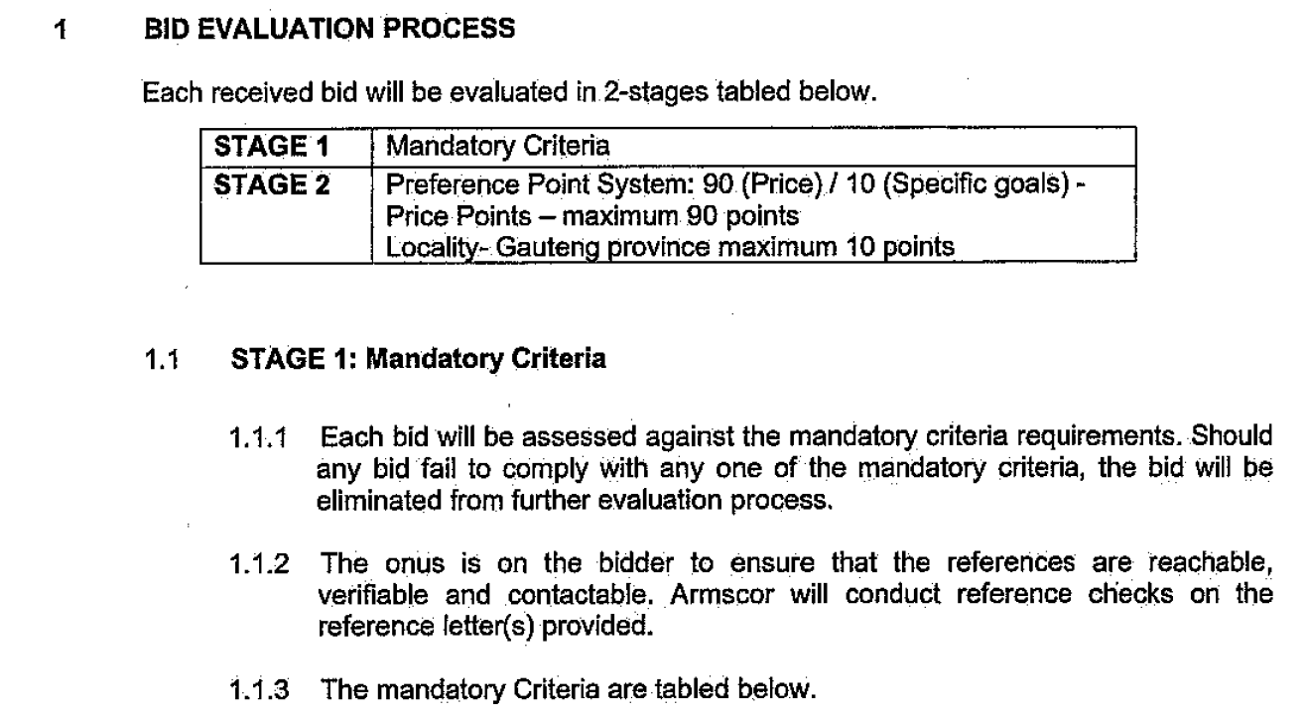
EVALUATION CRITERIA
EVALUATION CRITERIA

Slide 13
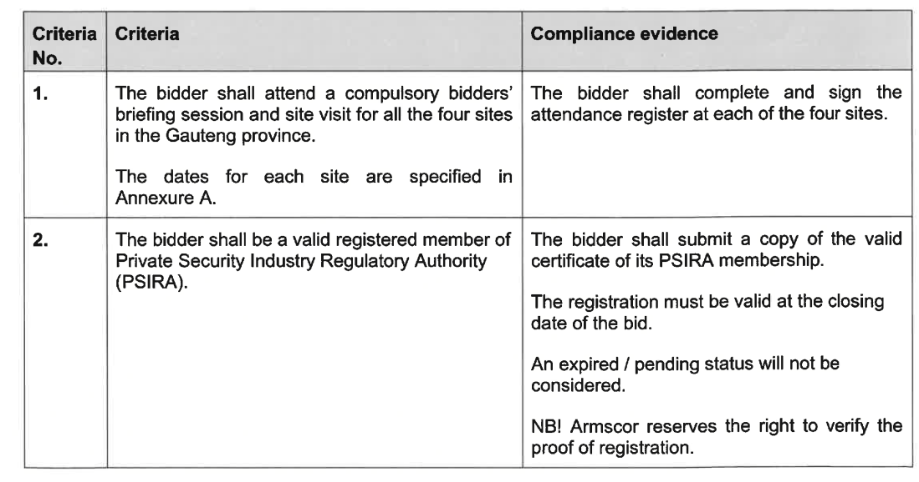
EVALUATION CRITERIA

Slide 14
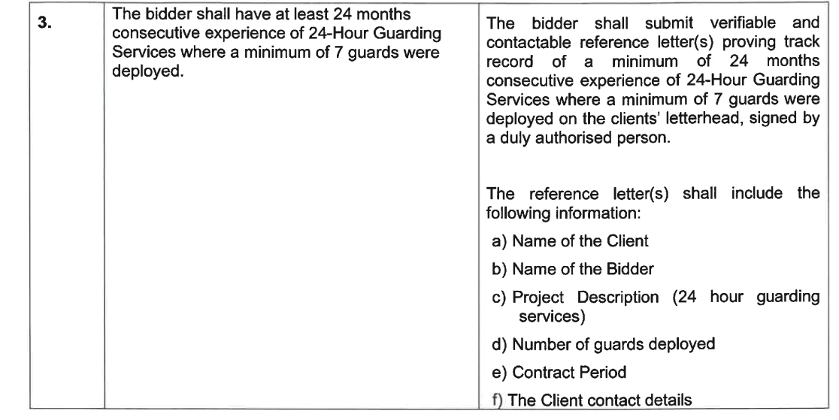
EVALUATION CRITERIA

Slide 15
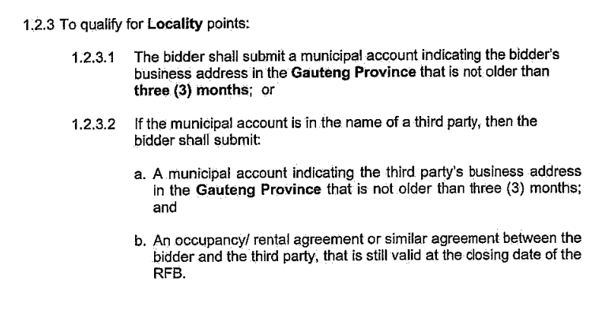
STAGE 2: SPECIFIC GOALS
EVALUATION CRITERIA

Slide 16
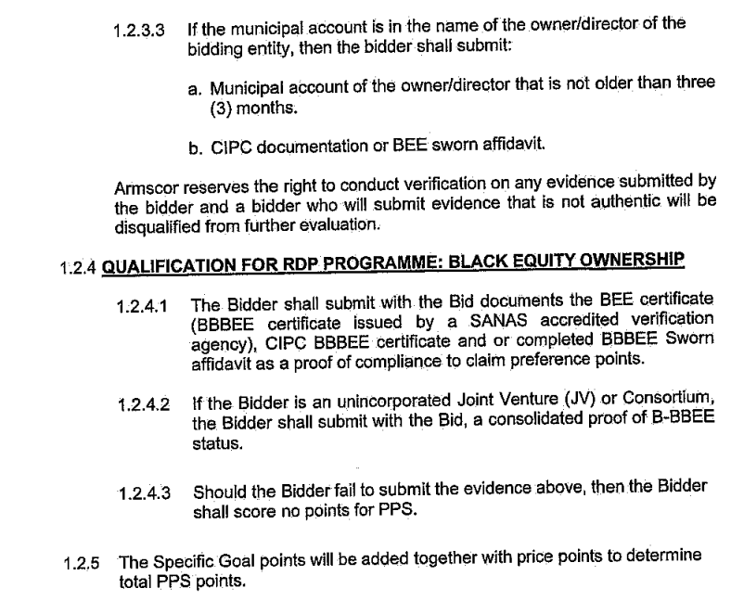
EVALUATION CRITERIA

Slide 17
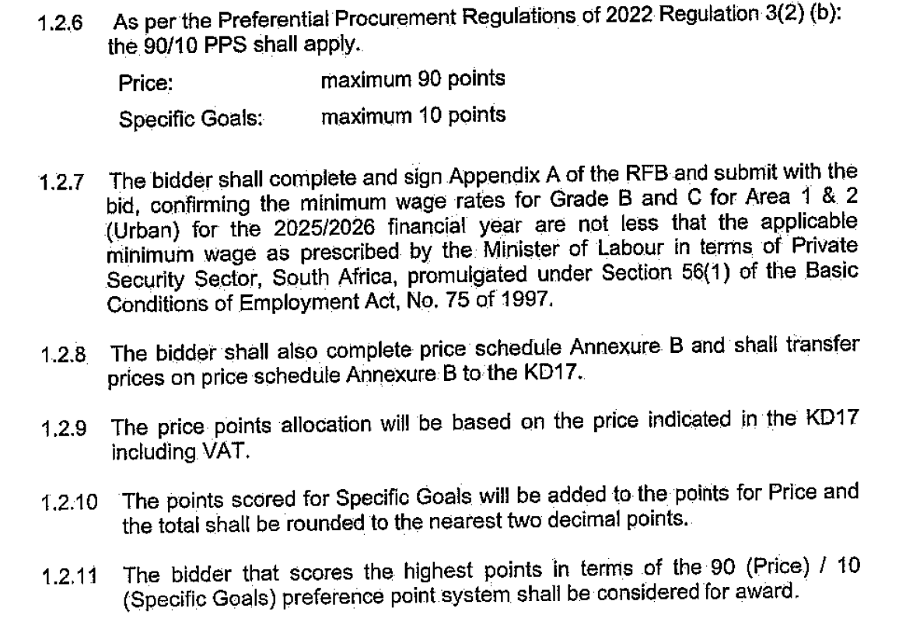
EVALUATION CRITERIA
Notes:
Appendix A is on Page 40 of the RFB

Slide 18
DETAILED PRICE SHEET
The Detailed Price Excel Spreadsheet must be populated and a soft copy submitted with the bid.
The price sheet is based on Years 1-5, bidders must factor in annual escalations to provide costing for Years 2-5. The award will be based on total 5-years cost
Summary of the detailed pricing must be transferred exactly to KD17 price table.
Notes:
KD17 is on page 12 of the RGB

Slide 19
SPECIAL REQUIREMENTS

Slide 20
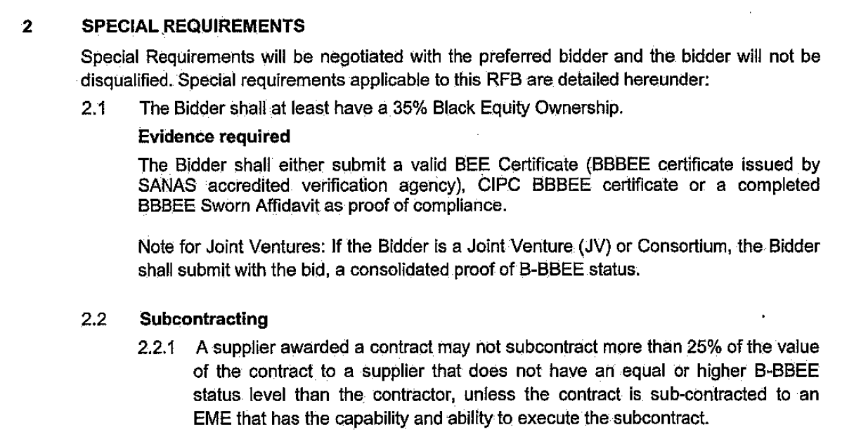
SPECIAL REQUIREMENTS

Slide 21
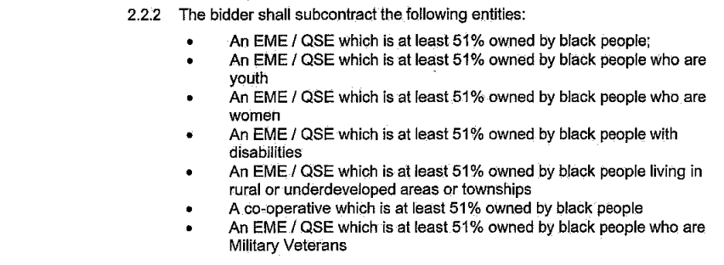
SPECIAL REQUIREMENTS

Slide 22
SPECIAL CONTRACT CONDITIONS
ANEXURE D TO THE RFB

Slide 23
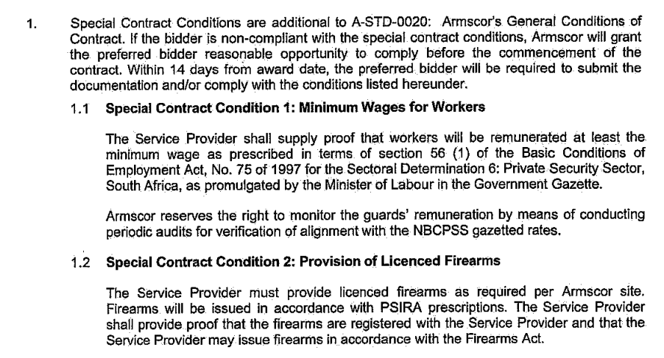
SPECIAL CONTRACT CONDITIONS

Slide 24
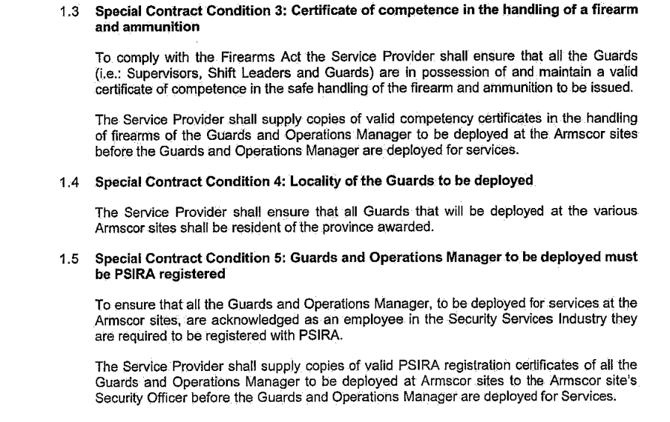
SPECIAL CONTRACT CONDITIONS

Slide 25
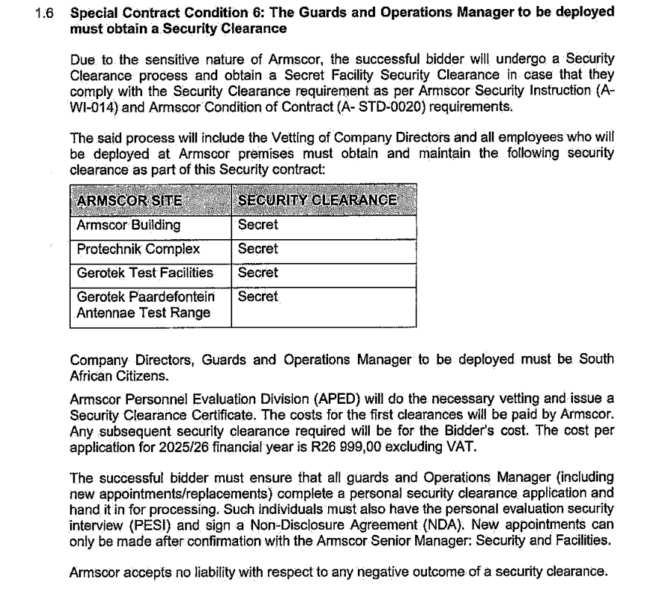

Slide 26
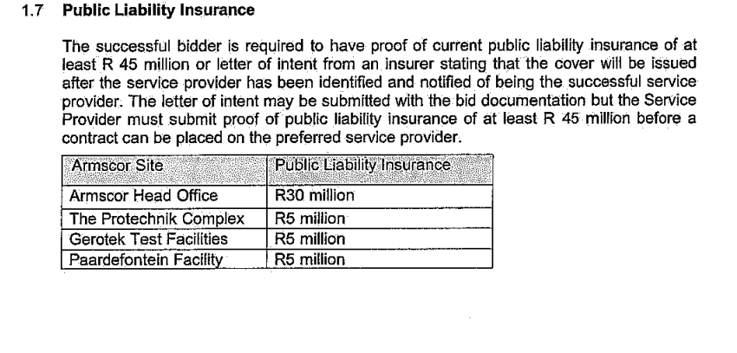
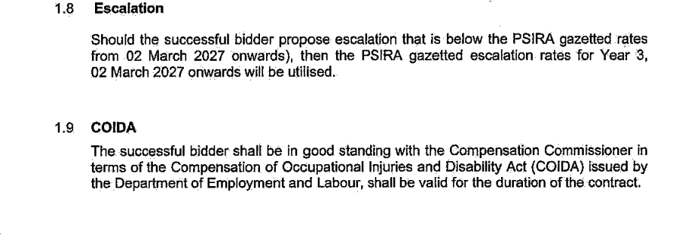
SPECIAL CONTRACT CONDITIONS

Slide 27
Contents
PROCESS MATTERS

Slide 28
  THE RFB IS CLOSING ON 25 July 2025 AT 11h00 am.
  Note: all bids are submitted to Armscor HQ – No bids will be submitted to the site office

Slide 29
PROCESS STEPS
Closing date
25-JULY
SCM Administrative Due Diligence
Bid Evaluation
Bid Adjudication Dept.
Adjudication @ EXCO
Adjudication@ Board Level
BID VALIDITY – 150 DAYS

Slide 30
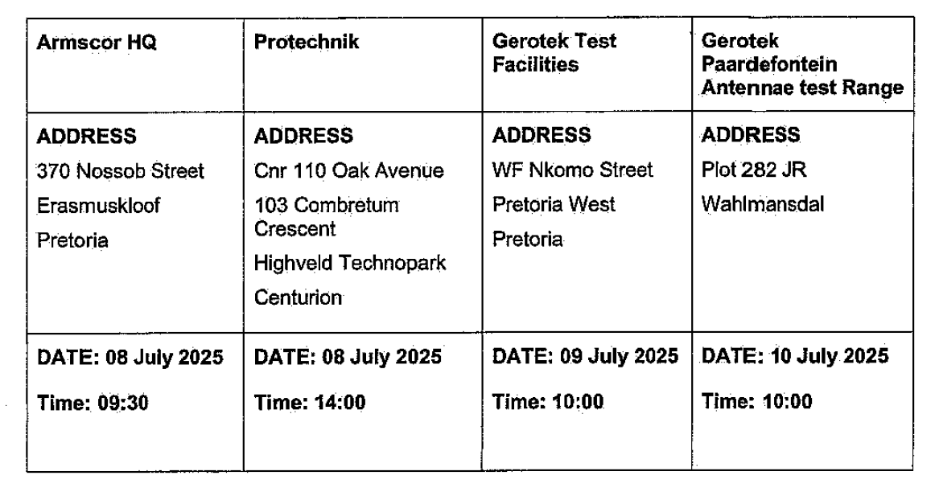
SITE VISIT/ WALK-THROUGH

