Slide 1
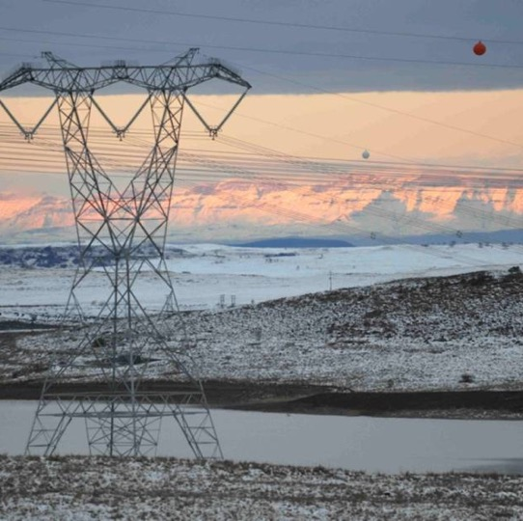
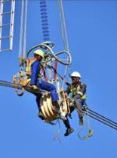
Digital Transducers Enquiry
Presented By: Samuel Letwaba
Date: 06 June 2025

Slide 2
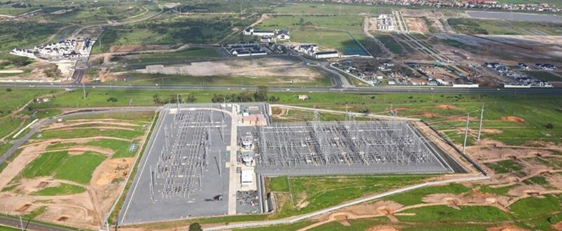

Technical Requirements – Digital Transducers

Slide 3
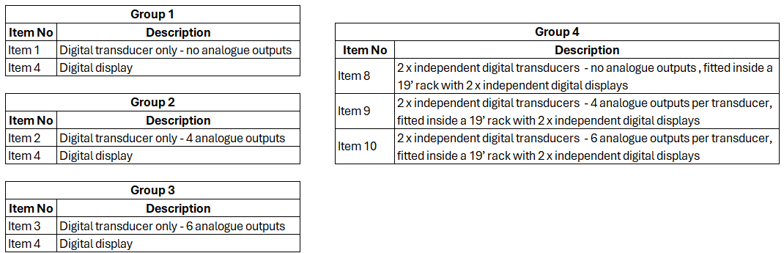
Technical Specifications – Digital Transducer
Eskom standard for digital transducer based measurement system (240-51999977)
The enquiry shall include the following groups of digital transducer based measurement system:

Slide 4
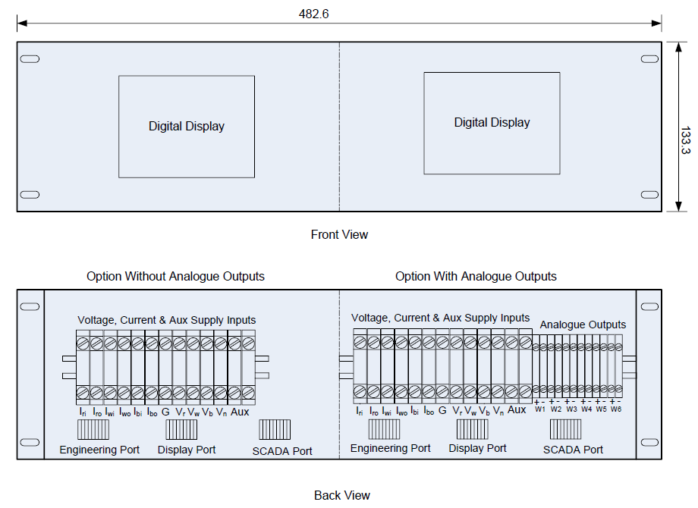
Technical Specifications – Digital Transducer
19” Rack Options (Group 4, item 8, 9 and 10)

Slide 5
Technical Tender Returnables
Completed Excel Workbook for each tendered item, containing the following sheets:
  General Questionnaire
  Mandatory Requirements
  Technical A&B Schedule
  Support Schedule
  Deviation Schedule
Supplier Equipment Tendered Declaration Form (Annex A, Technical Evaluation Criteria - 240-185000396)
Quality, Risk and Support Questionnaire (Annex B, Technical Evaluation Criteria - 240-185000396)
Remember to provide relevant supporting documents where applicable
All information must be completed in electronic format in the Excel sheets. Excel sheets should also be completed in PDF for audit purposes.
Do not password protect the Excel sheets.

Slide 6
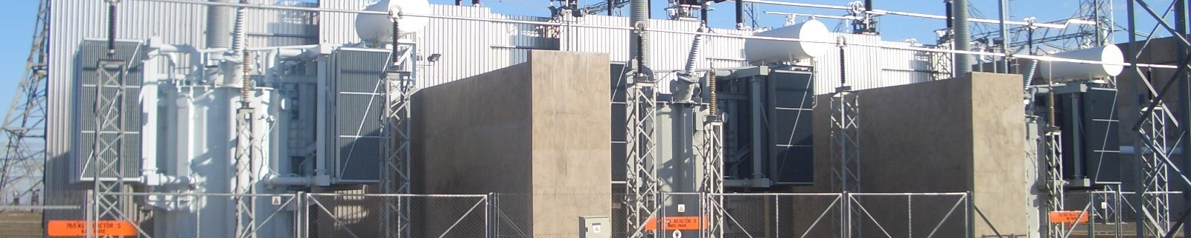
Technical Evaluation Criteria– Digital Transducers

Slide 7
Technical Evaluation Stages
The evaluation method consists of three (3) main stages:
Mandatory Requirements Evaluation
Supplier Equipment Tendered Declaration
Technical Qualitative Requirements Evaluation
Laboratory Demonstration – Transducer and software evaluation
SCADA Integration and Protocol Testing
Deemed Offer Risk(s) Evaluation

Slide 8
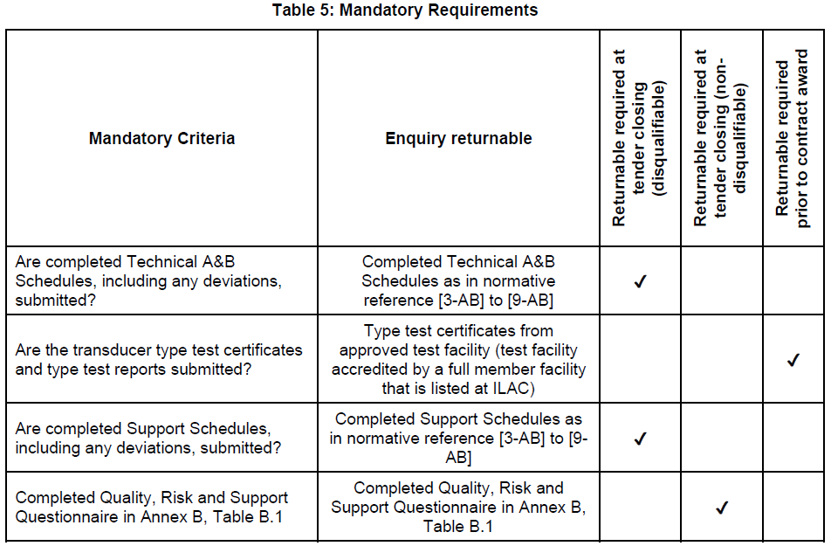
Mandatory Requirements Evaluation
Based on the evaluation of the Tenderer responses provided on the Mandatory Requirements Excel sheet for each item, and the necessary supporting documents provided.
Tenderers who do not meet this requirement will not be evaluated further.

Slide 9
Supplier Equipment Tendered Declaration Evaluation
The tenderers are required to complete the ‘Supplier Equipment Tendered Declaration’ form in Annex A of the Technical Evaluation Criteria document.
At NTCSA’s discretion, previously evaluated equipment may be exempt from further technical evaluation, where NTCSA’s specifications have not changed and the tenderer has submitted a technical bid comprising of equipment previously tendered, and having been evaluated as acceptable by Eskom / NTCSA.

Slide 10
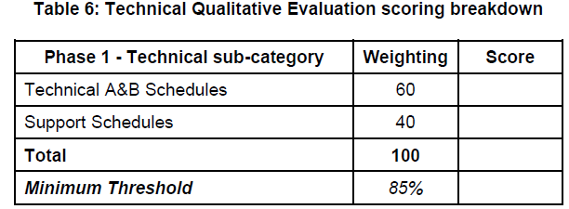
Technical Qualitative Requirements Evaluation
This stage will be adjudicated a score out of 100% based on the evaluation of the Tenderer’s responses provided in the “Technical A&B Schedules” and “Support Schedule” for each item.
Include all relevant supporting documents,
and make the references as precise as possible to provide the evaluation team with the necessary proof.
Tenderers who do not meet the minimum threshold will not be evaluated further.

Slide 11
Laboratory Demonstration
Tenderers that have qualified for this stage of the evaluation will be notified of their respective dates for the laboratory evaluation that will be conducted in the NTCSA / Eskom premises in Gauteng.
Suppliers are required to provide a sample of all the variants of transducers and display items offered, to be subjected to configuration and testing, on the day of the laboratory demonstration.
The sample for shall have a minimum of 1 x transducer (6 analogue outputs) and 1 x display but the wiring in the rack shall be for complete rack i.e. 2 x transducers and 2 x display.
Prototype transducers, displays and their respective software shall be functionally evaluated and tested against the requirements of the respective specifications and allocated a score based on the various use cases listed in the technical evaluation criteria document.
This stage shall be adjudicated a score out of 100% with a minimum threshold for qualification of 85% required to proceed to next stage of the technical evaluation.
Tenderers who do not meet the minimum threshold of 85% will not be evaluated further

Slide 12
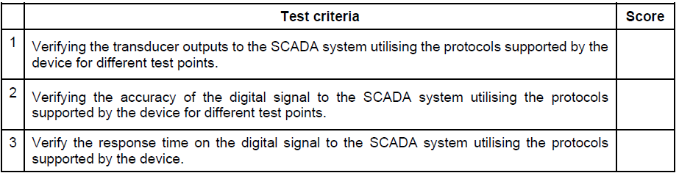
SCADA Integration and Testing
The technical evaluation team shall conduct integration testing to the NTCSA SCADA systems (RTUs and Bay processors) over the protocols supported by the transducers.
The prototype transducers submitted for the laboratory demonstration will be used for the SCADA integration testing will include the following verification tests:
Each item will be assigned a score by the technical evaluation team member based on the verification of the SCADA integration functionality and protocol tested against the requirements.
Only submissions that pass the SCADA integration testing scoring threshold of 95% will proceed to the next stage of the evaluation.
Tenderers who do not meet the threshold of 95% will not be evaluated further

Slide 13
Deemed Offer Risk(s) Evaluation
The technical evaluation team shall compile a narrative summarising risks associated with any aspect of the offer:
a) noted during the Technical Qualitative Requirements Evaluation,
b) noted during the Transducer and Software Evaluation during Laboratory Demonstrations,
c) noted during the SCADA integration and protocol testing,
d) based on the tenderers response to Quality, Risk and Support Questionnaire,
e) based on the deviations provided in the Deviation schedule Excel sheet to referenced technical standards, and
f) based on any pricing anomalies, noted during the subsequent financial evaluation that cannot be acceptably clarified.
This narrative shall be used to determine and motivate whether the risk is deemed low / acceptable / high and will serve as input to the recommendation as to whether the offer should be accepted.

Slide 14
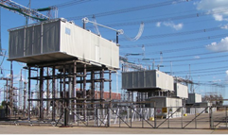
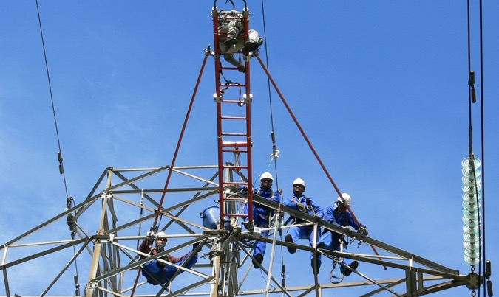
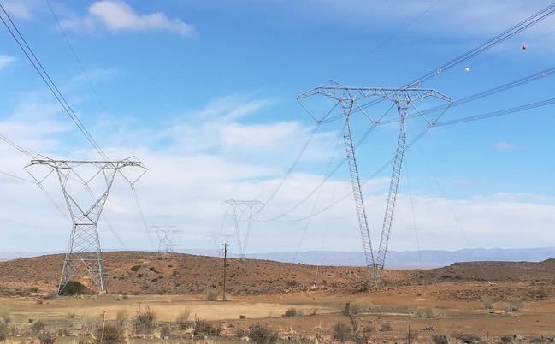
Questions

Slide 15
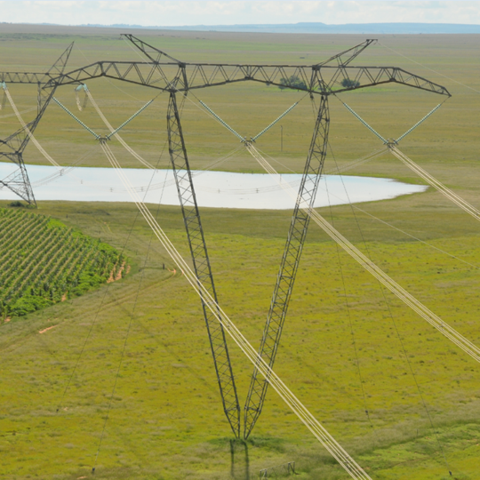
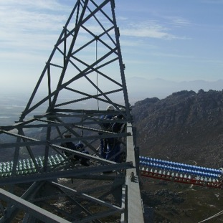
Thank you

