Slide 1
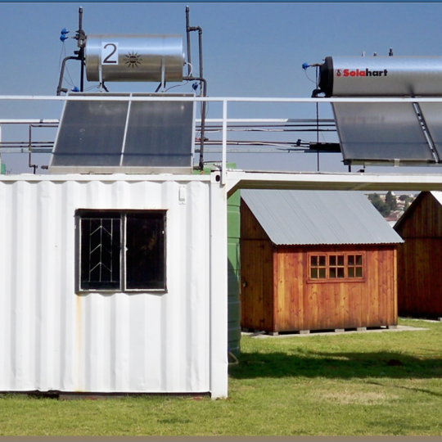

Clarification Meeting
Provision of Tax Health Assessment Review at Eskom Holdings SOC Ltd and National Transmission Company South Africa (NTCSA) SOC Ltd.
Presented by: Bulelwa Mabuya
18 March 2026

Slide 2
Key components of the scope of work
Analysing transactions using advance data analytics and technology
Review of records and returns
Review of current tax planning strategies
Compliance review
ESKOM HOLDINGS SOC LTD | NATIONAL TRANSMISSION COMPANY SOUTH AFRICA SOC LTD
Income Tax | Income Tax
VAT | VAT
PAYE | PAYE
Customs Duties | Customs Duties
Environmental Levy
Carbon Tax
Withholding tax on interest

Slide 3
Technical evaluation
Gate keeper
Mandatory requirement that the parties involved are Registered Tax Practitioners
Requirement to provide Registration Numbers of the tax practitioners intended to be used in the employment of the tenderer.
Bidders who do not meet the mandatory requirements will not go through to the next evaluation stage.
Minimum score card
Tenderers must obtain a minimum of 80% score to qualify for further evaluations. Tenderers that fail to meet 80% threshold will be disqualified.

Slide 4
Technical evaluation – cont.
Technical experience
The tenderer must have demonstrable experience in using advance data analytics and technology to provide tax health assessments.
The tenderer must provide a detailed company profile, including, the number of years of experience in providing tax health assessments and the list of benefits derived by the client that is a South African taxpayer company from the tax health assessment.
Years of experience more than twenty (20) years (20 points)
Years of experience between fifteen (15) and twenty (20) years (15 points)
Years of experience between ten (10) and fifteen (15) years (10 points)
Years of experience between five (5) and ten (10) years (5 points)
Years of experience below five (5) years (0 points)

Slide 5
Technical evaluation
Complexity - Revenue:
The tenderer must have demonstrable experience in the provision of tax health assessment services to large and complex South African taxpayer companies as measured by revenue.
The tenderer must provide contactable references (i.e. reference letters on clients’ letterheads) in respect of the provision of tax health assessment services to South African taxpayer companies.
The tenderer must provide a reference from a client with the highest revenue per their latest audited annual financial statements.
Revenue more than R300bn (30 points)
Revenue between R200bn and R300bn (25 points)
Revenue between R100bn and R200bn (20 points)
Revenue between R50bn and R100bn (15 points)
Revenue below R50bn (10 points)

Slide 6
Technical evaluation – cont.
Complexity - Assets:
The tenderer must have demonstrable experience in the provision of tax health assessment services to large and complex South African taxpayer companies as measured by assets.
The tenderer must provide contactable references (i.e. reference letters on clients’ letterheads) in respect of the provision of tax health assessment services to South African taxpayer companies.
The tenderer must provide a reference from a client with the highest total Property Plant and Equipment per their latest audited annual financial statements
Assets more than R900bn (30 points)
Assets between R700bn and R900bn (25 points)
Assets between R500bn and R700bn (20 points)
Assets between R300bn and R500bn (15 points)
Assets below R300bn (10 points)

Slide 7
Technical evaluation – cont.
Management experience:
The managing executive or partner for each tax type must demonstrate relevant experience.
The tenderer to provide the CV of the managing executive or partner for each tax type including years of experience in providing tax health assessments to South African taxpayer companies.
Years of experience in providing tax health assessments more than twenty (20) years (20 points)
Years of experience in providing tax health assessments between fifteen (15) and twenty (20) years (15 points)
Years of experience in providing health tax assessments between ten (10) and fifteen (15) years (10 points)
Years of experience in providing tax health assessments between five (5) and ten (10) years (5 points)
Years of experience in providing tax heath assessment below five (5) years (0 points)

Slide 8
Duration of contract
Initial period - 4 months
New period - 12 months

