Slide 1

Clarification Meeting
  Vryburg Main Building Roof Repair and Reinstatement Project
  Compiled by: QS Team

Slide 2

Contents
1
CPA Breakdown
2
Contractual Percentage
3
Tendered Pricing

Slide 3
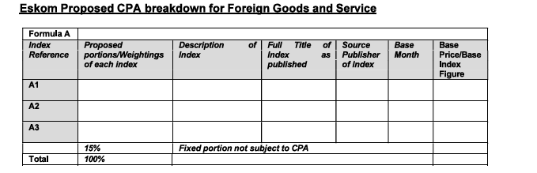
Contract Price Adjustment
Refer to Annexure E and F

Slide 4
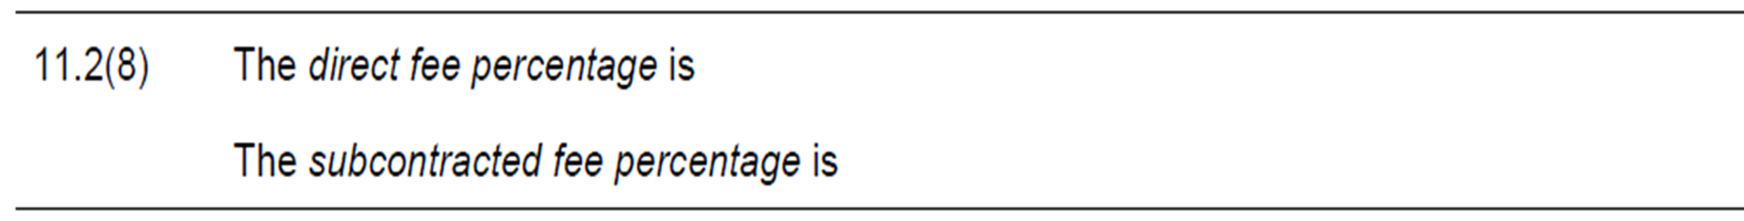
Contractual Percentage
Refer to C1.2 Contract Data under Clause (11.2(8)) in NEC

Slide 5
Tendered Pricing
The Bill of Quantities (BOQ) must be read in conjunction with NEC Scope of works requirements as detailed in the Scope of Works.
The rates submitted by the supplier shall be deemed to be inclusive of all costs necessary to complete the scope of work, including but not limited to:
Inspection report
Design
Demolition
Decommission and disposal
Supply and Installation
Commissioning
Transportation and delivery to the specified Eskom site
Warranty and Maintenance
All labour, overheads, and associated costs required to fulfil the contract
The supplier shall also be responsible for replacing any defective or non-compliant items supplied under this contract.

Slide 6
Tendered Pricing
All tenderers must comply with the following requirements when submitting their pricing:
The BOQ must not be changed, amended, or added to in any way.
All quantities and items must remain exactly as issued.
Tenderers must provide rates and amounts only in the BOQ. Responses such as Yes/No, comments, or notes in the pricing columns are not allowed.
All BOQ items must be priced. No items should be left blank or unpriced unless where a cost is deemed to be included in another item rate, the supplier must indicate this by inserting “Inclusive” or “Zero (R0.00)” against the relevant BOQ item.
The priced BOQ must be submitted in both Excel and PDF format, and both documents must match exactly.

Slide 7







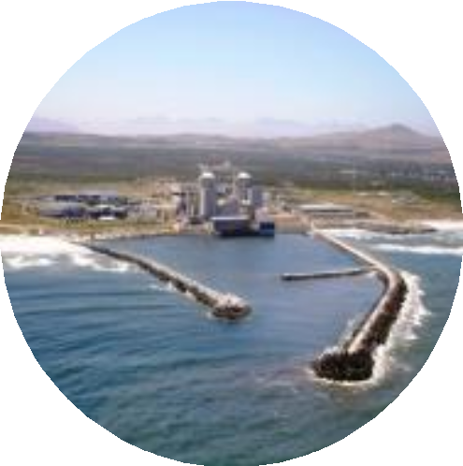
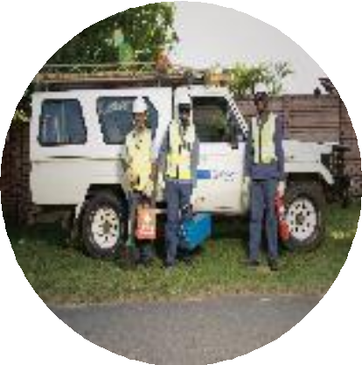
Thank You

