Slide 1
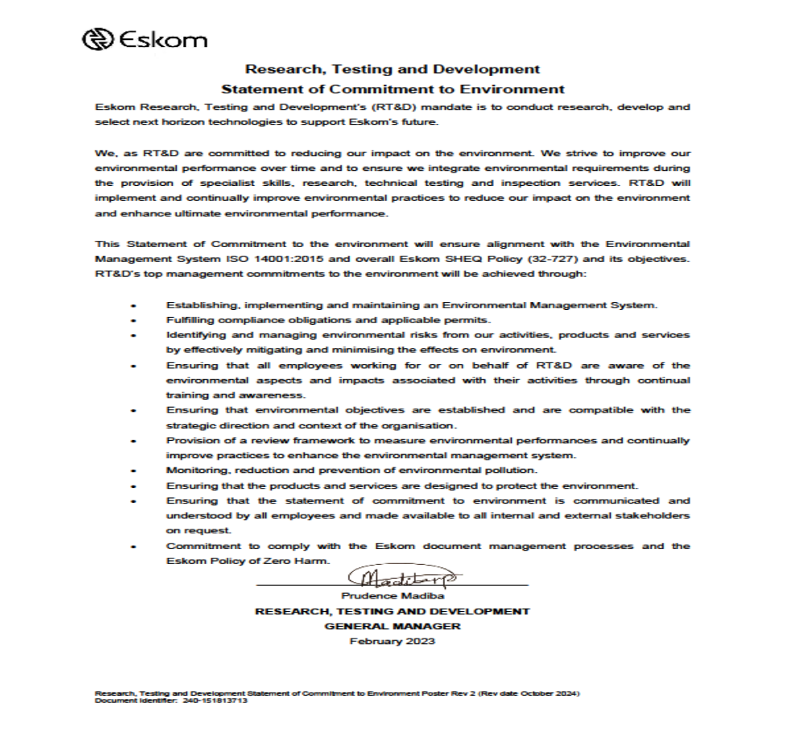
Environmental Policy
Environmental Policy
The contractor must submit an Environmental Policy and proof of communicating it with the employees (project team). The policy should demonstrate your organization (top management)’s commitment to protection of the environment which is not only intended to prevent adverse environmental impacts through prevention of pollution, but to protect the natural environment from harm and degradation arising from the organisation’s activities, products and services . The policy must also demonstrate commitment to compliance with legal and other requirements, prevent pollution and continually improve environmental performance..

