Slide 1
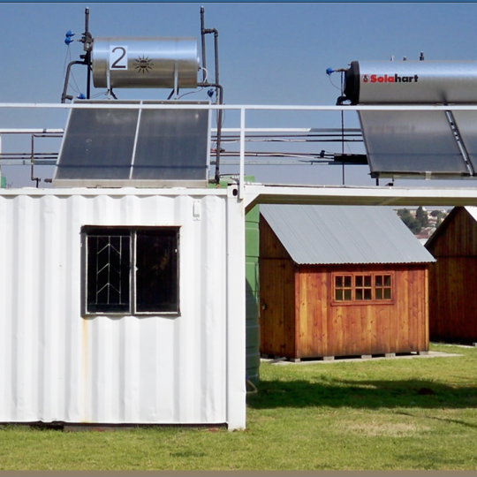
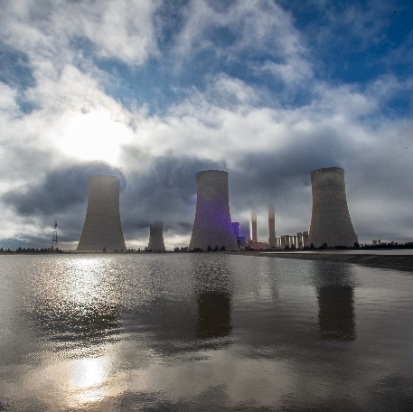
Feedback
Lwazi Nzama. T
PPU Audit technical criteria 14 August 2026

Slide 2
Mandatory requirements
Electrical Trade tested person-
Valid pre-paid training certificate- OTO 06A, OTO 06E, OTO 06G
Valid LV Regulation certificates (LVOR001) OR Valid LV Authorisation certificate,
Performing work on energized LV network, L3 E06
Valid ORHVS certificate OR Valid ORHVS Outcome 3 Authorisation certificate
Transport- 2X (4X2 LDV)
Electrical Contractor Registration
Note: All certificate copies must be certified as per requirement.
If any of the mandatory is not met, tenderer will be disqualified. Evaluation will not move to stage 2.

Slide 3
Functional scoring stage
Valid pre-paid training certificate- OTO 06A, OTO 06E, OTO 06G | Certified certificate With Modules OTO 06A, OTO 06E and OTO 06G | All submitted certificates must be accompanied by Validation letter. A person who is name appears in the certificate must be employed by tendering company. An affidavit not older than 3 Months, signed in front of commissioner of auth, must accompany any certificate. | 1 certificate =10 2 certificates = 15 Total Marks= 15
Valid LV Regulation certificates/Valid LV Authorisation certificate Valid ORHVS certificates/Valid ORHVS Outcome 3 Responsible person Authorisation certificate | Certified certificate LVOR 001 Certified certificate ORHVS | All submitted certificates must be accompanied by Validation letter. A person who is name appears in the certificate must be employed by tendering company. An affidavit not older than 3 Months, signed in front of commissioner of auth, must accompany any certificate. All submitted certificates must be accompanied by Validation letter. A person who is name appears in the certificate must be employed by tendering company. An affidavit not older than 3 Months, signed in front of commissioner of auth, must accompany any certificate. | 1 certificate= 10 2 certificates= 15 Total marks= 15 1 certificate= 10 2 certificates= 15 Total marks= 15

Slide 4
Technical Criteria continue
Performing work on energized LV network, L3 E06 | Certified certificate L3E 06 | All submitted certificates must be accompanied by Validation letter. A person who is name appears in the certificate must be employed by tendering company. An affidavit not older than 3 Months, signed in front of commissioner of auth, must accompany any certificate. | 1 certificate= 10 2 certificates= 15 Total marks= 15
FAS and Valid FAS Rescue Certificates | Certified certificate WFH 001 and Rescue | All submitted certificates must be accompanied by Validation letter. A person who is name appears in the certificate must be employed by tendering company. An affidavit not older than 3 Months, signed in front of commissioner of auth, must accompany any certificate. | 2 WFH certificate=5 1 FAS Rescue certificate= 5 Total Marks= 10

Slide 5
Technical Criteria Continue Vehicles
Transport- (4X2 LDV) and staff vehicle | The registered vehicle must be roadworthy, and registration is valid (not expired) at the time of tendering | Vehicles must be under the tendering company or Director of the company. Staff vehicle should be either a double cab LDV, SUV or Combi bus | 1 vehicle (4X2 LDV) =5 1 Staff vehicle= 5 Total=10

Slide 6
Tools evaluation
Ensure that tools photos are in color and all information is visible where applicable. No score will given if not in color.
Tool | Data | Clarification notes | Marks
Fiberglass Ladder | Length marking must be clearly visible | This should be able to extend up to 11 meters long | 2
Trimble/EDA | It must specify the version data information | Be compatible with Eskom software | 2
Laptop/PC | Make and type must be clear visible | Be compatible with Eskom software | 2
Electrician hand toolbox with tools | Show all tools | Must have basic hand tools | 2
Face shield and rubber gloves | Marking must be clear visible | Must be rated for 1000V AC/DC | 2
Voltage tester (Duspol) | Marking must be clear visible | Must be able to detect up to 1000V | 2
Multi- meter tester to measure Volts and Amps | Marking must be clear visible showing voltage and amps scales | range from 1V to 1000V 100mA to 10Amps | 2
Earth leakage tester | Marking must be clear visible | Be able to detect from 10mA upwards | 2
PPE suitable for PPU audit | Show each PPE unit | (Work wear, hard hat with chin strip, safety shoes, FAS belt and general hand gloves) | 4

Slide 7
Conclusion

