Slide 1
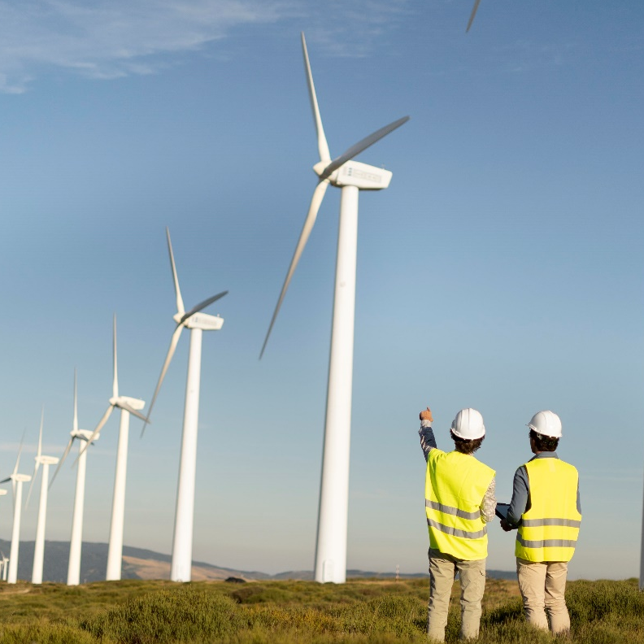
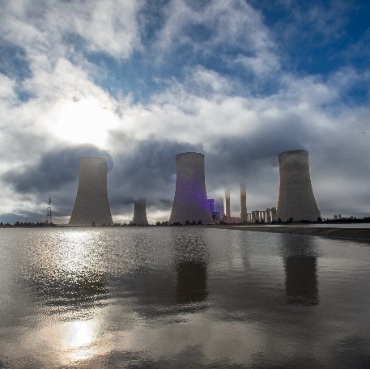
Non-Compulsory Clarification Meeting
E1022GXPEAK: Provision of Open Cycle Gas Turbine (OCGT) Trim Balancing at Ankerlig and Gourikwa Power Stations on an “as and when” required basis for a period of 5-yeards
Presented by: Kim Hughes
Date : 19 March 2025

Slide 2
Agenda
Item | Topic Discussion | Presenter
1. | Welcome and Introduction | Kim Hughes
2. | Safety Message | Kim Hughes / Pumi Tengani
3. | Commercial Requirements | Kim Hughes
4. | E-Tendering Presentation | Kim Hughes
5. | NEC Service Information Technical Evaluation Criteria | Khangelwa/ Mashudu Mulaudzi Leonard Calana /Tinus Keyser/Kim Hughes
6. | Contractual Requirements Safety Quality SDL&I Financial Due Diligence | Pumi Tengani (Safety) Lynn Allies/Thokozile Kolweni (Quality) Phinda Ndabula (SDL&I) Kim Hughes (Financial Due Diligence)
7. | General & Questions | All

Slide 3
Commercial Requirements
Deadline for Tender Submission :
Tuesday, 08 April 2025 at 10h00 (South African Standard Time)
Tenders to be submitted online via Eskom E-Tendering Platform.
Deadline for Clarification Questions:
5 working days prior to tender closing. 01 April 2025
Process for Submitting Clarification Questions :
Clarification questions must be made in writing and send to the Buyer, Kim Hughes via e-mail Hughesk@eskom.co.za
Clarification questions will be recorded onto Eskom Template and uploaded on the Eskom Tender Bulletin.
How to access clarification answers :
Tenderers can access the clarification answers via the same platforms where the Tender Documents have been loaded (i.e., National Treasury Tender Portal and Eskom E-Tendering Website.

Slide 4
Eskom E-Tendering
Eskom has introduced a new solution for submitting tenders.
Tenderers will now be submitted via Eskom’s e-tendering page and via the link:
https://www.eskom.co.za/tenders/
Presentation of Videos

Slide 5
Tender Returnables
Refer to pages 11 to 16 of Invitation to Tender Document
This section outlines all tender returnables required and their respective due dates by when these should be submitted.
Note : Display ITT Pages 11 to 16

Slide 6
NEC Service Information
Information pertaining to service information is contained under Part 3 : Scope of Work in Annexure L NEC TSC3 – E1022GXPEAK.
This document has been issued with the tender package.

Slide 7
Technical Evaluation Criteria
The Technical Evaluation Criteria applicable for this Tender Enquiry No. E1022GXPEAK is outlined in Attachment 4 (issued with this tender) and stipulated under section 3.13 of the invitation to tender document.
Note : Display Evaluation Criteria

Slide 8
Contractual Requirements
Mandatory Contractual Requirement:
Proof of CSD Number/ Registration
Safety:
The following documents will be required as part of SHE Tender returnable:
Annexure B - acknowledgement of Eskom's OHS legal and other requirements form.
Health and Safety plan - must be aligned with the scope of work. OHS risk(s) and with the health and safety specification provided.
Costing for Health & Safety management- the cost must be broken down and not be as a provided as a lump sum.
Baseline OHS Risk Assessment (BRA) - Identification, assessment, and management of OHS risks related to the scope of work. The methodology used for the risk assessment must be provided together with the BRA.
Valid Letter of Good Standing - COIDA or equivalent.
OHS policy signed by CEO - The submitted policy must comply to OHS Act Section 7.
OHS Competency- Consider scope of work, risks, OHS plan and applicability) CV’s and qualifications / certificates

Slide 9
Contractual Requirements Continued
Quality:
Category 3 quality requirements will apply.
The following documents will be required as part of Quality Returnables:
Complete Quality Requirements Standard for Category 3 requirements and provide the stipulated information into evidence to demonstration of compliance to the requirements, including submission of the following:
• A Quality Control Plan / Inspection Test Plan
• Contract Quality Plan
The applicable specification for quality requirements with document reference number 240-105658000 has been included with the tender package for information to tenderers.
SDL&I:
SDL&I Undertaking has been issued with the invitation to tender as Attachment 3. (Note: Display SDL&I Strategy)
Financial Due Diligence:
Evaluation of the Financial reports / statements may be requested prior contract award to determine if the tenderer is of a financial risk to Eskom.

Slide 10
Questions ???
Tenderer | Tenderer Question | Eskom’s Response

Slide 11


End of Presentation
Thank you

