Slide 1
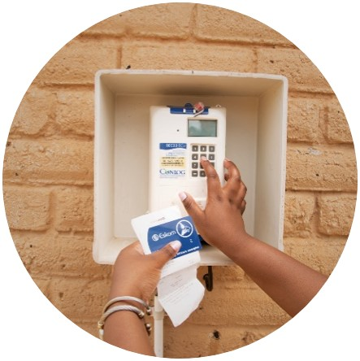
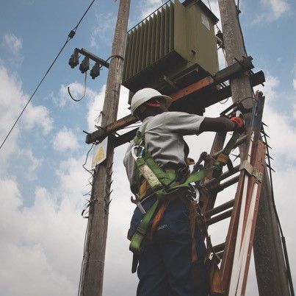
The Supply, Delivery, Servicing, Calibrating, Training, Maintenance and Repair of all hydraulic and battery-operated Crimping and Cutting Tools
Presented by Gwen Alexander
Date: 10 December 2025

Slide 2
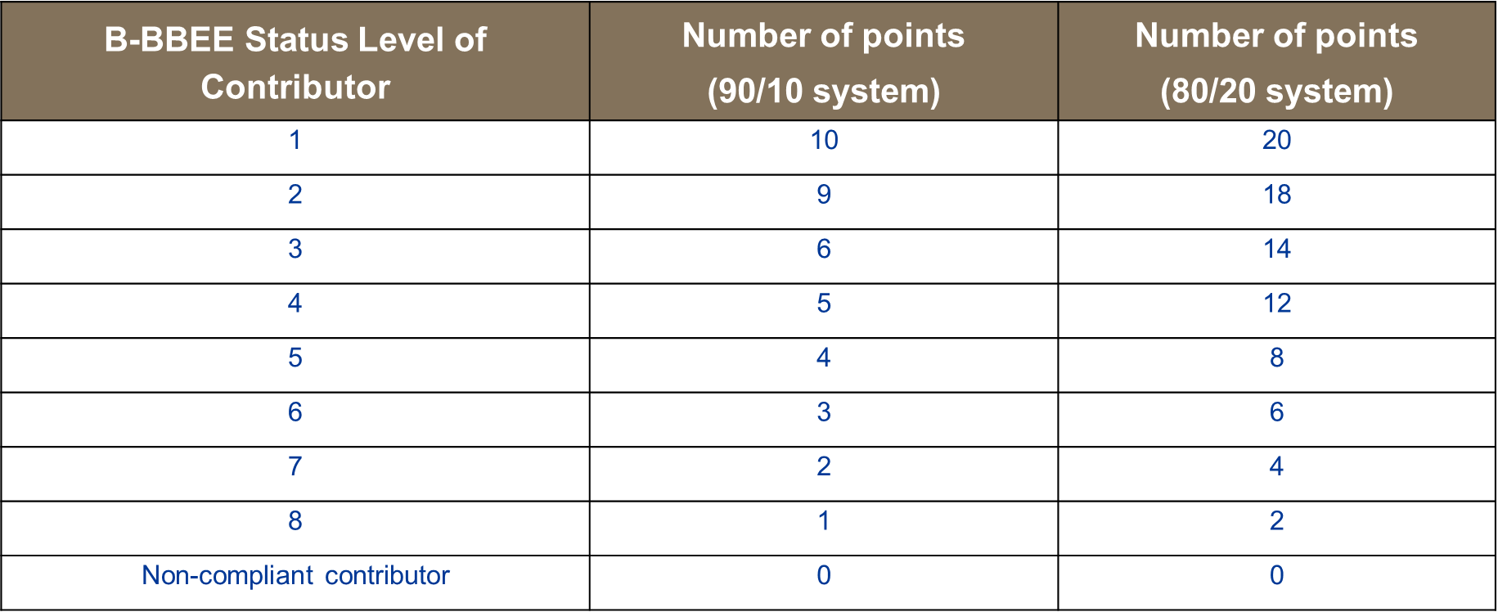
Preferential Scoring

Slide 3
SDL&I Requirements
NO PREQUALIFICATION CRITERIA:
This enquiry is open to EME, QSE and LME Service Providers
REQUIREMENT
All Tenderers must submit proof of their BBBEE Status based on the turnover on their Financial Statements (this is to verify that you are submitting the correct sworn affidavit)
  EME (up to R10 Million) - Valid copy of Sworn Affidavit or valid copy of BBBEE Certificate issued by CIPC
  QSE (Above R10 Million and up to R50 million) - Valid copy of Sworn Affidavit/ Valid copy of BBBEE Certificate issued by a SANAS accredited verification agency
  LME (Above R50 Million) - Valid copy of BBBEE Certificate issued by a SANAS accredited verification agency
  Joint Ventures - Valid copy of BBBEE Certificate (in the name of the Joint Venture) issued by a SANAS accredited verification agency

Slide 4
Key Elements on how to complete a Sworn Affidavit
Tenderers submitting B-BBEE Sworn Affidavits must ensure that the affidavits meet the following key pointers to ensure their validity:
a) Name/s of deponent as they appear in the identity document and the identity number.
b) Designation of the deponent as the director, owner or member must be indicated in order to know that person is duly authorized to depose of an affidavit. (Underline or circle whichever is applicable).
c) Name of enterprise as per enterprise registration documents issued by the CIPC, where applicable, and enterprise business address.
d) Percentage of black ownership, black female ownership and designated group. In the case of specialised enterprises as per Statement 004, the percentage of black beneficiaries must be reflected. (No blank spaces to be left).
e) Indicate total revenue for the year under review and whether it is based on audited financial statements or financial statements. (Underline the applicable option).
f) Financial year end as per the enterprise’s registration documents, which was used to determine the total revenue. (Financial year end to be stipulated by day/month/year).
g) B-BBEE Status level. An enterprise can only have one status level.
h) Empowering supplier status must be indicated
i) Date deponent signed and date of Commissioner of Oath must be the same. (The sworn Affidavit must be signed in the presence of the Commissioner of Oath).
j) Commissioner of Oath cannot be an employee or ex officio of the enterprise because, a person cannot by law, commission a sworn affidavit in which they have an interest
K) Sworn Affidavits attested / signed by a Commissioner of Oaths as a true copy stamp will not be accepted

Slide 5
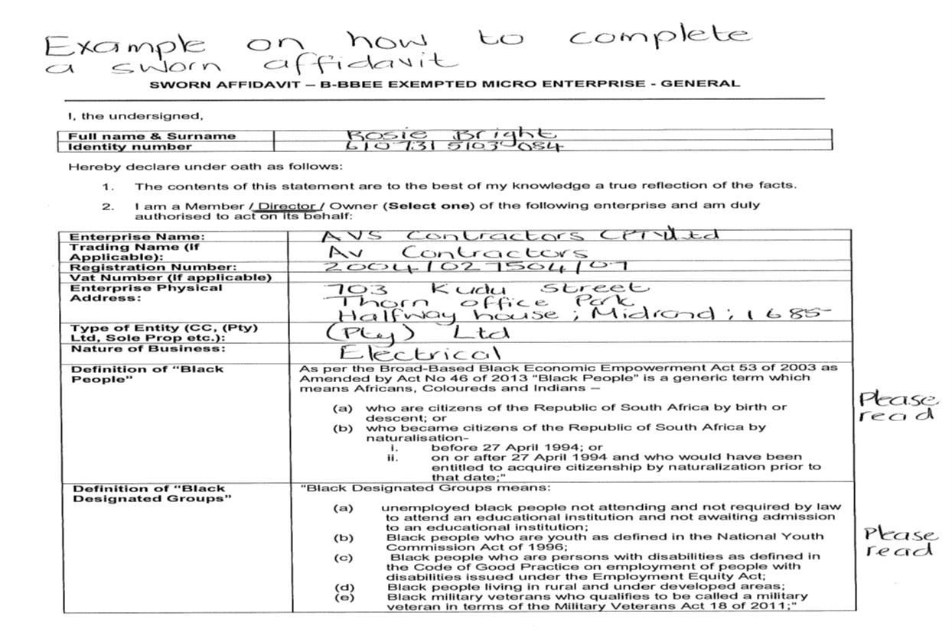
Example on how to complete a sworn affidavit - page 1

Slide 6
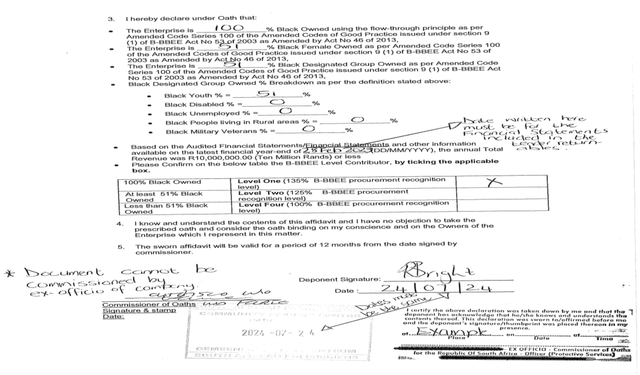
Example on how to complete a sworn affidavit – page 2

Slide 7
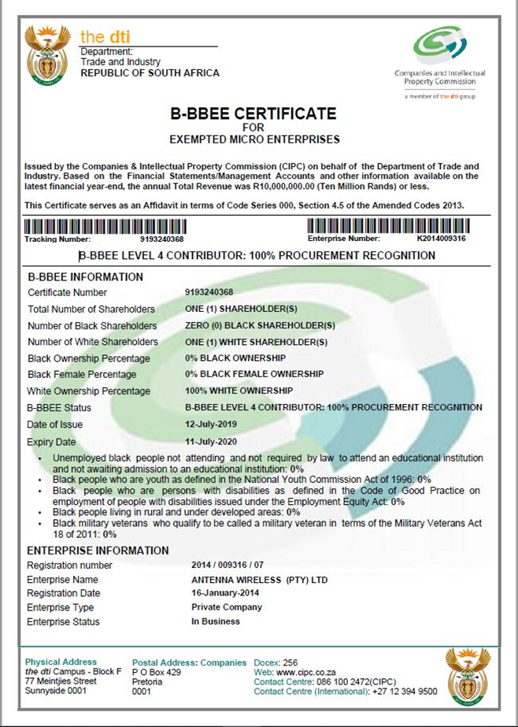
Example of a BBBEE certificate for Exempted Micro Enterprises

Slide 8
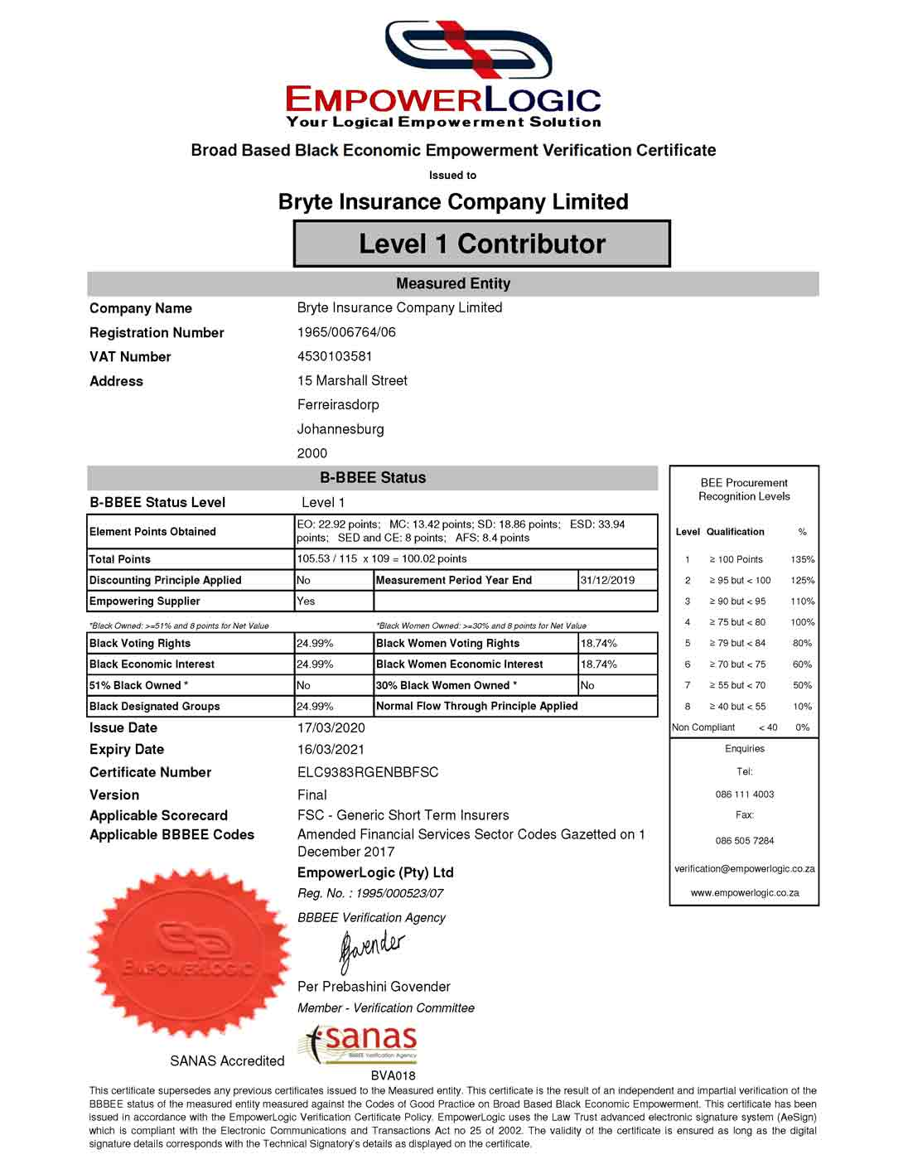
Example of an accredited BBBEE Certificate

Slide 9
Supporting documents to be submitted
Proof of ownership / shareholding (preferably CIPC documentation) inclusive of shareholding breakdown
Shareholders certificates
ID copies of shareholder(s) or owners of the business
Proof of disability of owner of the company (where applicable)

Slide 10
Local Procurement
Tenderers are required to submit their proposals in the table below:
Local Procurement Content | Eskom target | Tenderer Proposal
 | 100%

Slide 11
Procurement spend on entities with a minimum of 51% black ownership
Procurement from Designated Group | Eskom Target | Tenderer Proposal
Black Owned | 4.0%
Black Women Owned | 3.0%
Black Youth Owned | 2.0%
Black Persons with Disability | 1.0%

Slide 12
Jobs Created and Jobs Retained
Jobs to be created | Jobs to be retained

Slide 13
Skills Targets
All Service Providers to propose targets against the Eskom targets
Skill type / Occupation | Eskom target | Proposed Number of Candidates
N4 Civil or Electrical Engineering (FET or TVET) | 3
N5 Civil or Electrical Engineering (FET or TVET) | 3
N6 Civil or Electrical Engineering (FET or TVET) | 3

Slide 14
Bidder’s Document Signature
Name of tenderer:
Tenderer representative:
Representative signature:
Date:

Slide 15
INFORMATION TO NOTE:
All companies awarded a contract with Eskom need to be compliant throughout the contract period.
Documents that need to remain compliant are as follows:
  Letter of Good Standing (COIDA)
  BBBEE Certificate / Sworn Affidavit
  Taxes to be up to date with SARS
  Annual return needs to remain up to date with CIPC
  Any Changes in ownership needs to be communicated to Eskom Procurement Department as soon as possible to allow Eskom to complete the Due Dilligence process.
  Failure to adhere to the above could result in task orders and payment been delayed.

Slide 16
SDL&I Checklist
This Checklist can be used for guidance on submission of tender documents
 | Documents to complete /sign and submit | Tick Box
1 | SDL&I Bidder’s Document
2 | Valid B-BBEE certificate issued by a SANAS accredited verification agency / Valid sworn affidavit / BBBEE Certificate issued by CIPC for EME companies
3 | CIPC Registration Document
4 | Identity Documents of shareholder(s)
5 | Shares Certificate where applicable
6 | Latest Financial Statements corresponding to the financial date reflected on the sworn affidavit
7 | SBD 6.2 | N/a
8 | Annexure C | N/a
9 | Annexure D | N/a
10 | Annexure E | N/a
11 | Proof of sub-contracting agreement/s | N/a
12 | Sub-contractor/s valid B-BBEE certificate issued by a SANAS accredited verification agency / valid sworn affidavit / BBBEE Certificate issued by CIPC for EME companies | N/a

Slide 17
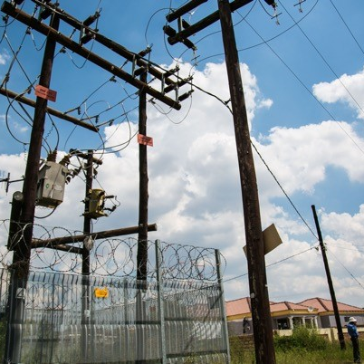
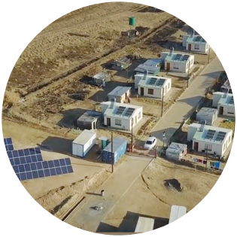
Conclusion

