Slide 1


GCD: Environmental Services Tender
28/10/2025

Slide 2
Environmental Services Contract
Ref: | Eskom Environmnetal Requirements Checklist: A service provider needs to have Knowledge of South Africa Environmental laws and regulations and implementation experience within project planning and construction. Knowledge of South African regulations is important due to Eskom’s role in providing energy generation facilities (including coal, renewables, and transmission and distribution infrastructure) and commitment to environmental Managememt. | Required with the tender submission | Submitted Yes | Submitted No
1 | Acknowledgement Form
1.1 | Provide a copy of your Acknowledgement form for Eskom Environmental legal and Other Requirements? | ü
2 | Environmental Management System
2.1 | Provide a copy of your Environment Policy that is signed by Senior Management/ Executives? | ü
3 | Environmental Costing
3.1. | Provide an example of detailed costing for Environmental- based on the overall scope of work/services. | ü

Slide 3
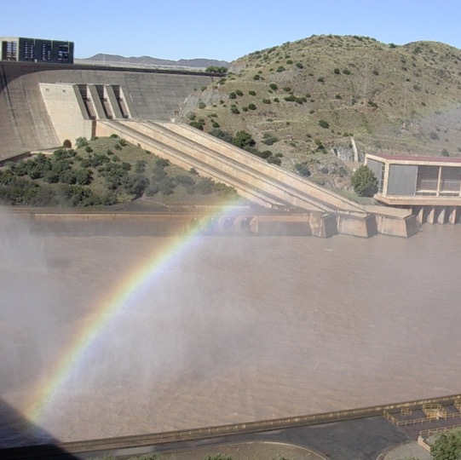

Thank you

