Slide 1


Supply, delivery, installation, and commissioning of clarifier sludge level detection for cooling water and raw water testing at Lethabo power station
Presented by: Jeanette Hantsi/ Happiness Kolo
14 November 2025

Slide 2
Background
The cooling water (CW) and Raw water clarifiers are currently de-sludged either manually by the plant operators or de-sludged via a time-based system
This is not optimal as the sludge level is critical for the operation of the system
If the sludge is too high, floc carryover occurs resulting in high turbidity and possible scale formation in the cooling water system.
The recovery of ash into the clarifiers also increase the high level of hardness salts in the sludge pockets and hence the frequency and duration of sludge blowdown needs to be adjusted
Sludge level detectors aid in the automation and control of water treatment clarifiers and will thus be of value to plant operations
The aim of this this project is to install sludge level detectors that are suitable for Eskom CW and Raw water systems at Lethabo Power Station.

Slide 3
Requirements for the service
Supply, delivery, installation, and commissioning of clarifier sludge level detection for cooling water and raw water for research testing and development.
The Sludge level detectors to be delivered, installed and commissioned at Lethabo Power Station.
Testing of the Sludge level detector will be conducted over a period of 6 months whereby the detector will be first installed at the raw water clarifier for a period of 90 days to collect data, then moved to the cooling water clarifier for a period of 90 days to collect data.
Submit project proposals for the online detection and continuous recording of sludge levels in CW and Raw Clarifiers.
The employer shall approve the proposal before the start of the service.
Provide the employer with monthly reports, the reports must include all the operational and analysis of the data, commissioning, and maintenance philosophy of all testing equipment

Slide 4
Deliverables
Detailed technical specification of the sludge level indicator to be installed including among others: drawings, operating ranges, sensitivities, limits of detection, equipment limitations, materials of construction etc.
Method statement on the instrument will be installed in the existing plant and an indication of any required modifications.
The supplier must include provision of a data logger with a minimum recording of one data point every 30 minutes.
The data from the data logger must be able to be downloaded and exported to excel.
The supplier will be required to provide a weekly data download of the sludge levels.
The supplier must provide a proposal on how the sludge levels displayed on the instrument will be validated.

Slide 5
Deliverables
Installation requirement of the technology (mechanical, electrical, C&I, civil, structural etc) for the demonstration.
Utility requirements (electricity, water, etc).
Information on the operating and maintenance requirements of the detector (operating and
maintenance manuals).
The cost of the demonstration equipment (it must include supply, delivery, installation, and
commissioning).
The operating cost of the sludge level detector.
The supplier must provide an indication of cost to relocate the instrument to the same site or different site and associated equipment
Should it be required (transport cost in rands per kilometre, removal, re-installation, and commissioning costs).
Indicate any exclusions from the supplier and modifications to be undertaken by the Employer.

Slide 6
Deliverables
The expected lead time for installation.
The supplier must operate and maintain (including providing for all consumables and spares) the demonstration.
Detailed training plan to train the Employers staff to operate and maintain the technology.
Provision of operating data for 90 days from an existing and operational Cooling Water clarifier.
Provision of operating data for 90 days from an existing and operational Raw water clarifier.

Slide 7
Evaluation Criteria
Technical Criteria | Weight | Evaluation Returnable | Technical scoring
1.Company experience | 15% | Company profile detailing the number of years in the process instrumentation industry. | Less than 3 years’ experience or no information submitted - 0% Greater than 3 years but less than 4 years’ experience - 40% Greater than 4 years and less than 5 years’ experience – 80% 5 years’ experience and more – 100%
2. Company must have experience in commercial applications of process instrumentation | 15% | Number of commercial application projects company involved in. This must include: a. Project Title and Scope of project for each project b. Contact details of customer (Employer reserves the right to contact the customer) c. Purchase order number of project | 0 projects or no information – 0% 1 or more projects with all requested (a,b,c) information – 40% 2 or more projects with all requested (a,b,c) information – 80% 3 or more projects with all requested (a,b,c) information and one of the projects is for sludge level detection – 100%
3. Tenderer must be able to train Eskom employees (3) (knowledge transfer) | 10% | Signed Company letter stating willingness to train Eskom employees provided and draft training program provided. | No training confirmation provided – 0% Confirmation of training to be provided – 40% – 40% Confirmation of training to be provided and Draft training program – 80% Confirmation of training to be provided and signed training program provided – 100%
4. Tenderer to indicate in detail how the Sludge Level that is determined via the use of their instrument will be validated/verified against the existing plant. | 10% | Method Statement | No information provided or information provided does not address the requirement – 0% Tenderer provides detailed description on how the instrument will be validated/verified against the existing plant 100%
5. Tenderer to provide Detailed Method statement which indicates how the instrument will be installed on the existing plant including all required modifications to enable this. | 15% | Method Statement | No information provided or the information provided is incomplete – 0% Detailed Method statement indicating both installation requirements and required modifications is provided. The modifications and installations require plant outages of more than seven (7) days – 40% Detailed Method statement indicating both installation requirements and required modifications is provided. The modifications and installations require short plant outages of less than or equal to seven (7) days – 80% Detailed Method statement indicating both installation requirements and required modifications is provided. The modifications and installations require plant outages no greater than two (2) days – 100%

Slide 8
Evaluation Criteria
6. Tenderer to provide Detailed technical specification of the sludge level indicator to be installed including: Drawings, Operating ranges, Limits of Detection, Equipment limitations and sensitivities, 5. Materials of construction | 15% | Detailed Technical Specification | Tenderer provides no information or less than three (3) out of the five (5) items requested – 0% Tenderer provides detailed technical specification which includes three (3) out of the five (5) items requested – 40% Tenderer provides detailed technical specification which includes four (4) out of the five (5) items requested – 80% Tenderer provides detailed technical specification which includes all items all five (5) items requested – 100%
7. Proposed detailed project plan (which covers the design, supply, installation, commissioning, testing, operation, dismantling and removal of equipment, and reporting. | 10% | Project Schedule | Tenderer provides no information or less than four (4) out of the eight (8) items requested – 0% Tenderer provides detailed schedule which includes four (4) out of the eight (8) items requested – 40% Tenderer provides detailed schedule which includes five (5) out of the eight (8) items requested – 80% Tenderer provides detailed schedule which includes all items all eight (8) items requested – 100%
8. Tenderer to provide fully signed Quality Control Plan (QCP) from a previous process instrumentation project. | 10% | Quality Control Plan | Tenderer provides no information– 0% Tenderer provides quality control plan (signed, partially signed or unsigned) which does not cover all elements of a project– 40% Tenderer provides partially signed QCP which covers all elements of a project – 80% Tenderer provides fully signed QCP which covers all elements of a project – 100%
The qualifying threshold for all the suppliers is 70%

Slide 9
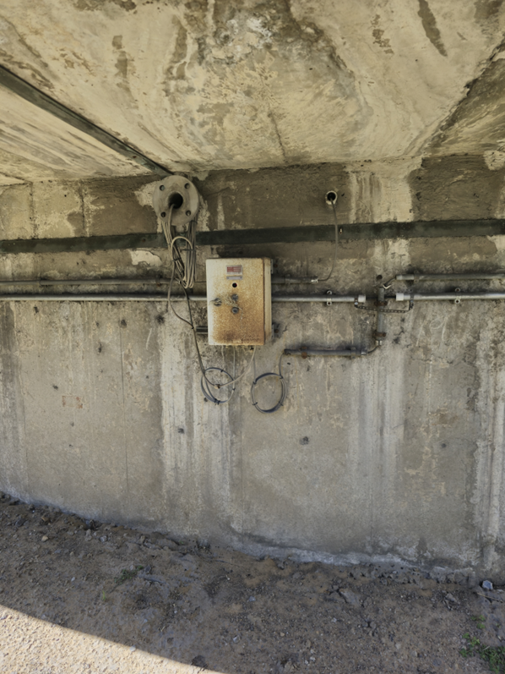
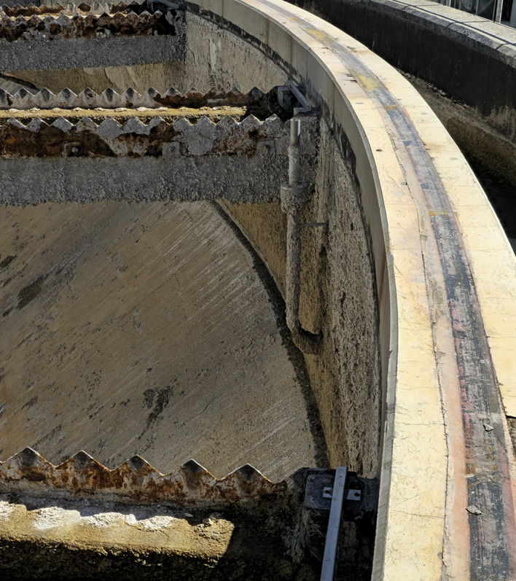
Lethabo PS Clarifiers

Slide 10
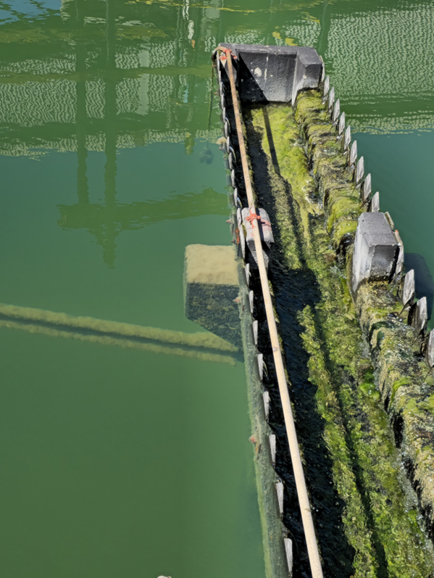
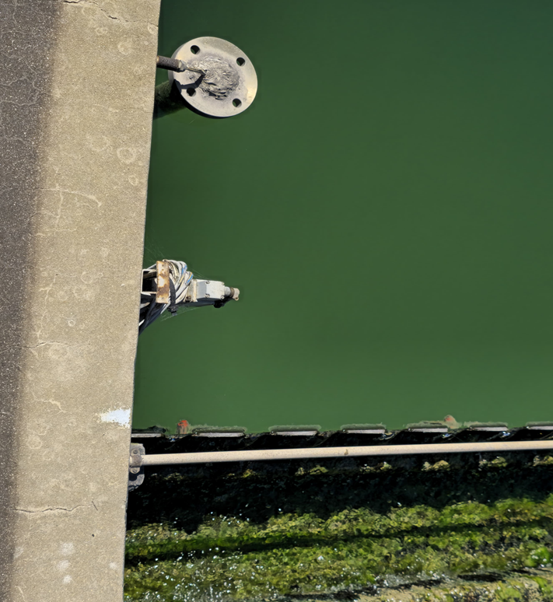
Lethabo PS Clarifiers

Slide 11
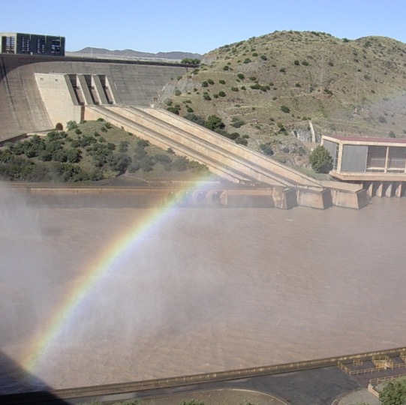

Thank you

