Slide 1
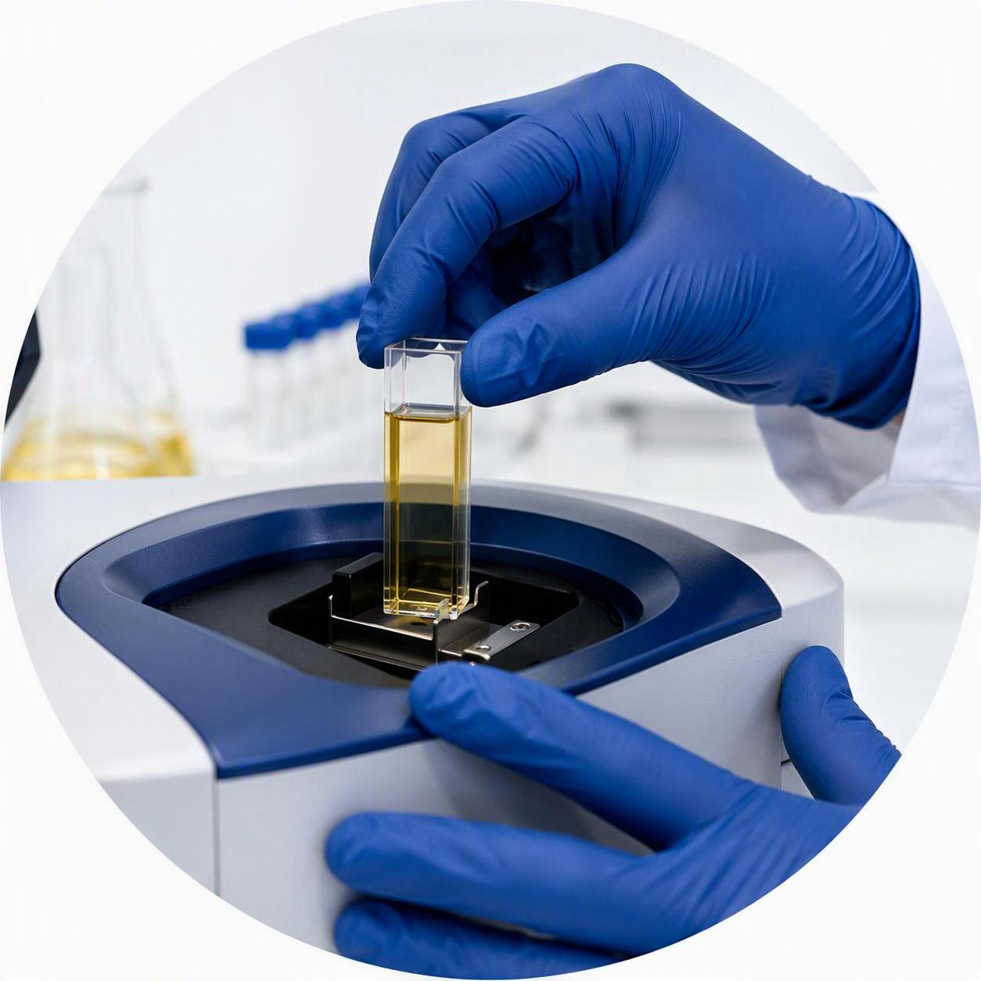
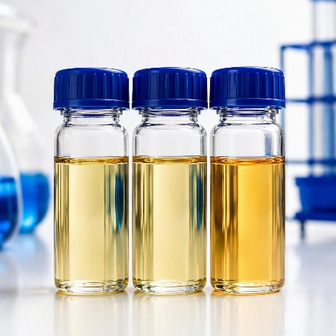
NIRS
Technical clarification
Vusumuzi Sibeko
Rosherville Oil Laboratory
Notes:
Technical clarification only. Commercial terms and costs are outside this presentation.
[Sources]
Procurement Purchase Request NIRS Rev1.pdf, pages 1–4.
Cover images: AI-generated illustrative laboratory scenes. They do not depict a specified supplier or offered NIRS system.
[/Sources]

Slide 2
Our laboratory and the need for NIRS
We test transformer oil to monitor asset condition and investigate oil degradation and contamination.
Current challenges
How NIRS would help
High sample volumes and tight turnaround times
Separate manual tests for moisture, acidity and antioxidant content
Routine testing leaves less time for investigations
Predict several oil properties
from a single scan
Automate routine testing and reduce sample preparation
Support contamination studies and research on alternative insulating fluids
We need one NIRS system at Rosherville, with validated oil models and operator training.
Notes:
[Sources]
Procurement Purchase Request NIRS Rev1.pdf, sections 2, 5 and 6, pages 2–4.
[/Sources]
The range values are examples in the request, not newly imposed limits. Section 5 requires at least moisture, TAN and antioxidant models. Section 6 additionally lists furans. Section 6 cites ASTM D8092 as an example; the applicable validation methods require confirmation. No claim of automatic compliance or proven prediction accuracy is made here.
Technical specification reference retained from the previous slide:
NIRS scope and technical requirements
One FT-NIR or dispersive NIR system: supply, delivery, installation and commissioning at Rosherville Oil Laboratory.
Instrument and sample handling
Near-infrared coverage, e.g. 800–2500 nm or 12,000–4,000 cm⁻¹.
Resolution: ≤10 nm or ≤8 cm⁻¹, suitable for liquid hydrocarbons.
Automated or semi-automated flow-cell / vial changer for mineral transformer oil.
Measurement: ≤1 minute per sample, including cell flush, with minimal cleaning.
Power supply: 100–240 V, 50/60 Hz.
Models, software and validation
Pre-loaded or user-developable models for moisture, TAN, furans and antioxidant (DBPC/DBP).
PLS, PCA and SIMCA modelling, calibration development and spectral library search.
Signal-to-noise adequate for trace prediction. Confirm performance with oil data.
Relevant ASTM / IEC validation, plus manuals, calibration guides and protocols.
Source: Procurement Purchase Request NIRS Rev1, pp. 2–4
Context source: Procurement Purchase Request NIRS Rev1.pdf, sections 1, 3 and 4, pages 2–3. The lab supports transformer-oil condition monitoring and non-routine investigations at RT&D. Manual tests constrain throughput and turnaround. Faster multi-parameter prediction and reduced sample preparation are intended NIRS outcomes, subject to validated calibration models. Alternative-fluid and degradation research are intended applications, not proven performance of an offered instrument.
Source: Procurement Purchase Request NIRS Rev1, pp. 2–4

Slide 3
What suppliers need to demonstrate
75%
Technical threshold
100% total weighting
Evaluation area | Weight | Key point
Instrument fit | 30% | Meets the oil-analysis specification
Prediction quality | 20% | R² evidence for moisture, TAN and antioxidant
Speed and automation | 15% | ≤1 minute per sample, including cell flush
Support | 15% | ≥3-year warranty, <48-hour on-site response, local spares
Relevant experience | 10% | Proven NIRS installations in SA oil / power labs
Training | 5% | At least 2 days for up to 5 operators, with model building
Delivery | 5% | Clear delivery and commissioning schedule
Scoring and warranty wording in the request still require confirmation.
Notes:
[Sources]
Procurement Purchase Request NIRS Rev1.pdf, section 5 and Technical Evaluation Criteria, pages 3–5.
[/Sources]
Detailed scoring as written in the source, not corrected: instrument specifications 30%, pass/fail, failure of any critical specification disqualifies. Prediction performance weight 20% but bands award 10% for R² >0.95 for all three, 5% for 0.90–0.95 and 0% below 0.90. Throughput: ≥60 samples/hour 15%; 30–59 7.5%; <30 0%. Warranty/support: 3 years + <48 hours + spares in RSA + ≥2 local technicians 15%; 2 years or one missing item 7.5%; <2 years or poor support 0%. Experience: ≥3 installations 10%, 2 installations 6%, 1 installation 3%, none 0%. Training: comprehensive ≥2 days including model building 5%; basic operation only 2.5%; none 0%. Timeline: ≤8 weeks 5%; 9–12 weeks 2.5%; >12 weeks 0%. Total stated 100%; threshold 75%. These rules require clarification before evaluation. Full detailed bands retained here to keep the four-slide summary readable.
Meeting reference: integrated from former slide 4
Technical points requiring clarification
01
Prediction scoring
The criterion carries 20%, but its highest stated score is 10%. Confirm the intended scoring scale.
02
Critical specifications
Identify the disqualifying requirements and how pass/fail compliance earns the stated 30% weight.
03
Warranty and support
Reconcile the minimum 3-year warranty with the evaluation band that awards points for 2 years.
04
Models and validation
Confirm whether furans are mandatory, who develops the models, and the applicable ASTM / IEC validation methods and acceptance limits.
05
End-to-end throughput
Confirm that the demonstrated sample rate includes flushing and cleaning, and meets the ≤1-minute measurement requirement.
Discussion boundary: technical requirements, evidence and acceptance criteria only.
Source: Procurement Purchase Request NIRS Rev1, pp. 3–5; clarification questions derived from the source
[Sources]
Procurement Purchase Request NIRS Rev1.pdf, sections 5–6 and technical evaluation table, pages 3–5.
[/Sources]
These are proposed clarification questions, not approved amendments to the request. Technical questions only. No changes to evaluation rules are assumed. The former thank-you slide uses the current deck’s title-and-content layout to accommodate the required technical discussion within the user-confirmed four-slide limit.
Slide 2 already includes furans in the current user-edited model scope. Preserve that scope. The original request has a scope/specification mismatch, so its evaluation treatment can be discussed if raised. No scoring rules or warranty requirements have been silently amended.
Detailed supplier evidence retained for reference:
Criterion | Weight | Evidence and deliverables
Instrument specifications | 30% | Compliance statement, datasheets and validation methods.
Critical specifications: pass/fail.
Prediction performance | 20% | R² for moisture, TAN and antioxidant.
Model scope, development and acceptance limits.
Throughput and automation | 15% | Demonstrated sample rate and automation.
≤1 minute per sample, including cell flush.
Warranty and support | 15% | ≥3-year warranty, <48-hour on-site response and local spares.
Local technician capability.
Supplier experience | 10% | Similar NIR installations in South African oil / power labs.
Client references with purchase orders or contracts.
Training programme | 5% | ≥2 days on site for up to 5 operators, including model building.
Software licence, manuals and validation documentation.
Project timeline | 5% | Delivery and commissioning schedule after purchase order.
The visible table summarises the existing evaluation criteria. It does not change specification limits, weights, scoring rules, warranty requirements or the technical threshold. See the source request and these notes for full details.
Source: Procurement Purchase Request NIRS Rev1, pp. 3–5

Slide 4

NIRS technical clarification
Thank you
Questions?
Rosherville Oil Laboratory
Notes:
Closing discussion.
[Sources]
Image: AI-generated conceptual artwork created for this presentation. The visible blue light is an artistic metaphor for spectroscopy, not a depiction of infrared radiation, instrument output or an offered product.
[/Sources]

