Slide 1

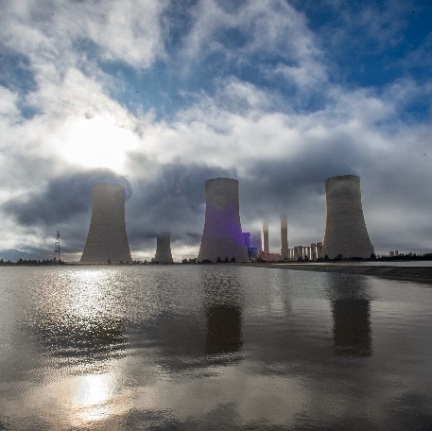
ENVIRONMENTAL PRESENTATION CRITERIA
Benito Williams / Winnie Sebogodi / Vuyazi Mongwe
2026

Slide 2
1. ACKNOWLEDGEMENT OF ESKOM'S SHE RULES AND REQUIREMENTS
Pre-requisite
Is the acknowledgement of Eskom's SHE rules and requirements form (Annexure B) signed and a copy thereof attached to this tender submissions by the tenderer?
Duplicate copy MUST be added to the Environmental Tender submission

Slide 3
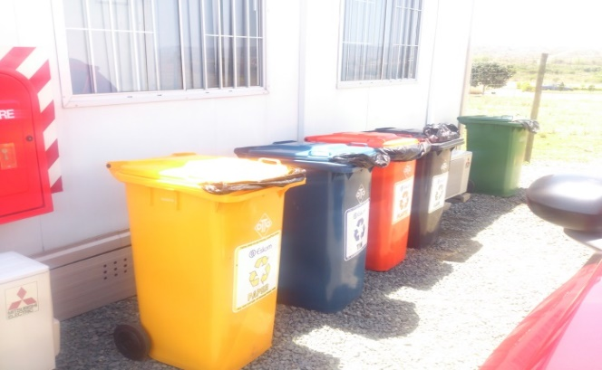

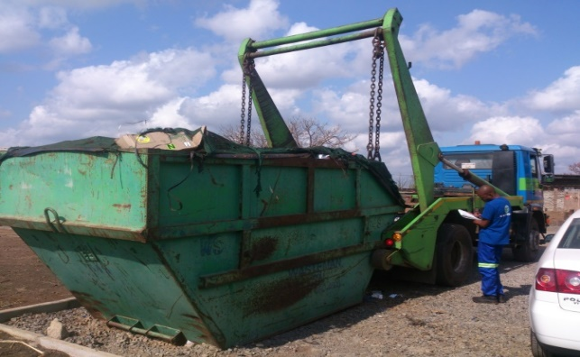
WASTE MANAGEMENT PLAN (WMP)
A WMP should include:
  The contractor’s detailed DESCRIPTION of the different waste streams expected during the RELATED PROJECT/SCOPE;
  How this waste will be STORED, TRANSPORTED AND DISPOSED OF;
  The WMP should also deal with the contractor’s PREVENTION OF POLLUTION, LITTERING AND WASTE MINIMIZATION METHODS SUCH AS REUSE, RECYCLE AND REDUCE

Slide 4

ENVIRONMENTAL INDUCTION & TRAINING
The Contractor shall develop and maintain a documented procedure outlining the method for implementing and managing environmental induction and training programmes.
The procedure shall address both internal and external environmental training, including site-specific inductions for employees, subcontractors, and visitors, as well as any specialized external training requirements.
Thorough consideration must be given when developing a company specific training needs analysis & matrix. The Contractor shall conduct a comprehensive training needs analysis (TNA) to identify competency requirements associated with environmental aspects, risks, and legal obligations.

Slide 5
ENVIRONMENTAL INCIDENT PROCEDURE & REGISTER
The requirement is for a procedure for the management of environmental incidents.
This includes the following, but not limited:
  REPORTING PERIOD;
  REPORTING CHAINS;
  CAPTURING OF INCIDENTS;
  IMMEDIATE & CORRECTIVE ACTIONS;
  KEY LESSONS LEARNED.
This register is in tabular format with the following fields: Description of incident, date of incident, reported to, actions taken and status of recommendations

Slide 6
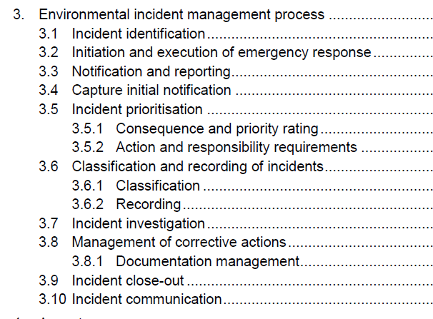
ENVIRONMENTAL INCIDENT PROCEDURE & REGISTER

Slide 7
ENVIRONMENTAL EMERGENCY PREPAREDNESS & RESPONSE PLAN
The Contractor shall establish and maintain a documented procedure that identifies all potential environmental emergencies relevant to site activities. These may include, but are not limited to:
Hazardous chemical or hydrocarbon spillages
Air pollution incidents (e.g. dust, smoke, gas emissions)
Waste management incidents (e.g. illegal dumping, uncontrolled waste release)
Encounters with dangerous wildlife (e.g. bees, snakes, other fauna)
Fire incidents that may result in environmental contamination
Water contamination (e.g. sewage spills, oil entering stormwater systems)
Note: Environmental emergencies exclude natural disasters such as hurricanes, tornadoes, blizzards, and earthquakes.

Slide 8

2. ENVIRONMENTAL POLICY
The Environmental Policy (or SHEQ Policy) shall be: Formally approved and signed by the named Chief Executive Officer (CEO) or Managing Member, demonstrating top management commitment; and dated and reviewed at defined intervals to ensure continued relevance.
MUST include a commitment to environment (Protection of the environment, including prevention of pollution and minimization of environmental impacts arising from operations;) Compliance with applicable environmental legislation and other requirements, including regulatory permits, licences, and client-specific obligations (e.g. Eskom requirements);

Slide 9
PART B
Ref | KPIs | Submission Y = Yes N= No | Actual score | Comments
1 | Annexure B Is the acknowledgement of Eskom's SHE rules and requirements form (Annexure B) signed and submitted by the tenderer?
2 | ISO 14001 Environmental Management Standard certificate.
 | TOTAL |  |  | Approved/Not Approved

Slide 10

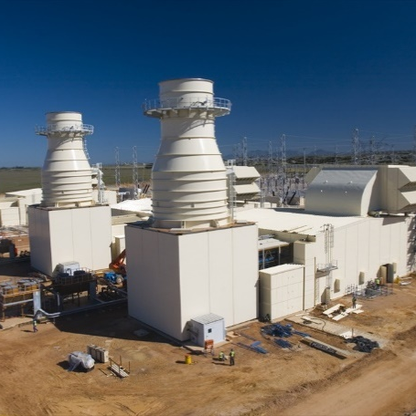
Conclusion

