Slide 1
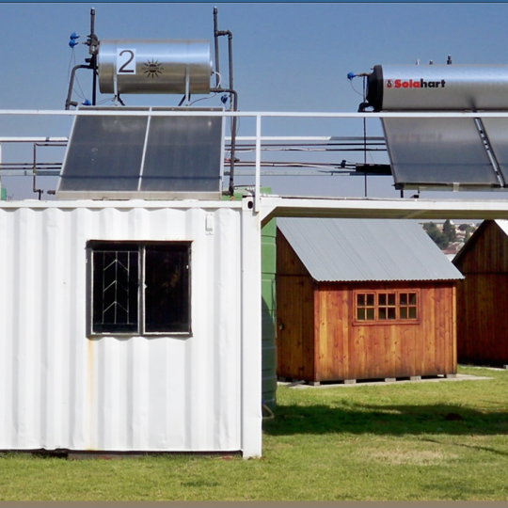
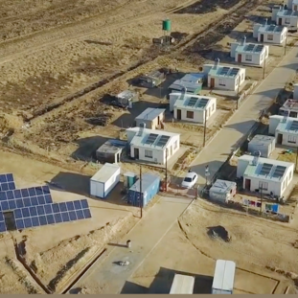
Supplier Quality Management - Quality Requirements
Duncan Ntshangase
28 May 2025

Slide 2
Quality Requirements Category 3
Quality Policy – High level statement of commitment to quality of your organisation
Quality Objectives – Goals and targets set by your organisation pertaining to quality
Control of documented information – How you control documents & records in your organisation
Internal audit procedure – How you manage internal audits in your organisation
Control of nonconforming outputs – How do you manage non confirming outputs of your products or services
Nonconformity and Corrective action procedure – How do you manage NCR’s, correction and corrective actions (preventive actions)
Contract quality plan (CQP) – Eskom template, should address quality assurance elements related to the scope of work e.g. communications and risk management
Quality control plan (QCP) – Eskom template, that details all quality control related activities e.g. Inspections and test procedures
Control of Externally Provided Processes, Products and Services. – How do you manage and control externally provided Processes, Products and Services. Management of sub suppliers and subcontractors
Documented information for roles, responsibilities and authorities. Organogram
Form A- Eskom template – It's an acknowledgment and acceptance of Eskom supplier quality management requirements (Must be completed and signed )

Slide 3
Quality Requirements Category 4
Quality Policy – High level statement of commitment to quality of your organisation (signed by senior management)
Quality Objectives - Goals and targets set by your organisation pertaining to quality
Control of Externally Provided Processes, Products and Services. – How do you manage and control externally provided Processes, Products and Services. Management of sub suppliers and subcontractors
Documented information for roles, responsibilities and authorities. Organogram/Structure
Quality Method Statement – Eskom template: Addresses all the business processes to ensure that all Eskom's requirements are fully met on a consistence basis
Form A - Eskom template – Its an acknowledgment and acceptance of Eskom supplier quality requirements (Must be completed and signed

Slide 4
Thank you

