Slide 1
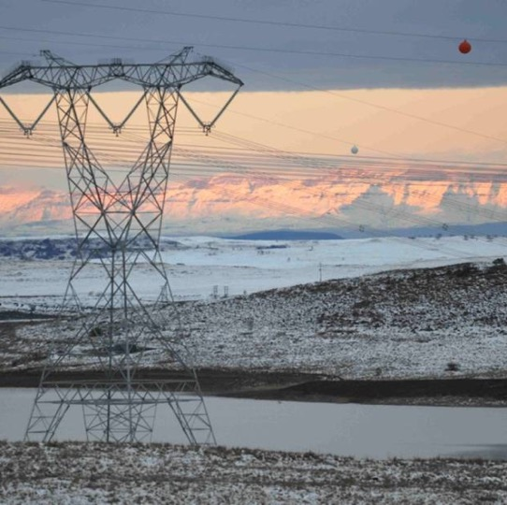

Supply and delivery of various production equipment for Northern Grid (HV Plant)
Presented by: Rudzani Tshikungulu
Date: 09 December 2025

Slide 2

Eskom Supplier Development and Localisation Mandate
Mandate
Our mandate is to achieve maximum and sustainable local development impact through leveraging Eskom’s procurement spend in a manner that allows flexibility within the business in order to accommodate government local development initiatives and policies

Slide 3
SD&L measures impact along 5 key performance areas
Key performance areas
Definition
  Skills development
  Increasing the skill base (number and skill level) of South African workers in areas relevant to the energy sector and where there is a national scarcity of skills
  Local content
  Utilisation of Transmission spend to develop South African based manufacturers/suppliers by ensuring that local content in line with DTI designated commodities is adhered to and advanced
  Industrialisation
  Utilisation of Eskom and suppliers’ spend to foster the establishment of new competitive industries in the Transmission sector
Employment and job creation
  Creation of new jobs by suppliers as a direct result of Transmission business
  Supplier development
  Providing a platform to develop emerging suppliers, and further contribution to local developmental opportunities for national and international suppliers

Slide 4
Designated sectors - DTIc
Note: Suppliers must submit completed and dully signed Annexure C and SBD6.2 which is mandatory on contract award.
.
Sector | Threshold
Steel | 100%
Cables | 90%

Slide 5
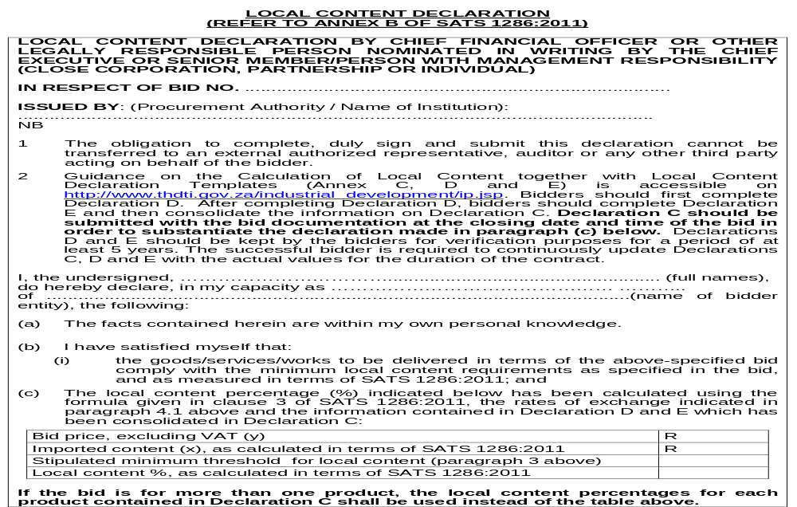
SBD 6.2
1

Slide 6
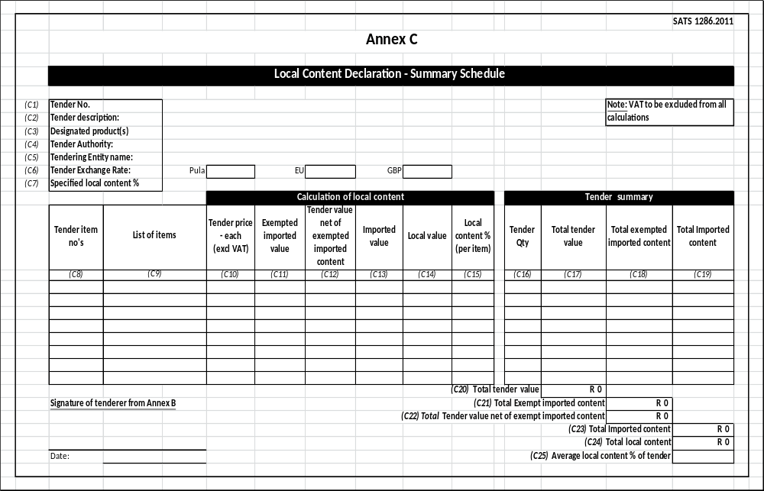
Annexure C
2

Slide 7
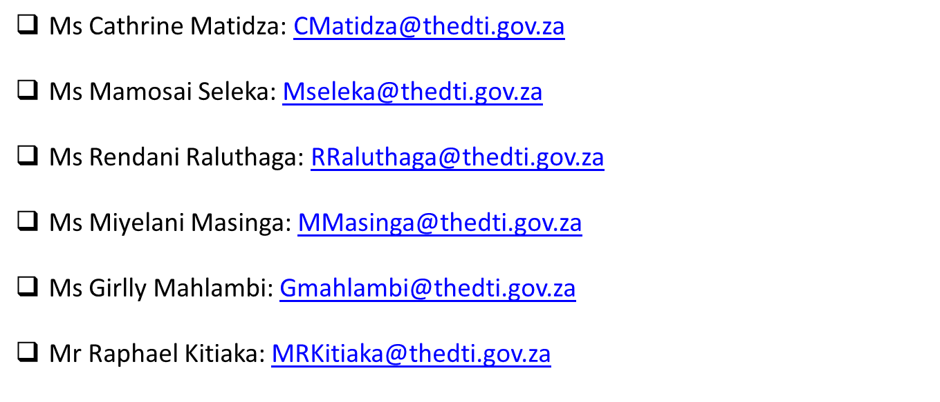
Local Content Enquiries: Bidding Documents, Calculations & Annexures
.

Slide 8
Evaluation criteria
The 90:10 OR 80:20 rule will apply in this project:
B-BBEE = 10 /20
Price = 90 /80
.

Slide 9
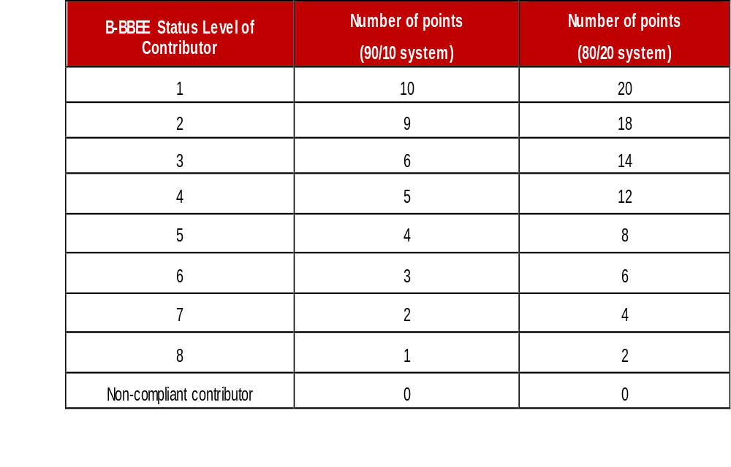
Preference Points B-BBEE

Slide 10

B-BBEE requirements
The certificate must be valid.
Verification Agency must be SANAS accredited.
There should be a logo of SANAS on the certificate.
QSEs and EMEs – Sworn affidavit is acceptable

Slide 11
Key Elements of B-BBEE Sworn Affidavits
Tenderers submitting B-BBEE Sworn Affidavits must ensure that the affidavits meet the following key pointers to ensure their validity:
a) Name/s of deponent as they appear in the identity document and the identity number.
b) Designation of the deponent as the director, owner or member must be indicated in order to know that person is duly authorized to depose of an affidavit. (Underline or circle Whichever is applicable).
c) Name of enterprise as per enterprise registration documents issued by the CIPC, where applicable, and enterprise business address.
d) Percentage of black ownership, black female ownership and designated group. In the case of specialised enterprises as per Statement 004, the percentage of black beneficiaries must be reflected. (No blank spaces to be left).
e) Indicate total revenue for the year under review and whether it is based on audited financial statements or management account. (Underline the applicable option).
f) Financial year end as per the enterprise’s registration documents, which was used to determine the total revenue. (Financial year end to be stipulated by day/month/year).
g) B-BBEE Status level. An enterprise can only have one status level.
h) Empowering supplier status must be indicated. For QSEs, the deponent must select the basis for the empowering supplier status.
i) Date deponent signed and date of Commissioner of Oath must be the same. (The sworn Affidavit must be signed in the presence of the Commissioner of Oath).
j) Commissioner of Oath cannot be an employee or ex officio of the enterprise because, a person cannot by law, commission a sworn affidavit in which they have an interest
K) Sworn Affidavits attested / signed by a Commissioner of Oaths as a true copy stamp will not be accepted

Slide 12
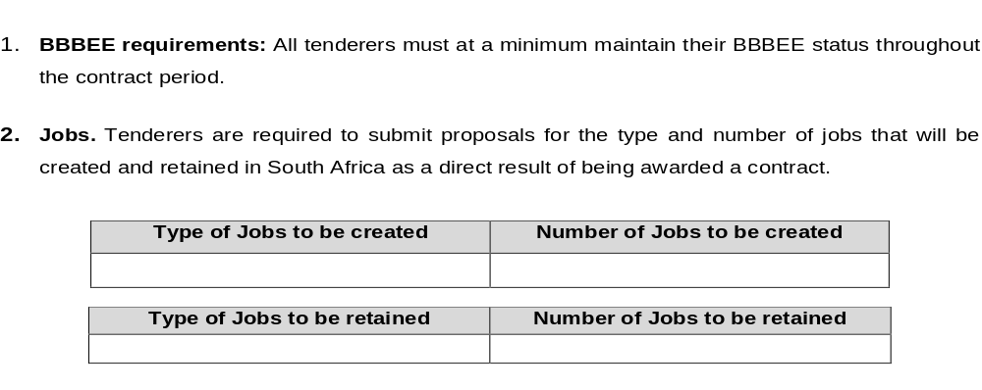
SDL&I Undertakings

Slide 13

SDL&I Undertakings

Slide 14
Monitoring ation (Not a weighted Criteria)
Implementation schedule to be submitted within a month of contract signing.
Quarterly or monthly reports on progress of implementation of SD&L to be submitted to the PM.
SDL&I penalty (2.5% retention / Performance Bond)

Slide 15

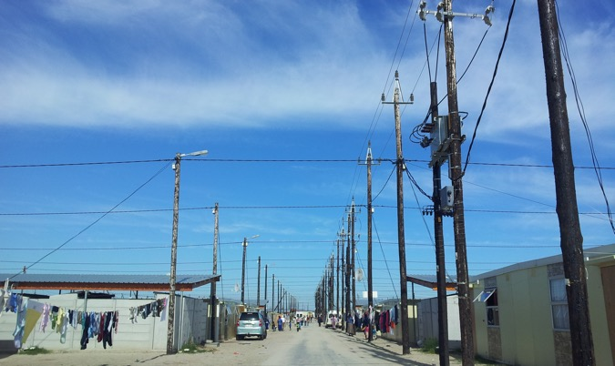
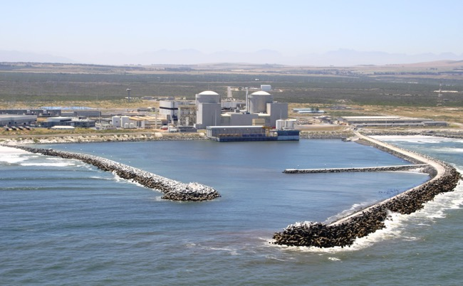
QUESTIONS

