Slide 1
TENDER NUMBER: TNPA/2025/02/0025/87996/RFP
COMPULSORY BRIEFING SESSION FOR:
FOR THE PROVISION OF CANTEEN SERVICES AT TRANSNET NATIONAL PORTS AUTHORITY (TNPA) PORT OF RICHARDS BAY FOR A PERIOD OF THIRTY-SIX (36) MONTHS
VENUE: EMPLOYEE CARE CENTRE
DATE: 11 APRIL 2025
TIME: 12H30
PRESENTED BY: PROCUREMENT LEAD REPRESENTATIVE
Notes:
Growth and Reinvent

Slide 2
RFP FOR PROVISION OF CANTEEN SERVICES AT TRANSNET NATIONAL PORTS AUTHORITY (TNPA) PORT OF RICHARDS BAY FOR A PERIOD OF THIRTY-SIX (36
RFP COVER DETAILS
RFP NUMBER TNPA/2025/02/0025/87996/RFP
ISSUE DATE: 03 APRIL 2025
COMPULSORY BRIEFING: 11 APRIL 2025 at 12h30pm
CLOSING DATE: 25 APRIL 2025
CLOSING TIME: 15:00
BID VALIDITY PERIOD: 180 Business Days from Closing Date
SUBMISSION TO: Transnet e-tender submission portal – see SBD 1 for details
THE FOLLOWING PREQUALIFICATION CRITERIA IS INCLUDED IN THIS BID:
LETTER OF GOOD STANDING RELEVANT TO NATURE OF BUSINESS IN: CATERING OR CANTEEN SERVICES

Slide 3
SECTION 1: SBD1 FORM
SBD1 FORM

Slide 4
SECTION 2: NOTICE TO BIDDERS
invitation to bid
RFP DOWNLOADING | This RFP may be downloaded directly from National Treasury’s e-Tender Publication Portal at www.etenders.gov.za free of charge. To download RFP and Annexures: Click on “Tender Opportunities”; Select “Advertised Tenders”; In the “Department” box, select Transnet SOC Ltd. Once the tender has been in the list, click on the ‘Tender documents” tab and process to download all uploaded documents. The RFP may also be downloaded from the Transnet Portal at https://transnetetenders.azurewebsites.net
COMMUNICATION OF BID OUTCOME & ADDENDUM/S | Transnet will publish the outcome of this RFP on the National Treasury e-tender portal and Transnet website with 10 days after the award has been finalised. All unsuccessful bidders have a right to request for reasons for their bid not being successful. This requested must be directed to the contact person stated in the SBD 1 form Any addenda to the RFP or clarifications will be published on the e-tender portal and Transnet website. Bidders are required to check the e-tender portal or Transnet website prior to finalising their bid submissions for any changes or clarifications to the RFP. Transnet will not be held liable if Bidders do not receive the latest information regarding this RFP with the possible consequence of either being disadvantaged or disqualified as a result thereof.

Slide 5
SECTION 2:
PROPOSAL SUBMISSION
PROPOSAL SUBMISSION
Transnet has implemented a new electronic tender submission system, the e-Tender Submission Portal, in line with the overall Transnet digitalization strategy where suppliers can view advertised tenders, register their information, log their intent to respond to bids and upload their bid proposals/responses on to the system.
The Transnet e-Tender Submission Portal can be accessed as follows:
Log on to the Transnet eTenders management platform website/ Portal (transnetetenders.azurewebsites.net)
Respondents are to submit bid documents by uploading them onto the Transnet system against each tender selected. A Bidder can upload 30mb per upload and multiple uploads are permitted.
Bidders should ensure that electronic bid submissions are submitted at least a day before the closing date and bidders should not wait for the last hour before the deadline to submit. This is to enable them to timeously address issues which they may encounter due to internet speed, bandwidth or the size of the number of uploads being submitted. Transnet will not be held liable for any challenges experienced by bidders as a result of their own technical challenges.
No late submissions will be accepted.

Slide 6
SECTION 2
Each company must register its own profile using its company details and use the corresponding registered profile to log an intent to bid as well as submitting any bid.
Transnet will not accept a bid or will disqualify a bidder who submits a bid in the Transnet e-tender submission through another bidders’/Company’s profile. In other words, each bidder must register the intent to bid and submit its bid through its own profile under the same company name that will eventually bid for the tender. No company shall submit a bid on behalf of another company regardless of the company being a subsidiary or holding company.
In case of a Joint Venture, any of the parties/companies to the Joint Venture may use its registered profile to submit a bid on behalf of the Joint Venture.
The bidder guide can be found on the Transnet Portal transnetetenders.azurewebsites.net and it is also attached as ANNEXURE H of the RFP

Slide 7
SECTION 2
RFP INSTRUCTIONS
RFP INSTRUCTIONS
  Please sign documents [sign, stamp and date the bottom of each page] before uploading them on the system. The person or persons signing the submission must be legally authorised by the respondent to do so.
  All returnable documents tabled in the Proposal Form [Section 5] must be returned with proposals.
Joint Ventures or Consortiums
Respondents who would wish to respond to this RFP as a Joint Venture [JV] or consortium with B-BBEE entities, must state their intention to do so in their RFP submission. Such Respondents must also submit a signed JV or consortium agreement between the parties clearly stating the percentage [%] split of business and the associated responsibilities of each party.
3. COMMUNICATION (Clarifications and Complaints)
  For specific queries relating to this RFP, an RFP Clarification Request Form should be submitted onto the system and to Simiso Maphumulo before 10:00am on 16 April 2025, substantially in the form set out in Section 8 hereto. In the interest of fairness and transparency, Transnet’s response to such a query will be published on the e-tender portal and Transnet website.
  After the closing date of the RFP, a Respondent may only communicate with Simiso Maphumulo on email TNPATENDERENQUIRIESRB@TRANSNET.NET on any matter relating to its RFP Proposal

Slide 8
SECTION 2
DISCLAIMERS
Respondents are hereby advised that Transnet is not committed to any course of action as a result of its issuance of this RFP and/or its receipt of Proposals. In particular, please note that Transnet reserves the right to:
  modify the RFP’s Services;
  award a contract for only a portion of the proposed Services which are reflected in the scope of this RFP;
  cancel the bid process;
  validate any information submitted by Respondents in response to this bid. This would include, but is not limited to, requesting the Respondents to provide supporting evidence. By submitting a bid, Respondents hereby irrevocably grant the necessary consent to Transnet to do so;
  request audited financial statements or other documentation for the purposes of a due diligence exercise;
8. not accept any changes or purported changes by the Respondent to the bid rates after the closing date and/or after the award of the business, unless the contract specifically provided for it.

Slide 9
SECTION 3
SCOPE OF REQUIREMENTS
  Preparation and serving of food at the Transnet National Ports Authority Main Canteen, Osizweni Centre, Ventura Road, Port of Richards Bay;
  Distribution of food from the Transnet National Ports Authority Main Canteen to Marine Satellite Canteen;
  Serving of food at Main Canteen and Marine Satellite Canteen.
  The service provider will be required to provide an all-inclusive Corporate Canteen Services providing basic meals, non-alcoholic beverages, snacks, and other items daily to on-site personnel, including providing and maintaining equipment and the provision of consumables required for the intended use.
  The Service Provider must provide meals at a competitive price.
  The service provider must provide Canteen Manager to ensures compliance with health and safety regulations, maintains high food safety standards.
  Service provider shall provide a point-of-sale system which is capable of managing subsidies provided to the employees. The subsidies shall be treated as gift vouchers where they can be topped up with cash in order for an employee can exhaust his/her allocation.

Slide 10
SECTION 3
SCOPE OF REQUIREMENTS
  8. Service provider shall provide adequate equipment, cutlery and crockery.
  9. Service provider shall provide suitable disposable environmentally friendly containers for the serving of food and beverages.
  10 Service provider shall prepare food according to acceptable food industry standards.
11. Service Provider must provide canteen equipment that are of acceptable industry and safety standards
12. Service provider shall provide a point-of-sale system which is capable of managing subsidies provided to the
employees.
Canteen Facilities (Buildings) overview
All the canteen facilities have metered water and electricity.
Osizweni Main Canteen facility has cold storage fridge and freezer.
TNPA has canteen equipment which can be provided to the service provider for preparation and distribution of food.
The service provider will be responsible for maintenance of the canteen equipment provided by TNPA.
TNPA will provide inventory of all its canteen equipment and verification will be done by TNPA representative and the service provider before the commencement of the contract
The service provider is permitted to provide its own canteen equipment for preparation, distribution and serving of food. The service provider will be responsible for transportation, installation and maintenance and inventory management of its canteen equipment.

Slide 11
SECTION 3
EVALUATION METHODOLOGY
STAGE 1:
TEST FOR RESPONSIVENESS
STAGE 2
STAGE 3
Step 1
Step 2
Step 3
Step 4
Step 5
Step 6
Administrative & Substantive responsiveness
Weighted scoring / 100***
MINIMUM THRESHOLDS
Returnable documents/ schedules/ Pre-qualification
Selection of the preferred bidder.
(Objective criterion to justify award to someone other than the highest ranked bidder must have been stated in the bid documents and can be used at this stage, if applicable)
Award of business and conclusion of contract
Functionality/ technical
66.67 points
Minimum Threshold
Price negotiation if applicable. (eg Market Related Price negotiation or Best And Final Offer
Price
(80/90)
Specific goals (20/10)
Letter of good standing – COIDA or tender letter from the Department of Employment and Labour or its agency indicating the Nature of Business in Catering or Canteen Services
WEIGHTED SCORE

Slide 12
SECTION 4:
PRICING SCHEDULE

Slide 13
SECTION 5
LIST OF RETURNABLE DOCUMENTS
RETURNABLE DOCUMENTS
Returnable Documents means all the documents, Sections and Annexures, as listed in the tables below. There are three types of returnable documents as indicated below, and Respondents are urged to ensure that these documents are returned with their bids based on the consequences of non-submission as indicated below:
Mandatory Returnable Documents | Failure to provide all these Mandatory Returnable Documents at the Closing Date and time of this RFP will result in a Respondent’s disqualification.
Returnable Documents Used for Scoring | Failure to provide all Returnable Documents used for purposes of scoring a bid, by the closing date and time of this bid will not result in a Respondent’s disqualification. However, Bidders will receive an automatic score of zero for the applicable evaluation criterion.
Essential Returnable Documents | Failure to provide essential Returnable Documents will result in Transnet affording Respondents a further opportunity to submit by a set deadline. Should a Respondent thereafter fail to submit the requested documents, this may result in a Respondent’s disqualification.

Slide 14
SECTION 5
RETURNABLE DOCUMENTS
MANDATORY RETURNABLE DOCUMENTS
SECTION 4: Pricing and Delivery Schedule
ANNEXURE B: Technical Pre-Qualification requirement has been met: Letter of good standing – COIDA or tender letter from the Department of Employment and Labour or its agency indicating the Nature of Business in Catering or Canteen Services
SECTION 10: Certificate of attendance of compulsory RFP Briefing
RETURNABLE DOCUMENTS USED FOR SCORING
Valid proof of Respondent’s compliance to Specific Goals requirements stipulated in Section 9 of this RFP (Valid B-BBEE certificate or Sworn- Affidavit as per DTIC guidelines)
Company Previous Experience
Experience Key Personnel
Quality Management Plan
Hygiene Management Plan
Method Statement

Slide 15
SECTION 5
RETURNABLE DOCUMENTS & SCHEDULES
ESSENTIAL RETURNABLE DOCUMENTS & SCHEDULES
In the case of Joint Ventures, a copy of the Joint Venture Agreement or written confirmation of the intention to enter into a Joint Venture Agreement
Latest Financial Statements signed by your Accounting Officer or latest Audited Financial Statements plus 2 previous years
Section 1: SBD1 Form
SECTION 5: Proposal Form and List of Returnable documents
SECTION 6: Certificate Of Acquaintance with RFP, Terms & Conditions & Applicable Documents
SECTION 7: RFP Declaration and Breach of Law Form
SECTION 9: Specific Goals Points Claim form
SECTION 11: Protection of Personal Information

Slide 16
SPECIFIC GOALS
PRESENTED BY: SD TEAM

Slide 17
EVALUATION METHODOLOGY – TRANSNET PREFERENTIAL PROCUREMENT POLICY
  In terms of Transnet Preferential Procurement Policy (TPPP) and Procurement Manuals, the following preference points must be awarded to a bidder who provides the relevant required evidence for claiming points.
Selected Specific Goals | Number of points (80/20 system) | Number of points (90/10 system)
B-BBEE Status Level of Contributor 1 or 2 | 04 | 02
30% Black Women Owned Entities | 06 | 03
EME or QSE 51% Black Owned Entities | 10 | 05
Non-compliant and/or B-BBEE Level 3-8 contributors | 00 | 00
Total points for Specific Goals | 20 | 10

Slide 18
EVALUATION METHODOLOGY - TRANSNET PREFERENTIAL PROCUREMENT POLICY
The following table represents the evidence required for claiming preference points for applicable specific goals to this tender:
Selected Specific Goals | Acceptable Evidence
B-BBEE Status Level of Contributor 1 or 2 | B-BBEE Certificate / Sworn - Affidavit / CIPC B-BBEE Certificate (in case of JV, a consolidated scorecard will be accepted) as per DTIC guidelines
30% Black Women Owned Entities | B-BBEE Certificate / Sworn - Affidavit / CIPC B-BBEE Certificate (in case of JV, a consolidated scorecard will be accepted) as per DTIC guidelines
EME or QSE 51% Black Owned Entities | B-BBEE Certificate / Sworn - Affidavit / CIPC B-BBEE Certificate (in case of JV, a consolidated scorecard will be accepted) as per DTIC guidelines
Should the evidence required for any of the Specific Goals applicable in this tender not be provided, a tenderer will score zero preference points for that particular “Specific Goals”

Slide 19
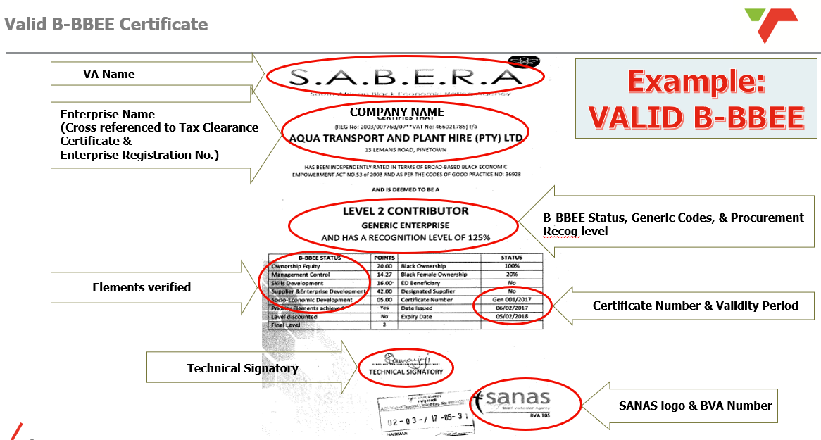
Key Pointers determining the validity of B-BBEE Certificate:

Slide 20
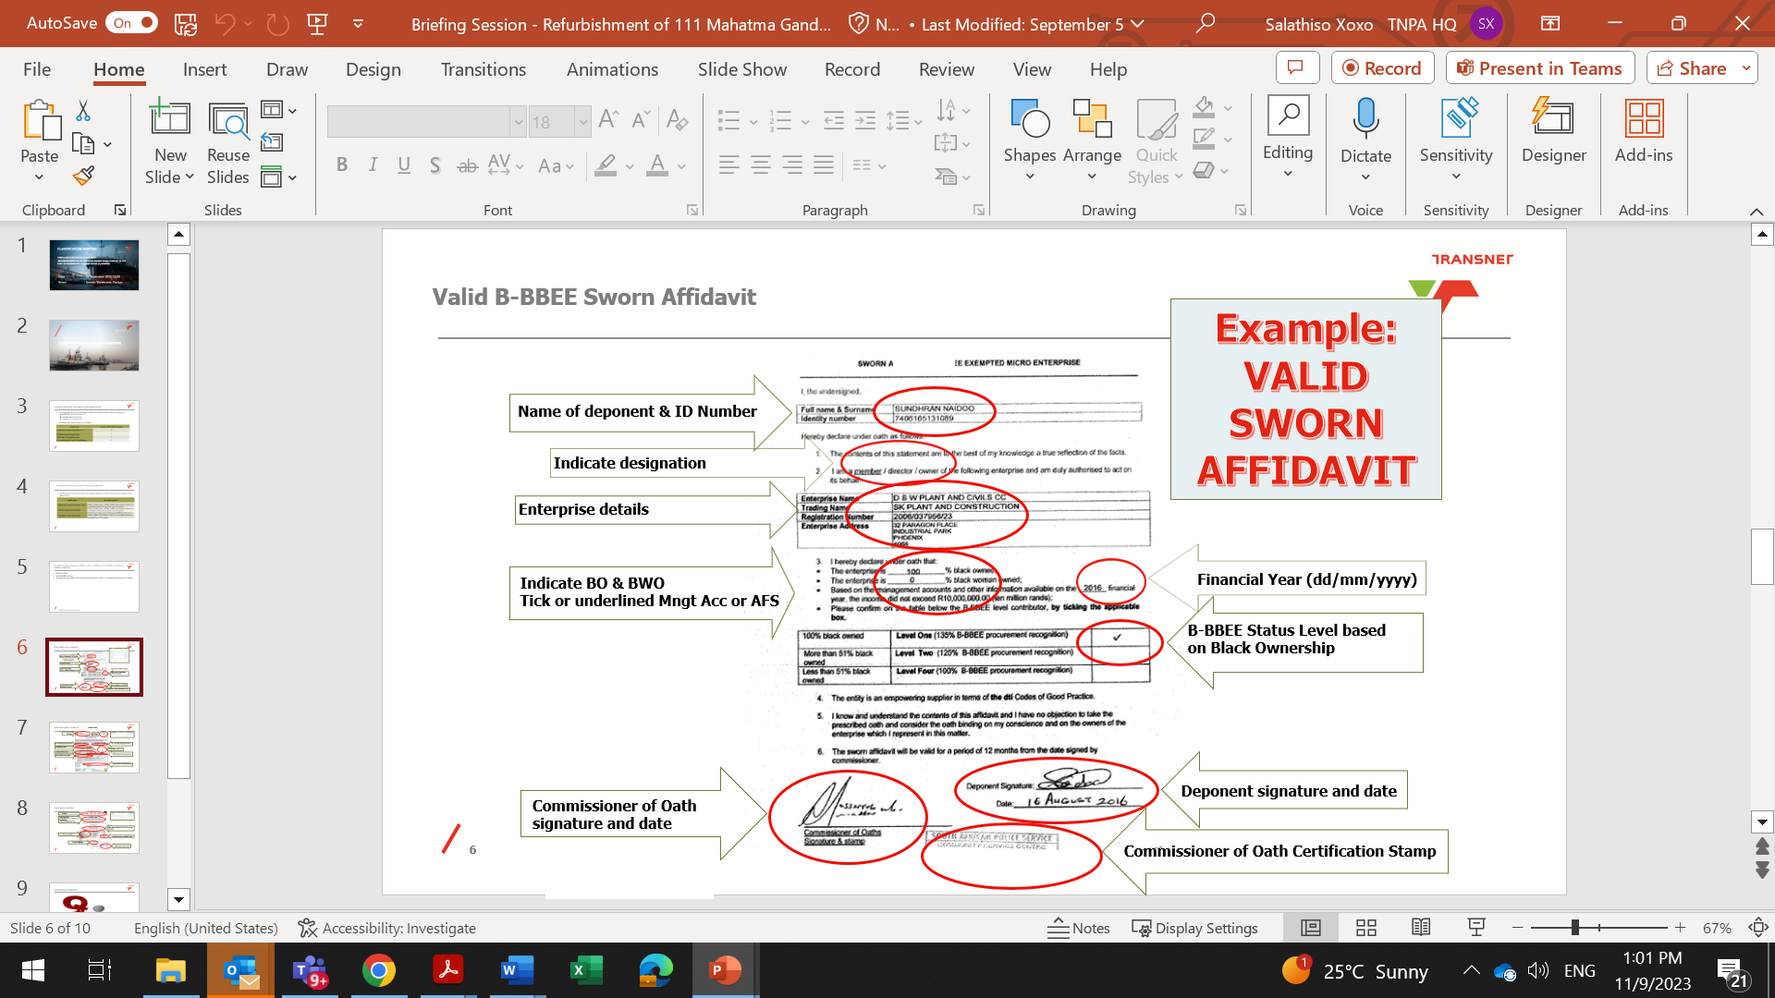
Key Pointers determining the validity of Sworn – Affidavit:

Slide 21
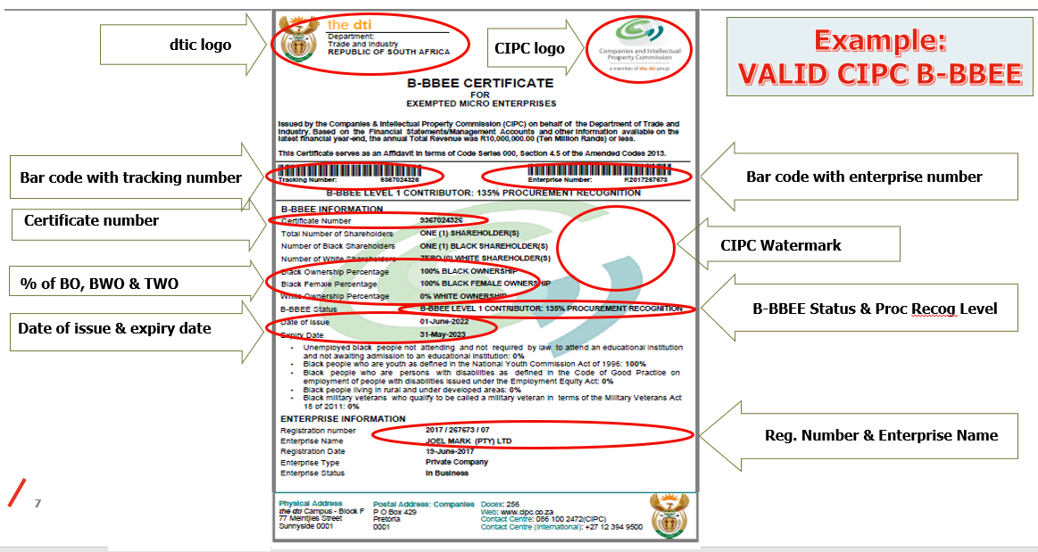
Key Pointers determining the validity of CIPC B-BBEE Certificate:

Slide 22



Q & A SESSION:

Slide 23
TENDER NUMBER: TNPA/2025/02/0025/87996/RFP
THANK YOU
Notes:
Growth and Reinvent

