Slide 1
BRIEFING SESSION
TNPA/2023/04/0015/28131/RFP
FOR THE PROVISION OF SERVICES FOR INTEGRATED MANAGEMENT SYSTEM (IMS) FOR CERTIFICATION AUDIT AT TRANSNET NATIONAL PORTS AUTHORITY FOR A PERIOD OF 3 YEARS (36 MONTHS))
Date : 19 May 2023
Venue : Microsoft Teams

Slide 2
AGENDA
Agenda Item | Responsible Person
1. Welcome and Introduction | Unarine Sikhwari
2. House/ Meeting Rules | Unarine Sikhwari
3. Background | Mpatisi Pantsi
4. Scope of Work / Requirements | Mpatisi Pantsi
5. Tender Evaluation Methodology | Unarine Sikhwari
5.1 Evaluation Steps | Unarine Sikhwari
5.2 Pricing Schedule | Unarine Sikhwari
6. Tender Submission | Unarine Sikhwari
7. Questions & Answers | All
RFP NO: TNPA/2023/04/0015/28131/RFP]

Slide 3
1. WELCOME AND INTRODUCTION
Meeting Purpose and Objective
The purpose of this meeting is to clarify the Request for Proposal: RFP No: TNPA/2023/04/0015/28131/RFP
advertised on the on the Transnet and National Treasury e-Tender Portals.
The objective of this meeting is to:
  Ensure that the Employer’s objectives are well understood.
  Building an environment for business (and projects) success.
  To report any fraud, tip-offs anonymous: 0800 003 056 or transnet@tip-offs.com

Slide 4
2. HOUSE/MEETING RULES
  Please put your laptops on mute during the presentations.
  All questions to be raised after the presentation.
  Make use of the hand raise function on MS Teams to be acknowledged if you have a question to raise.
  TNPA will endeavor to answer all questions in the session, however all answers to be responded to in writing and issued with briefing session minutes.
  Questions to be followed-up by email to Unarine.Sikhwari@transnet.net by no later than close of business, Monday, 31 May 2023 at 12:00pm.
  No content/information will be repeated during the session for the benefit of those who join the session late.

Slide 5
BACKGROUND & SCOPE OF WORK

Slide 6
3. BACKGROUND
A strategic decision was taken by the Transnet Risk Management Team on the 20th of October 2016 to develop and implement an Integrated Risk Management System processes for Transnet which gave effect to the establishment of the Transnet Integrated Management Approach (“TIMA”) Programme. Following this decision, the first phase (“Phase 1”) of the project which involved the development of the eighteen (18) procedures was completed and handed over on 13 November 2017.
Transnet had implemented Transnet Integrated Management System (“TIMS”) as from January 2018. This was known as phase 2, and this involved policies, procedures and standards implementation and system’s related data / documentation is loaded and managed in a centralized software systems called SharePoint.
Phase 3 involved the process of certifying the Transnet on ISO 45001:2018, ISO 14001:2015 and ISO 9001:2015. Transnet certification on ISO 45001:2018, ISO 14001:2015 and ISO 9001:2015 was achieved in 2021.
Following the certification of the 3 (three) ISO standards, TNPA a division of Transnet identified a need to implement additional ISO standards at TNPA namely ISO 31000:2018, ISO 22301:2019 and
ISO 20000-1:2018.

Slide 7
4. SCOPE OF REQUIREMENTS
Refer to paragraph 3 of RFP document for the detailed scope of requirements
4.1 The scope of this RFP is to conduct a full system certification audit, that includes Stage 1 and 2, to verify conformance and the effectiveness of the integrated management system implemented in accordance with ISO 20000-1:2018, ISO 22301:2019 and ISO 31001:2018 for TNPA requirements for a period of three (3) years.
4.2 Ascertaining the extent to which TNPA operations within each business unit comply currently with applicable system requirements.
4.3. Reviewing TNPA Integrated Management System and Compliance Obligations, including internal policies.
4.4. Highlighting instances of non-compliance and specifying the exact requirements that are not complied to.
4.5. Identifying short-comings and gaps in the system for each business.
4.6. Suggesting corrective measures or providing recommendations at each business.

Slide 8
4. SCOPE OF REQUIREMENTS
Refer to paragraph 3 of RFP document for the detailed scope of requirements
4.7. Recommending and/or proposing measures that must be taken to ensure system compliance.
4.8. Recommending the company for Certification, where compliance is satisfactory.
4.9. Compilation of comprehensive reports of TNPA detailing the findings and recommendations of the entire audit.

Slide 9
TENDER EVALUATION METHODOLOGY

Slide 10
5. EVALUATION METHODOLOGY
STAGE 1:
TEST FOR RESPONSIVENESS
STAGE 2
STAGE 3
Step 1
Step 2
Step 3
Step 4
Step 5
Step 6
Step 7
Administrative responsiveness
Substantive responsiveness
Technical and Functionality
Weighted scoring
Returnable documents/ schedules
Pre-qualification
Price (80)
B-BBEE scorecard (20)
Post tender negotiation with preferred bidders (if required) if pricing is not market-related
Selection of the preferred bidders.
(Objective criterion to justify award to someone other than the highest ranked bidder must have been stated in the bid documents and can be used at this stage, if applicable)
Award of business and conclusion of contracts
Technical Pre-qualification Criteria/minimum requirements:
- Submission of valid ISO 17021 accreditation certificate
Functionality/ technical
66.67points
Minimum Threshold
WEIGHTED SCORE

Slide 11
5.1 EVALUATION STEPS
Step One: Test for Administrative Responsiveness
The test for administrative responsiveness will include the following:
Step Two: Test for Substantive Responsiveness
The test for substantive responsiveness to this RFP will include the following:
Administrative responsiveness check | RFP Reference
Whether the Bid has been lodged on time | Section 1 paragraph 3
Whether all Returnable Documents and/or schedules [where applicable] were completed and returned by the closing date and time | Section 5
Verify the validity of all returnable documents | Section 5
Verify if the Bid document has been duly signed by the authorised respondent | All sections
Check for substantive responsiveness | RFP Reference
Whether any general and legislation qualification criteria set by Transnet, have been met | All sections including: General Bid Conditions clause 20
Whether the Bid contains a priced offer as prescribed in the pricing and delivery schedule | Section 4
Whether the Bid materially complies with the scope of service and/or technical specifications given | All Sections
Whether any Technical pre-qualification/eligibility criteria set by Transnet have been met as follows: - Submission of a valid ISO 17021 accreditation certificate | Section 3 – Scope of Work Annexure A

Slide 12
5.1 EVALUATION STEPS CONTINUED…
Step Three: Technical Evaluation Criteria
The test for the technical and functional evaluation criteria will include the following:
No. | Document that must be submitted
1. | Company Track Record – Traceable Reference Letters (For confirmation purposes) The bidder must demonstrate a strong track record of client satisfaction by submitting a minimum of three (3) client reference letters indicating client’s satisfaction on ISO 22301, 20000-1 and 31000 Standard/s (Management Systems) certification services rendered in the past six (6) years (Measured from date of advertisement of this bid).
2. | Company Experience The bidder must provide a list of ISO 22301, 20000-1 and 31000 Standard/s (Management Systems) Standard/s (Management Systems) certification services rendered to corporate clients.
3. | Years of Experience and Qualification for a Certified and Accredited Auditor on ISO 31000 (Risk Management System).
4. | Years of Experience and Qualification for a Certified and Accredited Auditor on ISO 20000-1 (Information Technology - Service Management System).
5. | Years of Experience and Qualification for a Certified and Accredited Auditor on ISO 22301 (Business Continuity Management System).

Slide 13
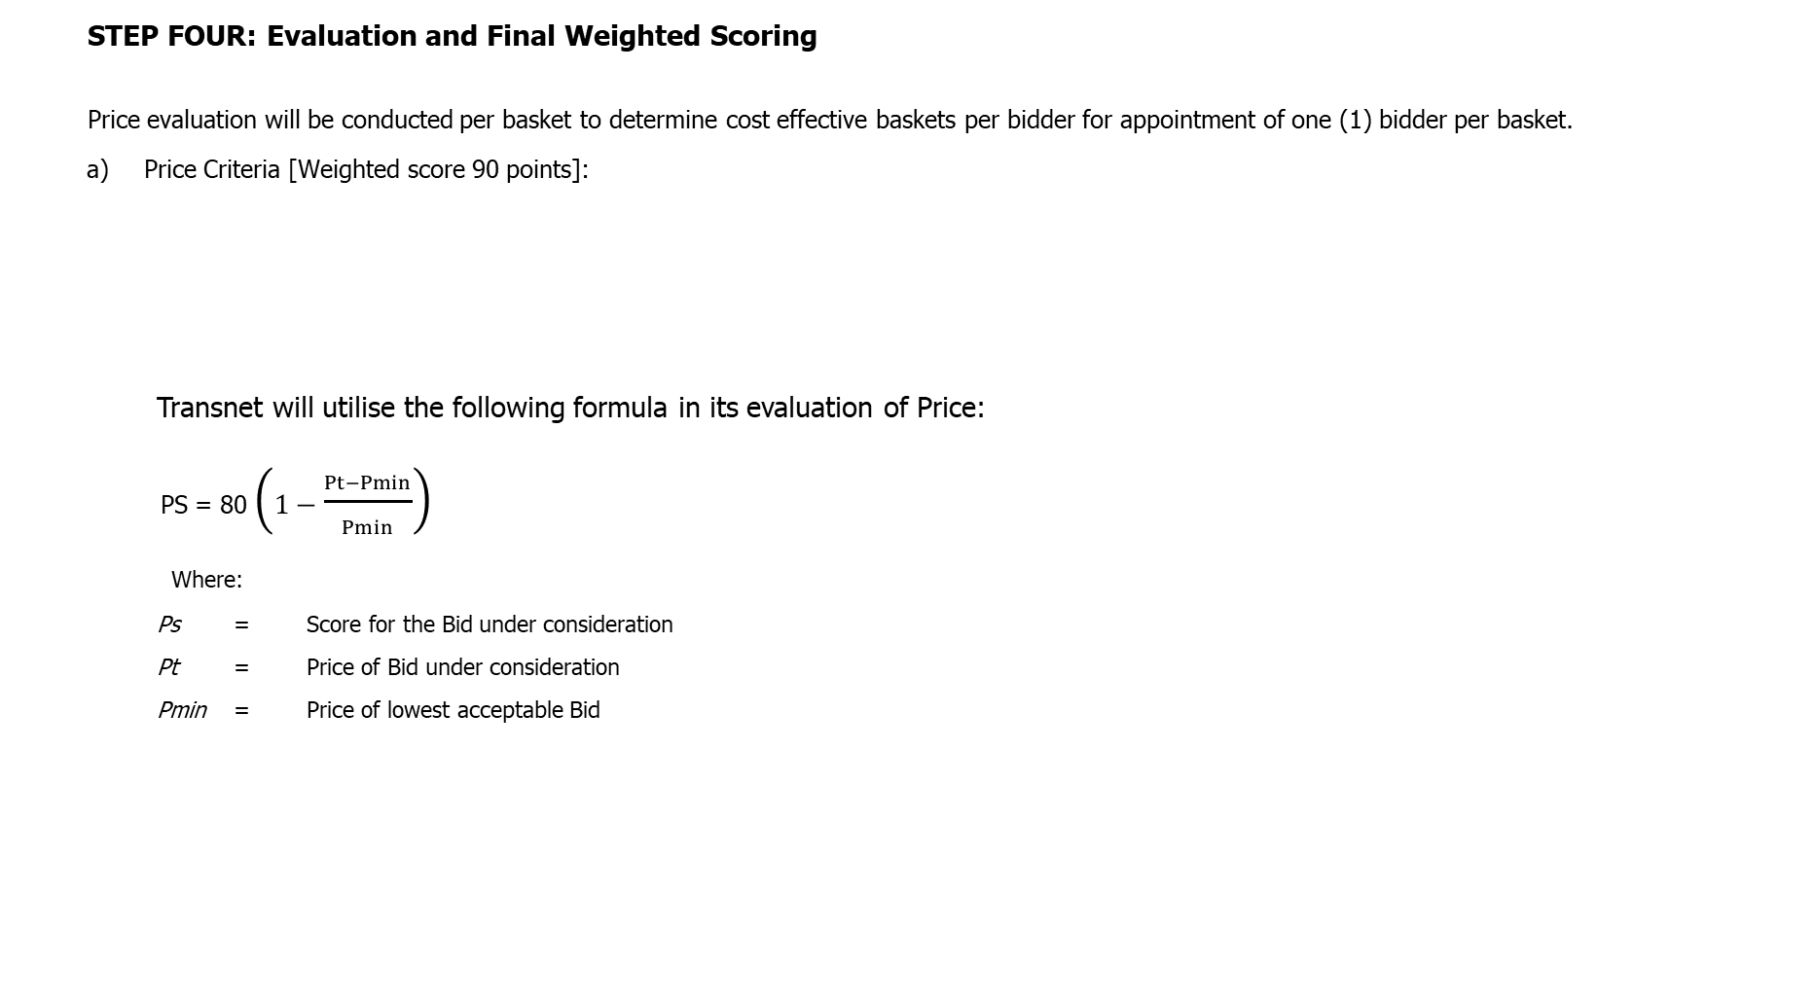
5.1 EVALUATION STEPS CONTINUED...
  STEP FOUR: Evaluation and Final Weighted Scoring
  Price evaluation will be conducted per basket to determine cost effective baskets per bidder for appointment of one (1) bidder per basket.
    Price Criteria [Weighted score 90 points]:
Transnet will utilise the following formula in its evaluation of Price:
PS = 80 $\left(1−\frac{Pt−Pmin}{Pmin}\right)$
Where:
Ps = Score for the Bid under consideration
Pt = Price of Bid under consideration
Pmin = Price of lowest acceptable Bid
Evaluation Criteria | RFP Reference
Commercial offer | Section 4

Slide 14
5.1 EVALUATION STEPS CONTINUED…
    STEP FOUR: Evaluation and Final Weighted Scoring
    SUMMARY: Applicable Thresholds and Final Evaluated Weightings
Thresholds | Minimum Threshold
Technical / functionality requirements | 66.67
Evaluation Criteria | Final Weighted Scores
Price | 80
B-BBEE - Scorecard | 20
TOTAL SCORE: | 100

Slide 15
5.1 EVALUATION STEPS CONTINUED...
    STEP FIVE: Post Tender Negotiations (if applicable)
  Respondents are to note that Transnet may not award a contract if the price offered is not market-related. In this regard, Transnet reserves the right to engage in PTN with the view to achieving a market-related price or to cancel the tender.
In the event of any Respondent being notified of such short-listed/preferred bidder status, his/her bid, as well as any subsequent negotiated best and final offers (BAFO), will automatically be deemed to remain valid during the negotiation period and until the ultimate award of business.
Should Transnet conduct post tender negotiations, Respondents will be requested to provide their best and final offers to Transnet based on such negotiations. Where a market related price has been achieved through negotiation, the contract will be awarded to the successful Respondent(s).

Slide 16
5.1 EVALUATION STEPS CONTINUED…
  STEP SIX: Objective Criteria (if applicable)
Transnet reserves the right to award the business to the highest scoring bidder/s unless objective criteria justify the award to another bidder. The objective criteria Transnet may apply in this bid process include:
- Geographical location;
- all Risks identified during a risk assessment exercise/probity check (which may be conducted by an authorised third party) that would be done to assess all risks, including but not limited to:
the financial stability of the bidder based on key ratio analysis, which would include, but not be limited to Efficiency, Profitability, Financial Risk, Liquidity, Acid Test, and Solvency;
a due diligence to assess functional capability and capacity.
A commercial relationship with a Domestic Prominent Influential Person (DPIP) or Foreign Prominent Public Official (FPPO) or an entity of which such person or official is the beneficial owner; and
Reputational and Brand risks.

Slide 17
5.1 EVALUATION STEPS CONTINUED...
  STEP SEVEN: Award of business and conclusion of contract
Immediately after approval to award the contract has been received, the successful bidder(s) will be informed of the acceptance of his/their Bid by way of a Letter of Award. Thereafter the final contract will be concluded with the successful Respondent(s).
A final contract will be concluded and entered into with the successful Bidder at the acceptance of a letter of award by the Respondent.

Slide 18
5.2 PRICING SCHEDULE
    a) Bidders are required to complete the mandatory Pricing Schedule (provided as Annexure F) indicating the price offered. Bids that do not contain a pricing schedule will be disqualified. All Prices must be quoted in South African Rand inclusive of VAT.
    b) To facilitate like-for-like comparison bidders must submit pricing strictly in accordance with the pricing schedule (Annexure F) and not utilise a different format. Deviation from this pricing schedule will result in a bid being declared non-responsive.
    c) Prices quoted must be all inclusive of all applicable taxes, direct and indirect related costs must be included in the prices and be firm for the duration of the contract.

Slide 19
TENDER SUBMISSION

Slide 20
6. TENDER SUBMISSION
Closing date: 07 June 2023
Time: 12:00PM
Proposal submission
Transnet has implemented a new electronic tender submission system, the e-Tender Submission Portal, in line with the overall Transnet digitalization strategy where suppliers can view advertised tenders, register their information, log their intent to respond to bids and upload their bid proposals/responses on to the system.
a) The Transnet e-Tender Submission Portal can be accessed as follows:
▪ Log on to the Transnet e-Tenders management platform website/ Portal (https://transnetetenders.azurewebsites.net) Please use Google Chrome to access Transnet link/site);
▪ Click on “ADVERTISED TENDERS” to view advertised tenders;
▪ Click on “SIGN IN/REGISTER – for bidder to register their information (must fill in all mandatory information);
▪ Click on “SIGN IN/REGISTER” - to sign in if already registered;
▪ Toggle (click to switch) the “Log an Intent” button to submit a bid;
▪ Submit bid documents by uploading them into the system against each tender selected.
▪ No late submissions will be accepted. The bidder guide can be found on the Transnet Portal https://transnetetenders.azurewebsites.net
b) The bid submission should be for the baskets bidding for, either all or any of the five (5) baskets. TNPA will appoint a qualifying Supplier per basket for the provision of uniform items.

Slide 21

7. QUESTIONS AND ANSWERS

Slide 22
THANK YOU

