Slide 1
CLARIFICATION MEETING
TNPA/2022/08/0892/10015/RFP:
THE ACQUISITION, DEVELOPMENT, IMPLEMENTATION,
DELIVERY AND COMMISSIONING OF SIMULATION SOFTWARE
TOOL FOR TNPA INFRASTRUCTURE PLANNING AND CAPACITY ENABLEMENT ACROSS ALL THE PORTS INCLUDING A 5-YEAR SUPPORT AND MAINTENANCE
Date : 02 September 2022
Venue : Port of Durban, Queen Warehouse, Mahatma Gandhi Road
Date : 05 September 2022
Venue : Port of Cape Town, TNPA House 4th floor boardroom, South Arm Road
Date : 06 September 2022
Venue : Port of Ngqura, TNPA Port Administration Building, eLwandle Boardroom

Slide 2
AGENDA
Agenda Item | Responsible Person
1. Welcome and Introduction | Mpho Mohapi
2. Safety Induction | TNPA Colleague for each Port location
5. Tender Documentation 5.1 Tendering Process and Tender Evaluation procedure 5.2 Pre-Qualification Criteria | Mpho Mohapi Mpho Mohapi Mpho Mohapi
6. Tender Evaluation | Mpho Mohapi & Siseko Gwazela
7. Tender Evaluation – Quality (Functionality) Criteria 7.1 T2.2-03 Customer Reference Letters 7.2 T2.2-04 Method Statement 7.3 T2.2-05 Technical Resource Allocation with key resources 7.4 T2.2-06 Skills Transfer 7.3 T2.2-07 Programme 7.4 T2.2-08 Fault Logging Methodology | Tinyiko Mabasa / Sonwabo Nkosana
CLARIFICATION MEETING TENDER NUMBER TNPA/2022/08/0892/10015/RFP

Slide 3
AGENDA
Agenda Item | Responsible Person
8. Background on Project and Executive Summaryng Information | Tinyiko Mabasa / Sonwabo Nkosana
9. Scope of Work | Sonwabo Nkosana
10. Conclusion/Signing of T2.2.01 – Certificate of Attendance | Mpho Mohapi
12. Site Walkabout | Tinyiko Mabasa / Sonwabo Nkosana
CLARIFICATION MEETING TENDER NUMBER TNPA/2022/08/0892/10015/ RFP

Slide 4
HOUSE/ MEETING RULES
  Adhere to latest Covid 19 Regulations;
  Please put cellphone on mute during the presentations;
  All questions to be raised after each presentation.
  Kindly raise your hand, instead of just speaking out of turn;
  TNPA will endeavor to answer all questions in the session, however all answers to be responded to in writing and issued with briefing session minutes.
  Questions to be followed-up by email to Mpho.mohapi@transnet.net by COB, Monday, 08 September 2022 (16:00)
  Late comers will be allowed; however nothing will be repeated for their benefit.

Slide 5
Welcome and Introduction/Safety Induction
Meeting Purpose and Objective
The purpose of this meeting is to clarify the Request for Proposal: RFP No: TNPA/2022/08/0892/10015/RFP advertised on the 25 August 2022 on the National Treasury e-Tender Portal and Transnet etender submission.
The objective of this meeting is to:
  Ensure that the Employer’s objectives are well understood.
  Building an environment for business (and projects) success.
  To report any fraud, tip-offs anonymous: 0800 003 056 or transnet@tip-offs.com
CLARIFICATION MEETING TENDER NUMBER TNPA/2022/08/0892/10015/ RFP

Slide 6
Tender Documentation
Mpho Mohapi

Slide 7
WELCOME AND INTRODUCTIONS
Client / Employer - Transnet SOC Ltd
Operation Division - Transnet National Ports Authority – Ports of Cape Town, Durban & Ngqura
Employer’s Agent - Mpho Mohapi (Mpho.Mohapi@transnet.net)
Project Manager - Tinyiko Mabasa

Slide 8
AGENDA…
Overview of RFP document: Mpho Mohapi
Tendering Procedure
Returnable Schedule
The (Draft) Contracts
The (Draft) Contract & Contract Data: Mpho Mohapi

Slide 9
OVERVIEW OF RFP DOCUMENT
Part T1: Tendering Procedure
T1.1 Tender Notice and Invitation to Tender
T1.2 Tender Data
Part T2: Returnable Documents
T2.1 List of Returnable Documents
T2.2 Returnable Schedules [28 in total (Excl. Agreements and Contract Data)])
Part C1: Agreement and Contract Data
C1.1 Form of Offer and Acceptance
C1.2 Contract Data (Parts 1 & 2)
C1.3 Form of security
Part C2: Tendering Procedure
C2.1 Pricing Instructions & C2.2 Activity Schedule
Part C3: Scope of Work
3.1 Works Information

Slide 10
PART T1: TENDERING PROCEDURES
Closing Date: : 19 September 2022 at 10:00am
The Transnet e-Tender Submission Portal • Log on to the Transnet eTenders management platform website (https://www.transnet.net);
• Click on “TENDERS”;
• Scroll towards the bottom right hand side of the page;
• On the blue window click on “register on our new eTender Portal”;
• Click on “ADVERTISED TENDERS” to view advertised tenders;
• Click on “SIGN IN/REGISTER – for bidder to register their information (must fill in all mandatory information);
• Click on “SIGN IN/REGISTER” - to sign in if already registered;
• Toggle (click to switch) the “Log an Intent” button to submit a bid;
• Submit bid documents by uploading them into the system against each tender selected.
All queries regarding the e-Tender submission to be addressed to Kabelo Mafohla, email: Kabelo.Mafohla@transnet.net
Tender Validity Period : 90 Business days
Stages/Procedure for evaluating responsive tenders
        PP2 Competitive Selection Procedure (PP2B open procedure)
        Financial 80 - Preference 20

Slide 11
PART T1: TENDERING PROCEDURES
Eligibility Criteria (Substantive Responsiveness)
        An authorized representative of the tendering entity or a representative of a tendering entity that intends to form a Joint Venture (JV) must attend the compulsory clarification meeting in terms C2.7
        Certificate of Attendance at Tender Clarification Meeting must be submitted with the tender
        A tenderer having a stipulated minimum B-BBEE status contributor of level 4.
        Quality/Functionality/Technical – Minimum threshold of 60points

Slide 12
PART T2: RETURNABLE DOCUMENTS
T2.1 List of returnable documents
T2.2 Returnable Documents & Schedules
C1.1 Form of offer and acceptance
C1.2 Contract Data Part 2
C2.2 Activity Schedule

Slide 13
PART C1: AGREEMENT AND CONTRACT DATA
Part 1 Agreements and Contract Data
  C1.1 Form of Offer and Acceptance
  C1.2 Contract Data Part 1 & 2
  C1.3 Forms of Security
Part 2 Pricing Data
  C2.1 Pricing Instruction
  C2.2 Activity Schedule
Part C3 Scope of Work
  C3.1 Scope of Work (Project Manager)
Part C4 Site Information
  C4.1 Site Information (Project Manager)

Slide 14
PART C1: AGREEMENT AND CONTRACT DATA…
  Conditions of Contract
  NEC3 Term Service Contract
  Contract Data Part 1 - Employer
  Main Option – A: Priced contract with price list
  W1: Dispute resolution procedure
  Secondary Options
  X2 Changes in the law
  X4: Parent company guarantee
  X13: Performance Bond 10% of the total of the Prices
  X17: Low service damages R 15 000 per day
  X18: Limitation of liability
  X19: Task Order
  Z: Additional conditions of contract

Slide 15
PART C1: AGREEMENT AND CONTRACT DATA…
  Z Clauses – Additional conditions of contract
  Z1 – Obligations in respect of Termination
  Z2 – Right Reserved by Transnet to Conduct Vetting through SSA
  Z3 – Additional clause relating to Collusion in the Construction Industry
  Z4 – Protection of Personal Information Act
  Z5 – Additional obligation in respect of Termination
  Z6 – Additional clause relating to Performance Bonds and/or Guarantees

Slide 16
PART C1.2 : CONTRACT DATA - Contractor
  Part two
  10. 1 Contractor Details;
  11.2 (8) The direct fee percentage
  The subcontracted fee percentage
  24.1 The Contractor's key persons

Slide 17
Transnet’s evaluation methodology
STAGE 1: PREQUALIFICATION
STAGE 2
STAGE 3
Step 1
Step 2
Step 3
Step 4
Step 5
Step 6
Step 7
Administrative responsiveness
Substantive responsiveness
MINIMUM THRESHOLDS
Weighted scoring / 100***
Functionality/ technical 60points
Returnable documents/ schedules
Pre-qualification
Post tender negotiation with preferred bidder [2nd and 3rd ranked bidders (if required) in a sequential and not simultaneous manner] if pricing is not market-related
Award of business and conclusion of contract
Price (80)
B-BBEE scorecard (20)
Selection of the preferred bidder.
(Objective criterion to justify award to someone other than the highest ranked bidder must have been stated in the bid documents and can be used at this stage, if applicable)
Step 2: Preferential Procurement prequalification criteria that only one or more of the following may participate:
-minimum B-BBEE status level 4
-- Attendance of compulsory Briefing session
Technical / Functional criteria & weightings must be stipulated in the tender documents
WEIGHTED SCORE
Technical Pre-qualification:
1. 60points Threshold

Slide 18

QUESTIONS & ANSWERS

Slide 19
6. Supplier Development Presentation
Siseko Gwazela

Slide 20
PPPFA prequalification
The tender is strictly put as a pre-qualification for minimum B-BBEE level 4 contributor ONLY.
Failure to do so, will result in the tender being deemed non-responsive and therefore eliminated from further evaluation.
Submit a valid B-BBEE Sworn Affidavit OR B-BBEE certificates.
An entity that qualifies in terms of the B-BBEE Act to undergo a B-BBEE verification process, can only do so with a verification professional or agency that has been accredited by SANAS or a B-BBEE Verification Professional Regular that may be appointed by the Minister of Trade and Industry.

Slide 21
The following pointers are key in determining the validity of a sworn affidavit:
Name/s of deponent as they appear in the identity document and the identity number.
Designation of the deponent as either the director, owner or member must be indicated in order to know that person is duly authorised to depose of an affidavit
Name of enterprise as per enterprise registration documents issued by the CIPC, where applicable, and enterprise business address.
Percentage of black ownership, black female ownership and designated group. In the case of specialised enterprises as per Statement 004, the percentage of black beneficiaries must be reflected.
Indicate total revenue for the year under review and whether it is based on audited financial statements or management account.
Financial year end as per the enterprise’s registration documents, which was used to determine the total revenue.
B-BBEE Status level. An enterprise can only have one status level.
Empowering supplier status must be indicated. For QSEs, the deponent must select the basis for the empowering supplier status.
Date deponent signed and date of Commissioner of Oath must be the same.
Commissioner of Oath cannot be an employee or ex officio of the enterprise because, a person cannot by law, commission a sworn affidavit in which they have an interest.

Slide 22

Questions and Answers
  All Tenderers to please meet in the car park area.
CLARIFICATION MEETING TENDER NUMBER TNPA/2022/08/0892/10015/ RFP

Slide 23
7. Technical Evaluation

Slide 24
Technical Evaluation
  The threshold for the Functionality is 60 points and will be evaluated as follows:
Quality Criteria | Maximum number of points
T2.2-03 Customer Reference Letters | 25
T2.2-04 Method Statement | 30
T2.2-05: Technical Resource Allocation with key resources | 20
T2.2-06: Skills Transfer | 5
T2.2-07 Programme | 10
T2.2-08 Fault Logging Methodology for post implementation maintenance | 10
Maximum (possible) score for quality | 100
CLARIFICATION MEETING TENDER NUMBER TNPA/2022/08/0892/10015/ RFP

Slide 25
Background on Project and Executive Summary Information and Scope of Work

Slide 26
BACKGROUND
NEED FOR THE SIMULATION SOFTWARE:
Transnet National Ports Authority (TNPA) is embarking on a journey of acquiring smart simulation software tools that will be the intellectual property of TNPA.
To provide a futuristic view of our port's plans (planning ahead of demand)
To enable the Port Planners, Operation Specialists, and Port Engineering to predict the effect of changes in any port operational precinct within TNPA.
To simulate port processes overtime to identify bottlenecks and improve efficiencies.
The tool needs to be creative in calculating and validating capacity for all commercial ports and ensures that all ports users are utilizing the ports existing facilities to their efficient and effective capacity.
This tool must also TNPA in performing terminal oversight role by setting meaningful targets for all the Terminal Operators in line with TOPS.

Slide 27
KEY CHALLENGES
Inability to conduct simulation modelling internally
Manual and cumbersome capacity validation process
TNPA soley rely on consultancy in conducting simulation modelling for the ports.
Lack of port processes knowledge from consultants which is resulting in substandard results
High level of inconsistency due to different inputs and assumptions applications by consultants
Limitations on capacity sustainability plan
Under utilisation of internal resources
Limitation in revisiting capacities and simulation modelling that were conducted previously

Slide 28



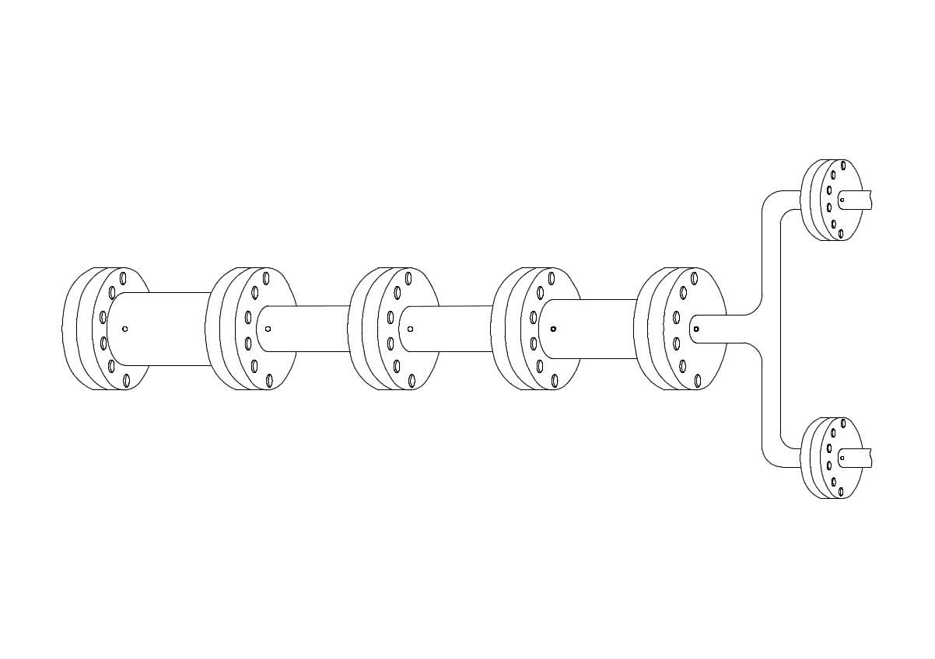


















PORT SIMULATION SOFTWARE REQUIREMENTS
MARINE SERVICES
BERTH CAPACITY
STORAGE CAPACITY
GATE CAPACITY
Water side
Land side
Anchorage
Berth
Apron
Terminal
Intermodal
CARGO FLOWS

Slide 29
SIMULATION SOFTWARE REQUIREMENTS
Service provider must have a basic understanding of the port operations processes and develop port configurations model based on those processes.
Simulation Software Design Capability encompasses the ability for the tool to perform desired IT related activities and transactions through its features and technical infrastructure to achieve business needs.
The tool must be able to address port operational and capacity constrains for each commodity types such as Container, Automotive, Liquid bulk, Dry bulk and Break bulk.
It must be able to determine theoretical and installed berth, storage and gate capacities of the ports for all commodity type.
The Simulation software must be able to provide a predictive analysis by predicting the futuristic view of port capacities against the demand which will have a direct influence in the development of National Port Plans and Port Development Framework.
The Simulation software must have an ability to generate performance reports for the selected performance metrics using data and information and convert that into some form of a dashboard and power BI facility .
The system need to have a built-in capability to integrate data, reports to other systems such as Microsoft Word, Excel, PowerPoint, Navis, IPMS, VTS and any data related system that may exist in the port environment.

Slide 30
SIMULATION SOFTWARE INPUTS
The model must be set up taking into consideration the three different objects such as Berth, Storage and Gate object but neglecting the side of the whole supply chain.
Arrival duration of the vessel from Port limits to the Berth (alongside)
Mooring services (First Line and last line)
Pre-loading/pre-offloading time of the vessel (Import/Export/Transshipment)
Loading or offloading duration of Vessels using relevant equipment (import/export/Transshipment)
Post loading time of vessel
Mooring services (First line and last line)
Departure time
Berth object
Storage object
Terminal yard in Sqm
Movement of cargo using relevant equipment.
Feeding space factor (Roads, rail and buildings)
Stacking principles (Height, slots, bays, tanks, peaking factor)
Dwell time of cargo in the port
Gate object
Road and Rail Characteristics
External trucks and train intervals and service time.
Truck Stagging

Slide 31
EXTENDED SIMULATION SOFTWARE REQUIREMENTS
The model set up must be able to take the following attributes into consideration:
Software Simulation Model Processes
Graphics / Animation / Automation and Digitization
Simulation Software Capabilities
  Data Analytics
  Descriptive Analysis
  Diagnostic Analysis
  Predictive Analysis
  System Integration and Interface
  Performance Reporting and Dashboard
  Capability to Extract/Export Information
  Capability to Modify and Factor Changes

Slide 32
ICT SIMULATION SOFTWARE REQUIREMENTS
1. Technology Readiness:
Solution Architecture
2. Software Readiness:
Operating Software
3. People Readiness, Support and Maintenance
Business, ICT & Operations Team: Structuring of the team, the development of the skills and the structured exposure to develop the experience need to model, run, and interpret simulation models.
Process Mapping, Design & Systems Integration
Servers: Physical Hardware; Virtual Server & Private Cloud
Network Architecture
Subscription Software Licenses
Other Simulation software packages
Support and maintenance of the software

Slide 33
11. Site Walkabout

Slide 34
Conclusion/Signing of T2.2.01
– Certificate of Attendance
  All queries to be addressed to : Mpho Mohapi at Mpho.Mohapi@transnet.net
    Telephone: 066 293 2210
    All queries regarding the e-Tender submission to be addressed to Kabelo Mafohla at Kabelo.Mafohla@transnet.net
    Telephone: 066 2924389
CLARIFICATION MEETING TENDER NUMBER TNPA/2022/08/0892/10015/ RFP

Slide 35
Conclusion/Signing of T2.2-01
– Certificate of Attendance
  CLOSING DATE: 19 September 2022
  CLOSING TIME: 10h00am
  TENDER VALIDITY PERIOD: 90 Business Days
  NB:
  Signing of T2.2.01 – Certificate of Attendance
CLARIFICATION MEETING TENDER NUMBER TNPA/2022/08/0892/10015/ RFP

Slide 36
11. Site Walkabout

Slide 37
Site Walkabout
  All Tenderers to please meet in the car park area.
CLARIFICATION MEETING TENDER NUMBER TNPA/2022/08/0892/10015/ RFP

Slide 38
Questions and Answers
  All Tenderers to please meet in the car park area.
CLARIFICATION MEETING TENDER NUMBER TNPA/2022/08/0892/10015/ RFP

Slide 39
THANK YOU

