Slide 1

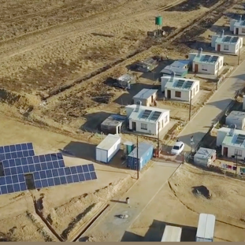
Supply and deliver to site of 2X Infrared Camera Kits for the Western Grid
Presented By: Viwe Hermanus
Date: 30 April 2026

Slide 2
Contract Details
NEC Supply Contract (SC3)
Supply and deliver to site of 2X Infrared Camera Kits for the Western Grid
Area:- 34 Field Street, Worcester 6850
Commencement date: As soon as the contract has been awarded

Slide 3
Clauses applicable to the contract
CLAUSE | STATEMENT | DATA
Main Option A - Priced contract with a pricelist Dispute resolution W1
Secondary Clauses
X1 | Price adjustment for inflation | The prices of all goods will remain fixed for the Duration of the contract.
X2 | Changes in the law
X2.1 | Changes in the law | Republic of South Africa is a compensation event if it occurs after the Contract Date
X7 | Delay damages | 0.5% per day to maximum of 5 % value of a purchase order
Z | The additional conditions of contract are | Z1 to Z15 always apply for NTCSA

Slide 4
Scope of work
Supply and deliver to site of 2X Infrared Camera Kits for the Western Grid
Detailed Specification of the 2X Infrared Camera Kits on NEC page 16 – 17
Supply Requirements
The Supplier to take note of the requirements stipulated in the NEC – Page 20
Rejection or return of defective Goods
The Purchaser reserves the right to inspect the goods upon delivery. The period for the correction of defects after delivery is eight (8) weeks.
The Purchaser shall notify the Supplier in writing of the rejection, specifying the nature of the defect or non-conformance.
Upon receipt of such notice, the Supplier shall, at its own cost:
Collect the rejected Goods
Repair or replace the Goods
Remedy the defect within reasonable time / as agreed with the Purchaser’s representative
All risks and costs associated with rejected goods shall remain with the Supplier until acceptance by the Purchaser.

Slide 5
Technical evaluation criteria
Technical evaluation criteria
Tenderers are required to score a minimum of 100% to be evaluated further.

Slide 6
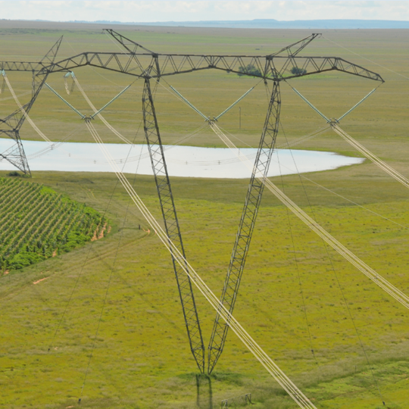
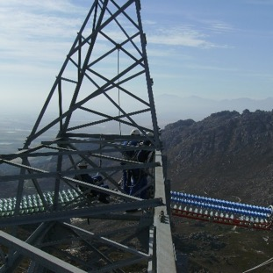
Conclusion

