Slide 1

IMPLEMENTATION OF LOCAL CONTENT AND PRODUCTION REQUIREMENTS
How to complete the local content declarations

Slide 2
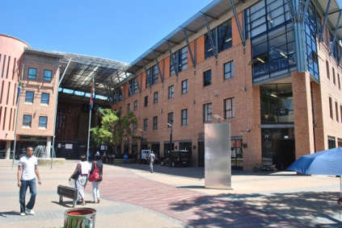
^{CONTENTS}
POLICY AND REGULATORY CONTEXT
LIST OF DESIGNATED PRODUCTS
IMPLEMENTATION OF LOCAL CONTENT IN PROCUREMENT OF FIRE FIGHTING VEHICLES
DOCUMENTS FOR LOCAL CONTENT DECLARATION
EXEMPTION PROCESS

Slide 3
POLICY AND REGULATORY CONTEXT
Industrial Policy - developed to up scale production in the manufacturing sector and to support growth.
South Africa has been experiencing severe decline in the manufacturing sector and in its employment levels. This can be attributed to the importation of high value added products into the country. As a way to address this decline, in line with the NDP and the Industrial Development Plan (IPAP and the Re-Imagined Industrial Strategy) government has designated specific sectors for local production with minimum Local Content thresholds.
In so doing, public procurement was identified as a key policy intervention
An important strategic approach in South Africa’s industrial policy is to use government’s leveraging muscle as a “large buyer” that can influence how much is locally manufactured.
The Public Procurement Preferential Framework Act (PPPFA) Regulations are regularly reviewed in order to designate certain sectors/products for preferential procurement by government and state owned entities.

Slide 4
PREFERENTIAL PROCUREMENT REGULATIONS, 2017
ON LOCAL CONTENT
  Local Procurement Accord (signed in June 2011)
  Local Content and Production Regulations came into effect on 7 December 2011 through the 2011 Public Procurement Regulations. They are still applicable in the Public Procurement Regulations, 2017.
  Section 8: Local Production and Content
  Empowers the dti to designate specific industries/sectors for local procurement by organs of state.

Slide 5
PREFERENTIAL PROCUREMENT REGULATIONS, 2017
ON LOCAL CONTENT
  Regulation 8 (1): empowers the dti to designate specific industries/sectors, where only locally manufactured products that meet the stipulated minimum threshold for local content will be considered.
  Regulation 8 (2): organs of state must include local content in their bid invites
  Regulation 8 (3): National Treasury must inform organs of state via circular.
  Regulation 8 (4): allows organs of state to “self designate” provided they consult with the dti and National Treasury
  Regulation 8 (5): bid that fails to meet the required local content is unacceptable

Slide 6
OBJECTIVES OF LOCAL CONTENT POLICY
Leverage public expenditure, both CAPEX and OPEX, made by organs of state (all spheres of government and SOCs) to:
  Develop and enhance local manufacturing capacity and capabilities
  Support industrial innovation and technological developments
  Create employment and sustain jobs
  Boost exports and ensure suppliers are integrated into OEMs global value chains
  Support broader economic empowerment through the creation of black industrialists

Slide 7
Products Designated for local production
2012/13
2013/14
2014/15
2015/16
2016/17
2017/18
Rail Rolling Stock
Steel Power Pylons and Substation Structures
Bus Bodies
Canned/Processed Vegetables
Textile, Clothing, Leather and Footwear Sector
Pharmaceuticals
Solar Water Heater Components
Set-top Boxes
Furniture Products
Electrical and Power Cables,
Valves Products and Actuators
Working Vessels (Boats)
Residential Electricity and Water* Meters
Steel Conveyance Pipes
Transformers and Shunt Reactors
Two-way Radios
Solar Photovoltaic System Components
Rail-Signalling System and Components
Wheelie bins
Fire Engine/Truck (Nov 2016)
Steel Products and Components for construction
Rail Perway (Track)
Pumps & Medium Voltage Motors
2019/20
Plastic Pipes
Bulk Material Handling
Lead Acid Batteries
MV Switchgear
27 designations over 8 years

Slide 8
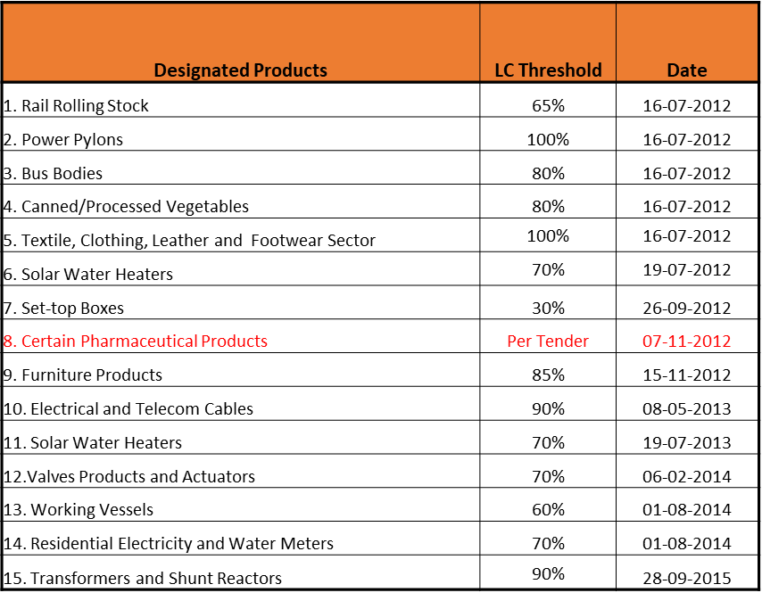
MINIMUM LOCAL CONTENT THRESHOLDS FOR DESIGNATED PRODUCTS
Designated Products | LC Threshold | Date
16. Two Way Radio Terminals | 60% | 30-06-2016
17. Solar PV Components | 70% | 30-06-2016
18. Rail Signalling System | 65% | 30-06-2016
19. Wheelie Bins | 100% | 18-08-2016
20. Fire Fighting Vehicles | 30% | 21-11-2016
21. Steel Products and Components for Construction | 100% | 13-01-2017
22. Rail Perway (Track) Infrastructure | 90% | 13-11-2017
23. Pumps & Medium Voltage Motors | 70% | 12-12-2017
24. Plastic Pipes & Fittings | 100% | 16-08-2019
25. Air insulated MV Switchgear | 50% | 20-12-2019
26. Bulk Material Handling | 85% | 20-12-2019
27. Industrial Lead Acid Batteries | 50% | 20-12-2019

Slide 9
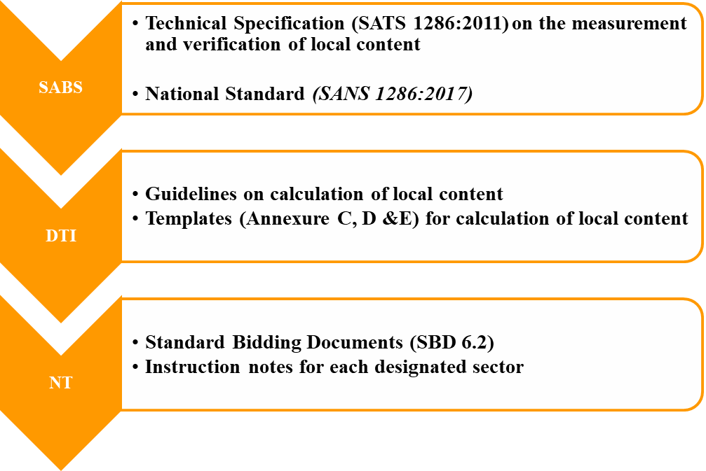
LOCAL CONTENT DOCUMENTS

Slide 10

INVITATION OF BIDS
All the designated requirements must be clearly listed by the procuring organ of state on the SBD/MBD 6.2 and their minimum threshold for local content.
In response bidders will complete the following:
  SBD/MBD 6.2
  Annex C: Local Content Declaration (Summary Schedule)
  If the bid is for more than one item, local content percentages for each product must be reflected on Annex C.
  Annex D: Imported Content Declaration (Supporting Schedule to Annex C)
  Annex E: Local Content Declaration (Supporting Schedule to Annex C)
  SABS approved national standard- SANS 1286:2017
  DTI’s Guidance Document for the Calculation of Local Content
Note: Local content declaration should be on item level and not on the overall contract value.
The Declaration Certificate for Local Production and Content (SBD / MBD 6.2) together with the Annex C (Local Content Declaration: Summary Schedule) must be completed, duly signed and submitted by the bidder at the closing date and time of the bid.

Slide 11
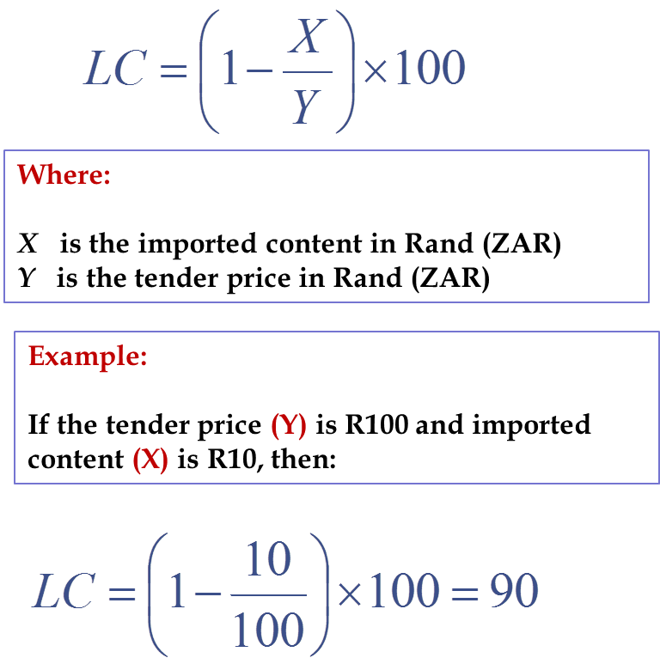
LOCAL CONTENT CALCULATION
“Local Content” means that portion of the tender price which is not included in the imported content, provided that local manufacturing does take place within the boarders of South Africa (SABS approved technical specification SANS 1286:2017)
Prices referred to in the determination of X must be converted to Rand (ZAR) by using the exchange rate published by the SARB on the date of advertisement of the bid

Slide 12
LOCAL CONTENT REQUIREMENTS AND EXEMPTIONS
Bids for all designated sectors/products must contain a specific bidding condition that only locally produced or locally manufactured goods, works and services with a stipulated minimum threshold for local production and content will be considered.
  If the raw material or input to be used for a specific item is not available locally, bidders should obtain written exemption from the dtic should there be a need to import such raw material or input; and
  A copy of the exemption letter must be submitted together with the bid document at the closing date and time of the bid

Slide 13
LOCAL CONTENT AND EXEMPTION REQUIREMENTS
S. 3.10 If the quantity of materials and/or products required cannot be wholly sourced from South African based manufacturers and/or at the designated local content threshold at any particular time, bidders should obtain written exemption from the dtic to supply the remaining portion at a lower local content threshold. the dtic, in consultation with the procuring organ of state, will grant exemption on a case-by-case basis and will consider the following:
  • required volumes in the particular bid;
  • available collective South African industry manufacturing capacity at that time;
  • delivery times;
  • availability of input materials and components;
  • technical considerations including operating conditions; and
  • materials

Slide 14
EXEMPTION PROCESS
For Exemption Letters, bidders are to state the following in the request:
Procuring Entity/ Government Department,
Bid Number,
Closing date,
Item(s) for which the exemption is being requested for,
Description of the goods, services or works for which the requested exemption item will be used for ( attach detailed specification for item),
Reason for the request.
Attention to:
Dr Tebogo Makube
Chief Director: Industrial Procurement Unit
Email: TMakube@thedti.gov.za
Tel: 012 394 3927

Slide 15

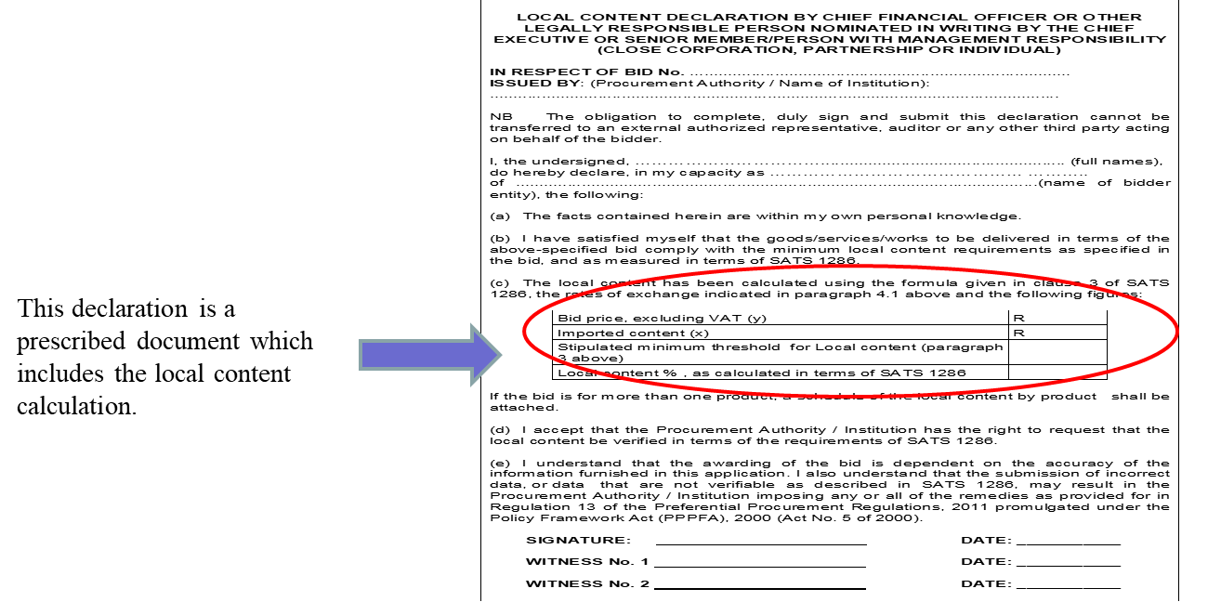
SBD 6.2

Slide 17
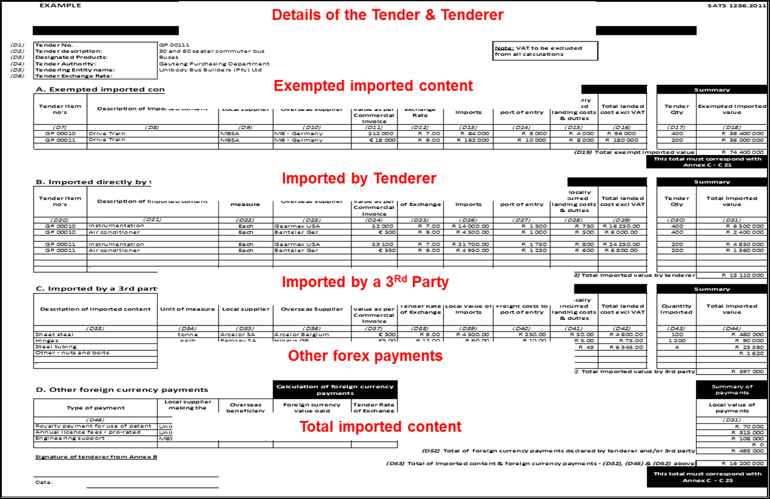
ANNEXURE D

Slide 18
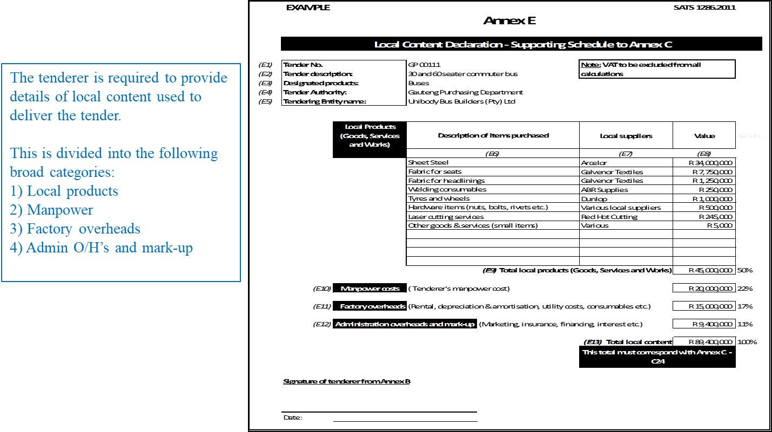
ANNEXURE E

Slide 19
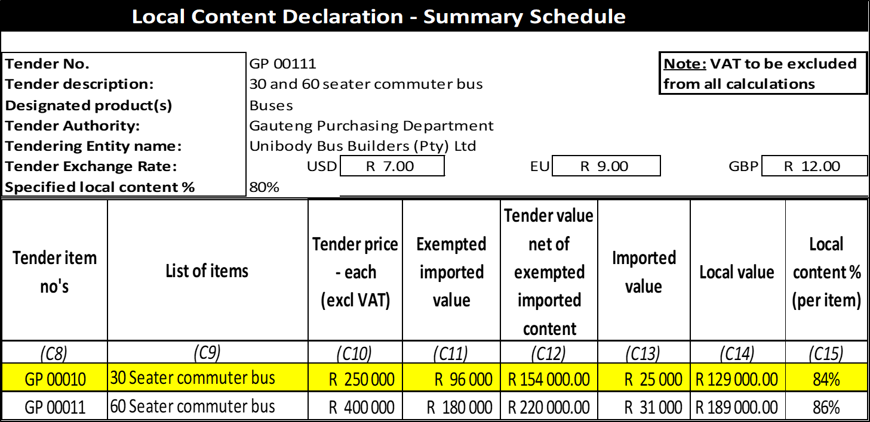
ANNEXURE C

Slide 20
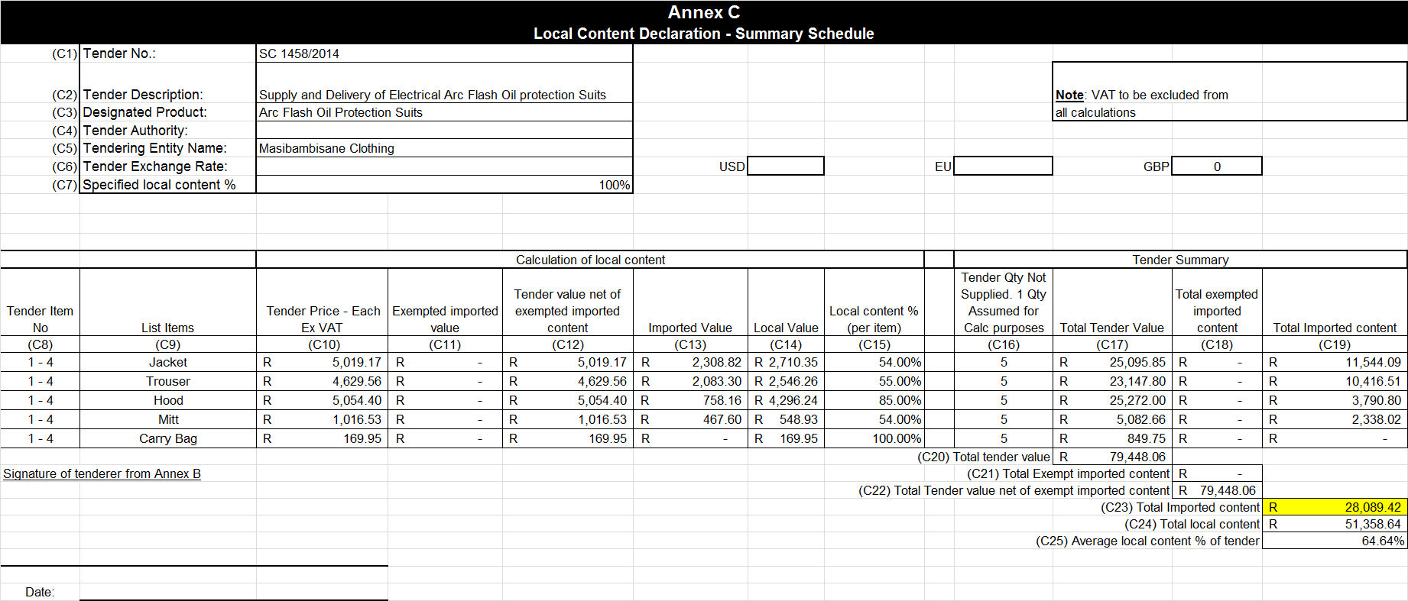
ANNEX C

Slide 21
EVALUATION AND VERIFICATION PROCESS
Bid Evaluation
- First stage: Local content and functionality (if applicable)
- Second stage: Preference point system - BBBEE and Price
Verification and Record Keeping
SABS local content verification agency
LC office was launched on 5 July 2013
- Random checks to be conducted by the dtiC & SABS after award
- Records of supporting documents to be kept for 5 years

Slide 22
LINKS TO ACCESS DOCUMENTS
The following documents are downloadable from the National Treasury Website http://www.treasury.gov.za/divisions/sf/sc/PracticeNotes/default.aspx
Standard bidding document (SBD 6.2)
Latest version published by the National Treasury
Should forms part of the bid document for all designated products
Instruction Notes & Circulars for each of the designated sectors/products
The following are downloadable from the dtic Website
http://www.thedtic.gov.za/sectors-and-services-2/industrial-development/industrial-procurement/
SANS 1286:2017
Standard approach for the calculation of local content
Guidance document for calculation of Local Content
Annex C, D & E for declaration of Local Content

Slide 23
LOCAL CONTENT CONTACTS FOR QUERIES
Ms Cathrine Matidza: CMatidza@thedti.gov.za
Mr Raphael Kitiaka: MRKitiaka@thedti.gov.za
Ms Mamosai Seleka: Mseleka@thedti.gov.za
Ms Rendani Raluthaga: RRaluthaga@thedti.gov.za
Ms Miyelani Masinga: MMasinga@thedti.gov.za
Ms Girlly Mahlambi: GMahlambi@thedti.gov.za

Slide 24
Thank You

