Slide 1
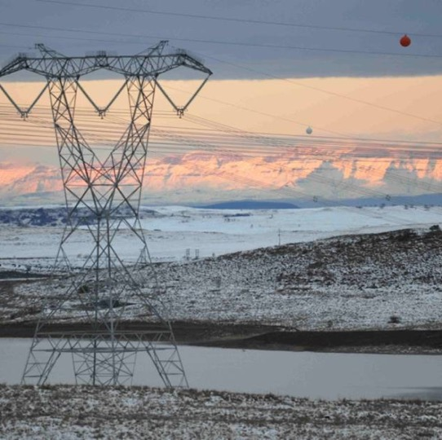
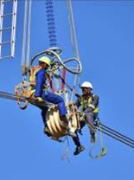
CLARIFICATION meeting for the Supply and delivery of TWO INFRA-RED CAMERAS for WORCESTER & STIKLAND L&S DEPOTS Western grid
Marshall Felaar
30 May 2026

Slide 2
General Responsibilities of the Contractor
Environmental Policy Statement must be in place:
The Policy must be version controlled
Signature of the Top Management must be visible
Commitment on continues improvement pertaining to the environmental management
Environmental Legal compliance
Provision for adaptabilities
Integration with other policies
Date

Slide 3
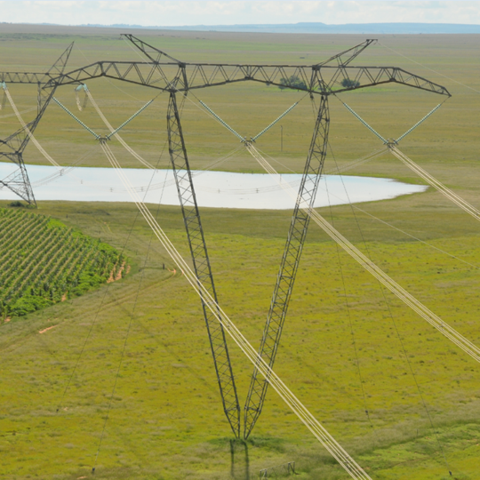
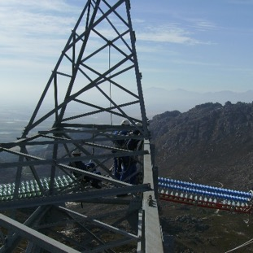
Thank you

