Slide 1




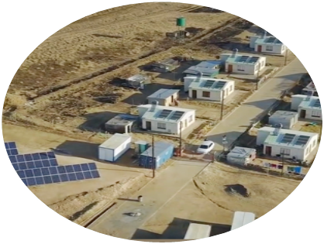

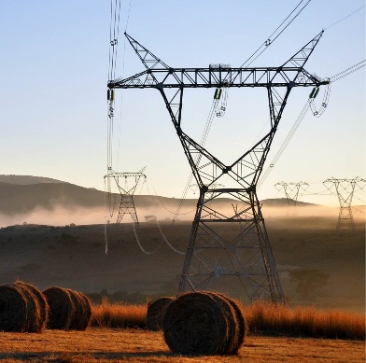
MSME Business Connect -
Supplier Development Convention comes to Western Cape
The Eskom Business Connect Programme is an initiative by the Eskom Development Foundation to support sustainable supplier development. Eskom is bringing together local Micro Small and Medium sized Enterprises (MSMEs) to access business opportunities at Eskom and other large companies in the area and to hear from business experts about new trends.
Invitation
Date: 15 -16 September 2026
Time: 08:00 – 15:30
Venue Mossel Bay Town Hall – 101 Marsh Street, Mossel Bay, WC Province
RSVP: Click here to RSVP
before Monday 14 September 2026, include your MSME Status and Business Address.
Please note that seats are limited to the first 250* responses from the Western Cape Province
*One representative per MSME will be admitted, strictly by RSVP confirmation
GPS: Coordinates: - 34.181809° S , 22.139222° E
The next Business Connect Conventions for different provinces will be announced.

