Slide 1
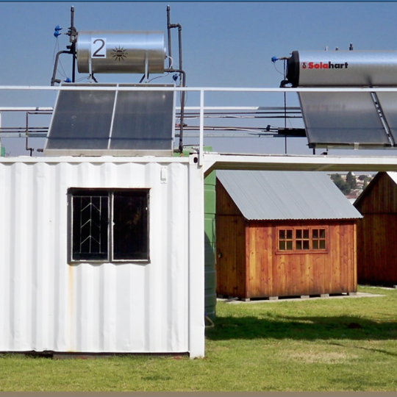
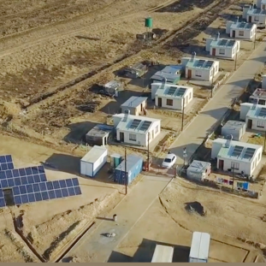
Supplier Quality Management - Quality Requirements
Duncan Ntshangase
2026/27FY

Slide 2
Quality Requirements Category 3
Quality Policy – High level statement of commitment to quality of your organisation (Signed by senior management)
Quality Objectives – Goals and targets set by your organisation pertaining to quality management
Control of documented information – How you control documents & records in your organisation - Clause 7.5 of ISO 9001:2015
Documented information for Internal audit (procedure) – How do you manage internal audits - Clause 9.2 of ISO 9001:2015
Control of nonconforming outputs – How do you manage non confirming outputs of your products or services - Clause 8.7 of ISO 9001:2015
Nonconformity and Corrective action procedure – How do you manage NCR’s, correction and corrective actions (preventive action) - Clause 10.2 of ISO 9001:2015
Contract quality plan (CQP) – Eskom template, should address quality assurance elements related to the scope of work e.g. communications and risk management
Quality control plan (QCP) – Eskom template, that details all quality control related activities e.g. Inspections and test procedures
Control of Externally Provided Processes, Products and Services. – How do you manage and control externally provided Processes, Products and Services. Management of sub suppliers and subcontractors (Clause 8.4 of ISO 9001:2015)
Documented information for roles, responsibilities and authorities. Organogram (Clause 5.3 of ISO 9001:2015)
Form A- Eskom template – It's an acknowledgment and acceptance of Eskom supplier quality requirements (Must be completed and signed ) Training Plan (If required)

Slide 3
Quality Requirements: Category 4
Quality Policy - High level statement of commitment to quality of your organisation (signed by senior management)
Quality Objectives - Goals and targets set by your organisation pertaining to quality
Control of Externally Provided Processes, Products and Services. How do you manage and control externally provided Processes, Products and Services. Management of sub suppliers and subcontractors
Documented information for roles, responsibilities and authorities. Organogram
Quality Method Statement - Eskom template: Addresses all the business processes to ensure that all Eskom's requirements are fully met on a consistence basis
Form A- Its an acknowledgment and acceptance of Eskom supplier quality requirements (Must be completed and signed
Quality Policy
Quality Objectives
Cotrol of Externally Provided Processes, Products and Services.
Documented information for roles, responsibilities and authorities. Organogram
Quality Method Statement
Form A

Slide 4
Thank you!

