Slide 1


Quality Clarification Meeting
The supply, delivery, testing and training/support of 6 x portable dissolved gas analysers for Gromis, Oranjemond, Upington, Helios, Olien and Kronos substations and, the supply, delivery, installation, testing and commissioning of 2 x fixed dissolved gas analysers for Gromis and Paulputs Substations.
Presented by:
Gold Mametja
TPD (Transmission Projects Delivery) – Western Portfolio
Date:
07/04/2026

Slide 2
Evaluation Criteria
From the various categories of evaluations from within TPD (Transmission Projects Delivery), this enquiry has been selected to be executed under Conventional Requirements aligned with line items of Category 3.
Returnable submissions must comply with NTCSA’s Certification of ISO 9001:2015 – Quality Management Systems - Requirements.
The following documents are supplied to tenderers as part of the enquiry:
1. FORM A - 559-586306088 _Tender & Sheqs Requirements For Pc & Conventional Rev 1
2. List of Tender Returnable Documents - 240-12248652 Category 3_Rev 6
3. QM58 - 240-105658000 Supplier Quality Management Specification (3)

Slide 3
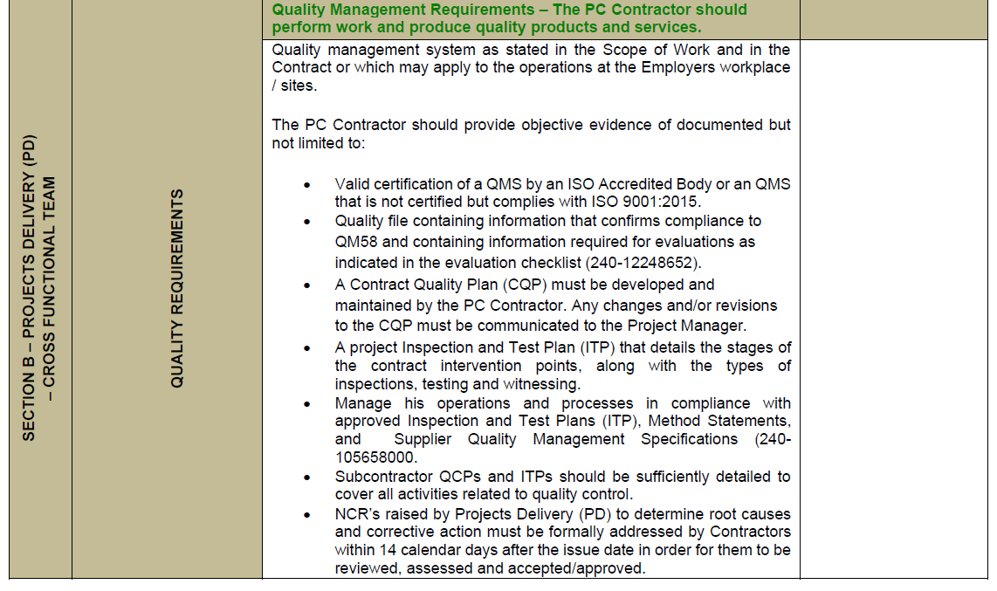
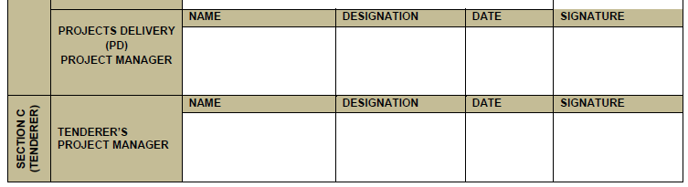
1. Form A
The supplier shall complete and sign Form A (Enquiry/Contract/Quality Requirements for Supplier Quality Management Specification 240-105658000/ QM 58 and ISO 9001). This document confirms the supplier being a participant and must be returned with other submissions (Section E of List of Tender Returnable Documents).
X
NTCSA Quality/Project Manager……
Gold Mametja Quality Advisor 02/03/2026
Contractor to fill in…..

Slide 4
Quality Management Requirements
The Contractor should provide objective evidence of documented but not limited to:
Valid certification of a QMS by an ISO Accredited Body or an QMS that is not certified but complies with ISO 9001:2015.
Quality file containing information that confirms compliance to QM58 and containing information required for evaluations as indicated in the evaluation checklist (240-12248652).
A Contract Quality Plan (CQP) must be developed and maintained by the PC Contractor. Any changes and/or revisions to the CQP must be communicated to the Project Manager.
A project Inspection and Test Plan (ITP) that details the stages of the contract intervention points, along with the types of inspections, testing and witnessing.
Manage his operations and processes in compliance with approved Inspection and Test Plans (ITP), Method Statements, and Supplier Quality Management Specifications (240-105658000.
Subcontractor QCPs and ITPs should be sufficiently detailed to cover all activities related to quality control.
NCR’s raised by Projects Delivery (PD) to determine root causes and corrective action must be formally addressed by Contractors within 14 calendar days after the issue date in order for them to be reviewed, assessed and accepted/approved.

Slide 5
2. List of Tender Returnable Documents…
This document consists of five sections in which the supplier is guided to submit objective evidence of a developed QMS that complies with ISO 9001, or the latest applicable revisions (Section A & B). The QMS should drive all the supplier’s business management processes to ensure that all of NTCSA’s requirements are fully met on a consistent basis (Section C & D). In the absence of an ISO certification in Section A, a quality manual and other requirements should be submitted as listed.
Category 3: Quality Requirements | Deliverables to be evaluated indicator = 1 |  | Weights
SECTION A: Quality Management System Requirements ISO 9001Objective evidence of documented QMS that is not certified but complies with ISO 9001
 |  | Apply (Yes=1)
A.1 QMS Manual or a document that defines and describes the QMS and its scope. |  | 1 | 25%
A.2 Quality Policy Approved by top management. |  | 1
A.3 Quality Objectives Approved by top management. |  | 1
A.4 Control of documented information |  | 1
A.5 Documented information for Control of nonconforming outputs |  | 1
A.6 Documented information for Nonconformity and Corrective action |  | 1
A.7 Documented information for Internal audit |  | 1
Section A Score |  | 7
SECTION B: Evidence of QMS in operation (Tender Quality Requirements -Ref 240-105658000 /240-105658000)
 | Apply (Yes=1)
B.1 Documented information for defined roles, responsibilities and authorities | 1 | 25%
B.2 Documented information for Control of Externally Provided Processes, Products and Services | 1
Section B Score | 2

Slide 6

2. List of Tender Returnable Documents…continued
SECTION C: Contract Quality Plan Requirements (Ref 240-105658000 and 240-109253698). Draft Contract Quality Plan specific to the scope of work as described in the tender documents (Ref ISO 10005)
 | Apply (Yes=1)
NB! Draft Contract/Project Quality Plan has important QA deliverables | 1 | 20%
Section C Score | 1
SECTION D: Quality Control Plan Requirements (Ref QM-58 or 240-109253302) QCP /Checklist/ ITP (Quality Control Plans) as per Scope of Works (Ref ISO 10005 & 240-105658000)
NB! Draft/Example of an Inspection and Test Plan (ITP) or Quality Control Plan (QCP) on similar and/ or previous work done | Apply (Yes=1) | 20%
 | 1
Section D Score | 1
SECTION E: User defined additional Requirements & miscellaneous (Ref 240-105658000) Customer specific requirements & other standards and required can be listed and evaluated here
NB! Draft/Example of an Inspection and Test Plan (ITP) or Quality Control Plan (QCP) on similar and/ or previous work done | Apply (Yes=1) | 10%
E.1 Form A is completed and signed. | 1
E.2 Add other requirements (if applicable) as per the scope of work and/ or specification | 1
Section E Score | 2
Threshold = 80%

Slide 7
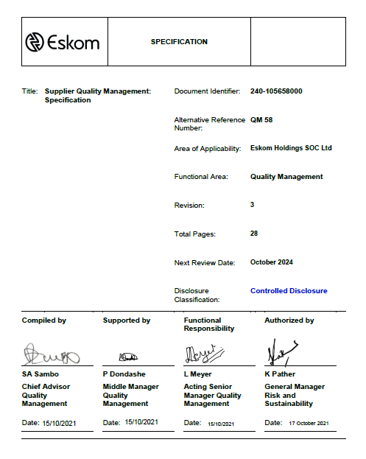

3. QM58
The ‘QM58’ Quality Management document is a reference specification from which contractors have to understand and adhere to the requirements of Eskom’s quality expectations. Reference of the Category 3 requirements are in Clause 3.5.4.

Slide 8


Conclusion

