Slide 1

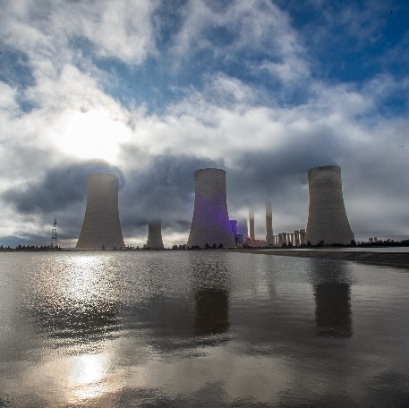
Non-Compulsory Tender Clarification
E1354GXPOU: Supply and Delivery of Guide Vane Bush Seals for Drakensberg Units
1 to 4, for a period of five (5) years
Presented by: Christelle Stuart
Date : 09 June 2025

Slide 2
Agenda
Item | Topic Discussion | Presenter
1. | Welcome and Introduction | Christelle Stuart/Cross-Functional Team
2. | Safety Message | Christelle / Phumlani Ntombela
3. | Commercial Requirements | Christelle Stuart
4. | E-Tendering Presentation | Christelle Stuart
5. | NEC Pricing Schedule | Christelle Stuart
6. | Technical Evaluation Criteria | Jaco van Zyl
7. | Technical Scope | Jaco van Zyl
8. | Contractual Requirements Safety, Quality, SDL&I, Financial Due Diligence | Christelle Stuart/Thokozile Kolweni/Phinda Ndabula
9. | General | ALL
10. | Questions | ALL

Slide 3
Commercial Requirements
Deadline for Tender Submission :
Tuesday, 20 June 2025 at 10h00 (South African Standard Time)
Tenders to be submitted online via Eskom E-Tendering Platform.
Deadline for Clarification Questions:
5 working days prior to tender closing (13 June 2025)
Process for Submitting Clarification Questions :
Clarification questions must be made in writing and send to the Buyer, Christelle Stuart via e-mail Stuartcj@eskom.co.za
Clarification questions will be recorded onto Eskom Template and uploaded on the Eskom Tender Bulletin.
How to access clarification answers :
Tenderers can access the clarification answers via the same platforms where the Tender Documents have been loaded (i.e., National Treasury Tender Portal and Eskom E-Tendering Website.

Slide 4
Eskom E-Tendering
Eskom has introduced a new solution for submitting tenders.
Tenderers will now be submitted via Eskom’s e-tendering page and via the link:
https://www.eskom.co.za/tenders/
E-Tendering Help Manual for suppliers:
Refer: Annexure L

Slide 5
NEC Pricing Schedule
The NEC Form of Offer and Acceptance must be signed.
Suppliers who fail to submit the above at tender closing, will be disqualified.
For e-tendering, the price schedule needs to be submitted in PDF(signed) and a copy in excel format.
Refer Tender returnables on ITT, page 16 where the above information is highlighted in yellow.

Slide 6
Tender Returnables
Refer to pages 13 to 18 of Invitation to Tender Document
This section outlines all tender returnables required and their respective due dates by when these should be submitted.
Note : Display ITT Pages 13 to 18

Slide 7
Technical Evaluation Criteria
The Technical Evaluation Criteria applicable for this Tender Enquiry No. E1354GXPOU is outlined in Annexure Y(issued with this tender) and stipulated under section 3.13 of the invitation to tender document.
Note : Display Evaluation Criteria

Slide 8
Contractual Requirements
Mandatory Contractual Requirement:
Proof of CSD Number/ Registration
Safety(Annexure O-S)
The following documents will be required as part of SHE Tender returnable:
The tender enquiry must be accompanied by a specific project base line risk assessment, SHE specification, Annexure B (Acknowledgement of SHE rules and requirements) and the applicable Annexure C (Annexure C1 - High risk): SHE tender evaluation and scoring card).
Annexure B must be returned with the supplier’s tender document whereas Annexure C1 provides guidance to suppliers on the minimum SHE evaluation which will be used for the specific tender (the appropriate annexure C will be selected prior to issuing the enquiry).
Only the SHE criteria sent out with the tender enquiry will be evaluated. The SHE professional will conduct the OHS evaluation.

Slide 9
Contractual Requirements Continued
Quality(Annexure T-W)
The requirements that may be applicable to the tenders are as follows:
• Category 3 quality criteria listing all returnables.
• Category 3 form A for section E of the criteria.
• CQP and QCP templates for section C & D respectively.
• Supplier QM specification (QM 58) for reference only.
SDL&I:
SDL&I Undertaking has been issued with the invitation to tender as Annexure N(SDLI) Strategy Setting Report.
Financial Due Diligence:
Evaluation of the Financial reports / statements may be requested prior contract award to determine if the tenderer is of a financial risk to Eskom.

Slide 10
Questions ???
Tenderer | Tenderer Question | Eskom’s Response
 | Is the grease being used for the seals, environmentally friendly grease because some of those are not compatible with polyutherane? | The grease used by Drakensberg is as follows: Castrol Tribol : GR 100-1 PD. It is not an environmentally safe grease and Eskom discard the used grease according to a Waste Management procedure.

Slide 11


End of Presentation
Thank you

