Slide 1

iCLM HQ 926/TPT
FOR THE CUSTOM DESIGN, SUPPLY, INSTALLATION, CONFIGURATION, TESTING AND COMMISSIONING OF A FUEL MANAGEMENT SYSTEM FOR TRANSNET SOC LIMITED (REG. NO. 1990/000900/30) OPERATING AS TRANSNET PORT TERMINALS (HEREINAFTER REFERRED TO AS “TPT”), AT THE RICHARD’S BAY, DURBAN, EASTERN CAPE AND WESTERN CAPE TERMINALS FOR A PERIOD OF 60 MONTHS.
Presented By: Hlengiwe Zulu

Slide 2
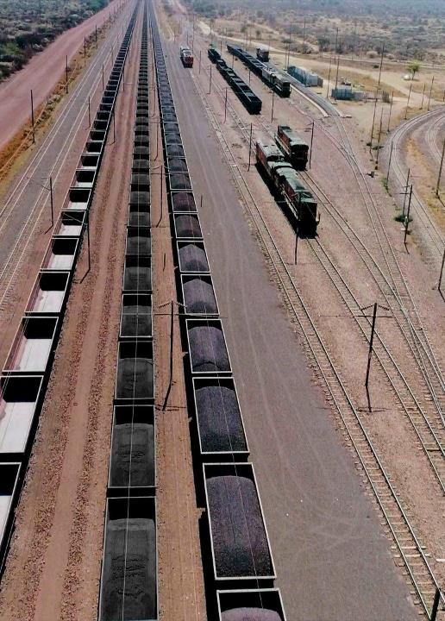
AGENDA
Agenda Point | Time Allocated | Presenter
Welcome and introduction | 2 minutes | TPT Team
Session rules of engagement | 2 minutes | Hlengiwe Zulu
Procurement process briefing | 15 minutes | Hlengiwe Zulu
SD – Transformational objectives | 10 minutes | Dudu Sibiya
Technical Scope & requirements | 40 minutes | Sphamandla Mathonsi/ Nosipho Bhengu
Questions and closing | 15 minutes | all
2

Slide 3
SESSION RULES OF ENGAGEMENT
This briefing session is non-compulsory
Bidders are requested to remain for the entire duration of the briefing session as important information pertaining to the RFP will be presented.
An opportunity for Clarification questions will be provided after the briefing session
Any additional clarification questions hereafter will only be accepted by TPT until 12h00 pm , 27 April 2025.
All communication subsequent to this briefing session must only be directed to Hlengiwe Zulu Hlengiwe.Zulu@transnet.net
After the closing date of the RFP, a Respondent may only communicate with the name of delegated individual (DBAC Secretariat), at email nonduduzo.mahlaba@transnet.net on any matter relating to its RFP Proposal.

Slide 4
PROCUREMENT PROCESS
FOR THE CUSTOM DESIGN, SUPPLY, INSTALLATION, CONFIGURATION, TESTING AND COMMISSIONING OF A FUEL MANAGEMENT SYSTEM FOR TRANSNET SOC LIMITED (REG. NO. 1990/000900/30) OPERATING AS TRANSNET PORT TERMINALS (HEREINAFTER REFERRED TO AS “TPT”), AT THE RICHARD’S BAY, DURBAN, EASTERN CAPE AND WESTERN CAPE TERMINALS FOR A PERIOD OF 60 MONTHS.
RFP NUMBER iCLM HQ 926/TPT
ISSUE DATE: 01 APRIL2025
CLOSING DATE: 05 MAY 2025
CLOSING TIME: 12:00 PM
BID VALIDITY PERIOD: 180 Business Days from Closing Date

Slide 5
PROPOSAL SUBMISSION
The Transnet e-Tender Submission Portal can be accessed as follows:
Log on to the Transnet eTenders management platform website/ Portal (transnetetenders.azurewebsites.net)
Click on “ADVERTISED TENDERS” to view advertised tenders;
Click on “SIGN IN/REGISTER –to register new bidder information and ensure that all mandatory information is completed) OR;
to sign in if already registered;
Toggle (click to switch) the “Log an Intent” button to submit a bid;
Submit bid documents by uploading them into the system against each tender selected.

Slide 6
PROPOSAL SUBMISSION
No late submissions will be accepted.
Each company must register its own profile using its company details and use the corresponding registered profile to log an intent to bid as well as submitting any bid.
In case of a Joint Venture, any of the parties/companies to the Joint Venture may use its registered profile to submit a bid on behalf of the Joint Venture.

Slide 7
EVALUATION METHODOLOGY
STAGE 1:
TEST FOR RESPONSIVENESS
STAGE 2
STAGE 3
Step 1
Step 2
Step 3
Step 4
Step 5
Step 6
Step 7
Administrative & Substantive responsiveness
Minimum Thresholds-Desktop
Minimum Thresholds- Presentation
Weighted scoring / 100***
Returnable documents/ schedules/ Pre-qualification
Price negotiation if applicable. (eg Market Related Price negotiation or Best And Final Offer d
Technical
70 points
Minimum Threshold
Presentation
70 points
Minimum Threshold
Price (90)
Specific goals (10)
Selection of the preferred bidder.
(Objective criterion to justify award to someone other than the highest ranked bidder must have been stated in the bid documents and can be used at this stage, if applicable)
Award of business and conclusion of contract
Technical Pre-qualification Criteria/minimum requirements/legal requirements
-Proof of professional registration of Key Person required in the project organogram is supplied- Instrumentation Engineer / Technologist has active professional registration certificate with Engineering Council of South Africa (ECSA)
1
WEIGHTED SCORE
The minimum threshold for functionality [Step Two] must be met or exceeded for a Respondent’s Proposal to progress to Step Three for evaluation

Slide 8
EVALUATION METHODOLOGY
STEP ONE: Test for Administrative and Substantive Responsiveness
Administrative & Substantive responsiveness check | RFP Reference
Whether the Bid has been lodged on time | Section 1 paragraph 3
Whether all Returnable Documents and/or schedules [where applicable] were completed and returned by the closing date and time | Section 5
Verify the validity of all returnable documents | Section 5
Verify if the Bid document has been duly signed by the authorised respondent | All sections
Whether the Bid contains a priced offer | Section 4 - Quotation Form
Whether the Bid materially complies with the scope and/or specification given | All Sections
Whether Technical Pre-qualification Criteria have been met as follows: - Proof of professional registration of Key Person required in the project organogram is supplied -Instrumentation Engineer / Technologist has active professional registration certificate with Engineering Council of South Africa (ECSA) | Annexure B

Slide 9
EVALUATION METHODOLOGY
STEP TWO: Minimum Threshold 70 points for Technical Criteria
The minimum threshold for functionality [Step Two] must be met or exceeded for a Respondent’s Proposal to progress to Step Three for evaluation
  STEP THREE: Minimum Threshold 70 points for Technical Presentation Evaluation
The minimum threshold for Presentation [Step Three] must be met or exceeded for a Respondent’s Proposal to progress to Step Four for final

Slide 10
EVALUATION METHODOLOGY
STEP FOUR Evaluation and Final Weighted Scoring
Evaluation Criteria | Final Weighted Scores
Price | 90
Specific goals - Scorecard | 10
TOTAL SCORE: | 100
10

Slide 11
EVALUATION METHODOLOGY
  STEP FIVE : Price Negotiations (if applicable)
  STEP SIX : Objective Criteria (if applicable)
  STEP Seven : Award of business and conclusion of contract

Slide 12
RETURNABLE DOCUMENTS
Mandatory Returnable Documents | Failure to provide all these Mandatory Returnable Documents at the Closing Date and time of this RFP will result in a Respondent’s disqualification.
Returnable Documents Used for Scoring | Failure to provide all Returnable Documents used for purposes of scoring a bid, by the closing date and time of this bid will not result in a Respondent’s disqualification. However, Bidders will receive an automatic score of zero for the applicable evaluation criterion.
Essential Returnable Documents | Failure to provide essential Returnable Documents will result in Transnet affording Respondents a further opportunity to submit by a set deadline. Should a Respondent thereafter fail to submit the requested documents, this may result in a Respondent’s disqualification.

Slide 13
RETURNABLE DOCUMENTS
MANDATORY RETURNABLE DOCUMENTS | SUBMITTED [Yes/No]
SECTION 4 : Pricing and Delivery Schedule
Annexure B -Technical Pre-Qualification requirement -Instrumentation Engineer / Technologist has active professional registration certificate with Engineering Council of South Africa (ECSA)

Slide 14
RETURNABLE DOCUMENTS USED FOR SCORING
RETURNABLE DOCUMENTS USED FOR SCORING | SUBMITTED [Yes or No]
Annexure C - CVs of Key Persons
Annexure D - Previous Experience
Annexure E - Method Statement
Technical presentation
Valid proof of Respondent’s compliance to Specific Goals requirements stipulated in Section 9 of this RFP (Valid B-BBEE certificate or Sworn- Affidavit as per DTIC guidelines)

Slide 15
ESSENTIAL RETURNABLE DOCUMENTS
ESSENTIAL RETURNABLE DOCUMENTS & SCHEDULES | SUBMITTED [Yes or No]
In the case of Joint Ventures, a copy of the Joint Venture Agreement or written confirmation of the intention to enter into a Joint Venture Agreement
Latest Financial Statements signed by your Accounting Officer or latest Audited Financial Statements plus 2 previous years
Section 1: SBD1 Form
SECTION 5 : Proposal Form and List of Returnable documents
SECTION 6 : Certificate Of Acquaintance with RFP, Terms & Conditions & Applicable Documents
SECTION 7 : RFP Declaration and Breach of Law Form
SECTION 9 : Specific Goals Points Claim Form
SECTION 10: Protection Of Personal Information

Slide 16
Thank you

